Slide 1

Web Development
HTML
CSS
JavaScript

Slide 2



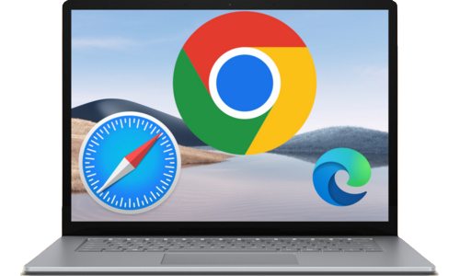
How Do the Website Work ?
Server returns response in the form of ( HTML, CSS, JavaScript )
Search on Browser
https://www.example.com
User
https://www.example.com
Users request to find a website from the server through the browser
12.45.56.67
Web Server
Local Machine
( 12.45.56.67 )
DNS Server
( Domain Name System. )

Slide 3

H T M L

Slide 4
HTML
HTML stands for Hyper Text Markup Language
HTML is the standard markup Language for creating web pages and describes the structure of a Web Page.
HTML elements tell the browser how to display content.
HTML provides a stable skeleton to web Applications and Websites.

Slide 5

Download VS Code Editor
Search on Browser vs code editor download
Select this Link : https://code.visualstudio.com/download
You can download it by selecting the option according to your device.

Slide 6
Basic Structure of HTML
<!DOCTYPE html>
<html lang="en">
<head>
<meta charset="UTF-8">
<meta name="viewport" content="width=device-width, initial-scale=1.0">
<title>Document</title>
</head>
<body>
// html code write here...
</body>
</html>

