Slide 1


Smart city surveillance
Unveiling Indian Person Attributes in Real Time
The 9th National Conference on Computer Vision, Pattern Recognition, Image Processing and Graphic
Presented by:
Chandan Raj
Amandeep Yadav
Date: 18th July 2024

Slide 2
Person Attribute Recognition (PAR) in City Surveillance
Key Role:
Enables identification and tracking of individuals across multiple cameras.
Facilitates retrieval of instances with specific attributes for effective surveillance.
Common Attributes:
Gender
Clothing style
Carried items
High-Level Semantic Information:
Provides detailed and meaningful data about individuals.
Limitations of Standard Datasets:
Datasets like PETA, Market 1501, and PA100K lack attribute classes relevant to Indian attire.
Missing classes include kurta, salwar, dupatta, and saree.
Project Objective:
Develop a dataset and methodology tailored to the Indian context.
Enhance the efficacy of PAR in Indian city surveillance systems.

Slide 3
Approach to Enhancing PAR in Indian City Surveillance
State-of-the-Art Deep Learning Models:
Tailored specifically for attribute recognition.
Key Steps:
Model Selection:
Evaluate various models such as ResNet, VGG, and MobileNet for their suitability in PAR.
Training:
Utilize transfer learning to leverage pre-trained weights.
Fine-tune models on our specific dataset.
Attribute Prediction:
Implement a multi-label classification framework to predict multiple attributes simultaneously.
Optimization:
Conduct hyperparameter tuning to achieve optimal model performance.

Slide 4
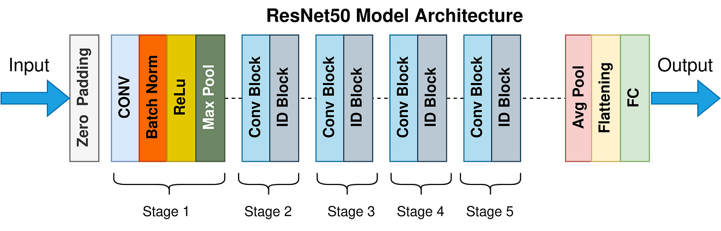

Slide 5
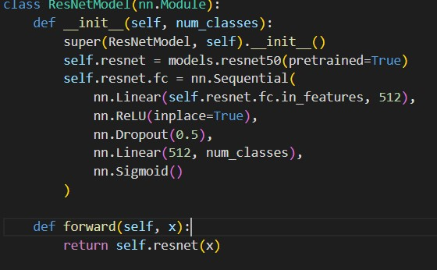
Base Model: Uses pre trained ResNet-50.
Fully Connected Layer Customization:
nn.Linear(self.resnet.fc.in_features, 512) - Adapts input size.
nn.ReLU(inplace=True) - Adds non-linearity.
nn.Dropout(0.5) - Reduces overfitting.
nn.Linear(512, num_classes) - Outputs the number of classes.
nn.Sigmoid() - Converts outputs to probabilities for multi-label classification

Slide 6
Experimental Results:
Significant Improvements:
Demonstrated enhancements in recognizing Indian attire attributes compared to baseline models trained on existing datasets.
Key Metrics:
Accuracy:
Achieved higher accuracy rates for Indian attire attributes.
Precision and Recall:
Improved precision and recall metrics, indicating better attribute detection.
Baseline Comparisons:
Comparative analysis shows our model's superior performance over traditional approaches.

Slide 7
Model Performance Metrics
Validation Accuracy: 90.72% Overall MAE: 0.0028 Label-wise MAE: [0.00083333, 0.005, 0.0025, 0, 0, 0.00166667, 0.00083333, 0.00333333, 0.00083333, 0.00916667, 0.00916667, 0, 0.00083333, 0.00083333, 0.00333333, 0, 0.00333333, 0, 0.00333333, 0, 0.00166667, 0, 0.00416667, 0.00166667, 0.00666667, 0.00333333, 0.0025, 0.0025, 0, 0.005, 0.00166667, 0, 0.00083333, 0.0025, 0.00666667, 0.00083333, 0.00166667, 0.00916667, 0.00083333, 0.00583333, 0.00166667, 0.01083333, 0.0075, 0.00166667, 0.00166667, 0.00333333, 0.0025, 0.00083333, 0.00333333]
Precision: 92.59% Recall: 91.81% F1 Score: 95.20% ROC-AUC: 91.36% Hamming Loss: 0.28% Subset Accuracy: 89.67%

Slide 8
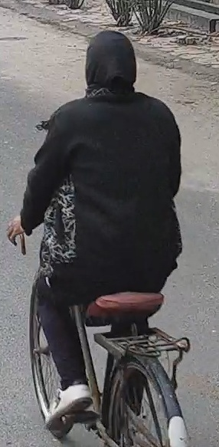
Test Result:
1 - UBCOLOR_black, 0 - UBCOLOR_blue, 0 - UBCOLOR_green, 0 - UBCOLOR_orange, 0 - UBCOLOR_red, 0 - UBCOLOR_white, 0 - UBCOLOR_yellow, 0 - UBCOLOR_mix, 0 - UBCOLOR_other, 1 - LBCOLOR_black, 0 - LBCOLOR_blue, 0 - LBCOLOR_green, 1 - LBCOLOR_red, 0 - LBCOLOR_yellow, 0 - LBCOLOR_white, 0 - LBCOLOR_orange, 0 - LBCOLOR_other, 0 - LBCOLOR_mix, 1 - UB_jacket, 0 - UB_kurta, 0 - UB_other, 0 - UB_Saree, 0 - UB_Shirt, 0 - UB_Suitwomen, 0 - UB_tshirt, 0 - UB_sweater, 0 - LB_Leggings, 0 - LB_Salwar, 0 - LB_Shorts, 0 - LB_Trousers, 0 - LB_Jeans, 0 - LB_Saree, 0 - LB_other, 0 - SLEEVES_long, 0 - SLEEVES_short, 0 - SLEEVES_none, 0 - Carry_handbag, 0 - Carry_backpack, 0 - Carry_other, 0 - Acc_headgear, 1 - Foot_Sandals, 0 - Foot_shoes, 0 - Foot_slippers, 1 - POSE_sitting, 0 - POSE_lying, 0 - POSE_standing, 1 - VIEW_back, 0 - VIEW_front, 0 - VIEW_side

Slide 9
Conclusion
Addressing Dataset Gaps:
Successfully introduces a comprehensive dataset tailored to Indian attire.
Methodology:
Demonstrates significant improvements in attribute recognition accuracy.
Highly relevant for Indian city surveillance applications.
Future Focus:
Integration with Surveillance Systems:
Implement the model in live surveillance systems for real-time testing.
Cross-Dataset Evaluation:
Test the model on different datasets to evaluate generalization capabilities.
Advanced Attributes:
Expand the attribute set to include more detailed aspects of Indian attire.

