Slide 1

BNI CHAMPIONS

Slide 2
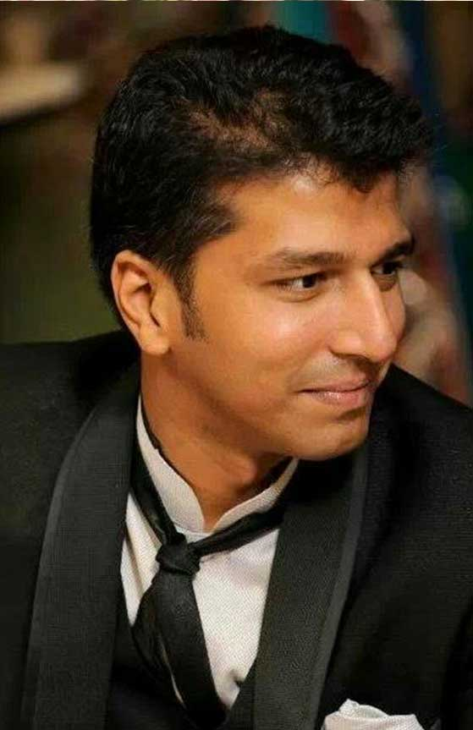
Aditya Bajaj Bon Evento
Wedding planners D-Day management Guest relations, hospitality & logistics - B2B/B2C Wedding carnivals - B2B/B2C Kidsventureindia.com
www.bonevento.com

Slide 3
LATE COMERS

Slide 4
SUBSTITUTES

Slide 5
BNI CHAMPIONS

