Slide 1
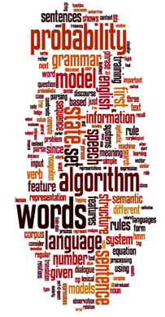
Why Text Analytics and Python?

Slide 2
Why Python?
Python is a general purpose programming language that was named after the Monty Python
Python is simple and incredibly readable since closely resembles the English language.
It’s a great language for beginners, all the way up to seasoned professionals.
Python recently bumped Java as the language of choice in introductory programming courses with eight of the top 10 computer science departments now using Python to teach coding, as well as 27 of the top 39 schools.

Slide 3
Why Python?
Because of Python’s use in the educational realm, there are a lot of libraries created for Python related to mathematics, physics , machine learning, data analytics ,web development ,natural processing…
PBS, NASA and Reddit use Python for their websites.
For the fourth year in a row, Python retains it's #1 dominance followed by Java, C++, and Javascript as per the survey conducted by over 600,000+ coding tests and challenges by over 2,000+ employers.

Slide 4
Why Python?
This gives us a pretty valuable insight on what the trends are in hiring demand amongst tech companies for the upcoming years.
Python is used as the main programming choice of Google, IBM, Oracle, Ubuntu, JP Morgan and in each of those companies and industries that work on data analytics , machine learning and applications.

Slide 5
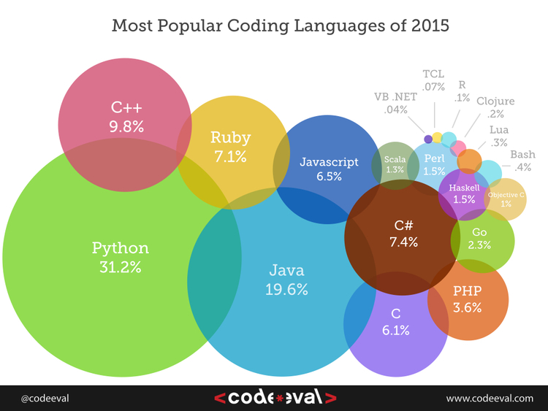

Slide 6
Why Natural Language Processing(NLP)
Natural language processing is considered important because natural language is important.
Google, Apple, Amazon, and Facebook with their respective messenger apps, personal assistants and voice apps need models and processes for getting chunks of information from voice or textual utterances and manipulating them inside a computer. These models’ catch-all name is natural language processing.

Slide 7
Some applications of NLP

Slide 8
Question Answering: IBM’s Watson
Won Jeopardy on February 16, 2011!
WILLIAM WILKINSON’S
“AN ACCOUNT OF THE PRINCIPALITIES OF WALLACHIA AND MOLDOVIA”
INSPIRED THIS AUTHOR’S
MOST FAMOUS NOVEL
Bram Stoker

Slide 9
Information Extraction
Event: Curriculum mtg
Date: Jun 12 - 2017
Start: 10:00am
End: 11:30am
Where: V1
Subject: curriculum meeting
Date: June 12 - 2017
To: Gopal
Hi Gopal, we’ve now scheduled the curriculum meeting.
It will be in V1 tomorrow from 10:00-11:30.
-Kishore
Create new Calendar entry

Slide 10
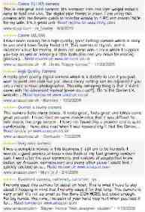

Sentiment Analysis
Attributes:
zoom
affordability
size and weight
flash
ease of use
Size and weight
✓
nice and compact to carry!
since the camera is small and light, I won't need to carry around those heavy, bulky professional cameras either!
the camera feels flimsy, is plastic and very light in weight you have to be very delicate in the handling of this camera
✓
✗

Slide 11
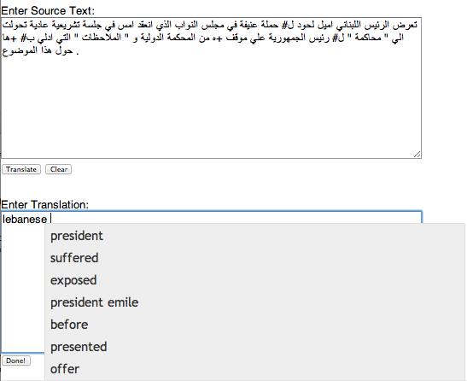
Machine Translation
Helping human translators
Fully automatic
Enter Source Text:
这 不过 是 一 个 时间 的 问题 .
Translation from Stanford’s Phrasal:
This is only a matter of time.

Slide 12


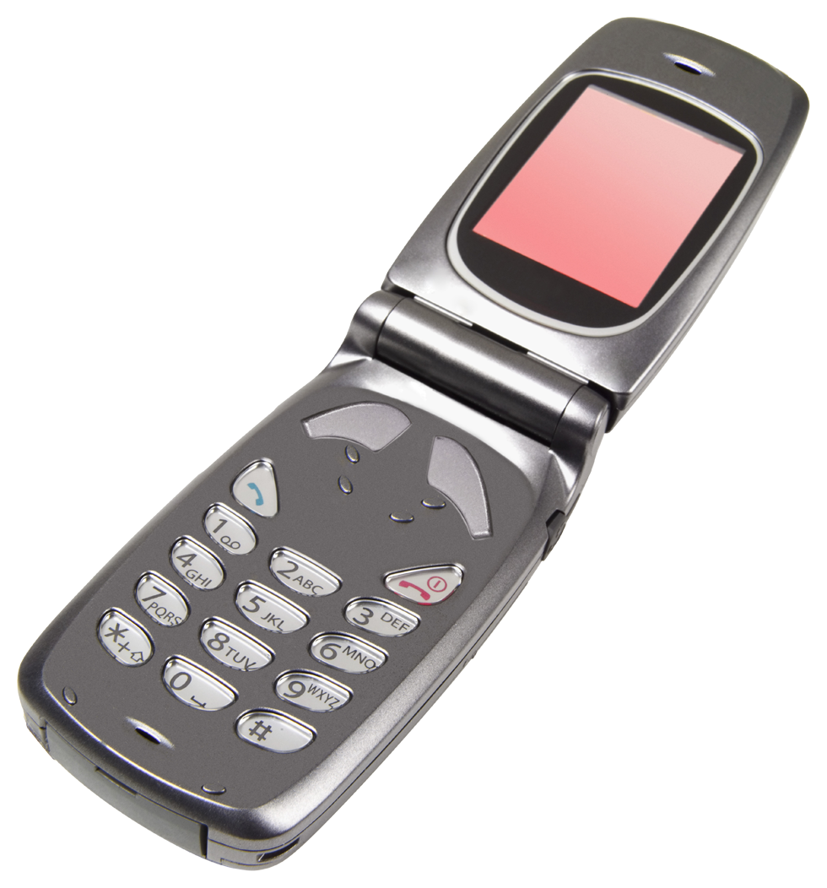

Language Technology
making good progress
Sentiment analysis
still really hard
mostly solved
Best roast chicken in San Francisco!
Question answering (QA)
The waiter ignored us for 20 minutes.
Spam detection
Coreference resolution
Q. How effective is ibuprofen in reducing fever in patients with acute febrile illness?
✓
Let’s go to Agra!
Paraphrase
✗
Carter told Mubarak he shouldn’t run again.
Buy V1AGRA …
Word sense disambiguation (WSD)
XYZ acquired ABC yesterday
Part-of-speech (POS) tagging
I need new batteries for my mouse.
ABC has been taken over by XYZ
ADJ ADJ NOUN VERB ADV
Summarization
Colorless green ideas sleep furiously.
Parsing
The Dow Jones is up
Economy is good
I can see Alcatraz from the window!
The S&P500 jumped
Named entity recognition (NER)
Machine translation (MT)
Housing prices rose
PERSON ORG LOC
第13届上海国际电影节开幕…
Dialog
Where is Citizen Kane playing in SF?
Einstein met with UN officials in Princeton
The 13th Shanghai International Film Festival…
Information extraction (IE)
Castro Theatre at 7:30. Do you want a ticket?
You’re invited to our dinner party, Friday May 27 at 8:30
Party May 27 add

Slide 13
Speech applications
Speech recognition (Speech-to-text)
Uses
As a general interface to any text-based application
Text dictation
Speech understanding
Not the same: computer must understand intention, not necessarily exact words
Uses
As a general interface to any application where meaning is important rather than text
As part of speech translation

Slide 14
Speech Applications…
Voice recognition
Not really a linguistic issue
But shares some of the techniques and problems
Text-to-speech (Speech synthesis)
Uses:
Computer can speak to you
Useful where user cannot look at (or see) screen

Slide 15
Text prediction
Speed up word processing
Facilitate text dictation
At lexical level, already seen in SMS
More sophisticated , might be based on corpus of previously seen texts
Especially useful in repeated tasks
Translation memory
Authoring memory

Slide 16
Dialogue systems
Computer enters a dialogue with user
Usually specific cooperative task-oriented dialogue
Often over the phone
Examples?
Usually speech-driven, but text also appropriate
Modern application is automatic transaction processing
Limited domain may simplify language aspect
Domain ‘model’ will play a big part
Simplest case: choose closest match from (hidden) menu of expected answers
More realistic versions involve significant problems

Slide 17
Conversation machines
Another old AI goal (cf. Turing test)
Also (amazingly) for amusement
Mainly speech, but also text based
Early famous approaches include ELIZA, which showed what you could do by cheating
Modern versions have a lot of NLP, especially discourse modelling, and focus on the language generation component

Slide 18
QA systems
NL interface to knowledge database
Handling queries in a natural way
Must understand the domain
Even if typed, dialogue must be natural
Handling of anaphora
e.g. When is the next flight to Sydney?
And the one after?
What about Melbourne then?
6.50
7.50
7.20
OK I’ll take the last one.

Slide 19
NLP in finance
Gather real-time intelligence on specific stocks
Provide key hire alerts
Monitor company sentiment
Anticipate client concerns
Upgrade quality of analyst reporting
Understand and respond to news events

Slide 20
Career in NLP
There are so many jobs in NLP as all of us speak.
As the data on web increases beyond the capacity to handle we will need NLP algorithms to tackle all of it.
Looking at innumerable applications , there are plenty of opportunities in some of the best industries.
The application you saw are already there in the technology around you and is being refined by giants.
So what are you waiting for?????
Come and enroll for this short term course.

Slide 21
Skills you’ll need
Simple linear algebra (vectors, matrices)
Basic probability theory

