Slide 1
LWC - JAN_2023

Slide 2
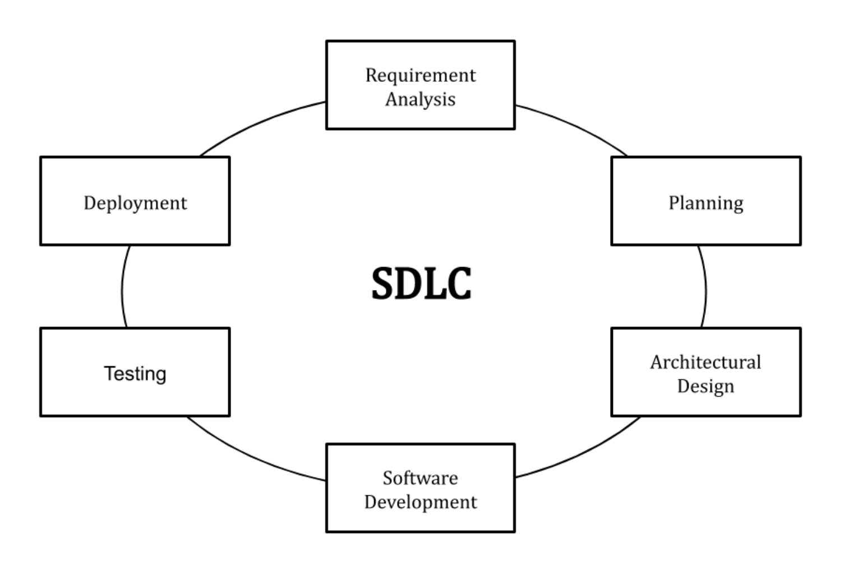
Software Development Life Cycle

Slide 3
SDLC - Models
Waterfall Model
One phase is completed before the start of the next phase.
The output of one phase will be the input of the next phase.
One big launch
Agile Model
Delivery in small consumable increments
Continuous evaluation of requirements, plans and results
Frequent customer feedback and course correction

Slide 4
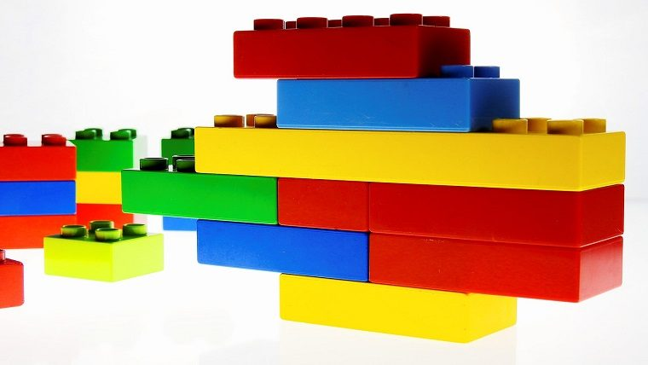
Component based architecture
Each component is built to perform a task
Components talk to each other
Components can be expanded
Components are self reliant

Slide 5
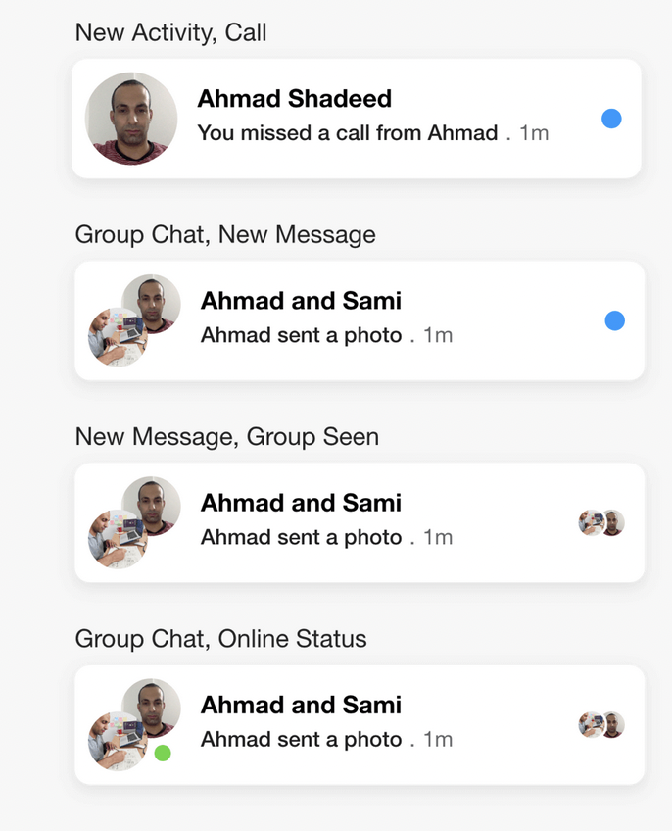
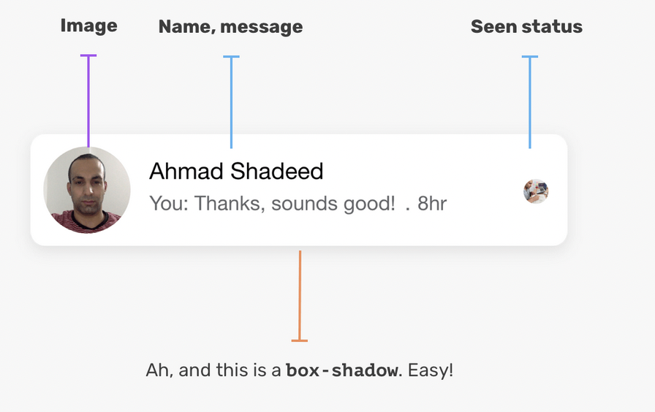
A Sample Component

Slide 6
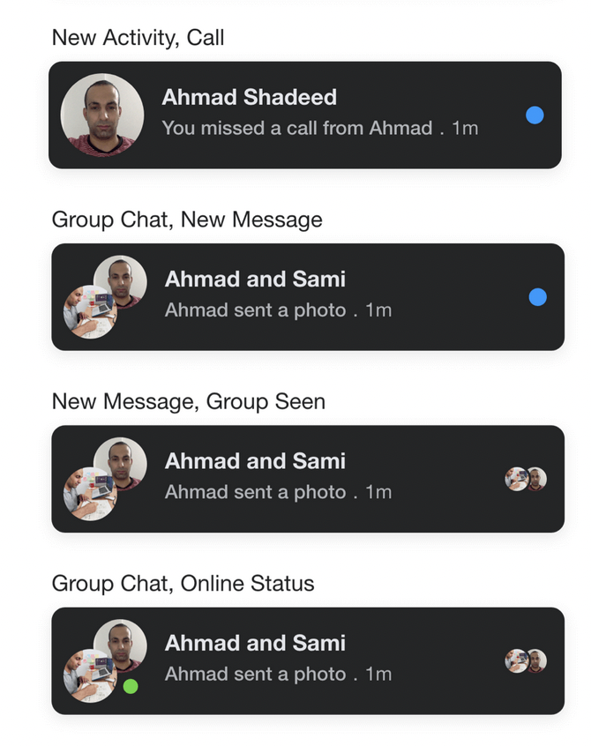
A Sample Component - Dark Mode

Slide 7
…Component Based Architecture
Software components have a number of common characteristics:
Reusability. They are designed to plug into a variety of applications without the need for modification or special accommodations.
Extensibility. A component can be combined with others to create new behaviors.
Replaceability. Components with similar functionality can be swapped.
Encapsulation. Components are self-contained and expose functionality through interfaces while hiding the details of internal processes.
Independence. Components have minimal dependencies on other components and can operate in different environments and contexts.

Slide 8
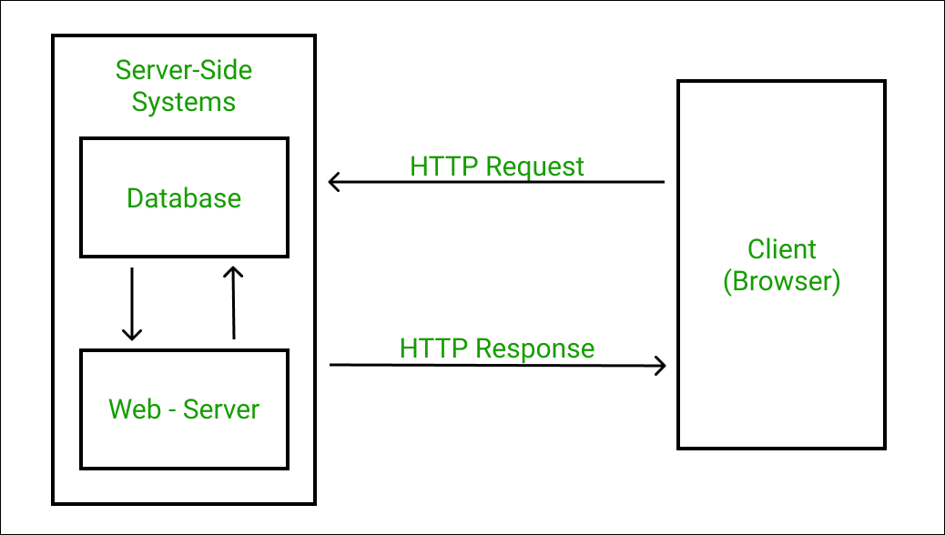
The Web and HTTP Protocol
Connectionless
Media Independent
Stateless

Slide 9
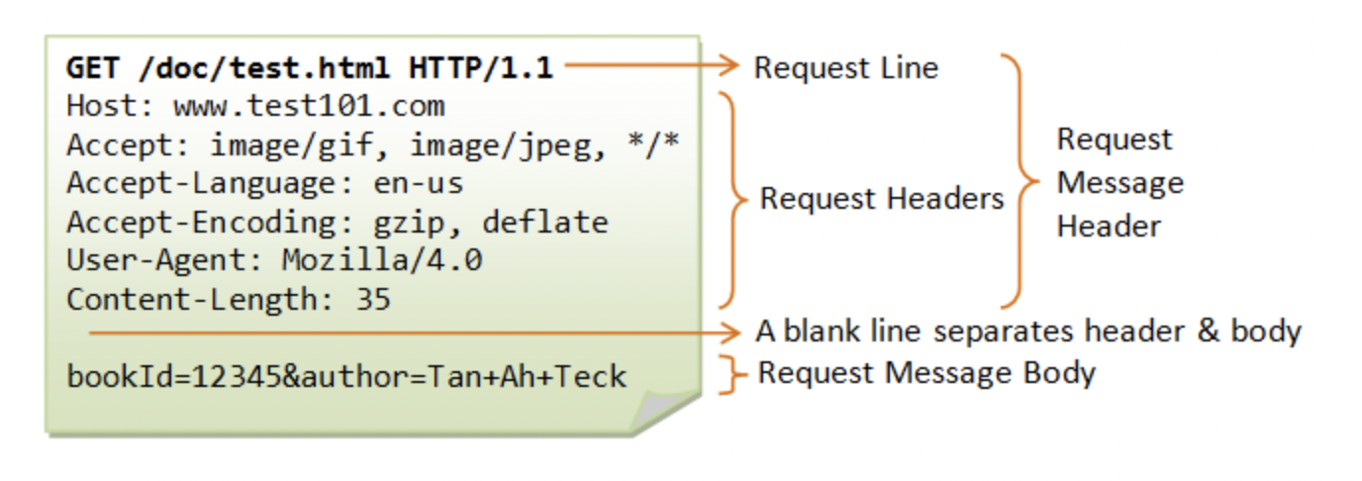
HTTP Request

Slide 10
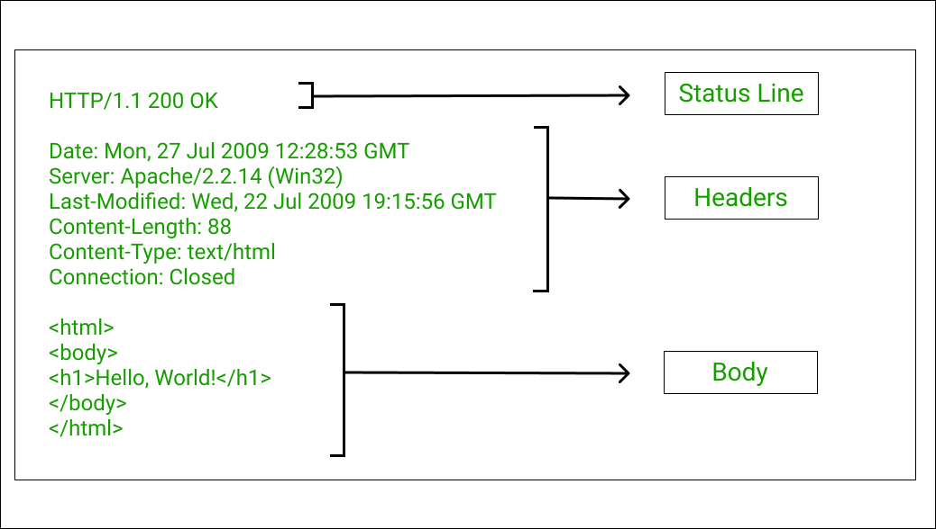
HTTP Response

Slide 11
Web Technologies
HTML
CSS
Javascript

Slide 12
HTML
HTTP Protocol
Tags/Elements - building blocks
Each Tag is a component
Attributes
Styles
https://www.w3schools.com/html/
Topics - HTML Tutorial, HTML Forms, HTML Media

Slide 13
CSS
Selectors
Colors
Background
Margin, Padding
Height/Width
Box Model
Text/Font
Icons
Links
Lists
Tables
Display
ZIndex
Units
Rounded Corners
Backgrounds
https://www.w3schools.com/css/ Topic - CSS Tutorial

Slide 14
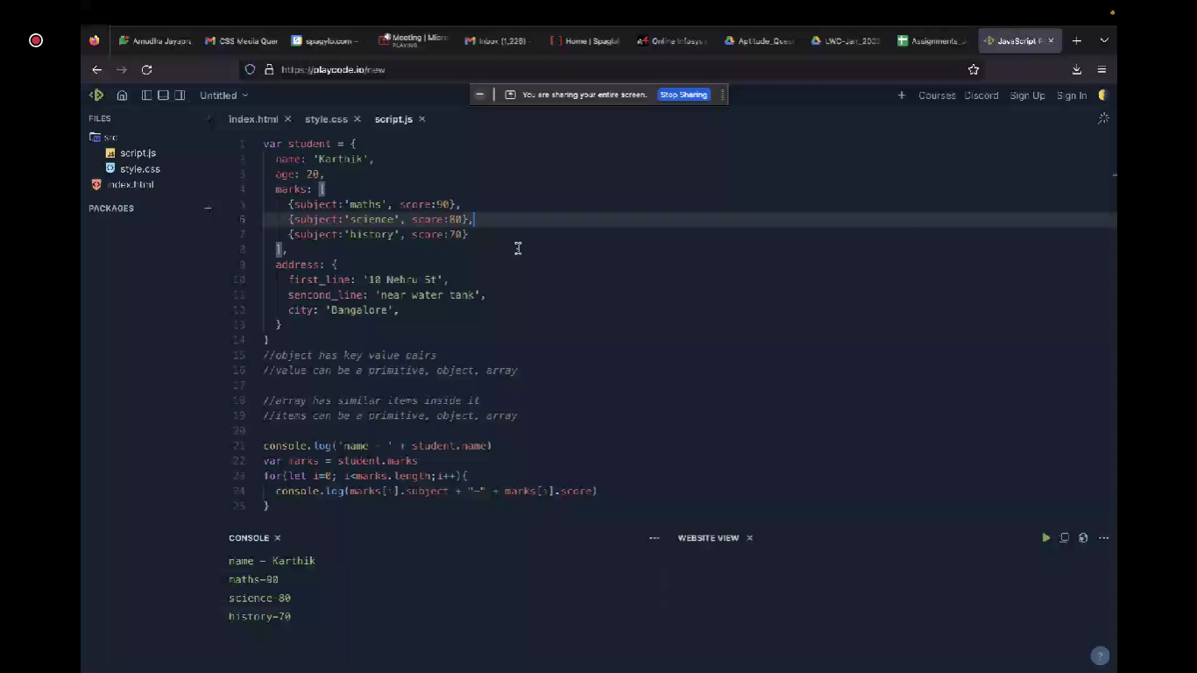

Slide 15
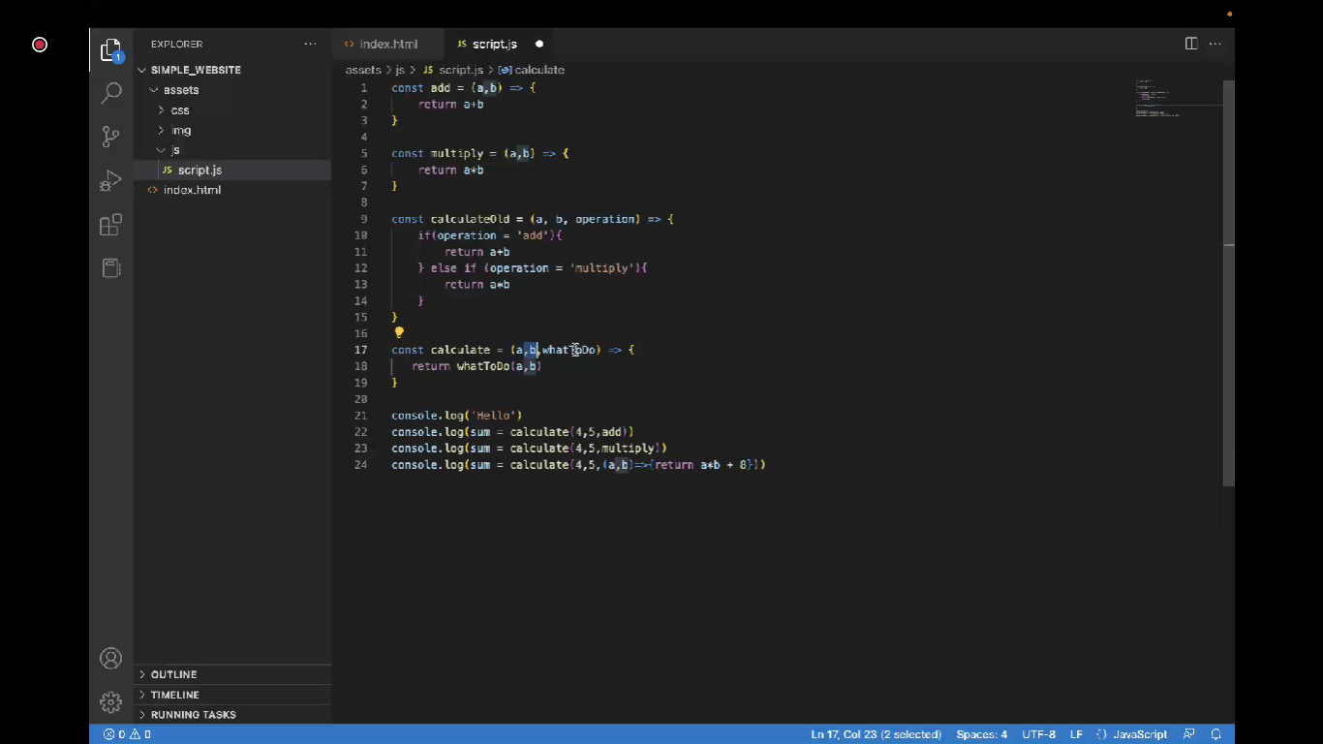

Slide 16
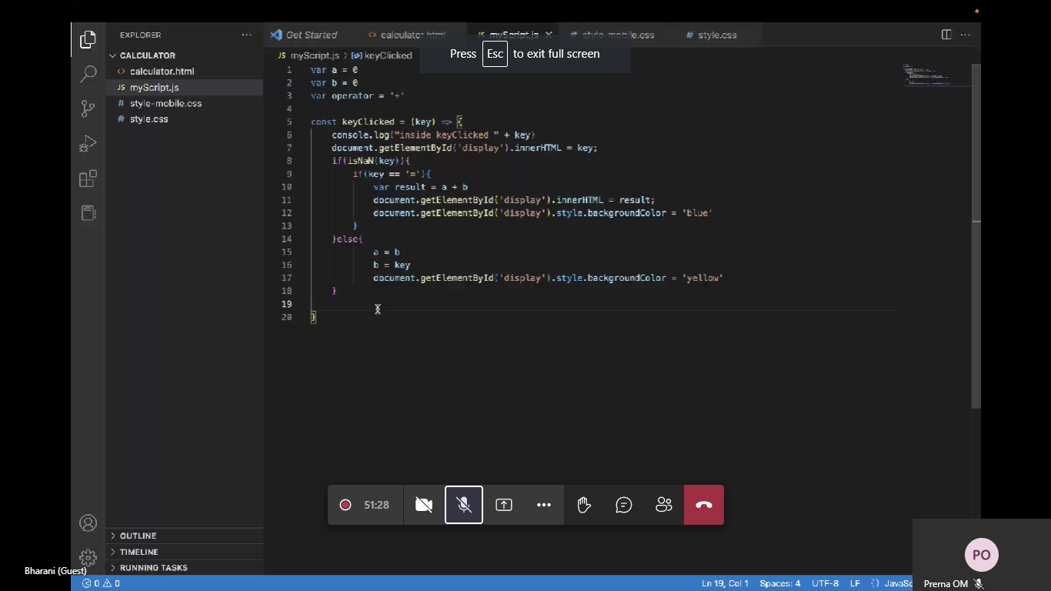

Slide 17
Ticket Manager
Event 1
Event 1 Details
No. of Tickets bought
Total Amount collected
Event 2
Event 3
Event 4
Click to book ticket

Slide 18
