Slide 1

STUDENT MANAGEMENT SYSTEM
Presented By:
Prabesh subedi
Sristi Lamichhane
Tikaram Subedi

Slide 2
Acknowledgement
We express gratitude to Gandaki University (Faculty of Science and Technology), our Supervisor [Dammar Khadayat], Coordinator[Saroj Giri], and all Faculty Members for their invaluable guidance and support throughout this project.

Slide 3
Table of Content
1.Introduction
2.Problem Statement
3.Objectives
4.Scope of project
5.Literature Review
6.Methodology
7.Tools and Technologies
8.Performance Parameters
9.Testing and Validations ‘
10. Limitations
11.Conclusion and Future Recommendations

Slide 4
Introduction
Our Project “ STUDENT MANAGEMENT SYSTEM” developed using the Django web framework, provides a web-based solution that allows administrators, teachers, and students to efficiently manage and access academic data from a single platform
The goal is to create a transparent, secure, and digital environment for academic data management.

Slide 5
Problem Statement
Manual data handling causes duplication and errors.
Difficulty in maintaining large records of attendance, grades, and feedback.
Lack of real-time data access and transparency.
Need for an integrated, user-friendly, and secure system for institutions.

Slide 6
Objectives
General Objective:
To develop a web-based Student Management System using Django for efficient and secure academic record handling.
Specific Objective
Create user modules (Admin, Staff, Student).
Automate attendance, results, and feedback.
Implement role-based authentication.
Provide dashboards for performance analysis.
Securely store institutional data using Django ORM.

Slide 7
Scope of the Project
Designed to digitalize student and staff record management.
Covers core modules — attendance, results, feedback, leave, and courses.
Applicable for schools, colleges, and universities.
Built using Django with SQLite for local deployment.
Can be expanded with features like online payments or library modules.

Slide 8
Literature Review
Previous studies show manual systems are inefficient for large institutions.
Web-based management improves data accuracy and accessibility.
Research supports automation in record-keeping for academic institutions.
Django framework provides scalability, security, and maintainability.

Slide 9
Methodology (Agile SDLC)
Chosen Model: Agile Software Development Life Cycle
Phases Followed:
Requirement Analysis – Gathering stakeholder needs.
Design – Database schema, flowcharts, UI wireframes.
Development – Django backend, responsive frontend.
Testing – Unit, integration, and UAT testing.
Deployment – Local hosting using SQLite.
Feedback & Iteration – Continuous refinement.
Maintenance – Bug fixes and updates.

Slide 10
Flowcharts
Admin Functions: Manage students, staff, courses, attendance, and feedback.
Staff Functions: Update attendance, manage results, and send feedback.
Student Functions: View attendance, results, and submit feedback.

Slide 11
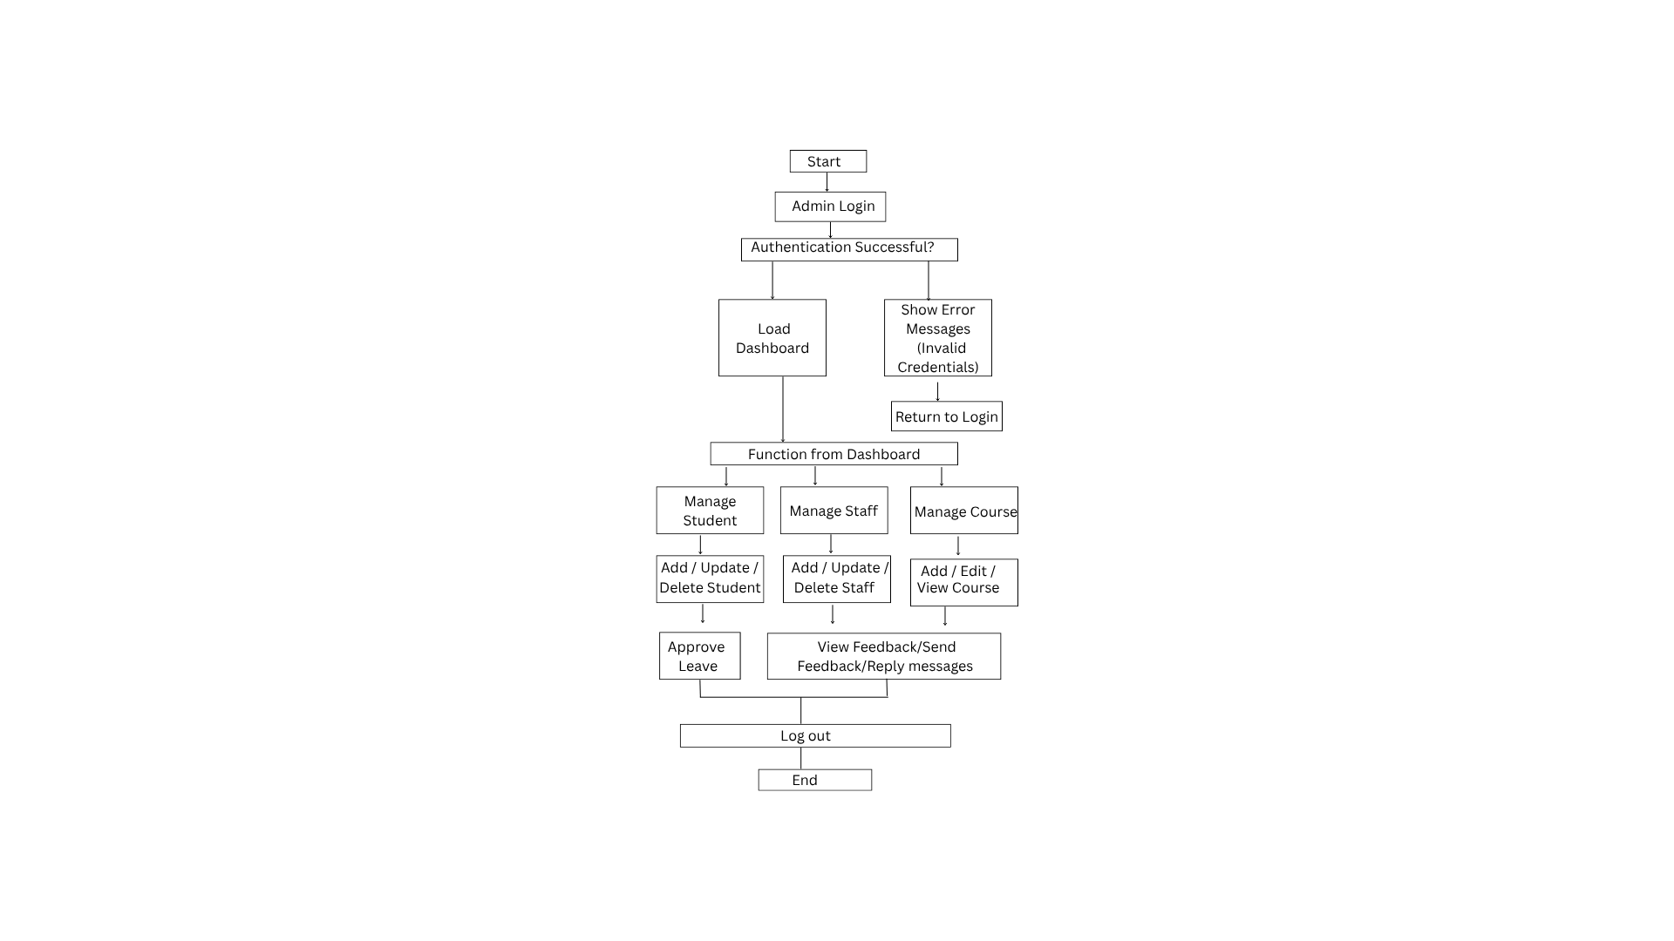
Admin Flowchart

Slide 12
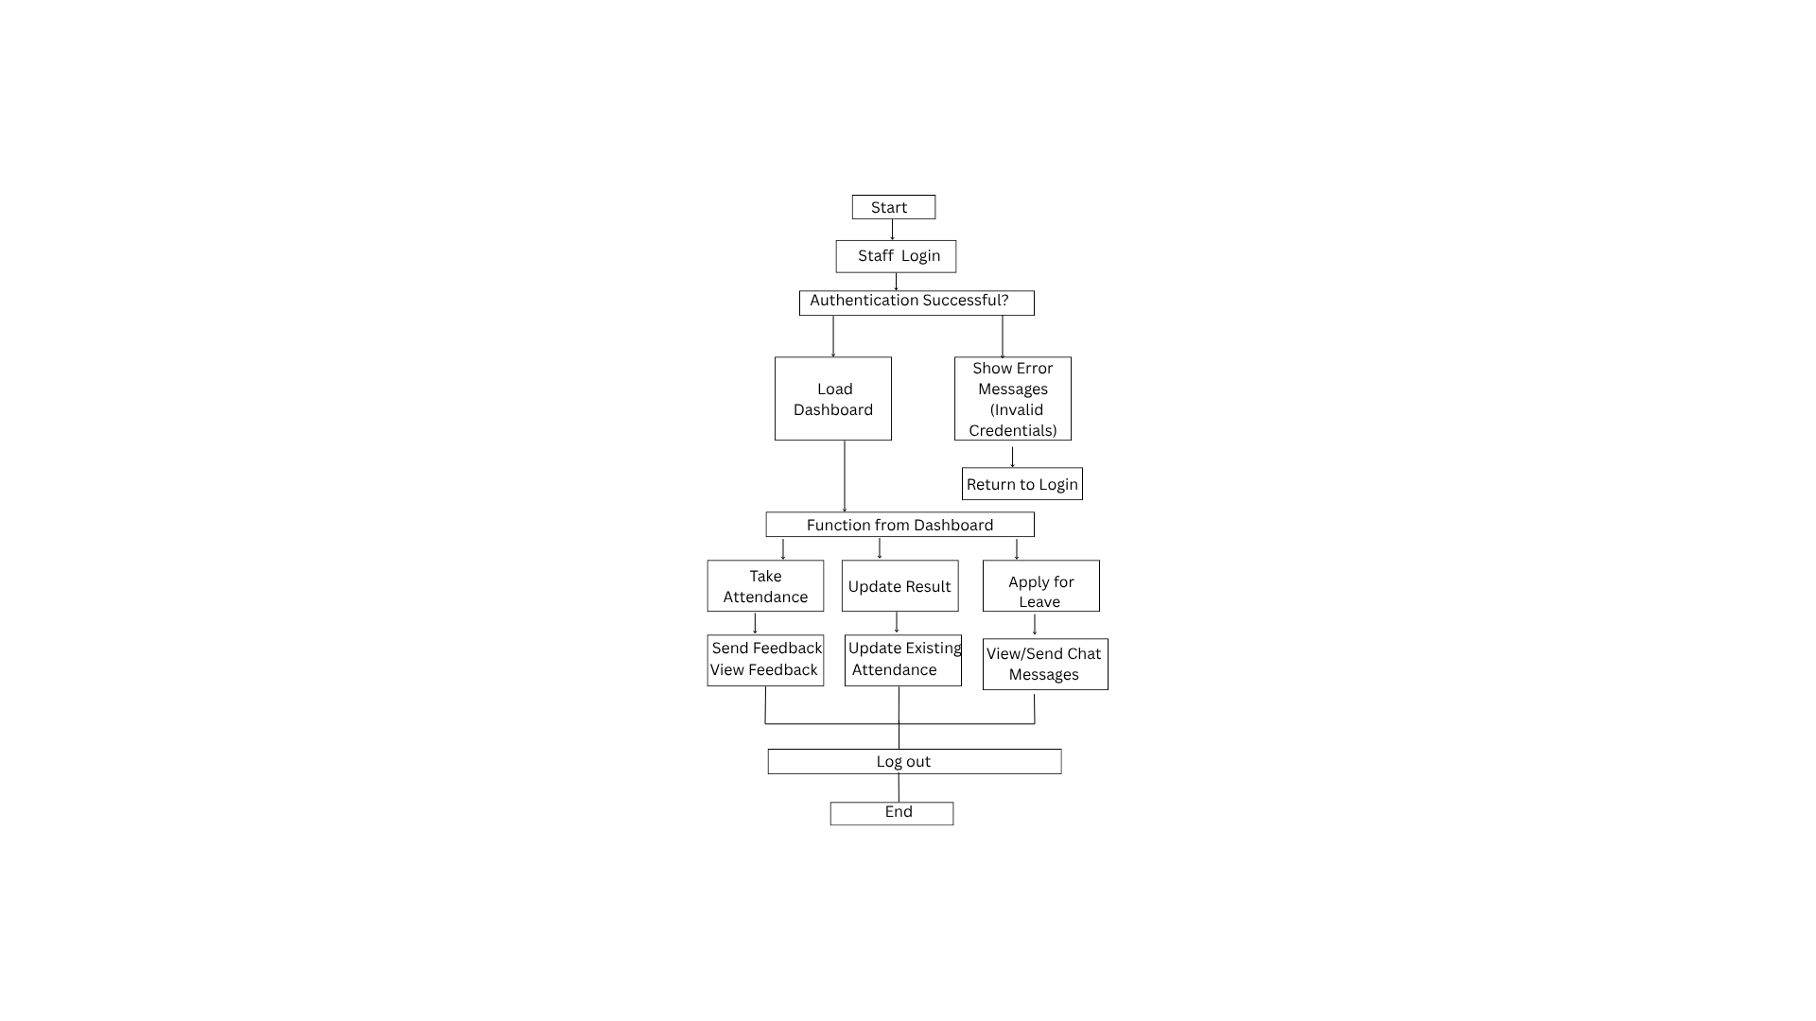
Staff Flowchart

Slide 13
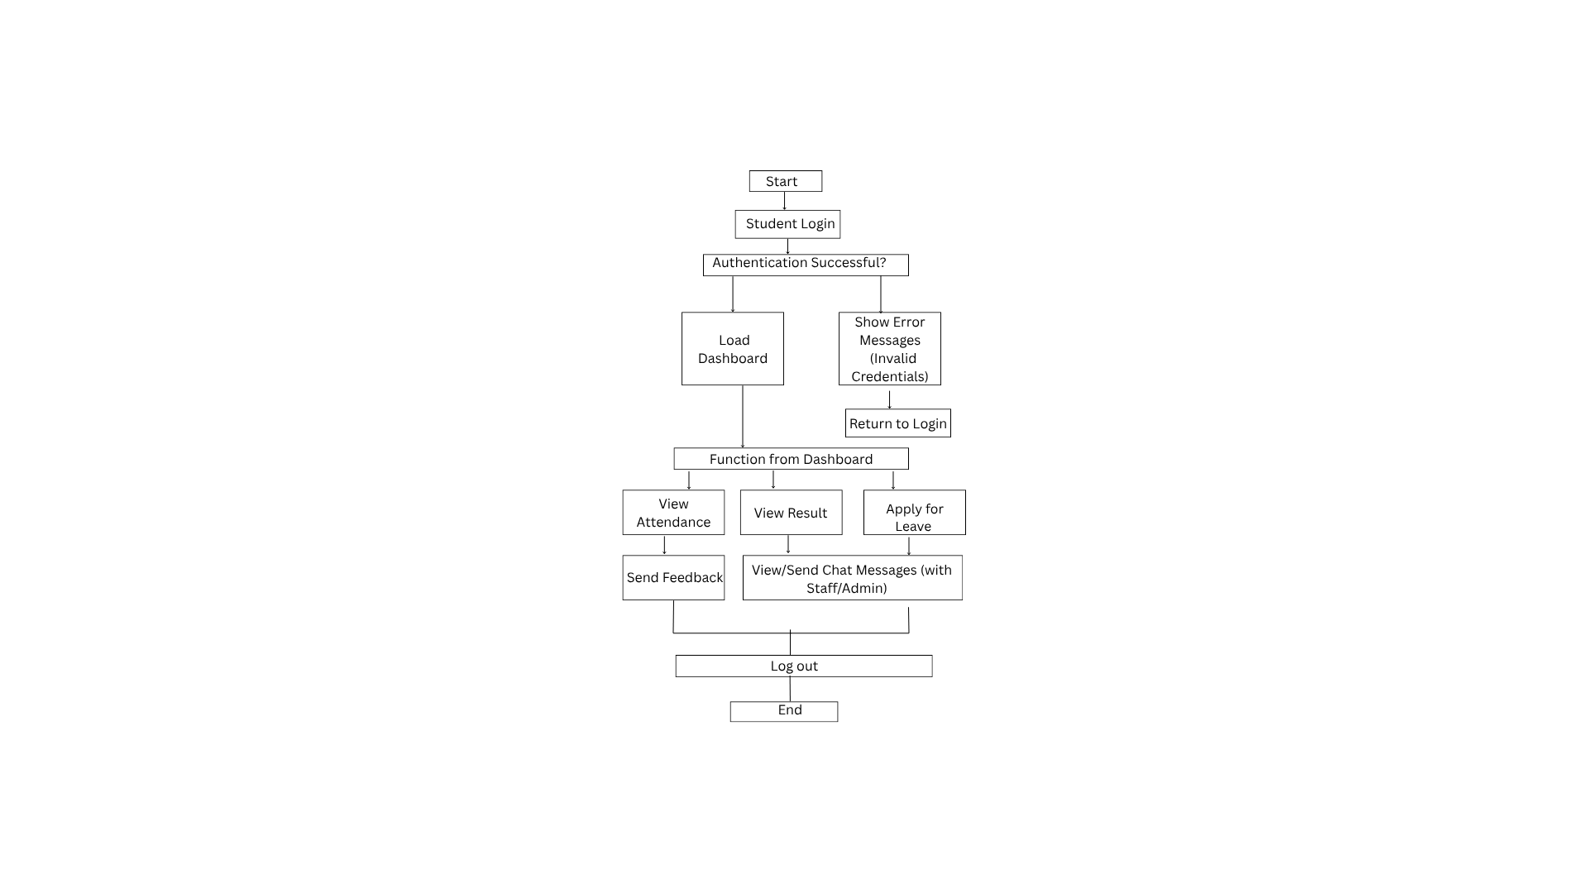
Student Flowchart

Slide 14
System Architecture
Three-Tier Architecture:
Presentation Layer: Interface for Admin, Staff, and Students.
Business Logic Layer: Django framework handling data processing.
Data Layer: SQLite database storing all records securely.

Slide 15
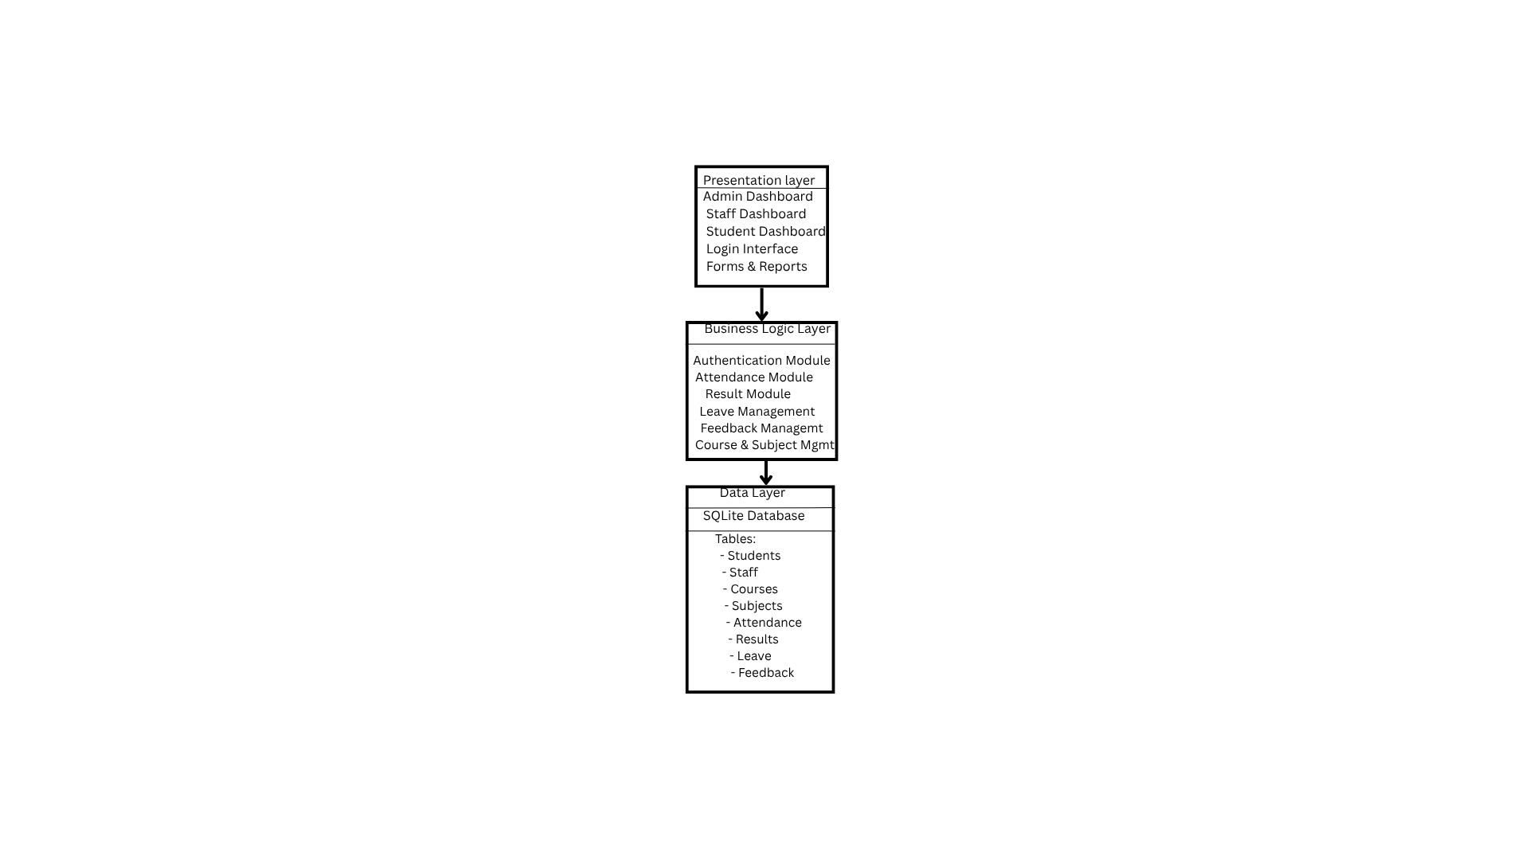
System Architecture

Slide 16
Tools and Technologies
Programming Language: Python Framework: Django (MVT Architecture) Database: SQLite Frontend: HTML, CSS, JavaScript, Bootstrap Editor: VS Code Hosting: Localhost / Django Server

Slide 17
Performance Prameters
Efficiency: Faster data processing and access
Accuracy: Error-free record management
Security: Authentication-based user access
Scalability: Easy to expand for future needs
Usability: Simple and responsive interface

Slide 18
Testing & Validation
Testing Methods:
Unit Testing – Module verification
Integration Testing – Module interaction
User Acceptance Testing – Role-based validation
Results:
✅ 100% functional accuracy
✅ Smooth CRUD operations
✅ Error handling validated
✅ Secure login and authorization

Slide 19
Limitations
Automated notifications (email/SMS) are not yet implemented.
Future upgrades required for large-scale institutional deployment.
The system currently supports local deployment only (not cloud-hosted).

Slide 20
Conclusions
Efficient digital management system for institutions.
Reduces manual errors and improves transparency.
Django ensures strong backend security and flexibility.
Achieved all project objectives successfully.

Slide 21
Future Recommendations
Biometric or facial recognition attendance.
Online fee payment integration.
Mobile app (Android/iOS).
Cloud hosting for scalability.
Advanced analytics dashboard.
Multi-factor authentication (2FA/OTP).

Slide 22
Thank You

