Slide 1

Introduction to RxJava

Slide 2
Topics
Revisit Publisher/Subscriber
Subscriber/Observer Interfaces
Operators
Asynchronous/Concurrency
Flow Control
Subjects

Slide 3
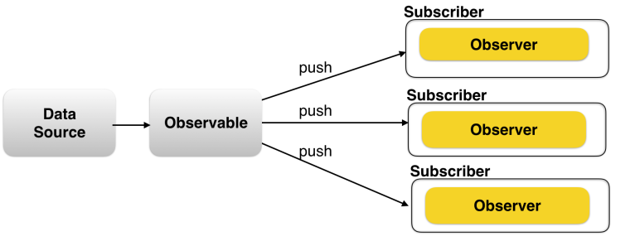
Revisit Publisher/Subscriber

Slide 4
Revisit Publisher/Subscriber
Publisher is publishing events.
Subscriber(one to many) listening to events.
Complexities
Chain publishers, pipe one stream into other.
Compose multiple publishers. Combine multiple streams.
Execute on desired threads.
Concurrent execution on callbacks.
Unsubscribe, cleanup, error handling.

Slide 5
Reactive?
https://en.wikipedia.org/wiki/Reactive_programming
ReactiveX is an API for asynchronous programming with observable streams
ReactiveX is a combination of the best ideas from the Observer pattern, the Iterator pattern, and functional programming

Slide 6
RxJava
A library for composing asynchronous and event-based programs.
Begins with the observer pattern of producer/consumer callbacks and extends it with operators.
Allow composing, transforming, scheduling, throttling, error handling, and lifecycle management.

Slide 7
Subscriber/Observer Interfaces
Subscriber Interface, onNext, onCompleted, onError
Lazy versus Eager
Lazy, meaning it does nothing until it is subscribed to.
Lazyiness allows composing Observables together without data loss due to race conditions
Observable is lazy and will not start until subscribed to so that all composition can be done before data starts flowing.
Subscription, not construction starts work

Slide 8
Operators
Map,
DoOnNext,
FlatMap,

Slide 9
Concurrency & Schedulers
Sync/Async – understand how RxJava enables Async
Rx contract – onNext, onError, onCompleted are ensured to be called concurrently
SubscribeOn, ObserveOn

Slide 10
Composability
FlatMap
Merge
Zip

Slide 11
Flow Control
Backpressure

Slide 12
Subjects
Publish Subject
Behavior Subject

