Slide 1

ReactiveX using RxJava

Slide 2
Topics
Revisit Publisher/Subscriber
Subscriber/Observer Interfaces
Asynchronous/Concurrency
Operators
Flow Control
Subjects

Slide 3
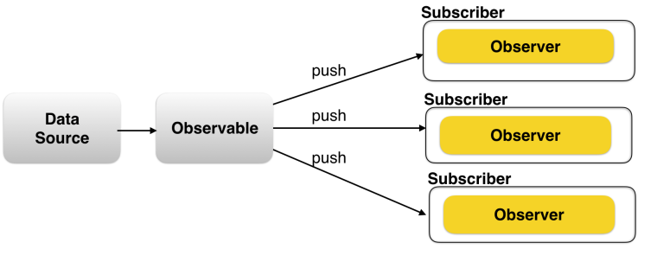
Revisit Publisher/Subscriber

Slide 4
Revisit Publisher/Subscriber
Publisher is publishing events.
Subscriber(one to many) listening to events.
Complexities
Chain publishers, pipe one stream into other.
Compose multiple publishers. Combine multiple streams.
Concurrent execution on callbacks.
Unsubscribe, cleanup, error handling.
Execute on desired threads.

Slide 5
Reactive?
ReactiveX is an API for asynchronous programming with observable streams
ReactiveX is a combination of the best ideas from the Observer pattern, the Iterator pattern, and functional programming
https://en.wikipedia.org/wiki/Reactive_programming

Slide 6
Reactive?
Reactive-functional programming is solving is concurrency and parallelism. It is solving callback hell.
Reactive programming such as that implemented by RxJava is influenced by functional programming.

Slide 7
RxJava/RxSwift
A library for composing asynchronous and event-based programs.
Begins with the observer pattern of producer/consumer callbacks and extends it with operators.
Allow composing, transforming, scheduling, throttling, error handling, and lifecycle management.

Slide 8
Subscriber/Observer Interfaces
Subscriber Interface, onNext, onCompleted, onError
Lazy versus Eager
Lazy, meaning it does nothing until it is subscribed to.
Lazyiness allows composing Observables together without data loss due to race conditions
Observable is lazy and will not start until subscribed to so that all composition can be done before data starts flowing.
Subscription, not construction starts work

Slide 9
Operators
Map
DoOnNext
FlatMap
Retry

Slide 10
Concurrency & Schedulers
Sync/Async – understand how RxJava enables Async. RxJava never adds concurrency unless it is asked to do so
Rx contract – onNext, onError, onCompleted are ensured to be called concurrently
SubscribeOn, ObserveOn

Slide 11
Concurrency & Schedulers
Concurrency can come from multiple places, not just thread pools. If the data source is already async because it is on an event loop, RxJava should not add more scheduling overhead or force a particular scheduling implementation.
Concurrency can come from thread pools, event loops, actors, and so on. It can be added, or it can originate from the data source. RxJava is agnostic with respect to where the asynchrony originates

Slide 12
Composability
FlatMap
Merge
Zip

Slide 13
Subjects
Publish Subject
Behavior Subject

Slide 14
Thanks
PPT & Source code available at https://github.com/chandanthakur/rxjava-basics

