Slide 1

ONLINE-COMPLAIN management system
KIBALABS PVT Ltd.

Slide 2

PATNA UNIVERSITY PATNA
SYNOPSIS
on
ONLINE-COMPLAINT Management System
Submitted to:-
Mr. ANISH KUMAR
KIBALABS,
Patna
Submitted by:-
Name: Kumari Aparna
Course: MCA Course
Semester: 6th
Regn. no:-09150020
College: Dept. of Stat., Patna University

Slide 3
Contents
Topics
Organization Overview
Problem Statement
Aim
Objective
Methodology
Proposed H/W & S/W Used
Proposed Advantages
Page no.
1
2
3
4
5
6
7

Slide 4

Organization Overview
KIBA LABS Pvt. Ltd. is reckoned as one of the most trusted it based service providers,specializing in back-end services in the spectrum of human resources ,finance & accounting and information technology.In this, company offers payrolls, compliances HRMS ,accounting and finance and ERP solution s with integration of technology.
The company headquartered in Bangluru,India.since2019.we are best with our forecasting system which allow clients to consistency hit their goals. Our work has resulted in a substantial growth for our clients .We have been recommended for our timeliness and proactively.
1

Slide 5
Problem Statement
Many people consider this to be the most important phase. It defines the problem to be solved and thus sets the direction for the whole project. It guides the software developer to how will the project will be solved out. It also defines the project bound and what parts are outside its control. The resource to be made available to the project are also specified in this phase. Mainly it consider to the first phase of developing the software because the problem can’t be solved out unless it is defined, so it is considered as a very important phase.The three important factors,the project goal, the project bounds and resources limits are sometimes called the project’s term of reference.
There are three levels of securities which are meant to safeguard sensitive and important data by making it accessible only to authorized persons. They are:
Data level
User level
Administrator level
2

Slide 6
AIM
The project entitled as “COMPLAIN MANAGEMENT SYSTEM” proposed to handle the CMS allows rectifying complains faced by person in various departments and getting the service on their place only. CMS keeps & maintains following information:
Easy to lodge complaint.
To view the status of complaint by entering complain number and viewing the action taken on that problem and the
officer that attended.
To monitor the handling of various types of complaints and rectifying them in proper manner.
To categorize the complaint officer that deal with different type of complains.
Easy to check daily report of different complains by viewing the scenario of status of complains that is whether they are over or still pending with concerned complain officer.
. Easy to filter complains on various criteria’s.
Easy to edit information or for the new entry when login through admin.
The total number of complaints can be seen in overall bases as well as according to different status of complains.
3

Slide 7
the project “COMPLAIN MANAGEMENT SYSTEM” has achieved the following objectives in favor of employee Information:-
OBJECTIVE
Accuracy: The system is accurate. Thus, its utility is very high.
Flexibility: The system is such that changes and modification can be easily incorporated in it.
Reliability: The system is reliable, as the person gains access on the basis of his/her user identity.
GUI: The system gives Graphical Interface, so it’s User friendly.
User friendliness: The system is easy to learn and understand. A negative user can also use the system effectively, without any difficulty.
User satisfaction: The system is such that it stands up to the user’s expectation.
Probability: The application can be easily move from on hardware to other
4

Slide 8
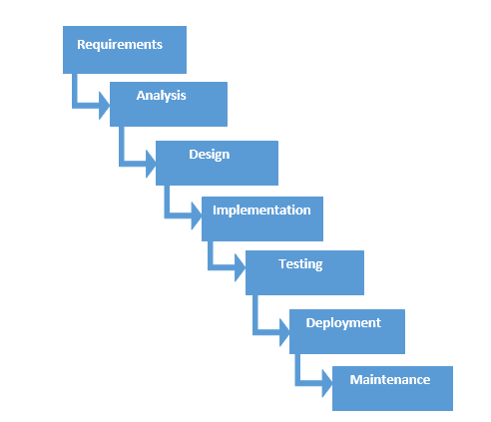
Methodology
The waterfall model seems an ideal choice here. No other model seems a reasonable alternative to accept as a different answer.
Strengths: 1. The company is large and bureaucratic, requiring documentation and good project visibility. Waterfall documentation satisfies this. 2. The company has a high staff turnover. So probably many employees are new and inexperienced. Waterfall works well with inexperienced staff. 3. The application type is well known to the company, so a thorough user requirements analysis should be possible early on. 4. An existing application is to be re-engineered. This also confirms that the user requirements are known early. They could be extracted from the existing application. 5. The company will maintain the software, so good documentation will be essential. 6. The company has a good reputation to maintain in this area, so quality control will be essential. Waterfall emphasis of requirements-before-design and design-before-coding will emphasize quality.
5

Slide 9
Proposed Hardware & Software Used
Hardware Interfaces :
The minimum hardware requirement for the proposed system is as given below:-
Processor :- Dual core
Ram :-1GB
Hard disk :-120 GB
Laptop :-15’’ color monitor
Printer :-Laser
Software Interfaces Operating system –
Operating System
Web Technology
Front end tool
Back end tool
6

Slide 10
Proposed Advantages The purpose of Software Requirement specification is to bridge the communication gap between the client and the users. SRS is the medium through which the client and user needs are accurately specified indeed, SRS firms the basis of software development.

