Slide 1
Utterance Clustering Pipeline
From Raw Text to Labeled Intent Clusters
01
Embed
02
Cluster
03
Evaluate
04
Label
Embedding → Clustering → Evaluation → Labeling

Slide 2
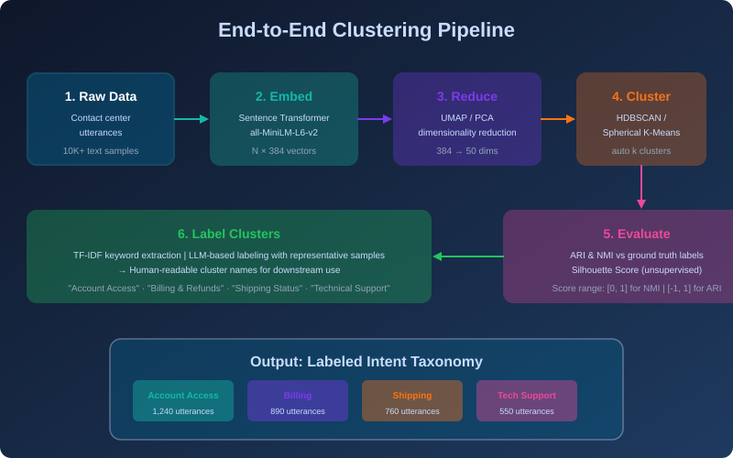
Pipeline Overview
End-to-end flow from raw utterances to a labeled intent taxonomy

Slide 3
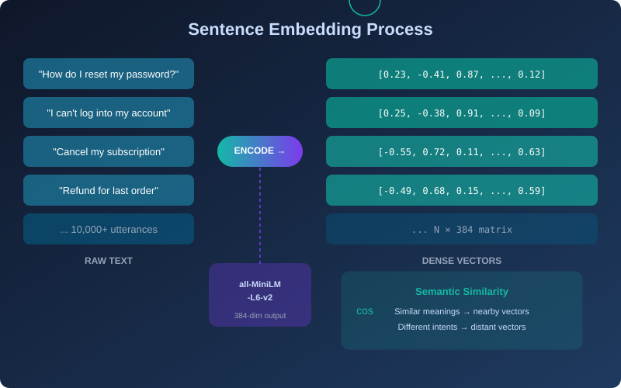
01
Sentence Embedding
Transform natural language into dense vector representations

Slide 4
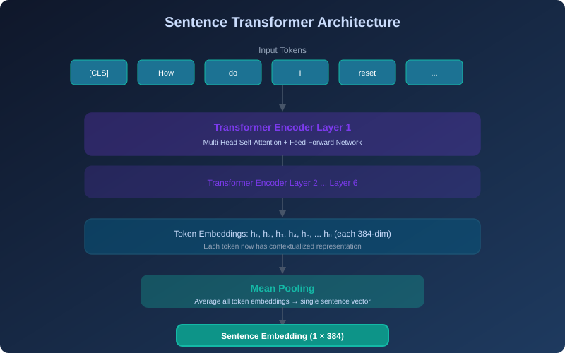
01
How Sentence Transformers Work
Model Details
all-MiniLM-L6-v2
6-layer transformer, 22M params
Fast inference, strong quality
BGE-base-en-v1.5
12-layer, 110M params
Higher quality, slower
Key Concept:
Mean pooling averages all token embeddings into a single fixed-size vector for the entire sentence.
Why Sentence Transformers? Unlike word2vec or bag-of-words, these models capture full semantic meaning. "How do I reset my password?" and "I can't log in" are nearby in vector space because they share intent, even with zero word overlap.

Slide 5
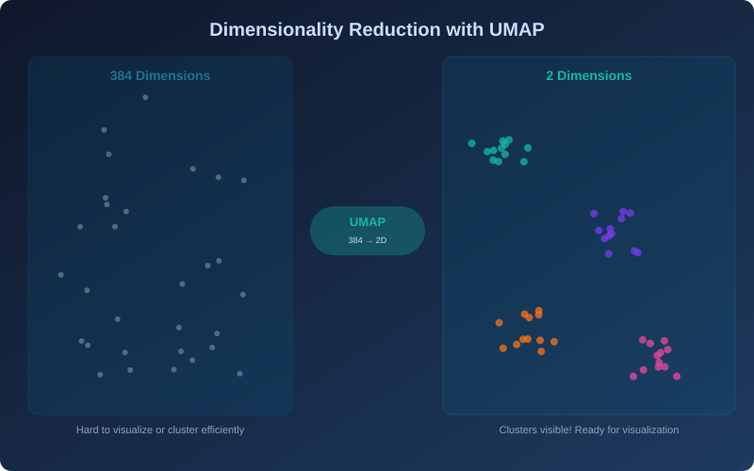
Dimensionality Reduction
UMAP preserves local neighborhood structure while reducing 384 dims to 2D for visualization

Slide 6
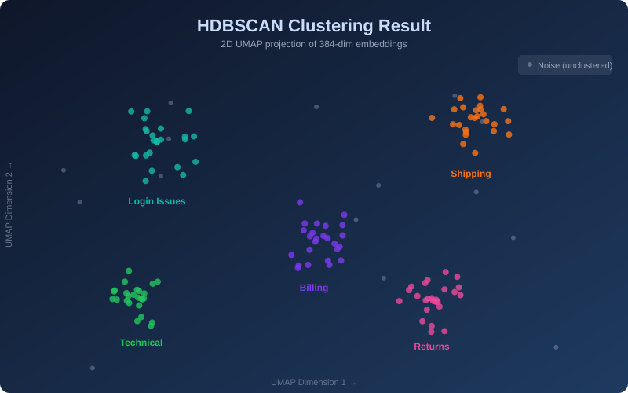
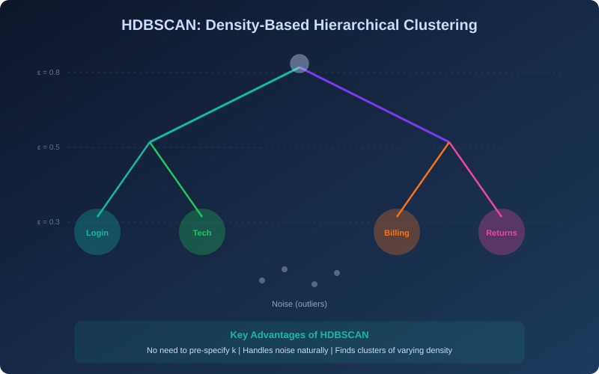
02
Clustering with HDBSCAN
Density-based clustering that automatically finds the right number of groups
Why HDBSCAN? It doesn't require you to guess k (the number of clusters) upfront. It builds a hierarchy of density-based clusters, extracts the most stable ones, and gracefully labels outliers as noise — perfect for messy real-world data.

Slide 7
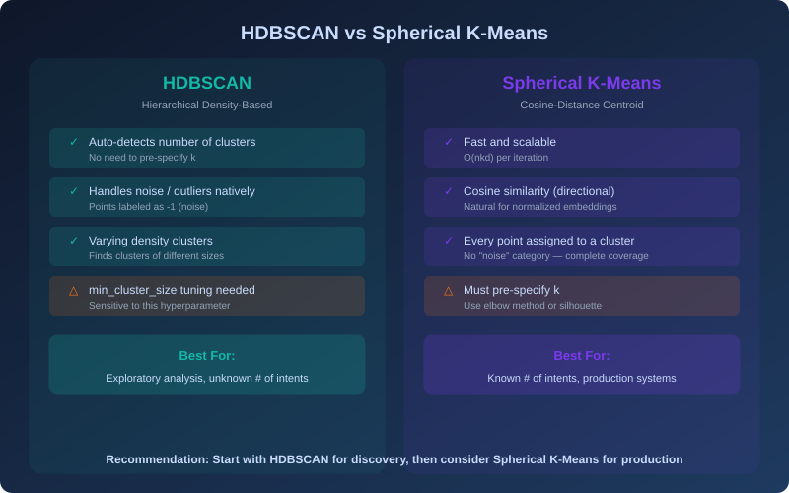
Clustering Algorithm Comparison

Slide 8
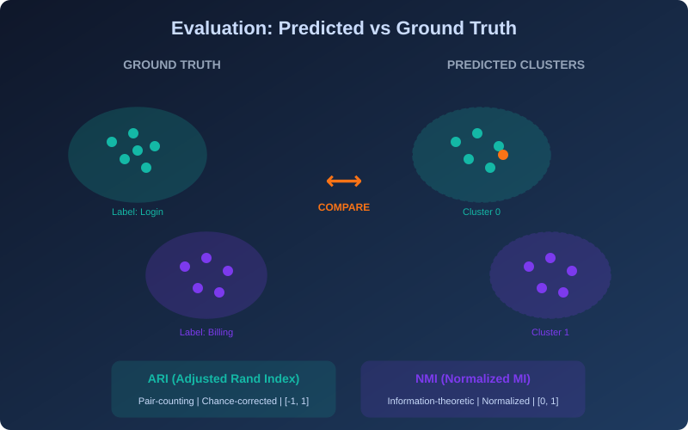
03
Evaluation Against Ground Truth
Measuring clustering quality using ARI and NMI

Slide 9
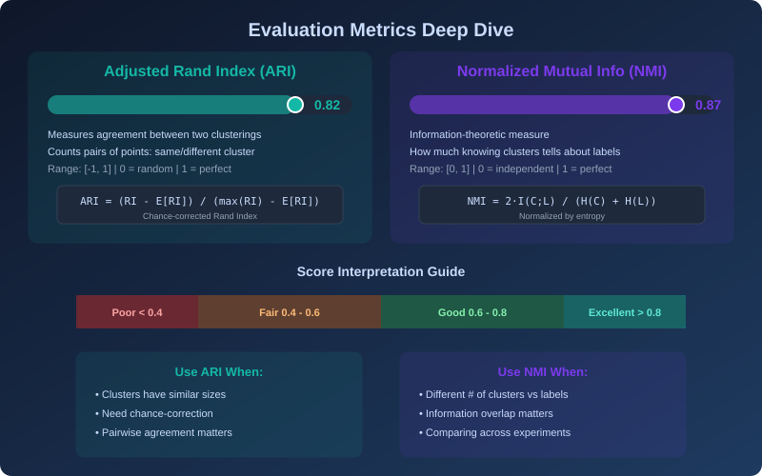
Metrics Deep Dive: ARI & NMI

Slide 10
V2
v2 Pipeline Improvements
Key methodological and performance improvements over the baseline clustering pipeline
DBCV-Based Selection
3D Parameter Sweep
Replaced ARI (circular, uses labels) with DBCV — an internal validity metric that evaluates clustering quality from data geometry alone, with no label leakage.
Expanded from 5 configs (min_cluster_size only) to 64 configs (min_cluster_size x min_samples x epsilon). Constrained to <= 30 clusters.
Full-Dataset Evaluation
Precomputed NN Graph
Noise points assigned via approximate_predict before scoring. Reports both excl-noise and full-dataset ARI/NMI for honest comparison.
Nearest-neighbor graph computed once and shared across both UMAP projections (15d clustering + 2d visualization), halving UMAP time.
Also: cosine distance for centroid sampling | async LLM labeling | global random seeds | reusable scatter helper

Slide 11
DBCV: Density-Based Clustering Validation
An internal validity metric designed for density-based clustering (Moulavi et al., 2014)
How DBCV Works
Why DBCV Is Needed
1. Build a minimum spanning tree within each cluster using mutual reachability distance (density-aware).
2. Measure intra-cluster density (how tight) vs inter-cluster density (how separated).
3. Per-cluster score: (separation - compactness) / max(both)
4. Global score: density-weighted average across all clusters.
Circular evaluation: Selecting HDBSCAN parameters by ARI (ground-truth labels) is cheating — those labels won't exist in production.
Shape assumptions: Silhouette Score assumes convex clusters. HDBSCAN discovers arbitrary shapes.
Noise-aware: DBCV works with HDBSCAN's noise model; standard metrics don't handle noise points.
DBCV Range | Interpretation
0.75 – 1.0 | Excellent — dense, well-separated clusters
0.50 – 0.75 | Good — clear density structure
0.25 – 0.50 | Moderate — some cluster overlap
< 0.25 | Weak to poor — clusters not well-defined

Slide 12
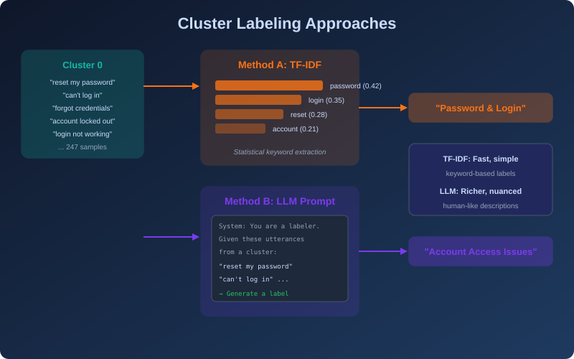
04
Cluster Labeling
Turning anonymous cluster IDs into meaningful, human-readable intent names

Slide 13
Python Implementation
Complete pipeline in ~20 lines of Python
# 1. Embed utterances
from sentence_transformers import SentenceTransformer
model = SentenceTransformer('all-MiniLM-L6-v2')
embeddings = model.encode(utterances)
# 2. Reduce dimensions (optional)
import umap
reduced = umap.UMAP(n_components=50).fit_transform(embeddings)
# 3. Cluster with HDBSCAN
import hdbscan
labels = hdbscan.HDBSCAN(min_cluster_size=15).fit_predict(reduced)
# 4. Evaluate
from sklearn.metrics import adjusted_rand_score, normalized_mutual_info_score
ari = adjusted_rand_score(gt_labels, labels)
nmi = normalized_mutual_info_score(gt_labels, labels)
Key Libraries
sentence-transformers
HuggingFace-based embedding
hdbscan
Density-based clustering
umap-learn
Dimensionality reduction
scikit-learn
Metrics (ARI, NMI, Silhouette)
pip install
sentence-transformers hdbscan umap-learn scikit-learn

Slide 14
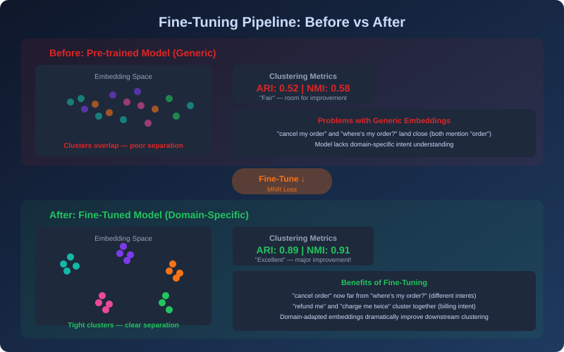
FT
Fine-Tuning: Why & How
Adapting a pre-trained sentence transformer to your domain dramatically improves cluster quality

Slide 15
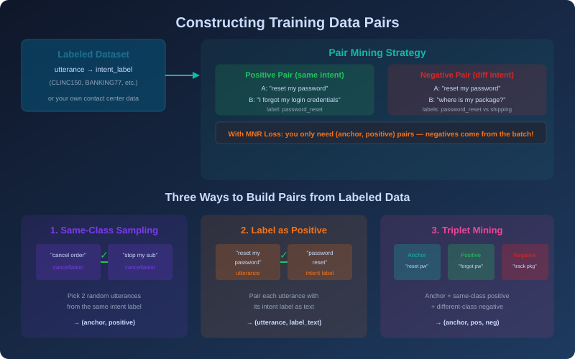
FT
Constructing Training Pairs
Three strategies for building (anchor, positive) pairs from your labeled data

Slide 16
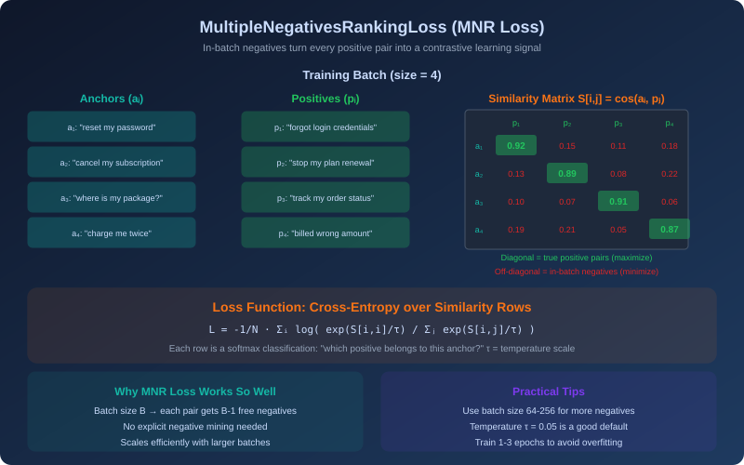
FT
MultipleNegativesRankingLoss
The go-to contrastive loss for sentence transformer fine-tuning — free negatives from each batch

Slide 17
Fine-Tuning: Python Code
Complete fine-tuning setup with sentence-transformers
# 1. Build training pairs from labeled data
from sentence_transformers import (
SentenceTransformer, InputExample, losses
)
from torch.utils.data import DataLoader
pairs = []
for intent, utts in grouped_by_intent.items():
for a, b in combinations(utts, 2):
pairs.append(InputExample(texts=[a, b]))
loader = DataLoader(pairs, batch_size=128, shuffle=True)
# 2. Load base model + MNR loss
model = SentenceTransformer('all-MiniLM-L6-v2')
loss = losses.MultipleNegativesRankingLoss(model)
# 3. Fine-tune
model.fit(
train_objectives=[(loader, loss)],
epochs=3,
warmup_steps=100
)
model.save("finetuned-model")
How It Works
Step 1: Pair Mining
Sample all (a, b) from the same intent label using combinations
Step 2: Loss Function
MNR Loss treats other pairs in the batch as automatic negatives
Step 3: Training
1-3 epochs is usually sufficient; use warmup to stabilize early training
Batch size matters!
Larger batch = more in-batch negatives = better contrastive signal. Use 128+ if GPU memory allows.

Slide 18
FT
Fine-Tuning Results (v2 Pipeline)
Base all-MiniLM-L6-v2 vs fine-tuned model — each with its own DBCV-optimal HDBSCAN parameters
Metric | Base Model | Fine-Tuned | Delta
DBCV (internal) | — | — | —
ARI vs Intent (full dataset) | — | — | —
NMI vs Intent (full dataset) | — | — | —
ARI vs Category (full dataset) | — | — | —
Clusters Found | — | — | —
Noise % | — | — | —
Mean Purity (full dataset) | — | — | —
Embedding Separation | — | — | —
Note: Values marked '—' will be populated after running finetune_embeddings.ipynb with the v2 pipeline. Each model gets its own DBCV-optimal parameters — no more hardcoded min_cluster_size=500. Full-dataset metrics include noise points assigned via approximate_predict.

Slide 19
Fine-Tuning: Key Takeaways
Tighter Clusters
Less Noise
Per-Model Tuning
Fine-tuning pulls same-intent utterances closer together in embedding space, increasing intra-class cosine similarity and the gap between intra- and inter-class similarity.
The base model had ~18.7% noise; fine-tuning drops this dramatically. v2's full-dataset eval via approximate_predict ensures a fair comparison that doesn't hide hard points.
v2 runs a separate DBCV parameter sweep for each embedding set. The optimal HDBSCAN config differs between base and fine-tuned because the density structure changes after training.
Training Configuration: 27K same-intent pairs | MultipleNegativesRankingLoss (InfoNCE) | 3 epochs, batch 64, lr 2e-5 | Stratified 80/20 split | TripletEvaluator on validation set
Category ARI may decrease because fine-tuning optimizes for intent-level separation (27 classes), which can oversplit the coarser 11-category grouping. This is expected and reflects the training objective.

Slide 20
Summary & Next Steps
01
Embed
Sentence transformers capture semantic meaning in 384-dim vectors
02
Cluster
HDBSCAN + DBCV-based parameter sweep; ≤30 cluster constraint
03
Evaluate
DBCV (internal) + ARI/NMI on full dataset via approximate_predict
04
Label
TF-IDF for fast keyword labels; LLM prompting for richer descriptions
FT
Fine-Tune
MNR Loss + per-model DBCV sweep; fairer base vs fine-tuned comparison
Ready to build? Upload your dataset and we can run the full pipeline — embedding, fine-tuning, clustering, and visualization.

