Slide 1
SQL

Slide 2
Select Statement
It is used to read from a table or view.
The SELECT statement is the central construct for read access to data (database) with SQL.
SELECT Column, Column, COUNT(*)
FROM Table
WHERE Condition
GROUP BY Column, Column
HAVING Group_Condition
ORDER BY Column ASC, Column DESC;

Slide 3
single column
-SELECT Name FROM Official;
multiple columns
-SELECT PNr, Name, Salary FROM Official;
(The sequence of the columns In the projection list is relevant)
The same column can appear several times in the projection list (We do not recommend using this option)
-SELECT PNr, PNr, PNr FROM Official;
An asterisk(*) in the projection list represents "all columns“
-SELECT * FROM Official;
Columns can be specified in the projection list In addition to the asterisk (*) (We do not recommend using this option)
-SELECT PNr, *, Name FROM Official;
The asterisk (*) can be used multiple times In the projection list. (We do not recommend using this option)
-SELECT *, *, * FROM Official;

Slide 4
You can generate additional "artificial" result columns:
-SELECT 'Today', Name, 'has been assigned to salary group', Salary FROM Official;
The additional artificial result column can have a numeric type:
-SELECT 'The working week of', Name, 'amounts to', 40, 'hours. ' FROM Official;
The projection list may only contain artificial result columns:
-SELECT 'Good Morning! ' FROM Official;
If the projection list only contains artificial result columns, you can use the special table ''Dummy“
-SELECT 'Good Morning!' FROM Dummy;
You can rename result columns
-SELECT PNr AS PersNumber, Salary AS "Salary Group" FROM Official;
In the (re)naming of result columns the keyword "AS" can be omitted
-SELECT PNr PersNumber, Salary "Salary Group" FROM Official;
You can use existing column names for (re)naming of result columns
-SELECT PNr Salary, Salary PNr FROM Official;
Multiple result columns can have the same name. (We do not recommend this option)
-SELECT PNr AS xyz, Name AS xyz, Salary AS xyz FROM Official;

Slide 5
The projection list can have computed columns.
-SELECT Name, overtime * 60 FROM Official;
If a NULL value is used in an arithmetic operation, the result is also a NULL value
0*NULL results in NULL (and not 0)
You can explicitly name computed result columns and Quotation marks are required, If the result column name should include lowercase letters or blanks:
-SELECT Name, overtime * 60 AS “Over minutes” FROM Official;
You can use functions in the projection list and result columns can be named explicitly.
Which owner Is born In which year?
-SELECT Name, YEAR(Birthday) AS "Year of Birth“ FROM Owner;
When were vehicle owners first allowed to drive a car In Germany?
-SELECT Name, ADD_YEARS(Birthday, 18) AS "18th Birthday“ FROM Owner;
Function calls can be nested
On which day is the owner's 18th birthday?
SELECT Name, DAYNAME (ADDYEARS (Birthday, ROUND(ABS(-18.2)))) AS Weekday FROM Owner;

Slide 6
Sample Functions
Function | Explanation
YEAR(Date) | Year
ADD_YEARS(Date, n) | n years later
DAYNAME(Date) | weekday (English)
CURRENT_DATE | current date
ABS(Number) | absolute value
ROUND(Number) | Rounding
SQRT(Number) | square root
OPPER(String) | convert to upper case
SUBSTR(String, Start, Length) | cut out of a string (substring)
LENGTH (String) | length of a string

Slide 7
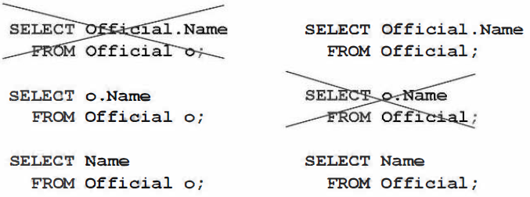
Tuple variables in the projection list.
Tuple variables are defined in the FROM clause and also referred to as table aliases
-SELECT o.Name, o.PNr FROM Official o;
Or
-SELECT o.Name, o.PNr FROM Official AS o;

Slide 8
Case Differentiation
-SELECT *,
CASE
WHEN HP < 120 THEN 'low'
WHEN HP >= 120 AND HP < 180 THEN 'medium'
ELSE 'high'
END AS Rating
FROM Car;
If a case differentiation does not correspond to any of the listed cases, a NULL value is returned:
-SELECT CarID,
CASE Color
WHEN 'red' THEN ' FF0000 '
WHEN 'green' THEN ' 00FF00 '
WHEN 'yellow' THEN 'FFFF00 '
WHEN 'blue' THEN '0000FF '
WHEN 'white' THEN 'FFFFFF'
WHEN 'black' THEN '000000 '
END AS Color
FROM Car;

Slide 9
Both the THEN and the ELSE branch can contain references to table columns:
-SELECT CarID,
CASE
WHEN PlateNumber IS NOT NULL THEN PlateNumber
ELSE 'The Car is not registered!'
END AS PlateNumber,
CASE Brand
WHEN 'Mercedes' THEN 'Mercedes-Benz'
WHEN 'VW' THEN 'Volkswagen'
ELSE Brand
END AS Brand,
Color, HP FROM Car;

Slide 10
Duplicate Elimination
A table with a primary key does not contain duplicates.
Duplicates can occur when a key column Is not included In the projection list.
-SELECT DISTINCT overtime FROM Official;
NULL values are treated in duplicate elimination as "normal" values.
If a projection list contains multiple columns, DISTINCT always refers to the combination of all these columns.
-SELECT DISTINCT Brand, Color FROM Car;
DISTINCT can also be used If the result table should contain all the columns
If the (source) table has a (primary) key DISTINCT Is not required
-SELECT DISTINCT * FROM Car;

Slide 11
Sorting
The result table can be sorted by a specific column
-SELECT Brand, Color FROM Car ORDER BY Brand;
-SELECT Brand, Color FROM Car ORDER BY Brand ASC;
-SELECT Brand, Color FROM Car ORDER BY Brand DESC;
The sorting can be applied using a column that does not appear In the projection list
-SELECT Brand, Color FROM Car ORDER BY PlateNumber;
You can sort using a combination of columns
-SELECT Brand, Color FROM Car ORDER BY Brand ASC, Color DESC;
Instead of the column names in the ORDER BY clause, the column numbers (based on the projection list) can be used
-SELECT Brand, Color FROM Car ORDER BY 1 ASC, 2 DESC;
If result columns are named explicitly, you can refer to the new name for sorting.
-SELECT Brand AS Manufacturer, Color FROM Car ORDER BY Manufacturer ASC, Color DESC;
You can sort based on calculated values.
-SELECT CarID, Brand, HP FROM Car ORDER BY 200 - HP / 1.36 ASC;
You can reference functions in the ORDER BY clause
-SELECT Name, Birthday FROM Owner ORDER BY YEAR(Birthday) DESC, Name ASC;

Slide 12
Top-n Clause
You can determine how many rows should be included in the query result (maximum).
What are the ten most powerful vehicles (based on horse power)?
-SELECT TOP 10 CarID, Brand, Color, HP FROM Car ORDER BY 4 DESC;
You can also use the Top-n Clause if the result table should include all columns.
-SELECT TOP 5 * FROM Car ORDER BY HP DESC;
You can combine the Top-n Clause with the keyword DISTINCT.
What are the 7 highest HP values?
-SELECT TOP 7 DISTINCT HP FROM Car ORDER BY 1 DESC;
No error is thrown if you request more rows than available.
The result set will not be filled with additional, "artificial" rows.
-SELECT TOP 570 DISTINCT Color FROM Car;
You can use the Limit clause as alternative to the Top-n clause.
The Limit clause comes at the very end of the SELECT statement.
-SELECT * FROM Car ORDER BY HP DESC LIMIT 5;
The Limit clause can be combined with the Offset clause to skip records.
This allows you to read result sets "page by page".
-SELECT * FROM Car ORDER BY HP DESC LIMIT 5 OFFSET 5 ;

Slide 13
WHERE Clause
The WHERE clause is used to filter rows.
It is used to extract only those rows that fulfill a specified criterion.
-SELECT PlateNumber, Brand, Color FROM Car WHERE Brand = 'BMW';
You can reference a column in the WHERE clause that is not included in the projection list.
-SELECT Brand, Color FROM Car WHERE HP >= 170;
You can check for NULL in the WHERE clause.
-SELECT CarID, Brand, Color FROM Car WHERE PlateNumber IS NULL;
You can check if values are included IN a value-list
SELECT Brand, Color FROM Car WHERE Color IN ( 'red' , 'blue' , 'orange') ;
You can check if values are included in an interval.
-SELECT PlateNumber, Brand, HP FROM Car WHERE HP BETWEEN 140 AND 170;
You can reference calculated values in the WHERE clause.
(This option is not recommended due to performance reasons.)
Which cars have a power of at least 125 kW?
-SELECT CarID, Brand, HP FROM Car WHERE HP / 1.36 >= 125;
You can use functions In the WHERE clause.
-SELECT * FROM Owner WHERE YEAR(Birthday) = 1986;

Slide 14
WHERE Clause (Contd…)
You can use search patterns in the WHERE clause.
-SELECT PlateNumber, Brand, HP FROM Car WHERE PlateNumber LIKE ‘%M%’;
The wildcard character % (percentage sign) represents any string containing no, one, or multiple characters.
The wildcard character_ (underscore) represents any single character.
WHERE MyColumn LIKE 'M%' | String starting with "M"
WHERE MyColumn LIKE 'M_' | String of two characters starting with "M"
WHERE MyColumn LIKE '%M' | String ending with "M"
WHERE MyColumn LIKE '%M%' | String containing "M"
WHERE MyColumn LIKE ‘___' | String with length 3
WHERE MyColumn LIKE ‘____T_M%' | T on fifth and "M" on seventh position

Slide 15
WHERE Clause (Contd…)
If you want to search for the percentage sign (%) or underscore (_) Itself, you have to place an ESCAPE character in front.
You can choose the ESCAPE character (with some restrictions).
LIKE '$%%' ESCAPE '$' | String starting with a percentage sign
LIKE '$__' ESCAPE '$' | String of two characters. starting with an underscore
LIKE '%$%' ESCAPE '$' | String ending with a percentage sign
LIKE '%$%%' ESCAPE '$' | String containing a percentage sign
LIKE '%$_$%%' ESCAPE '$' | String containing an underscore followed by a percentage sign
LIKE '____$%_$_%' ESCAPE '$' | "%"on fifth and "_" on seventh position.

Slide 16
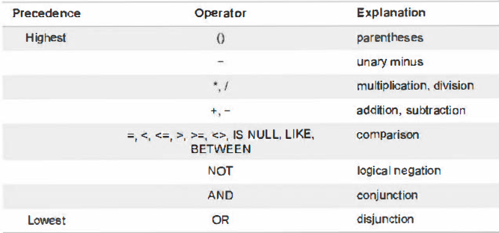
WHERE Clause (Contd…)
You can use compound WHERE clauses.
-SELECT PlateNumber, Brand FROM Car WHERE Brand= 'Skoda' AND Color= 'red';
You can reference the same column multiple times.
-SELECT PlateNumber, Brand FROM Car WHERE Brand= 'Skoda' OR Brand= 'BMW';
You can use brackets.
-SELECT PlateNurnber, Brand, Color FROM Car WHERE (Brand = 'Skoda' OR Brand = 'BMW') AND Color = 'black' ;
The operators have the precedence Indicated by the table below:

Slide 17
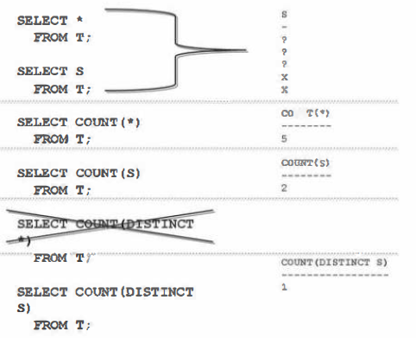
Aggregating Data
You can calculate the number of rows in the result set using COUNT.
Rows containing only NULL values are included.
-SELECT COUNT(*) FROM Car WHERE Brand = ‘Audi‘;
You can calculate the number of values within a sing le column.
NULL values are not included.
SELECT COUNT(Owner) FROM Car

Slide 18
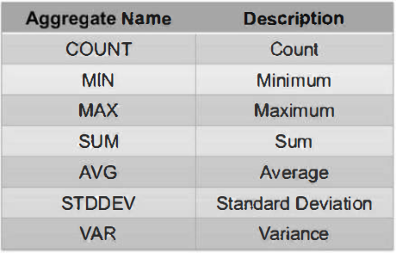
Aggregating Data
You can calculate the minimum or maximum value in a column.
-SELECT MIN(HP), MAX(HP) FROM Car;
You can combine aggregate expressions and "normal" functions.
-SELECT MAX (YEAR (Birthday) ) AS Year FROM Owner;
The sequence of nested functions should be relevant.
The WHERE clause is included in the minimum and maximum calculation.
-SELECT MIN(HP), MAX(HP) FROM Car WHERE Brand= 'BMW';
-SELECT SUM(DISTINCT HP) FROM Car WHERE Brand= 'Audi';
Aggregate Expressions

Slide 19
Group By
A table can be divided into (disjoint) groups of rows
A group is represented in the query result by a single row
Aggregate expressions will be evaluated separately for each group
-SELECT Brand, COUNT(*) FROM Car GROUP BY Brand;
NULL values of the GROUP BY column are treated as "normal" values creating a single group.
-SELECT overtime, COUNT(*) AS Frequency FROM Official GROUP BY overtime;
You can combine GROUP BY with ORDER BY for sorting.
-SELECT Brand, MAX(HP) FROM Car GROUP BY Brand BMW ORDER BY 2 DESC, 1 ASC;
You can use functions In the GROUP BY clause.
-SELECT YEAR(Birthday), COUNT(*) FROM Owner GROUP BY YEAR(Birthday) ORDER BY 2 DESC, 1 ASC;

Slide 20
Group By
The WHERE clause is processed before the grouping.
-SELECT Brand, COUNT(*) FROM Car WHERE Color = 'black' GROUP BY Brand;
You can use a combination of columns in the GROUP BY clause.
-SELECT Brand, Color, COUNT(*) FROM Car GROUP BY Brand, Color;
HAVING Clause
HAVING clause you can specify which conditions a group must meet to be included in the result set.
-SELECT Brand, Color, COUNT(*) FROM Car GROUP BY Brand, Color HAVING COUNT(*) >= 2;
The HAVING condition can reference columns not included in the projection list.
-SELECT Brand, Color, COUNT(*) FROM Car GROUP BY Brand, Color HAVING
MIN (HP) < 120;

Slide 21
Reading Data from Multiple Tables
To read data from multiple database tables or views the following options are available:
Combination of results from several queries
UNION ALL vs. UNION
INTERSECT
EXCEPT
Combination of several tables (JOIN)
CROSS JOIN vs. INNER JOIN vs. OUTER JOIN
Implicit JOIN vs. Explicit JOIN
Nested queries (Sub Query)
Uncorrelated Sub Query vs. Correlated Sub Query

Slide 22
UNION [ALL]
You can combine the result tables of multiple queries using UNION [ALL].
The individual result tables must have the same number of columns.
The corresponding result columns must have compatible data types.
The column names of the resulting output table are based on the first SELECT statement
-SELECT PNr, Name FROM Official WHERE Salary = 'A09'
UNION ALL
SELECT OwnerID, Name FROM Owner WHERE Birthday >= '1977-05-21';
With UNION [ALL] you can also explicitly rename the result columns.
If the results of multiple partial queries overlap, the overall result includes duplicates with UNION ALL.
You can use UNION (ALL] to combine result tables of multiple partial queries.
-SELECT PlateNumber, Brand, Color FROM Car WHERE Brand = 'BMW'
ONION
SELECT PlateNumber, Brand, Color FROM Car WHERE Color = 'yellow'
ONION
SELECT PlateNumber, Brand, Color FROM Car WHERE Color = 'orange' ;

Slide 23
INTERSECT
INTERSECT returns records that exist in all query results.
-SELECT PlateNumber, Brand, Color FROM Car WHERE Brand = 'Mercedes'
INTERSECT
SELECT PlateNumber, Brand, Color FROM Car WHERE Color = ' white ' ;
EXCEPT
EXCEPT returns results from the first query which are NOT available in subsequent queries.
-SELECT PlateNumber, Brand, Color FROM Car WHERE Brand = 'Mercedes'
EXCEPT
SELECT PlateNumber, Brand, Color FROM Car WHERE Color = ' white' ;

Slide 24
Joining Tables
CROSS JOIN
INNER JOIN
OUTER JOIN
LEFT OUTER JOIN
RIGHT OUTER JOIN
FULL OUTER JOIN
With JOIN syntax you can distinguish between Implicit JOIN and Explicit JOIN

Slide 25
CROSS JOIN (Cartesian Product)
Each row of the left table is connected to each row of the right table.
There is no CROSS JOIN join condition.
The result set contains 10 X 20 = 200 rows.
Implicit CROSS JOIN
-SELECT * FROM Owner, car;
Explicit CROSS JOIN
-SELECT * FROM owner CROSS JOIN car;
You can specify a WHERE clause for the Implicit and explicit CROSS JOIN.
-SELECT * FROM Owner, Car WHERE HP > 250;
-SELECT * FROM Owner CROSS JOIN Car WHERE HP > 250;
You can combine more than two tables.
The result set contains 10 X 20 X 3 = 600 rows.
-SELECT * FROM Owner, Car, Stolen;
-SELECT * FROM Owner CROSS JOIN Car CROSS JOIN Stolen;

Slide 26
INNER JOIN
One row of the left table and one row of the right table are always joined to a common result row - provided that the JOIN condition is fulfilled.
Implicit INNER JOIN
-SELECT * FROM Owner, Car WHERE OwnerID = Owner;
Explicit INNER JOIN
-SELECT * FROM Owner INNER JOIN Car ON OwnerID = Owner;
You can also use table aliases or tuple variables in the projection list for the implicit JOIN.
The JOIN condition can also refer to table aliases or tuple variables.
If column names are not unique, you must qualify them with the table aliases or tuple variables.
-SELECT o.Name, c.Brand, c.Color FROM Owner o, Car c WHERE o.OwnerID = c.Owner;
-SELECT o.Name, c.Brand, c.Color FROM Owner o JOIN Car c ON o.OwnerID = c.Owner;
-You can add a GROUP BY clause and can explicitly rename result columns.
-SELECT o.Name, COUNT(*) AS "# black cars" FROM Owner o, Car c WHERE o.OwnerID = c.Owner AND c.Color = 'black' GROUP BY o.OwnerID, o.Name ORDER BY 2 DESC, 1 ASC;

Slide 27
INNER JOIN
You can build the JOIN condition on multiple columns.
-SELECT DISTINCT o.Name AS "Owners" FROM Owner_EU o JOIN Car_EU c ON o.Country = c.Country AND o.OwnerID = c.Owner WHERE c.Color = 'black‘ ORDER BY o.Name;
You can join a table to itself.
-SELECT e.Narne AS Employee, m.Name AS Manager FROM Official e, Official m
WHERE a.Manager = m.PNr;
You can combine more than two tables.
-SELECT o.Name, a.Brand, a.Color, c.PlateNumber FROM Owner o, Car c, Stolen s WHERE o.OwnerID = c.Owner AND c.PlateNumber = s.PlateNumber;
-SELECT o.Name, c.Brand, c.Color, c.PlateNurnber FROM owner o JOIN Car c ON o.OwnerID = c.Owner JOIN stolen s ON c.PlateNumber = s.PlateNurnber;
You can use different comparison operators other than EQUAL and functions in the JOIN condition.
-SELECT ol.Name, ol.Birthday, o2.Name, o2.Birthday FROM owner ol JOIN Owner o2 ON YEAR(ol.Birthday) = YEAR(o2.Birthday) AND ol.OwnerID < o2.0wnerID;

Slide 28
OUTER JOIN
The OUTER JOIN has three sub types:
LEFT OUTER JOIN
RIGHT OUTER JOIN
FULL OUTER JOIN
For all three sub types of the OUTER JOIN, SAP HANA only provides the explicit syntax variant.

Slide 29
LEFT OUTER JOIN
One row of a table and one row of another table are always connected to a common result row - provided the JOIN condition is fulfilled.
In addition, rows of the left table without matching row in the right table are copied to the query result. The missing values (from the right table) are filled with NULL values.
-SELECT Name, CarID, Brand FROM Owner LEFT OUTER JOIN Car ON OwnerID = Owner;
RIGHT OUTER JOIN
Rows of the right table without matching row in the left table are copied to the query result. The missing values (from the left table) are filled with NULL values.
FULL OUTER JOIN
Rows of both tables without matching records are copied to the query result. The missing values (from the other table) are filled with NULL values.

Slide 30
Using Joins, you also can:
Project to certain columns .
Reference table aliases or tuple variables in the projection list.
Use table aliases or tuple variables in the JOIN condition.
Explicitly rename result columns.
Sort the query result.
Add a GROUP BY clause.
Use aggregate expressions.
Eliminate duplicates by using DISTINCT.
Specify a JOIN condition on multiple columns.
Use any comparison operator in the JOIN condition.
JOIN a table with itself.
JOIN more than two tables.
You have to qualify column names with the table alias or with a tuple variable if the column names are not unique.
You do not need to include a column from every table involved in the JOIN into the projection list.

Slide 31
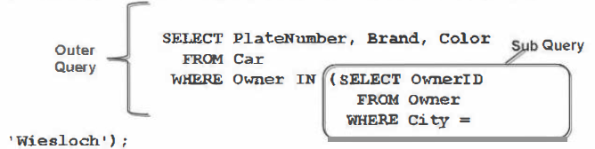
Nested Query or Sub Query
A sub query is a query (SELECT-FROM-WHERE statement) that is used in another query (SELECT-FROM-WHERE statement).
The "other Query" - containing the sub query - Is called the "outer query".
Sub Query can also referred as "Inner query".
Uncorrelated and a Correlated sub query
An uncorrelated sub query makes no reference to the outer query.
-SELECT * FROM Car WHERE Owner IN (SELECT OwnerID FROM Owner WHERE City = 'Wiesloch');
A correlated sub query refers to the outer query.
-SELECT * FROM Car c WHERE EXISTS (SELECT * FROM owner o WHERE o.OwnerID = c.Owner AND o.City = 'Wiesloch');

Slide 32
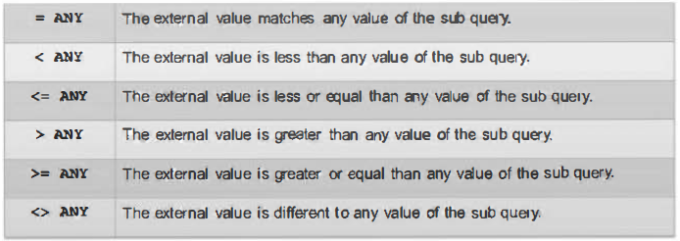
Uncorrelated sub query
You can use IN, if the outer value should be included in the result set of the sub query.
Which cars are registered to an owner from Wiesloch?
-SELECT * FROM Car WHERE Owner IN (SELECT OwnerID FROM Owner WHERE City = 'Wiesloch');
You can use= ANY, if the outer value should match any result value of the sub query. (= ANY is equivalent to IN)

Slide 33
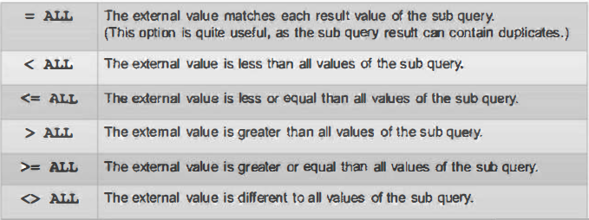
Uncorrelated Sub Query
You can use > ANY, if the external value should be greater than any value of the sub query.
Which officials have more than the minimum overtime hours?
-SELECT Name, overtime FROM Official WHERE Overtime > ANY (SELECT overtime FROM Official) ;
You can use > instead of > ANY, if the sub query results In only a single value.
-SELECT Name, overtime FROM Official WHERE Overtime > (SELECT MIN (overtime) FROM Official) ;

Slide 34
You can use <= ALL, if the outer value should be less or equal than all result values of the sub query (other comparison operators are possible)
Which officials have the fewest overtime hours?
-SELECT Name, overtime FROM Official WHERE overtime <= ALL (SELECT Overtime FROM Official WHERE Overtime IS NOT NULL) ;
You can use <= instead of <= ALL, if the sub query results in only a single value.
-SELECT Name, overtime FROM Official WHERE overtime <= (SELECT MIN(Overtime) FROM Official);
You can use functions In a sub query.
Which owners were born in the same year as the youngest owner?
-SELECT * FROM owner WHERE YEAR(Birthday) = (SELECT MAX(YEAR(Birthday)) FROM Owner) ;
You can use multiple columns in the sub query.
To whom is (at least) one blue car registered?
-SELECT Name FROM owner WHERE (Country, OwnerID) IN (SELECT Country, Owner FROM Car WHERE Color = 'blue');
You can use the same table in both the FROM clause of the outer query and in the FROM clause of the sub query.
What is the name of Mr A's manager?
-SELECT Name FROM Official WHERE PNr IN (SELECT Manager FROM Official WHERE Name = 'Mr A');

Slide 35
The WHERE clause of a sub query can contain another sub query.
-SELECT Name FROM Owner WHERE OwnerID IN ( SELECT Owner FROM Car WHERE PlateNumber IN ( SELECT PlateNumber FROM Stolen )) ;
You can combine JOIN and Sub Query.
To whom is the most powerful car per brand registered?
-SELECT DISTINCT Brand, Name FROM Owner RIGHT OUTER JOIN Car ON OwnerID = Owner WHERE (Brand, HP) IN ( SELECT Brand, MAX (HP) FROM Car GROUP BY Brand ) ORDER BY Brand ASC, Name ASC;
you can also use a sub query in the FROM clause.
Which blue cars have less than 120 HP?
-SELECT * FROM (SELECT PlateNumber, HP AS Power FROM Car WHERE Color = 'blue') WHERE Power < 120;
you can also use a sub query in the SELECT clause.
What is the HP deviation of each car when compared to the most powerful yellow car?
SELECT CarID, Brand, (SELECT MAX (HP) FROM Car WHERE Color = 'yellow') - HP AS Deviation FROM Car ORDER BY 3 DESC;

Slide 36
Correlated sub queries
A correlated sub query refers to the outer query.
Using EXISTS you can check that the query result of the sub query is not empty.
Which vehicles are registered to an owner from Wiesloch?
-SELECT * FROM Car c WHERE EXISTS (SELECT * FROM Owner o WHERE o.City = 'Wiesloch' AND o.OwnerID = c.Owner);
Using NOT EXISTS you can check if the result of the sub query is empty
Which cars are not reported as stolen?
-SELECT CarID FROM Car c WHERE NOT EXISTS (SELECT * FROM Stolen s WHERE s.PlateNumber - c.PlateNumber);
You can use the same table in both the FROM clause of the outer query and the FROM clause of the correlated sub query.
Which vehicle has the most HP?
-SELECT * FROM Car c1 WHERE NOT EXISTS (SELECT * FROM Car c2 WHERE c2.HP > c1.HP) ;
Even when using a correlated sub query, you can for example use">= ALL"
How much horsepower has the most powerful car of each brand?
-SELECT DISTINCT Brand, HP FROM Car c1 WHEBE c1.HP >= ALL (SELECT c2.HP FROM Car c2 WHEBE c2.Brand = c1.Brand);

Slide 37
The WHERE clause of a correlated sub query can contain an additional correlated sub query.
To whom (at least) one stolen car is registered?
-SELECT o.Name FROM Owner o WHERE EXISTS ( SELECT * FROM Car c WHERE c.Owner = o.OwnerID AND EXISTS (SELECT * FROM Stolen a WHERE a.PlateNumber = c.PlateNumber)) ;
You can also use a correlated sub query in the SELECT clause.
How much horsepower each car is lacking compared to the most powerful car of the same brand?
-SELECT CarID, Brand, (SELECT MAX(HP) FROM Car c2 WHERE c2.Brand = c1.Brand) - HP AS Difference FROM Car c1
Using Nested Queries you also can:
Restrict the projection list to certain columns
Explicitly rename the result columns
Sort the query result
Use grouping and Include aggregate expressions
Eliminate duplicates using DISTINCT
Involve the same table multiple times
Involve more than two tables

Slide 38
THANK YOU

