Slide 1

Automation Review
Capybara with Cucumber

Slide 2
Agenda
Setup for capybara and cucumber
Overview and directory structure.
Capybara using cucumber or any other ruby test framework.
Setting up the driver.
The DSL (Navigation, clicking link or button, interacting with forms)
The DSL (querying, finding, scoping)
The DSL (windows, scripting, modals, debugging)
Capybara test execution, tagging, reporting.

Slide 3
Setup for capybara and cucumber
Install Ruby
Install Ruby Devkit
Install the required gem

Slide 4
Setup for capybara and cucumber
Ruby Installation
Download ruby from source url “http://rubyinstaller.org/downloads/” preferred version Ruby 2.0.0-p648 (x64) and install it.
After installation verify the ruby installation by opening the command prompt and type ruby –version and press enter. You will see the installed ruby version.
NOTE: Before checking the version you need to set the ruby executables path to Environment path variable. Ignore if it is already set while installation.

Slide 5
Setup for capybara and cucumber
Ruby Devkit Installation
Download ruby Devkit from source url “http://rubyinstaller.org/downloads/” NOTE: Devkit version should be compatible with ruby version that you have installed.
Downloaded ruby Devkit is in zip format, extract the downloaded zip file.
In extracted folder you see dk.rb file. it is development kit installation file
Open the command prompt and locate the ruby devkit directory where we have dk.rb file.
Type “ruby dk.rb init” this cmd will initialize the devkit process.
Now type “ruby dk.rb install” this command will install the devkit
Devkit installation is completed.

Slide 6
Setup for capybara and cucumber
Install the required gem
gem install bundle
gem install cucumber
gem install selenium-webdriver
gem install rspec
gem install capybara
NOTE: if you found some version dependencies you can install them first with there supported versions. Also “gem list” command can be used to list all the installed gems with there versions.
NOTE: if you face SSL issue while gem download you can change the source:
gem sources -r https://rubygems.org/
gem sources -a http://rubygems.org/

Slide 7
Capybara Overview
Capybara
Capybara is a library written in the Ruby programming language which makes it easy to simulate how a user interacts with your application. Capybara can talk with many different drivers which execute your tests through the same clean and simple interface. You can seamlessly choose between Selenium, Webkit or pure Ruby drivers.

Slide 8
Capybara Benefits
Capybara Benefits summary
Open source
Built-in DSL
Support multiple drivers
No setup necessary for Rails and Rack application, it can work with cucumber, rspec or ruby unit test framework.

Slide 9
Cucumber Overview
Cucumber
Cucumber is a testing framework which supports Behaviour Driven Development (BDD). It lets us define application behaviour in plain meaningful English text using a simple grammar defined by a language called Gherkin. Cucumber itself is written inRuby, but it can be used to “test” code written in Ruby or other languages

Slide 10
Cucumber Benefits
Cucumber benefits summary
Open source.
Support multiple languages.
Style of writing tests allow for easier reuse of code in the tests
Quick and easy set up and execution
It is helpful to understand business scenarios written in cucumber.

Slide 11
Cucumber Directory Structure
Directory Structure for Cucumber
features
step_difinitions
Step_definitions files
Test_steps.rb
support
Support files
Env.rb
Feature files
Login.feature
Search.feature
Update.feature

Slide 12
Capybara with other ruby test framework
Capybara can be used with other ruby testing frameworks
Capybara with cucumber
Capybara with rspec
Capybara with ruby unit test framework

Slide 13
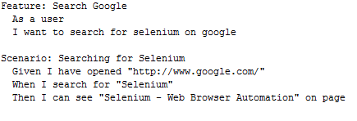
Capybara with Cucumber
Cucumber test scenarios
Follow the directory structure mentioned in previous slides and Create a feature file in features folder and write some test scenarios. Example below:

Slide 14
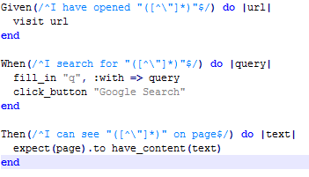
Capybara with Cucumber
Implementation of cucumber scenarios using Capybara.
Create a ruby file in step_definitions folder and write ruby code to implement cucumber test scenarios. Example below:

Slide 15
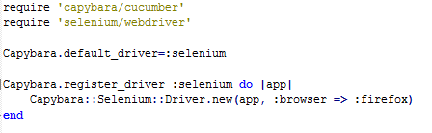
Capybara with Cucumber
Set the driver for test execution.
Create a env.rb file in support folder and write code to set driver for test execution. Example below:
NOTE: By only adding capybara.default_driver=:selenium line will also work and by default tests will be executed on firefox browser.

Slide 16

Capybara with Cucumber
Cucumber test execution.
Open the command prompt and locate features directory and run the below command:
Cucumber features\test.feature
e.g cucumber features\<feature file name>
After the execution of tests summary output can be seen as below:
Time may differ on other machine.

Slide 17
Capybara with Rspec
Rspec
Rspec is a testing tool for Ruby, created for behavior-driven development (BDD). It is the most frequently used testing library for Ruby in production applications. Even though it has a very rich and powerful DSL (domain-specific language), at its core it is a simple tool which you can start using rather quickly.

Slide 18
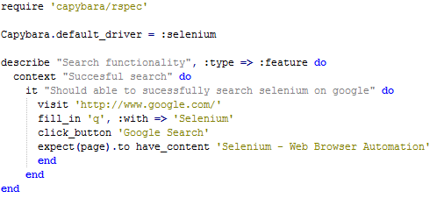
Capybara with Rspec
Rspec test scenario with capybara

Slide 19
Capybara with Rspec
Enough to understand the previous code
Default driver selenium is used.
Describe, context and it are keywords of rspec to give more clarity to the scenarios. They can take a class name or string argument.
Visit, fill_in and click_button are methods of capybara.
Expect (page) is rspec expectation.
NOTE: Execute the script with cmd “rspec <file_name.rb>”

Slide 20
Capybara with ruby unit test framework
Ruby’s Test::Unit
The general idea behind unit testing is that you write a test method that makes certain assertions about your code, working against a test fixture. A bunch of these test methods are bundled up into a test suite and can be run any time the developer wants. To write a test, follow these steps:
require ‘test/unit’ in your test script.
Create a class that subclasses Test::Unit::TestCase.
Add a method that begins with “test” to your class.
Make assertions in your test method.
Optionally define setup and/or teardown to set up and/or tear down your common test fixture.
You can now run your test as you would any other Ruby script

Slide 21
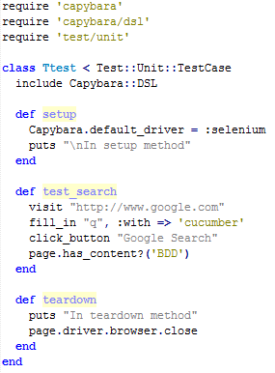
Capybara with ruby unit test framework
Ruby unit test scenario with capybara

Slide 22
Setting up the driver
Capybara drivers
RackTest
Selenium
Capybara-webkit

Slide 23
Setting up the driver
Racktest driver
RackTest is Capybara's default driver. It is written in pure Ruby and does not have any support for executing JavaScript. Since the RackTest driver interacts directly with Rack interfaces, it does not require a server to be started. However, this means that if your application is not a Rack application (Rails, Sinatra and most other Ruby frameworks are Rack applications) then you cannot use this driver. Furthermore, you cannot use the RackTest driver to test a remote application, or to access remote URLs (e.g., redirects to external sites, external APIs, or OAuth services) that your application might interact with.

Slide 24
Setting up the driver
Racktest driver
To use racktest driver add gem
Gem install cucumber-rails
If dependency occur add activesupport or other dependent gems

Slide 25
Setting up the driver
Selenium driver
At the moment, Capybara supports Selenium 2.0+ (Webdriver), not Selenium RC. In order to use Selenium, you'll need to install the selenium-webdriver gem, and add it to your Gemfile if you're using bundler. Provided Firefox is installed, everything is set up for you, and you should be able to start using Selenium right away.

Slide 26

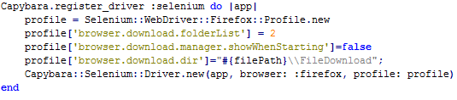
Setting up the driver
Selenium webdriver setup
Add the below line of code to your env.rb file
You can even set the browser profile, by registering the browser as below.
NOTE: by default firefox browser is used.

Slide 27
Setting up the driver
Capybara-webkit driver
The capybara-webkit driver is for true headless testing. It uses QtWebKit to start a rendering engine process. It can execute JavaScript as well. It is significantly faster than drivers like Selenium since it does not load an entire browser.
You can install it with:
gem install capybara-webkit
you can use it by:
Capybara.javascript_driver = :webkit

Slide 28
Setting up the driver
Overview

Slide 29
About DSL
DSL (Domain Specific language)
A domain-specific language (DSL) is a computer language specialized to a particular application domain. This is in contrast to a general-purpose language (GPL), which is broadly applicable across domains. There is a wide variety of DSLs, ranging from widely used languages for common domains, such as HTML for web pages.
Capybara offers a user-friendly DSL (Domain Specific Language) which is used to describe actions that are executed by the underlying web driver

Slide 30
DSL (Navigation)
Navigation
‘visit’ method can be used to navigate to web pages
The visit method only takes a single parameter, the request method is always GET.
Syntax:
visit('/projects')
visit(post_comments_path(post))
You can get the current path of the browsing session, and test it using the have_current_path matcher, example below:
expect(page).to have_current_path(post_comments_path(post))

Slide 31
DSL (Clicking Elements)
Clicking elements
You can interact with the webapp by following links and buttons. Capybara automatically follows any redirects, and submits forms associated with buttons.
click_link('id-of-link')
click_link('Link Text')
click_button('Save')
click_on('Link Text') # clicks on either links or buttons
click_on('Button Value')

Slide 32
DSL (Interacting with forms)
Interacting with forms
Following methods can be used to interact with web forms.
fill_in('First Name', with: 'John')
fill_in('Password', with: ‘John123')
fill_in('Description', with: 'Really Long Text...')
choose('A Radio Button')
check('A Checkbox')
uncheck('A Checkbox')
attach_file('Image', '/path/to/image.jpg')
select('Option', from: 'Select Box')
NOTE: There are number of methods in capybara to interact with web forms, you can query the text box using find method and fill the values with set method. Attach_file method checks the existence of file before attaching it to web page.

Slide 33
DSL (Querying)
Querying
Capybara has a rich set of options for querying the page for the existence of certain elements, and working with and manipulating those elements.
page.has_selector?('table tr')
page.has_selector?(:xpath, './/table/tr')
page.has_xpath?('.//table/tr')
page.has_css?('table tr.foo')
page.has_content?('foo')
You can use these with RSpec's magic matchers:
expect(page).to have_selector('table tr')
expect(page).to have_selector(:xpath, './/table/tr')
expect(page).to have_xpath('.//table/tr')
expect(page).to have_css('table tr.foo')
expect(page).to have_content('foo')

Slide 34
DSL (Finding Elements)
Finding Elements
You can also find specific elements, in order to manipulate them:
find_field('First Name').value
find_field(id: 'my_field').value
find_link('Hello', :visible => :all).visible?
find_link(class: ['some_class', 'some_other_class'], :visible => :all).visible?
find_button('Send').click
find_button(value: '1234').click
find(:xpath, ".//table/tr").click
find("#overlay").find("h1").click all('a').each { |a| a[:href] }

Slide 35
DSL (Scoping)
Scoping
Capybara makes it possible to restrict certain actions, such as interacting with forms or clicking links and buttons, to within a specific area of the page. For this purpose you can use the generic within method. Optionally you can specify which kind of selector to use.
within("li#employee") do
fill_in 'Name', with: 'Jimmy'
end
within(:xpath, ".//li[@id='employee']") do
fill_in 'Name', with: 'Jimmy‘
end

Slide 36
DSL (Working with windows)
Working with windows
Capybara provides some methods to ease finding and switching windows:
facebook_window = window_opened_by do
click_button 'Like‘
end
within_window facebook_window do
find('#login_email').set('a@example.com')
find('#login_password').set('qwerty')
click_button 'Submit'
end

Slide 37
DSL (Scripting)
Scripting
Javascript can be used in drivers which are supported.
Javascript example:
page.execute_script("$('body').empty()")
page.evaluate_script("window.location.reload()")
Jquery example:
page.execute_script %Q{
document.getElementById('file_upload1').style.display = "block";
}

Slide 38
DSL (Handling Modals)
Scripting
In drivers which support it, you can accept, dismiss and respond to alerts, confirms and prompts.
accept or dismiss alert messages
accept_alert do
click_link('Show Alert')
end
accept or dismiss a confirmation
dismiss_confirm do
click_link('Show Confirm')
end

Slide 39
DSL (Handling Modals Continue)
Scripting
accept or dismiss prompts
accept_prompt(with: 'Linus Torvalds') do
click_link('Show Prompt About Linux')
end
Verifying the return messages from modals
message = accept_prompt(with: 'Linus Torvalds') do
click_link('Show Prompt About Linux')
end
expect(message).to eq('Who is the chief architect of Linux?')

Slide 40
DSL (Debugging)
Debugging
Debugging for tests can be done using below methods
Take a snapshot of the page
page.save_screenshot('screenshot.png')
Retrieve the current state of the DOM as a string
print page.html
NOTE: You should avoid testing against the contents of page.html and use the more expressive finder methods instead.

Slide 41
DSL (Matching)
Matching
It is possible to customize how Capybara finds elements. There are two options available:
Exactness (Capybara.exact)
Strategy (Capybara.match)

Slide 42
DSL (Matching)
Matching (Exactness)
Capybara.exact and the exact option work together with the is expression inside the XPath gem. When exact is true, all is expressions match exactly, when it is false, they allow substring matches. Many of the selectors built into Capybara use the is expression. This way you can specify whether you want to allow substring matches or not. Capybara.exact is false by default.
For example:
click_link("Password") # also matches "Password confirmation"
Capybara.exact = true
click_link("Password") # does not match "Password confirmation"
click_link("Password", exact: false) # can be overridden

Slide 43
DSL (Matching)
Matching (Strategy)
Using Capybara.match and the equivalent match option, you can control how Capybara behaves when multiple elements all match a query. There are currently four different strategies built into Capybara:
first: Just picks the first element that matches.
one: Raises an error if more than one element matches.
smart: If exact is true, raises an error if more than one element matches, just like one. If exact is false, it will first try to find an exact match. An error is raised if more than one element is found. If no element is found, a new search is performed which allows partial matches. If that search returns multiple matches, an error is raised.
prefer_exact: If multiple matches are found, some of which are exact, and some of which are not, then the first exactly matching element is returned.
NOTE: The default value for Capybara.match is :smart

Slide 44


Capybara hooks
Hooks with cucumber tags
Capybara uses hooks to run setup and teardown for the test cases. hooks adds the before test and after test scenarios.
Before hook: It is used as setup for test case.
After hook: It is used as teardown for test case.
NOTE: @fileUpload and @fileDownload are cucumber tags.

Slide 45
Cucumber Command line options
Cucumber command line
You can check the available command line options in cucumber with command: “cucumber –help”. Below are some of the useful options.
--require : Require files before executing the features. If this option is not specified, all *.rb files that are siblings or below the features will be loaded auto-matically. Automatic loading is disabled when this option is specified, and all loading becomes explicit. Files under directories named "support" are always loaded first.
--format : How to format features. Available formats:
Debug
Html
Json
Pretty
NOTE: The default value for --format is pretty.

Slide 46
Cucumber Command line options
Cucumber command line (Continue)
You can check the available command line options in cucumber with command: “cucumber –help”. Below are some of the useful options.
--out : Write output to a file/directory instead of STDOUT. This option applies to the previously specified –format. e.g –out report.html
--tags : Only execute the features or scenarios with tags matching. e.g –tags @login
--dry-run : Invokes formatters without executing the steps. Check for test steps if they are implemented or not.
NOTE: You can check the available formats functionality by with help option.

Slide 47
Cucumber Test Execution and Reporting
Cucumber Execution
Command to execute all cucumber tests : Open the command prompt and locate to features directory and type “cucumber” press enter. It will execute all the cucumber test scenarios alphabetically.
Command to execute tests with specific tag : run command
“cucumber –tags @login” this will only execute scenarios with login tag.
Command to execute tests and generate html reports : Run command :
“cucumber –tags @login –format html –out report.html” this will execute scenarios with login tag and generate a report.html file in same directory from where the tests have been executed.

