Slide 1

VAE: Generate high-quality images of handwritten digits using the MNIST dataset.
Course: Generative AI
24ECSE458
Department of Computer Science and Engineering,
KLE Technological University’s Dr. M. S. Sheshgiri College of Engineering and Technology, Belagavi

Slide 2
Details of the Team
Team No.
Div: |  | A , B
Sl. No. | Name |  | SRN.
1 | Avika Mishra |  | 02FE21BCS019
2 | Chandsab Engineer |  | 02FE21BCS022
Department of Computer Science and Engineering,
KLE Technological University’s Dr. M. S. Sheshgiri College of Engineering and Technology, Belagavi

Slide 3
Introduction
Handwritten Digit Recognition is a crucial task in machine learning, used in applications like postal sorting and document processing.
While traditional models can classify digits, they struggle with variations in handwriting styles and noisy data, affecting performance.
VAEs are perfect for this problem because they learn to represent data in a simpler, compressed form while capturing the key patterns in how digits are shaped.
VAEs can create new, realistic digits, improving model robustness.
By leveraging VAEs, we can augment datasets with synthetic samples, making them a powerful tool to improve the accuracy and performance of handwritten digit recognition models.
Department of Computer Science and Engineering,
KLE Technological University’s Dr. M. S. Sheshgiri College of Engineering and Technology, Belagavi

Slide 4
Motivation
Handwritten digits can be challenging for some people to recognize, such as individuals with visual impairments or cognitive difficulties, and a robust VAE model can assist in digit recognition tasks, potentially leading to better accessibility tools.
Automating the recognition and generation of handwritten digits can improve accuracy and efficiency in data entry processes, reducing human error.
Department of Computer Science and Engineering,
KLE Technological University’s Dr. M. S. Sheshgiri College of Engineering and Technology, Belagavi

Slide 5
Problem Statement
To Develop a Variational Autoencoder (VAE) Model, that compresses handwritten digit images from the MNIST dataset into a simplified form and uses this to create realistic, synthetic digits.
Department of Computer Science and Engineering,
KLE Technological University’s Dr. M. S. Sheshgiri College of Engineering and Technology, Belagavi

Slide 6
Objectives
To design and train a Variational Autoencoder.
To validate the model’s ability to reconstruct and synthesize images.
To evaluate the performance using reconstruction loss and latent regularization (ELBO components).
Department of Computer Science and Engineering,
KLE Technological University’s Dr. M. S. Sheshgiri College of Engineering and Technology, Belagavi

Slide 7
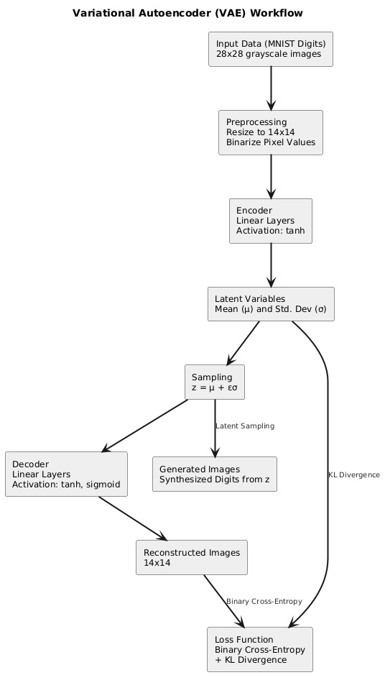
Proposed Framework
Input Data: The MNIST dataset provides 28x28 grayscale images of handwritten digits.
Preprocessing: Images are resized to 14x14 and binarized for simplification.
Encoder: Images pass through linear layers with tanh activation, generating latent variables.
Latent Variables: Mean (μ) and standard deviation (σ) are computed for the latent space representation.
Sampling: A latent vector z = μ + εσ is sampled using the re-parameterization trick.
Decoder: Latent vectors pass through linear layers (tanh and sigmoid activations) to reconstruct or generate images.
Output:
Generated Images: New digits sampled from the latent space.
Reconstructed Images: Original images reconstructed from the latent vector.
Loss Function: Combines Binary Cross-Entropy for reconstruction accuracy and KL Divergence for latent space regularization.

Slide 8
Dataset Description
Dataset: MNIST Handwritten Digits
Training Set:
60,000 images reduced to 14x14 resolution.
Sample balanced to include 1,000 images per class (0–9).
Validation Set:
1,000 images from test set reduced to 14x14 resolution.
Pixel Processing:
Binary representation (0 for pixel intensity < 128; 1 otherwise).
Department of Computer Science and Engineering,
KLE Technological University’s Dr. M. S. Sheshgiri College of Engineering and Technology, Belagavi

Slide 9
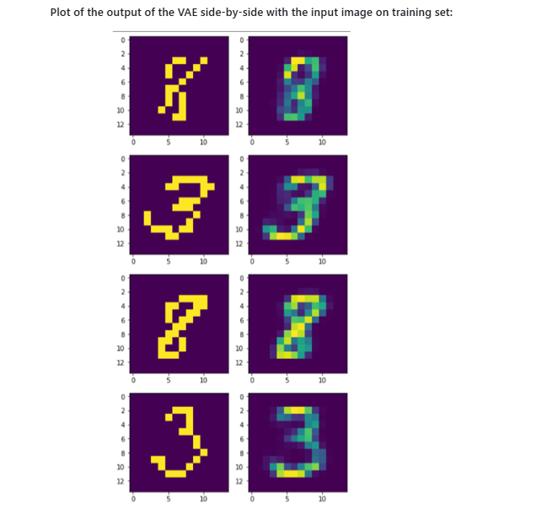
Results
Image Reconstruction:
Original and reconstructed digits side-by-side from the training set.
Input image on training set
Department of Computer Science and Engineering,
KLE Technological University’s Dr. M. S. Sheshgiri College of Engineering and Technology, Belagavi

Slide 10
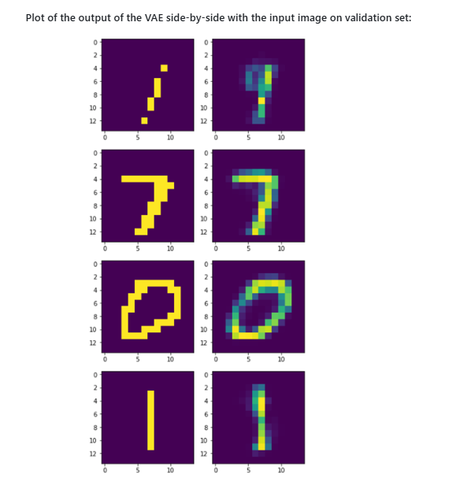
Results
Image Reconstruction:
Validation set reconstruction samples.
Input Image on Validation set
Department of Computer Science and Engineering,
KLE Technological University’s Dr. M. S. Sheshgiri College of Engineering and Technology, Belagavi

Slide 11
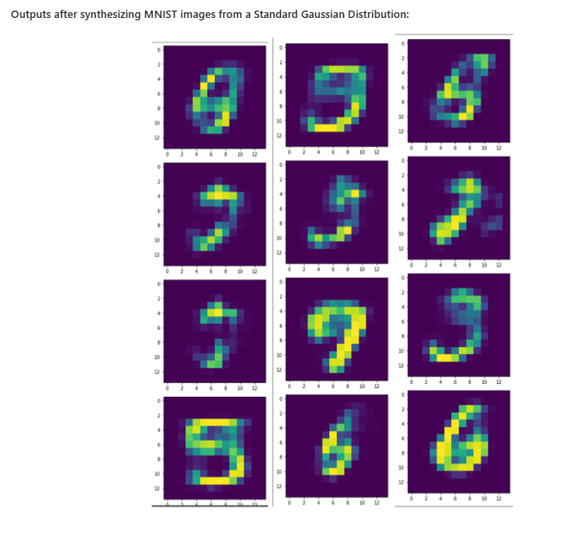
Results
Image Synthesis:
New Digits Generated:
Sampling random vectors from standard Gaussian distribution in latent space.
Visualization of synthetic handwritten digits resembling MNIST characters.
Department of Computer Science and Engineering,
KLE Technological University’s Dr. M. S. Sheshgiri College of Engineering and Technology, Belagavi

Slide 12
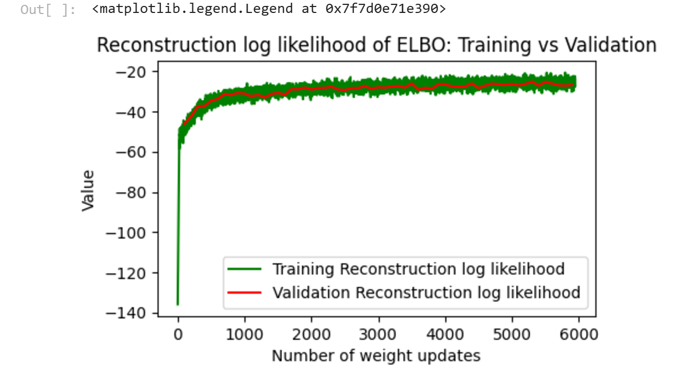
Results
The log-likelihood starts very low (around -140), indicating poor initial performance.
As the training progresses, the log-likelihood becomes less negative, meaning the VAE is reconstructing the data more accurately
Department of Computer Science and Engineering,
KLE Technological University’s Dr. M. S. Sheshgiri College of Engineering and Technology, Belagavi

Slide 13
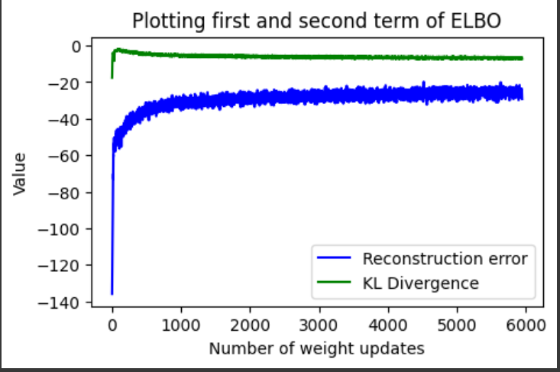
Results
Reconstruction Error (blue): Measures how well the VAE reconstructs input data. It starts high and decreases over time as the model learns to improve its outputs.
KL Divergence (green): Encourages the latent space to follow a normal distribution. It stabilizes quickly, indicating that the latent space is regularized effectively.
Department of Computer Science and Engineering,
KLE Technological University’s Dr. M. S. Sheshgiri College of Engineering and Technology, Belagavi

Slide 14
Thank you ☺
Department of Computer Science and Engineering,
KLE Technological University’s Dr. M. S. Sheshgiri College of Engineering and Technology, Belagavi

