Slide 1
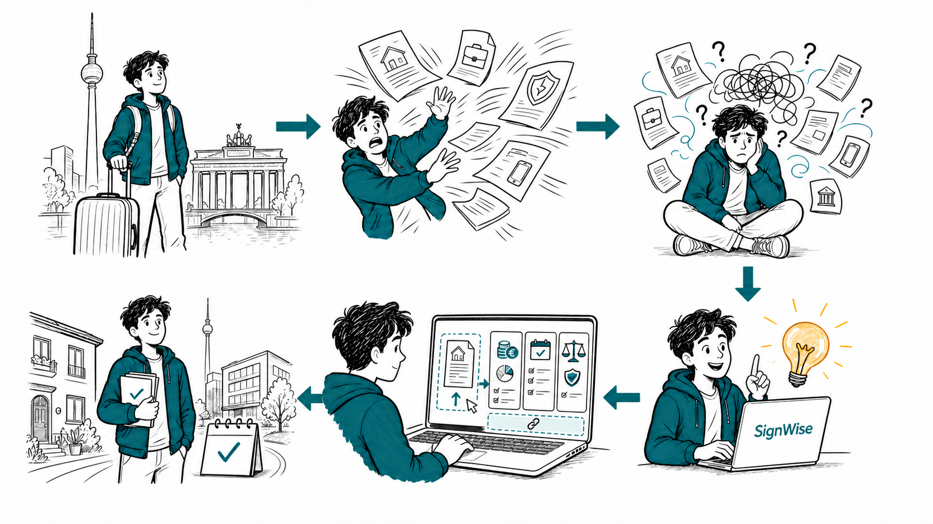
SignWise turns contract overload into clarity
One newcomer. Six moments. A clearer way to understand before signing.

