Slide 1
Employee Management System
Presented By:
Shital Gondhali.
Rutuja Shelar.
Monali Jadhav.
Poonam Sonawane.
Vrushali Chande
Notes:
We designed this template so that each member of the project team has a set of slides with its own theme. Members, here’s how you add a new slide to just your set:
Mark where you want to add the slide: Select an existing one in the Thumbnails pane, click the New Slide button, then choose a layout. The new slide gets the same theme as the other slides in your set.
Careful! Don’t annoy your fellow presenters by accidentally changing their themes. That can happen if you choose a different theme from the Design tab, which changes all of the slides in the presentation to that look.

Slide 2
INTRODUCTION
An employee management system is a software, that helps you employees to give their best efforts every day to achieve the goals of your organization.
It guides and manages employees efforts in the right direction.
It also securely stores and manages personal and other work related details for your employees.
Spring Boot is considered as a light-weight framework which results in less complexity in maintaining the data.

Slide 3
REQUIREMENTS
HARDWARE REQUIREMENTS | SOFTWARE REQUIREMENTS
OPERATING SYSTEM: WINDOWS 10 | SPRING TOOL SUITE(STS)
HARD DISK | JAVA JDK(1.8)
RAM : 8 GB | MySQL Server, Postman

Slide 4
TECHNOLOGIES USED
Spring Tool Suite(4)
Spring Boot is a java framework used for develop standalone application.
Need strong knowledge in OOPS & Java concept then only working with spring framework.
Mostly all applications are developed by spring boot. Because it was very secure no one hack the information. That’s why all of payment related software using java.

Slide 5
In the beginning spring was hard to learn. But after working with few months you can easily understand all queries.
Spring Boot is an open source Java-based framework used to create a micro Service.
It is developed by Pivotal Team and is used to build stand-alone and production ready spring applications.

Slide 6
MySQL
MySQL creates a database for storing and manipulating data, defining the relationship of each table.
Clients can make requests by typing specific SQL statements on MySQL.
The server application will respond with the requested information and it will appear on the clients' side.

Slide 7
MySQL works with an operating system to implement a relational database in a computer's storage system, manages users, allows for network access and facilitates testing database integrity and creation of backups.
MySQL is ideal for both small and large applications

Slide 8
POSTMAN
Postman is an API client that makes it easy for developers to create, share, test and document APIs.
With this open-source solution, users can create and save simple and complex HTTP/s requests, as well as read their responses.
When you are signed into your account, you are able to access your files. You can execute Postman API tests anytime, anywhere.

Slide 9
Postman is very convenient when it comes to executing APIs. Once you’ve entered and saved them.
you can simply use them over and over again, without having to remember the exact endpoint, headers, or API keys.

Slide 10
ANNOTATION USED
@Entity: This annotation specifies the table in the database with which this entity is mapped.
@Id :The @Id annotation is inherited from javax.persistence.Id, indicating the member field below is the primary key of the current entity.
@Column: This is used for Adding the column the name in the table of a particular MySQL database.

Slide 11
@GeneratedValue: Provides for the specification of generation strategies for the values of primary keys.
@Service: It is used with classes that provide basic functionalities.
@Autowired:Enables us to inject dependecies.
@PostMapping:It maps the HTTP POST requests on the specific handler method

Slide 12
@RestController: It is used to make restful web services.
@GetMapping: Maps the HTTP GET requests on handler metho
@JoinColumn: Specifies a column for joining an entity association or element collection.
@RequestMapping: It is used to map the web requests

Slide 13
@PutMapping: It is used to create a web service endpoint that creates or updates.
@DeleteMapping: It is used to create a web service endpoint that deletes a resource.
@PatchMapping: It is used instead of using
@RequestMapping(method = RequestMethod.PATCH)
@NotNull: A method should not return null.

Slide 14
@SpringBootApplication: This annotation is used to mark a configuration class that declares one or more
@Bean : methods and also triggers auto-configuration and component scanning.
@ManyToOne: It is many instances of this entity are mapped to one instance of another entity – many items in one cart.
@Generated: It is used to mark source code that has been generated
@JoinTable: It is applied to the owning side of an association.

Slide 15
MODULE USED
Entity
The entities are the persistence objects stores as a record in the database.
Persistence Unit: It defines a set of all entity classes. In an application, EntityManager instances manage it.
The set of entity classes represents the data contained within a single data store.

Slide 16
Repository
Spring boot framework provides us repository which is responsible to perform various operations on the object.
Repository classes are auto detected by spring framework through classpath scanning.

Slide 17
Service
Spring boot service component is defined as a class file that includes the @Service annotation and allows developers to add business functionalities.
The annotation is used with the classes that provide these business functionalities.

Slide 18
Controller
In Spring Boot, the controller class is responsible for processing incoming REST API requests, preparing a model, and returning the view to be rendered as a response.
The controller classes in Spring are annotated either by the @Controller or the @RestController annotation.

Slide 19
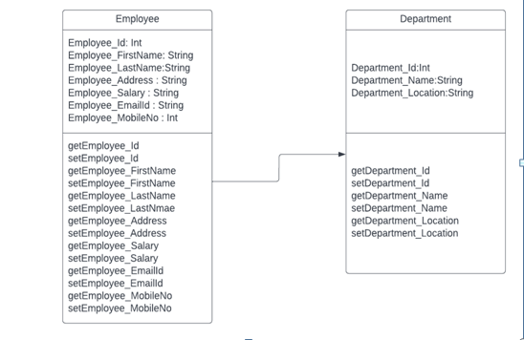
CLASS DIAGRAM

Slide 20
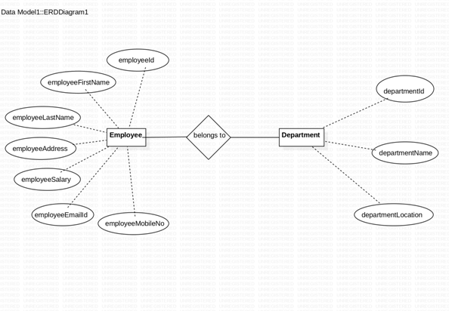
ER DIAGRAM

Slide 21
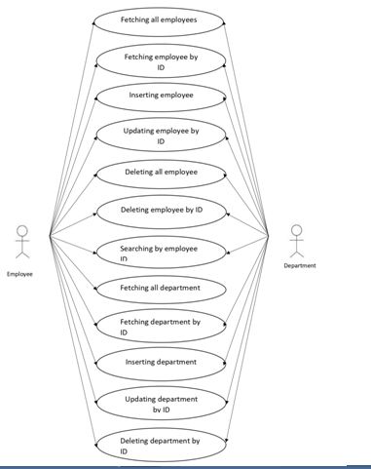
USE CASE DIAGRAM

Slide 22
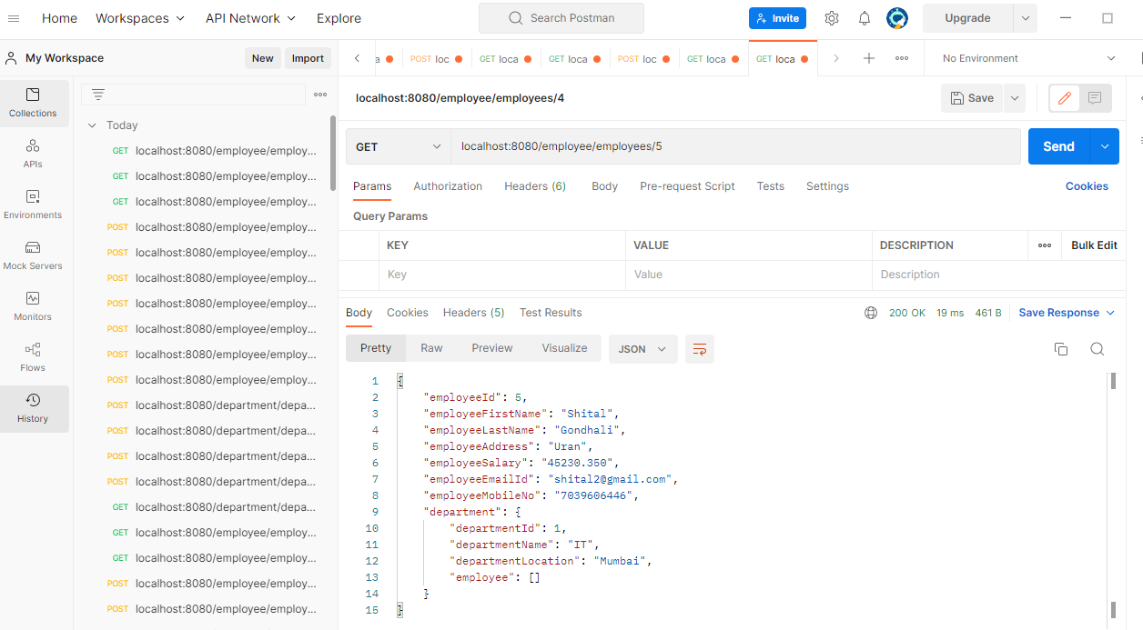
SCREENSHOT

Slide 23
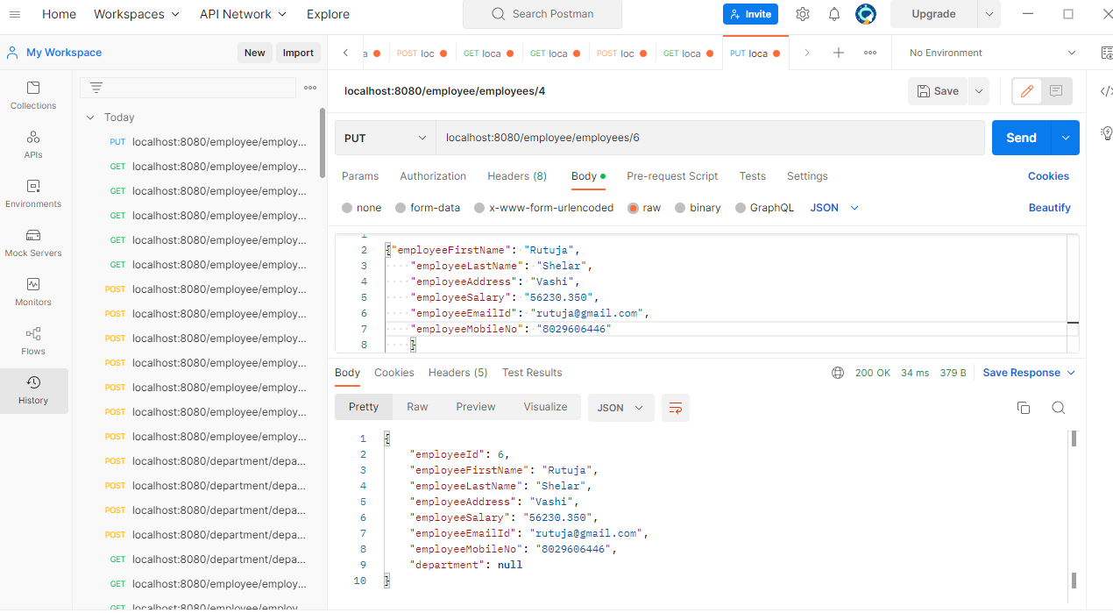

Slide 24
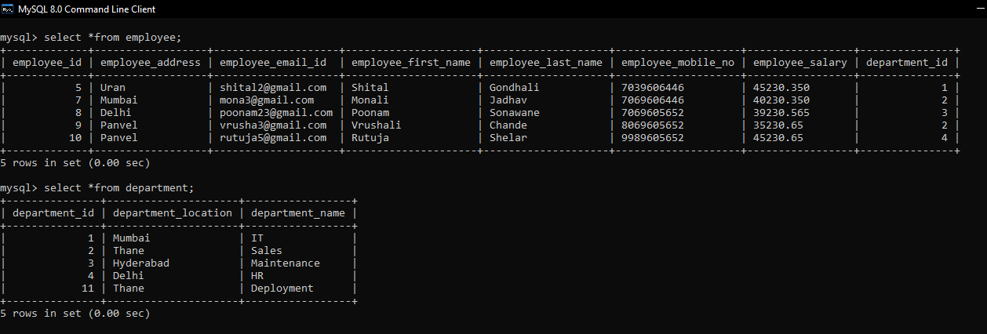

Slide 25
CONCLUSION
This project has been created to digitalize the database of employees in a particular department.
Software provides Employee management system for inserting, deleting, searching and updating records of employees.

Slide 26
Thank you

