Slide 1
Covid-19 Research Study Chandhana Padmanabhan – Springboard Data Science Capstone

Slide 2

Background
Given the large number of literature and the rapid spread of COVID-19, it is difficult for health professionals to keep up with new information on the virus.
This is a difficult time in which health care workers, sanitation staff, and much other essential personnel are out there keeping the world afloat.

Slide 3

Problem Statement
Develop Natural Language Processing & other AI techniques to generate insights support
of the ongoing fight against this infectious disease
Can clustering similar research articles together simplify the search for related publications?
How can the content of the clusters be qualified?
Keep up with the rapid acceleration in new literature
This tool was created to help make it easier for trained professionals to sift through many,
many publications related to the virus, and find their own determinations

Slide 4

Dataset Description
The White House and a coalition of leading research groups have prepared the COVID-19 Open Research Dataset (CORD-19)
CORD-19 is a resource of over 500,000 scholarly articles, including over 200,000 with full text, about COVID-19, SARS-CoV-2,
and related coronaviruses.
Available in Kaggle
~50gb
Sample data once imported
Cord_uid | Source_x | Title | License | Abstract | Publish_tme | Authors | Journal | url
ug7v899j | PMC | Clinical features of culture-proven Mycoplasma.. | no-cc | OBJECTIVE: This retrospective chart review des. | 2001-07-04 | Madani, Tariq A; Al-Ghamdi, Aisha A | BMC Infect Dis | https://www.ncbi.nlm.nih.gov/pmc/articles/PMC3..
02tnwd4m | PMC | Nitric oxide: a pro-inflammatory mediator in l... | no-cc | Inflammatory diseases of the respiratory tract... | 2000-08-15 | Vliet, Albert van der; Eiserich, Jason P; Cros.. | Respir Res | https://www.ncbi.nlm.nih.gov/pmc/articles/PMC5...

Slide 5
Data wrangling
Removing articles with missing abstract / title
Checking if there are any duplicates
Removing non-English words, stop words (like ‘the’, ‘to’, ‘and’ etc.) , words with single characters
Text parsing
Create an inverted index (algorithm used in search engine). It assigns each word with an id & it helps retrieve the articles with keyword matching fastly
Part of Speech tagging & Lemmatization ('NOUN','ADJ','VERB','ADV’)

Slide 6
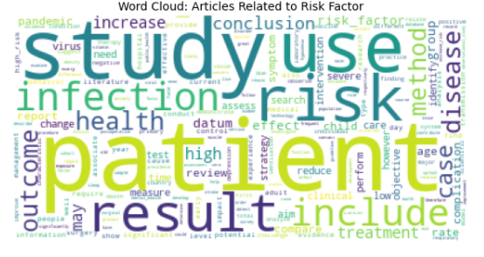
EDA
Article matching using WordCloud :

Slide 7
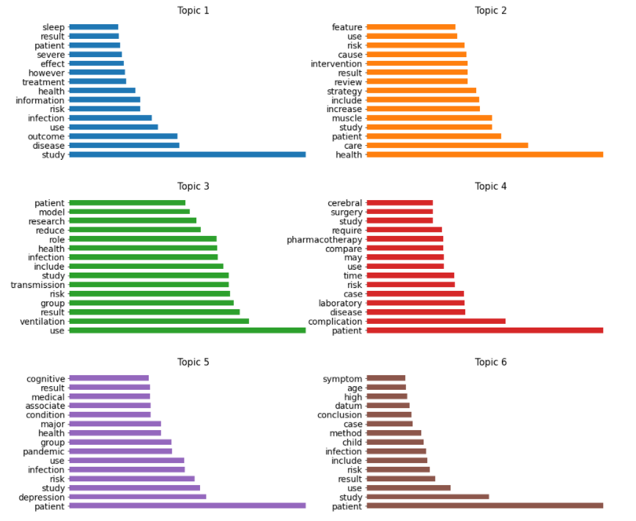
EDA
Topic modeling using
Latent dirichlet allocation
Takeaway
•The first topic is severity of disease. We can see the word like severe,patient,infection.
•The second topic is probably talking about the public service and work during pandemic. We can see the word like intervention,study,review,result.
•The third topic is probably talking about transmission dynamics of the virus. We can see the word like transmission,model,group.
•The fourth topic is probably talking about mortality/death. We can see the word like surgery,complication,treatment,
•The fifth topic is probably talking about mental health of people during pandemic. We can see the word like depression, pandemic.
•The sixth topic is probably talking about how it is affecting for different age groups. We can see the word like age,high,child,infection,risk,conclusion.

Slide 8
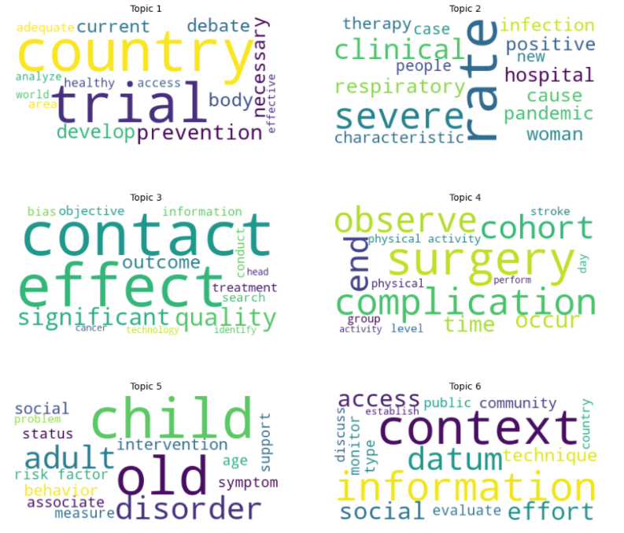
EDA
Topic modeling using
SentenceBert +
K-Means Clustering +
Term Frequency
Inverse Document
Frequency
Takeaway
The first topic is similar with topic 3 generated by LDA, talking about the transmission dynamic of the virus.
The second topic is talking about severity
The third topic is talking about research
The fourth topic is similar with topic 4 generated by LDA, talking about complication, surgery
The fifth topic is similar with topic 5 generated by LDA, talking about mental health
The sixth topic is probably similar with topic 6 generated by LDA, talking about how it is affecting for different age groups.

Slide 9
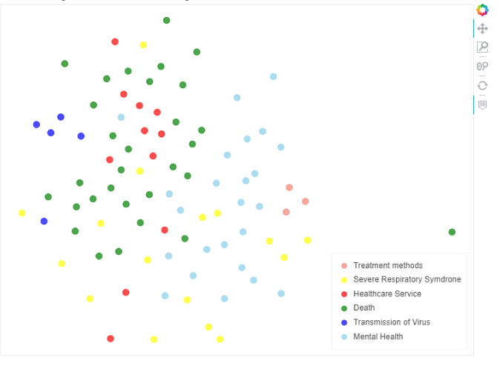
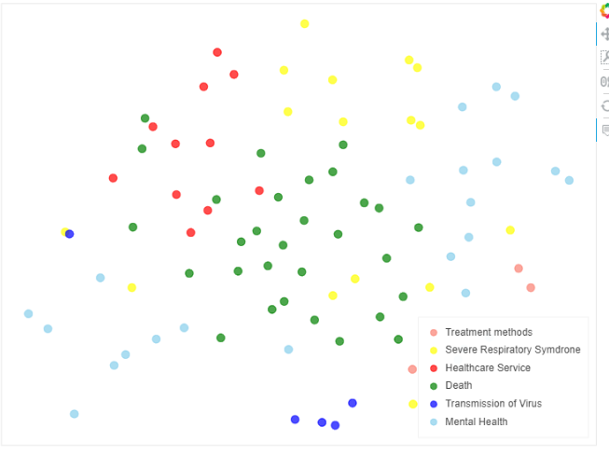
Modeling
1
Topic Modeling using Latent Dirichlet Allocation
Selected the number of topics (6) based on coherence score & perplexity
Topic Modeling using BERT+ K-Means clustering +Term Frequency-Inverse Document Frequency
Dimensionality Reduction with Autoencoder in Keras
Topic extracted using this is more specific(2) compared to the original (1)
2
Notes:
Perplexity(normalized log likelihood) as well is one of the intrinsic evaluation metric, and is widely used for language model evaluation.
Topic Coherence measures score a single topic by measuring the degree of semantic similarity between high scoring words in the topic.

Slide 10
Results
Topics extracted from two methods are similar, but the topics from the second method are more specific.
LDA
Traditional and go-to algorithm for topic analysis
Can extract real ideas from topics and cluster documents based on topics easily with this algorithm
Advantage : Can get relatively clear boundaries when clustering the documents
Disadvantage : real ideas from topics are somewhat ambiguous because it is not easy to tune the hyparameters of this unsupervised learning algorithm
Bert and its modified versions
Outperform everything and achieve state-of-art results in all kinds of NLP tasks
SentenceBert can give very good representation of the documents
Advantage : Real ideas from topics are more meaningful and interpretable
Disadvantage : Decision boundary of documents clustering is not clear

