Slide 1
Tech Stock Price Prediction
Chandhanu Mohan Kalamani – cm1573

Slide 2
Goal
The Scope of this project is to provide a simple interactive application for any new traders to easily understand the trends of Stock market and suggest which “Tech” stocks to buy or sell.
Notes:
The Scope of this project is to provide a simple interactive application for any new traders to easily understand the trends of Stock market and suggest which “Tech” stocks to buy or sell. This application collects the time-series historical data modify and clean the data and provide more extra features from tech companies value indicator data from Nasdaq and S&P500. And provide analytical models on the trends of data, machine learning models to recommend good portfolio for stakeholders and individual stock buyers. This application mainly focusses on providing suggestions to the first-time stock buyers and recommendation through the Django framework and APIs.

Slide 3
Service
Tech Stock Price Django application provides an interactive web application to visualize the data points of stocks, understand the trend and also provides 2 machine learning model to predict the stock price for a given stock.
Model 1 – LSTM, Ensembling (LSTM+RandomForest+GradientBoosting+AdamOptimiser)
Accuracy – 80.8 %
>Offline Model training
Model 2 – LSTM, Ensembling(LSTM+Ridge, Lasso, Elastice Net, SVR)
Accuracy – 76%
>Online Model training

Slide 4
Data Cleaning
Historical time-series data of last 10 years of popular tech companies such as
> Apple Inc, Amazon, Google, Microsoft and Tesla + S&P and NasDaq
Once the data is collected, it is necessary to clean it to remove any missing or invalid values. This is done using the dropna() function, which removes all the rows with missing values from the dataset.
The MinMaxScaler() function from the sklearn.preprocessing module is used to normalize the 'Close' prices of the stocks.
The normalized data is then split into training and testing sets using a 70:30 split ratio. The train_data variable holds the training data, and the test_data variable holds the testing data.
Look-back set to 60. The look-back refers to the number of previous time steps that the model uses to make the prediction – especially for LSTM.

Slide 5
Time Series Analysis
What I understood,
By analysing the trend and correlation of all the top 5 tech companies, the curves are fairly similar and correlation variation is lesser with very little outliers. But the values also correlated with S&P and NasDaq.This encouraged me to use S&P and NasDaq indicators to enhance the prediction algorithm.
Notes:
Since the stock price data is a time series, time series analysis techniques were used to extract meaningful insights from the data. This involved visualizing the data, identifying trends and seasonality, and decomposing the time series into its constituent components.
Visualizing the data is an important step in time series analysis as it allows us to identify patterns and trends. In this project, various visualization techniques such as line charts, scatter plots, and heatmaps were used to gain insights into the data. Identifying trends and seasonality is also important as it helps to understand the underlying patterns in the data and make more accurate predictions.

Slide 6
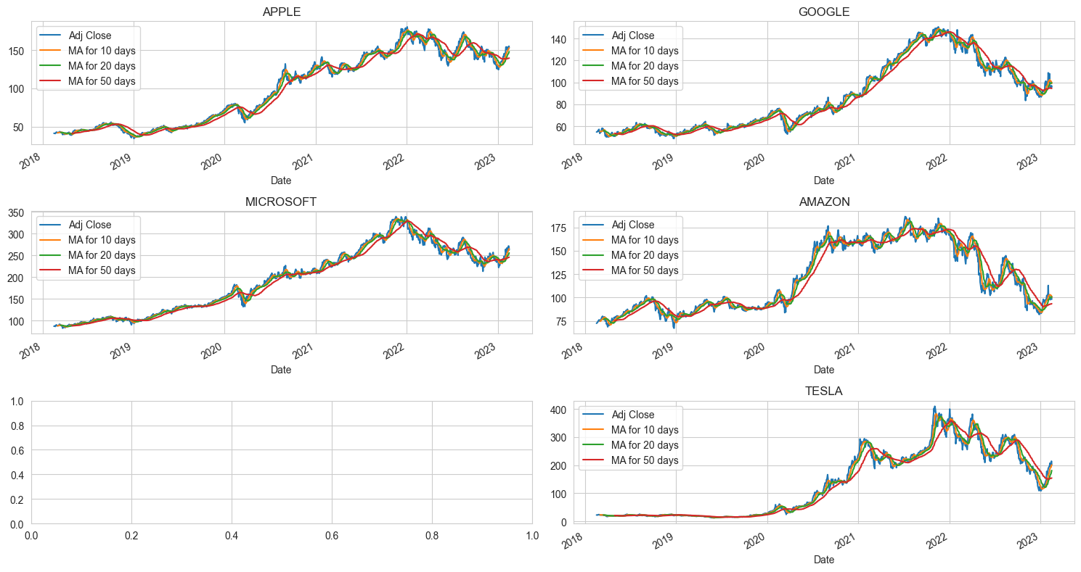
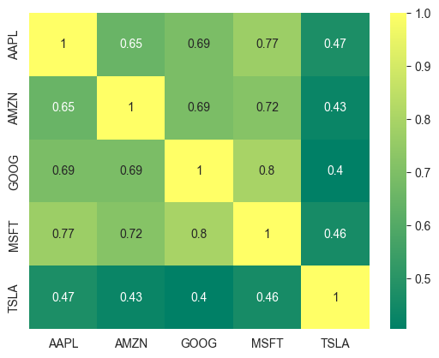

Slide 7
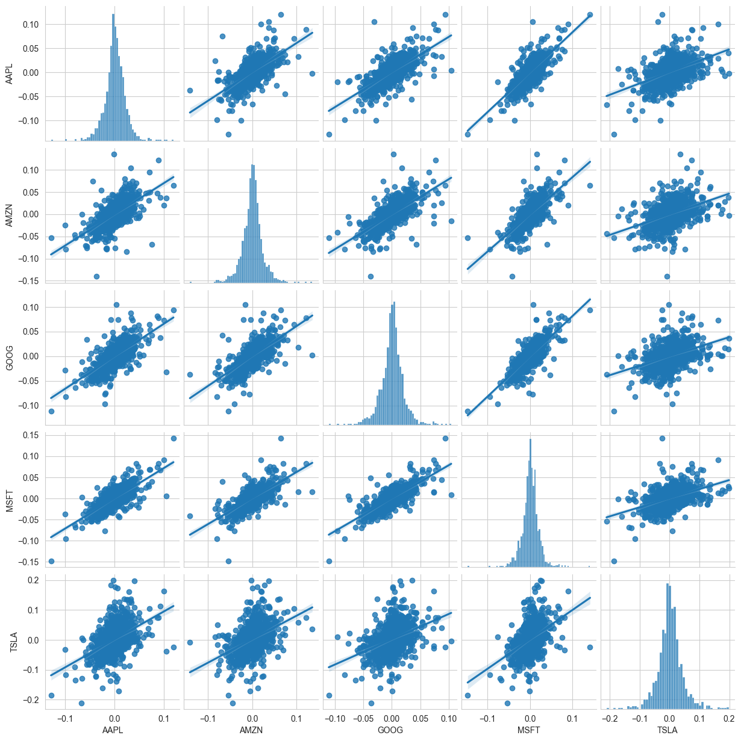

Slide 8
Bayes Proof - 1
Let,
A be the event that the stock price of a particular tech company increases
B be the event that both Nasdaq and S&P 500 indices increase.
Bayes theorem:
P(A|B) = P(B|A) * P(A) / P(B).
P(B|A) is the probability of both Nasdaq and S&P 500 indices increasing given that the stock price of the tech company increases. This can be estimated from historical data by counting the number of times when A and B occurred together, and dividing by the total number of occurrences of A.
P(A) is the prior probability of the tech company's stock price increasing, which can also be estimated from historical data. P(B) is the probability of both Nasdaq and S&P 500 indices increasing, regardless of the tech company's stock price. This can also be estimated from historical data.

Slide 9
Bayes Proof - 2
By computing P(A|B), we can determine whether the combined use of Nasdaq and S&P 500 indices with the stock value of top tech companies increases the accuracy of stock price prediction.
For example,
P(A) = 0.6
P(B) = 0.7
P(B|A) = 0.8.
By Bayes theorem,
P(A|B) = 0.8 * 0.6 / 0.7 = 0.6857
This means that given that both Nasdaq and S&P 500 indices increase, the confidentiality of the stock price output is 68.57% accurate.

Slide 10
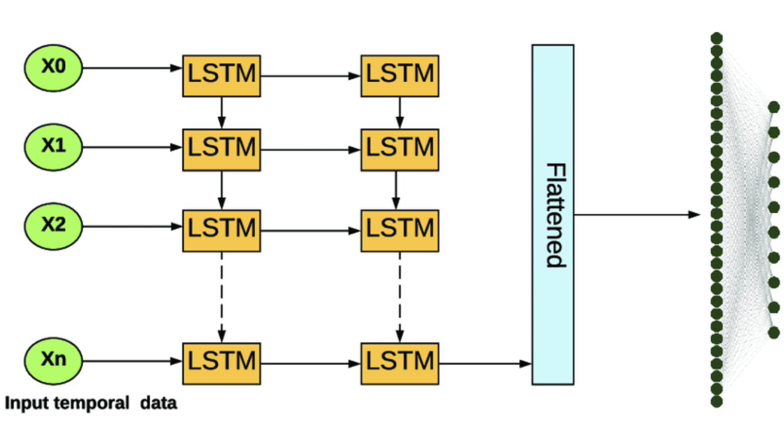
LSTM
model = Sequential(): Initializes an empty model object to which we can add layers individually.
model.add(LSTM(units=50, return_sequences=True, input_shape=(X_train.shape[1], 1)))
model.add(Dropout(0.2)): Adds a dropout layer with a rate of 0.2.
model.add(LSTM(units=50, return_sequences=True)): Adds the second LSTM layer to the model with 50 units and return_sequences=True.
model.add(Dropout(0.2)): Adds another dropout layer.
model.add(Dense(units=1)): Adds a fully connected dense layer with 1 unit to output the predicted value.
Notes:
LSTM is a type of Recurrent Neural Network (RNN) that is designed to model sequential data by remembering past data points. It is particularly useful for time series forecasting because it can capture patterns and trends in the data over time.

Slide 11
Model 1 - Offline
Ensemble of - LSTM+RandomForest+GradientBoosting+AdamOptimiser
Each of these models is a decision-tree-based machine learning algorithm that can learn complex patterns in the data and make accurate predictions. The number of estimators in each of these models is set to 100, which means each model has 100 trees. The random_state parameter is set to 42 to ensure that the random number generator used by each model produces the same sequence of random numbers, which helps to make the results reproducible.
Gradient Boosting and RandomForest is another ensemble learning algorithm that is used to build a predictive model by iteratively adding decision trees and Mutltiple decision trees for Robust model.
AdaBoostRegressor : combines multiple weak learners to create a more accurate model. Each new weak learner is trained to correct the errors of the previous learners, with minimizing the overall error.

Slide 12
Model 2 - Online
Ensemble of - Lasso, Ridge, Elastic Net
Ridge, Lasso, and Elastic Net are all linear regression techniques used for feature selection and regularization.
Voting Regressor: useful when multiple regression models are available and there is uncertainty about which model will perform the best on a particular task. By combining multiple models, it is possible to reduce the risk of overfitting and improve prediction accuracy. The voting mechanism also helps to reduce the impact of individual model errors on the final prediction.
Notes:
They are used to penalize large coefficient values in a regression model to prevent overfitting, which occurs when a model is too complex and fits the training data too well.
Ridge regression adds a penalty term that is proportional to the square of the coefficients,
while Lasso regression adds a penalty term that is proportional to the absolute value of the coefficients.
Elastic Net combines both methods, with a penalty term that is a combination of the L1 and L2 penalties.

Slide 13
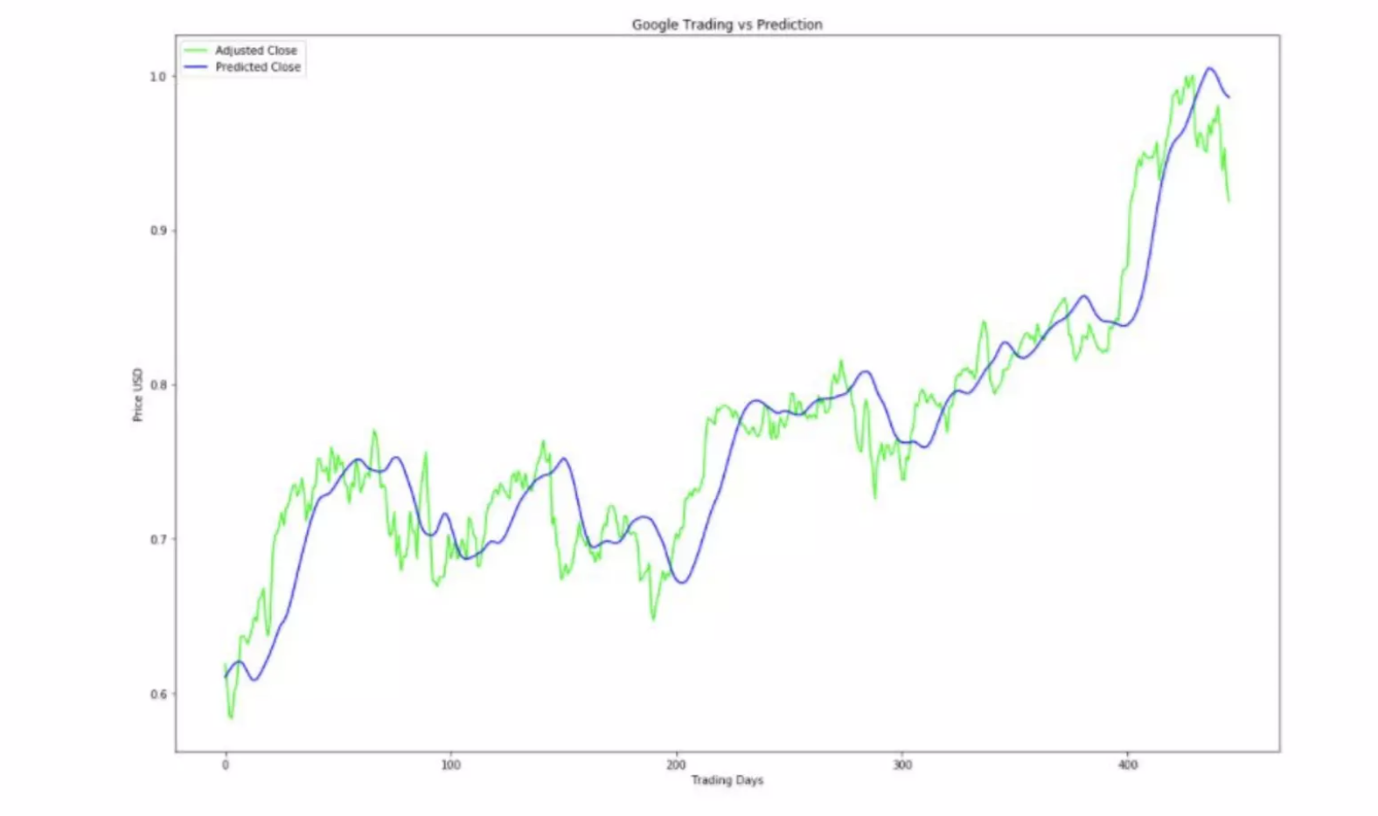
Predicted Output

Slide 14
Demo
Django
Stock prediction
Simple UI for the clients to easily navigate to pages
Navigation buttons and page redirects to learn more about stocks
Options to view a particular stock and predict its prices
Dashboard and graph of stock predictions
Link models to the Django backend and api to send and request data from the model as input and collect data as output
Data Cleaning and feature addons
Normalizing the data
Experiment with the features for best outcome prediction
Experiment on different models and layer modifications
Experiment on LSTM and compare with other RNN algorithm

Slide 15
THANK YOU
Chandhanu, Mohan Kalamani
cm1573

