Slide 1
FORMIQ - Intelligent Receipt Parser
Receipt Intelligence App – Intelligent Receipt Parsing & QA Chatbot
Presented by: Team NextGen
Apurva Karne (018221801)
Chandini Saisri Uppuganti (018228483)
Manjunatha Inti (018192187)
Praful John (018168514)

Slide 2
Problem Statement
Manual extraction - time-consuming and error-prone.
Handwritten receipts - low OCR accuracy.
Businesses lack automated tools to convert receipts into structured formats for analysis.
Traditional systems do not support natural language queries over receipt data.
There is a need for a unified solution to handle extraction, structuring, storage, and querying efficiently.

Slide 3
Proposed Solution
An AI-powered web application to digitize and structure receipt data.
Use PaddleOCR for high-accuracy text extraction, including handwritten inputs.
Leverage Perplexity LLM to convert raw text into structured JSON format.
Store structured data in AWS DynamoDB for scalable and persistent storage.
Enable interactive querying of receipt data via a FastAPI-powered chatbot.
Provide an evaluation module to visualize accuracy metrics and confusion matrix.

Slide 4
Tech Stack
Component | Technology Used | Purpose
Frontend UI | Streamlit | Web interface for uploading and viewing
OCR Engine | PaddleOCR | Extracts text from scanned/handwritten receipts
LLM Parser | Perplexity API | Converts raw text into structured JSON
Backend API | FastAPI | Powers chatbot and data retrieval services
Database | AWS DynamoDB | Stores structured receipt information
Evaluation | Matplotlib / Seaborn | Generates confusion matrix and metrics
Chat Interface | ChatGPT API | Enables natural language QA over receipts

Slide 5
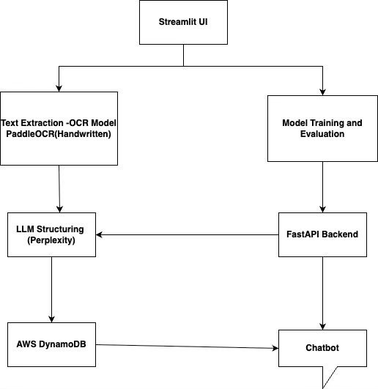
System Architecture

Slide 6
How OCR works?
Grayscale Conversion – Simplifies the image by removing colors.
Text Detection – Finds areas in the image that contain text.
Cropping – Extracts those text regions for focused processing.
Text Recognition – Uses a neural network to read characters.
Decoding – Converts model output into readable text.
Aggregation – Combines all recognized text into final output.

Slide 7
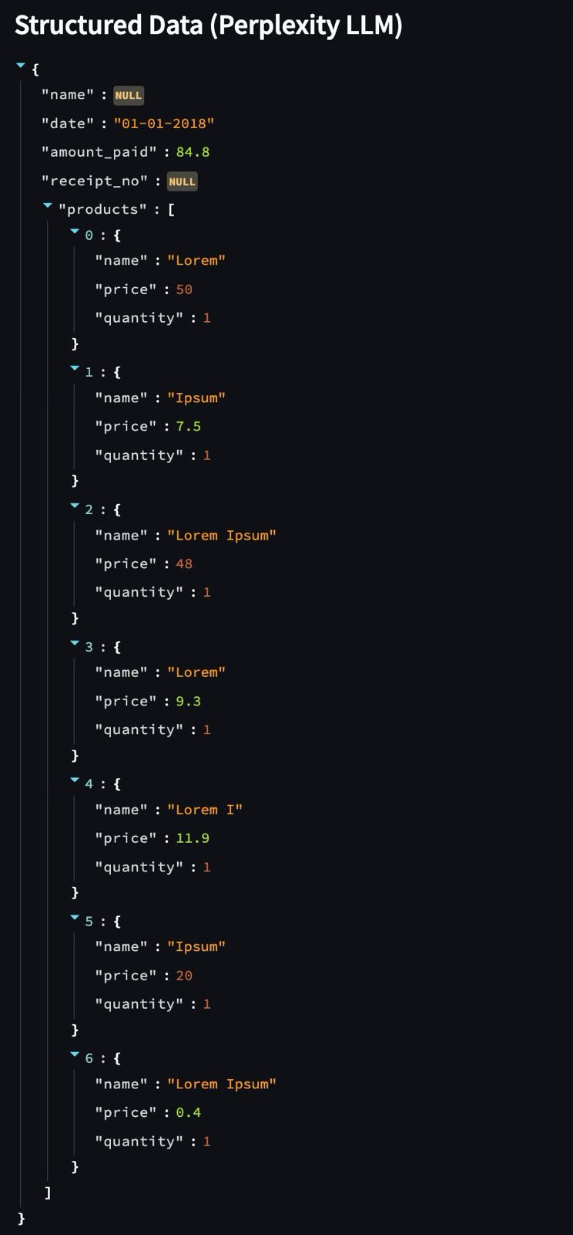
LLM Integration – Structuring OCR Data
OCR output is raw, unstructured text that lacks semantic meaning.
Perplexity LLM - understand and extract key information.
LLM converts plain text into structured JSON format (fields like date, items, amount).
This structured data enables easy storage, retrieval, and analytics.
Integration is done via API call from backend to LLM service.
Output is ready for storage in DynamoDB and chatbot querying.

Slide 8
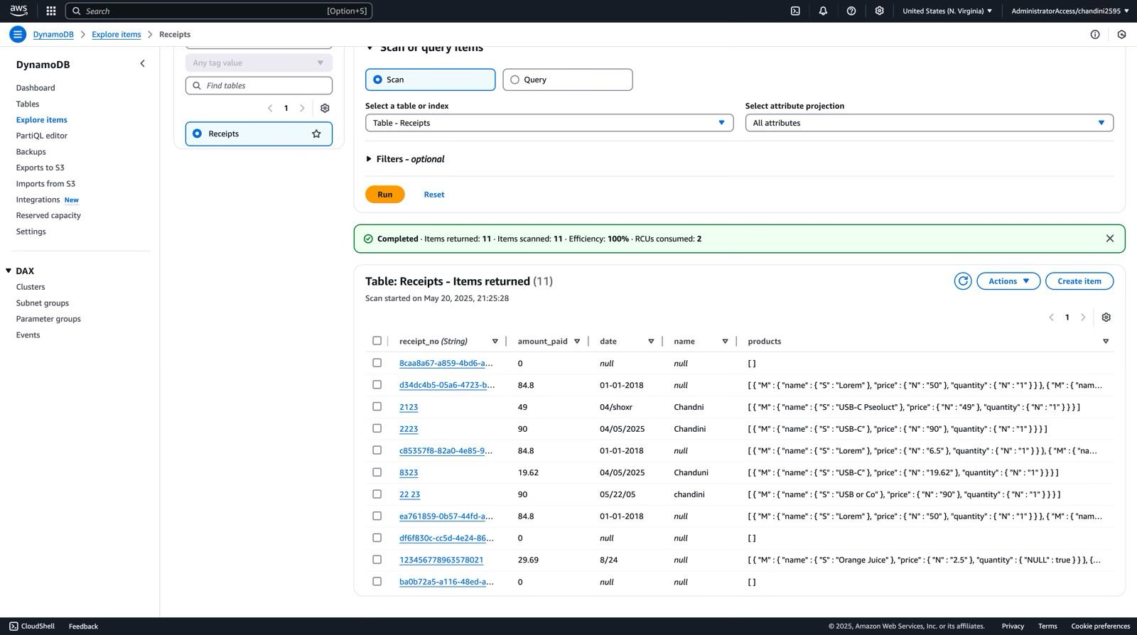
DynamoDB – Structured Data Storage
DynamoDB provides scalable, low-latency NoSQL storage for receipt data.
Each receipt is stored as a document with a unique key
Enables fast retrieval for both chatbot queries and analytics dashboards.
Schema-less design allows storing flexible fields (items, vendor, total, etc.).
Supports real-time read/write operations for the chatbot and evaluation modules.

Slide 9
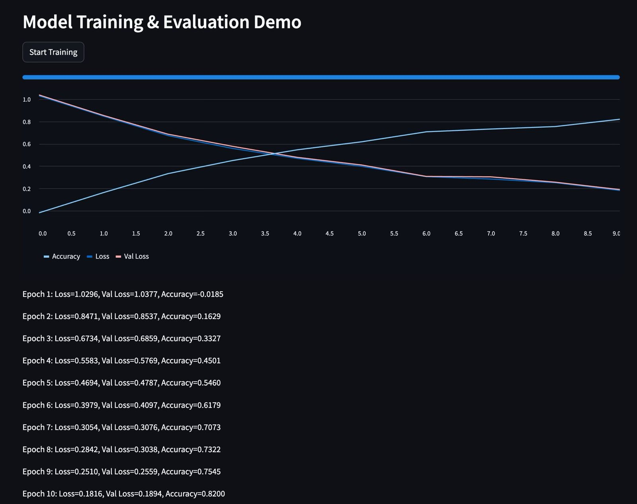
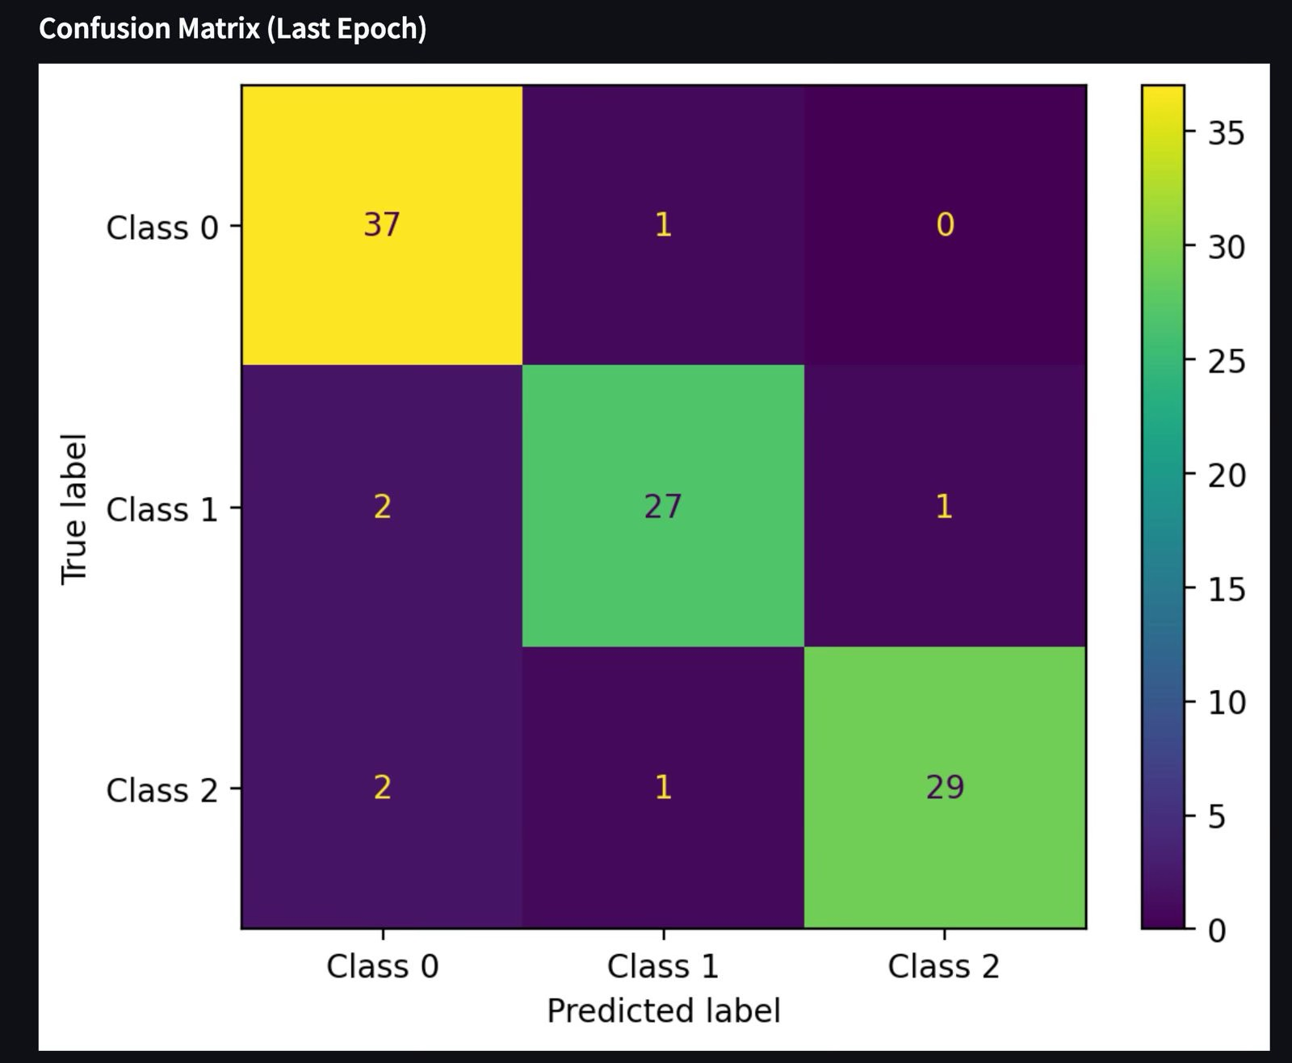
Model Training and Evaluation

Slide 10
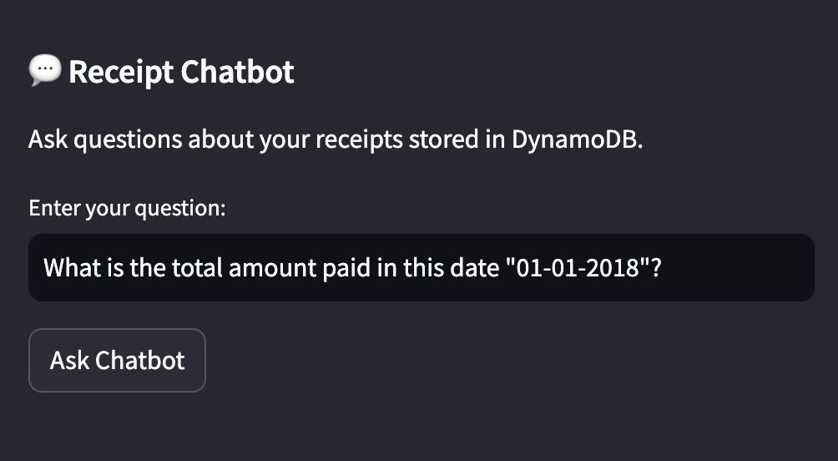
Chatbot - Receipt QA Assistant
Enables natural language Q&A over structured receipt data.
Built using FastAPI as the backend for query handling.
Fetches data from DynamoDB based on the user’s question.
Sends user query and relevant data to Perplexity API to generate intelligent responses.
Delivers a seamless AI assistant experience through the Streamlit UI.

Slide 11
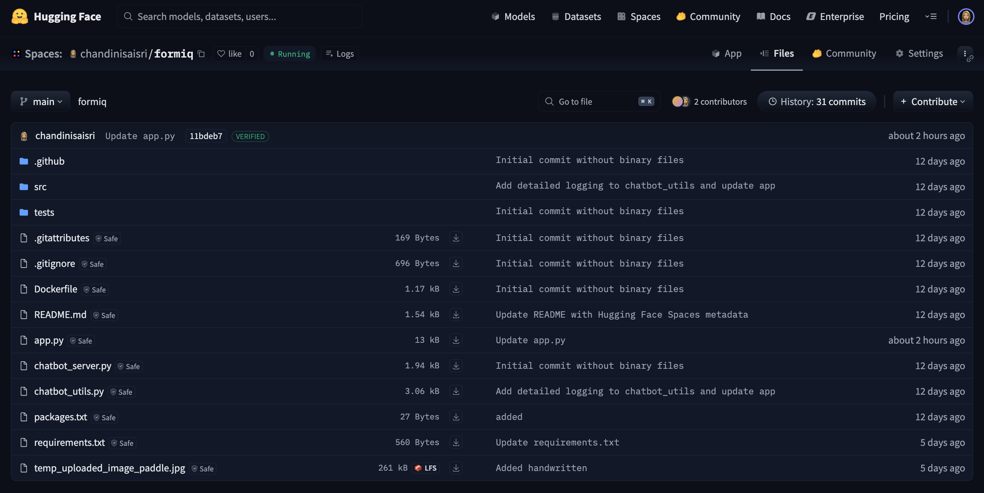
Deployment – Hugging Face Spaces
Deployed the entire application (Streamlit UI + FastAPI backend) on Hugging Face Spaces for public access.
Integrated with Perplexity API and DynamoDB, enabling live inference and real-time Q&A without local setup.

Slide 12
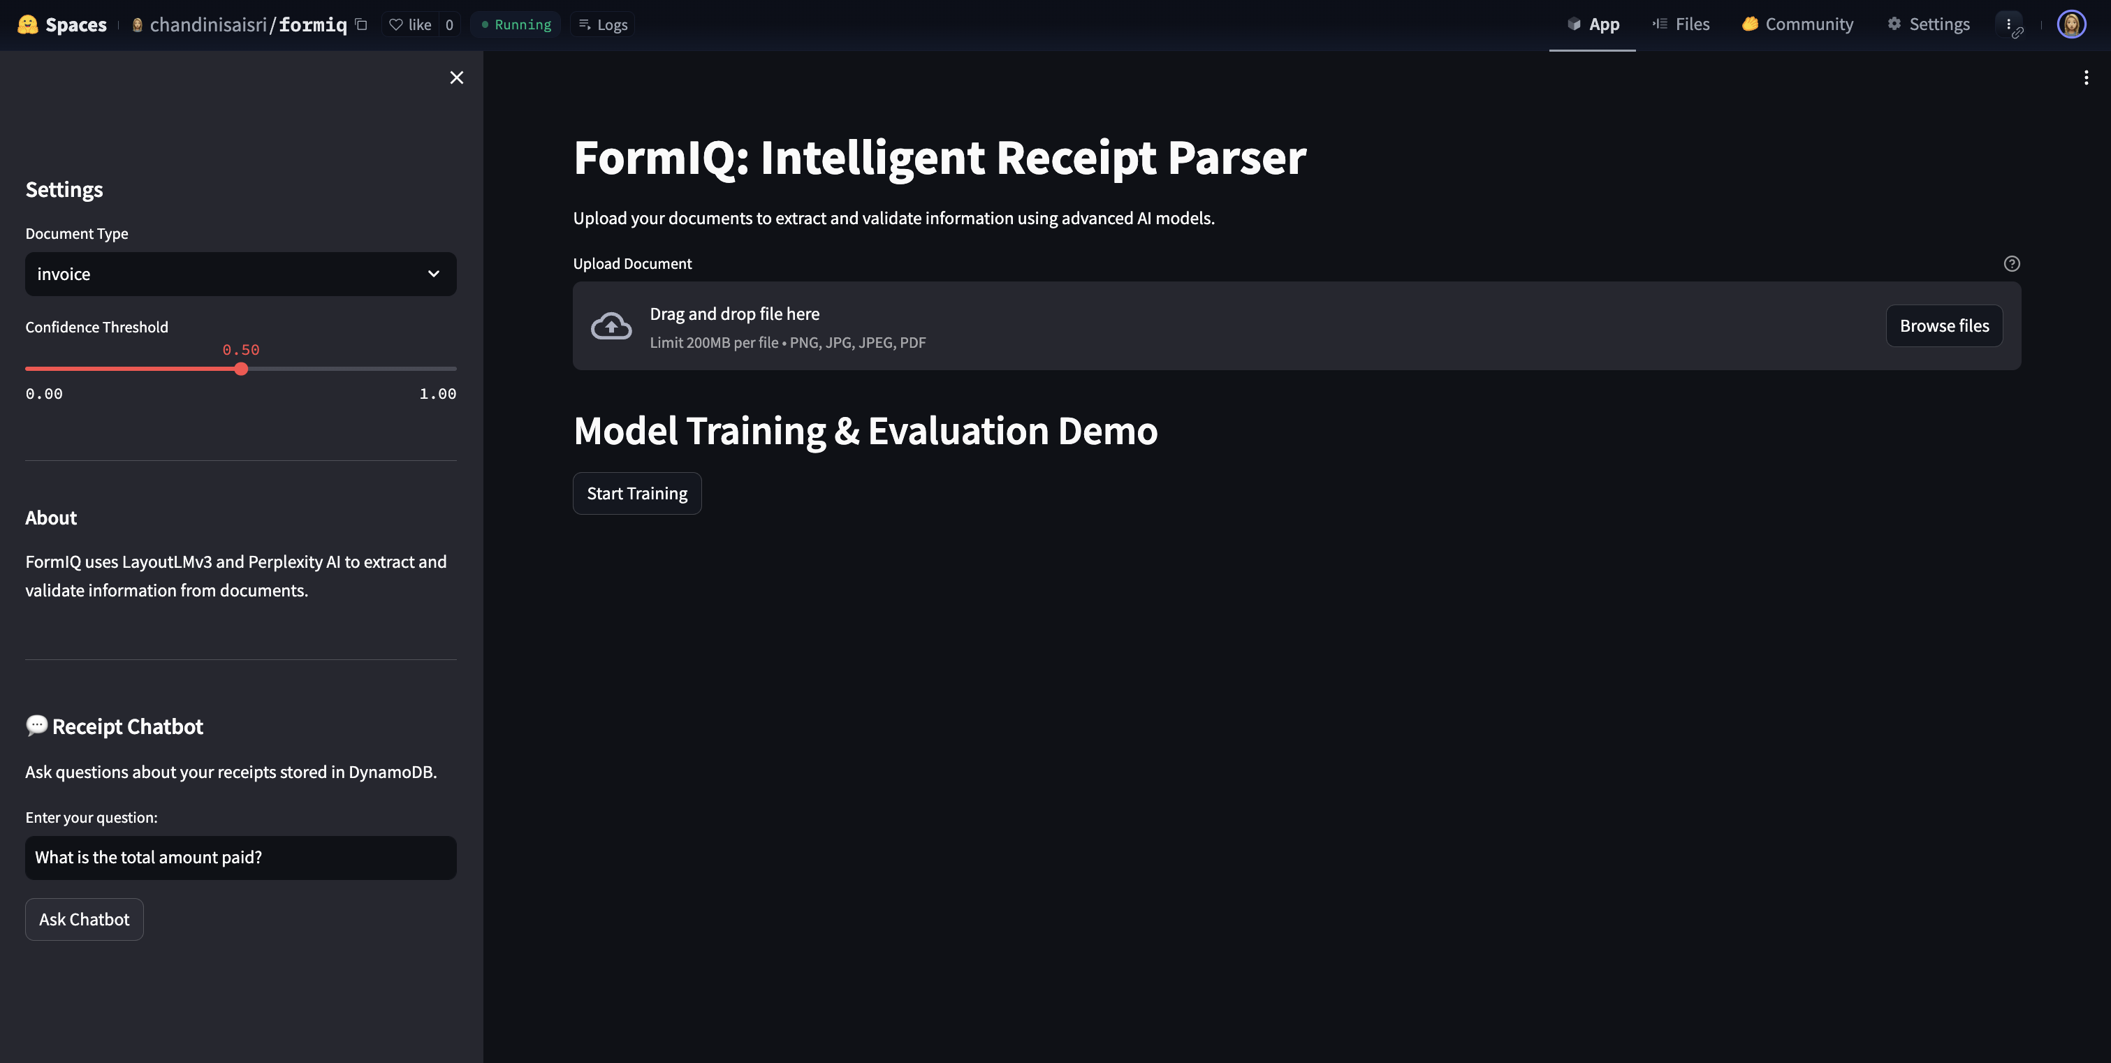

Slide 13
User Interface
https://huggingface.co/spaces/chandinisaisri/formiq

Slide 14
Thank You!!

