Slide 1
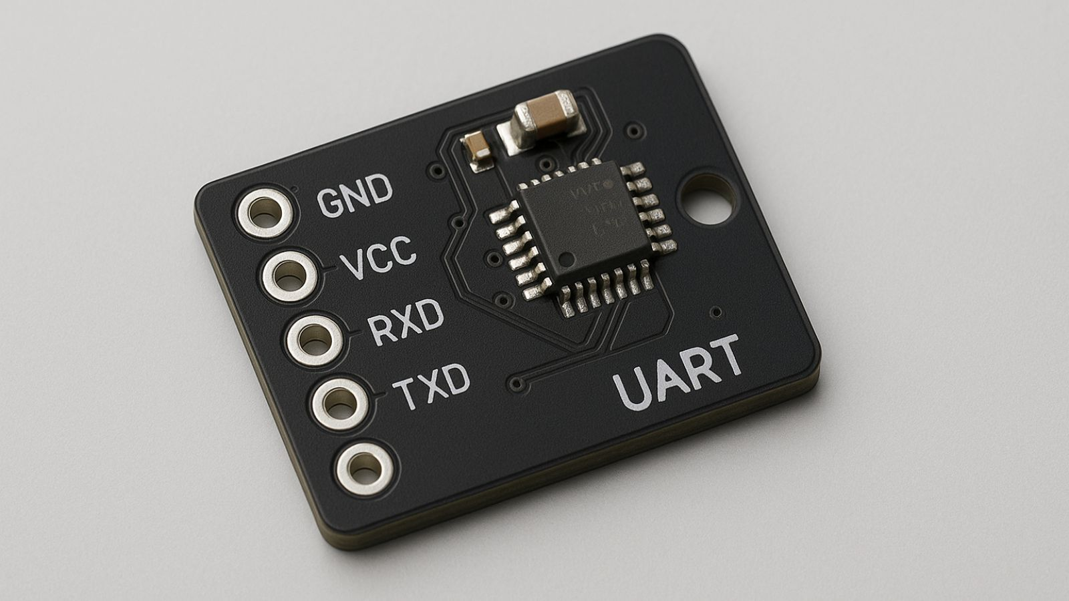
UNIVERSAL ASYNCHRONOUS RECIEVER AND TRANSMITTER(UART)

Slide 2
Introduction
UART (Universal Asynchronous Receiver/Transmitter) is an asynchronous serial communication protocol that sends data one bit at a time without a shared clock.
It works without a clock and follows an agreed speed called the baud rate.
Modern UARTs include FIFO (First-In, First-Out) buffers on the transmit and receive lines, allowing multiple bytes to be stored temporarily instead of handling data one byte at a time.
The FIFO reduces CPU load, prevents data loss at high baud rates, and improves reliability by handling burst data and minimizing interrupt frequency.

Slide 3
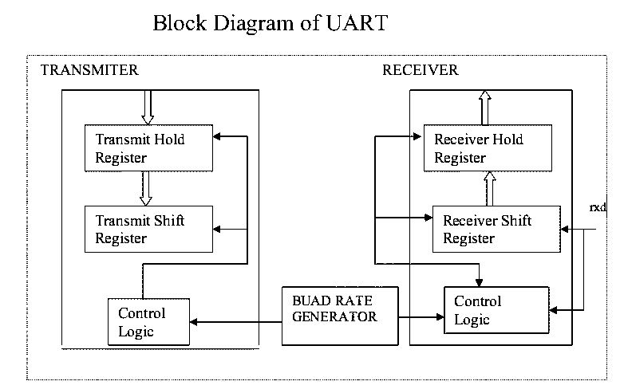

Slide 4
Why UART is a asynchronous
1. Asynchronous design = fewer wires UART is meant to be simple and low-cost, so it only uses two wires (TX and RX). If a clock line was added, it would need three wires, making the design more complex.
2. Devices agree on a baud rate instead Since there is no clock, both devices agree on a fixed baud rate (speed), like 9600 bps. This makes communication possible without sending a separate clock signal.
3. Suitable for long-distance and low-speed communication A clock line can get distorted or delayed over longer wires. UART avoids this problem by using start/stop bits and oversampling, letting each device stay synchronized
without an external clock.

Slide 5
FIFO in UART
Temporary Storage Area: The FIFO (First-In, First-Out) inside a UART acts like a small storage box that holds multiple bytes of data.
TX FIFO: stores outgoing data before it is sent
RX FIFO: stores incoming data before the CPU reads it
Data Comes In and Goes Out in Order: The first byte that enters the FIFO is the first byte that comes out. This prevents data loss when data arrives quickly or when the CPU is busy.
Reduces CPU Load & Interrupts: Instead of interrupting the CPU for every single byte, the UART interrupts only when the FIFO reaches a certain level (e.g., half full). This makes communication smoother and more efficient.

Slide 6
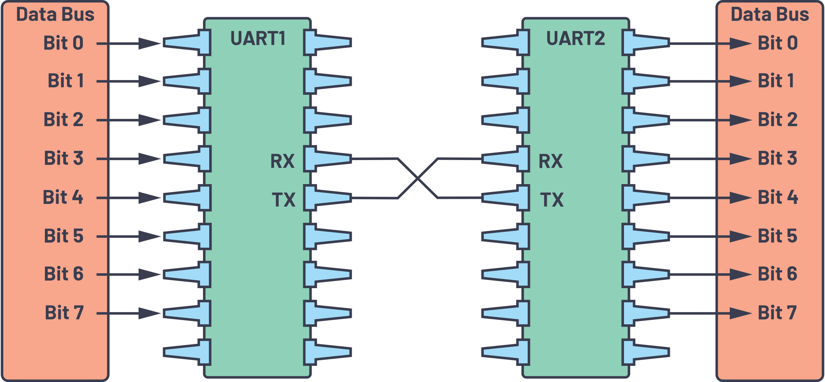
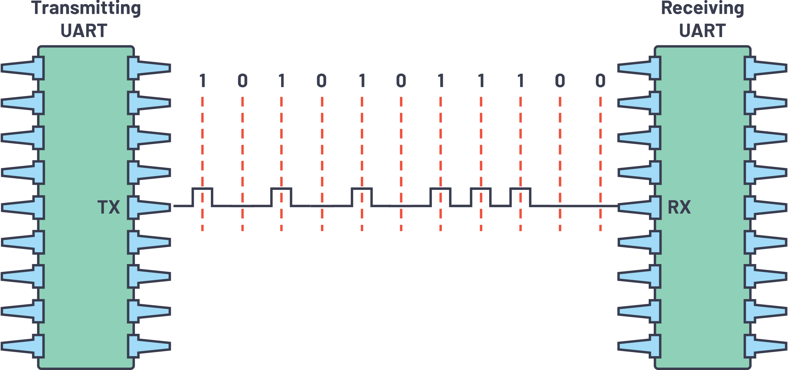

Slide 7
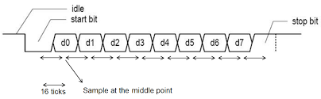
TX(Transmiter)
. The TX line sends data from the UART transmitter to the receiver of another device.
The data is framed with:
Start bit
Data bits (usually 8)
Optional parity bit
Stop bits
The TX FIFO (if available) stores multiple bytes, allowing continuous data flow without CPU intervention.

Slide 8
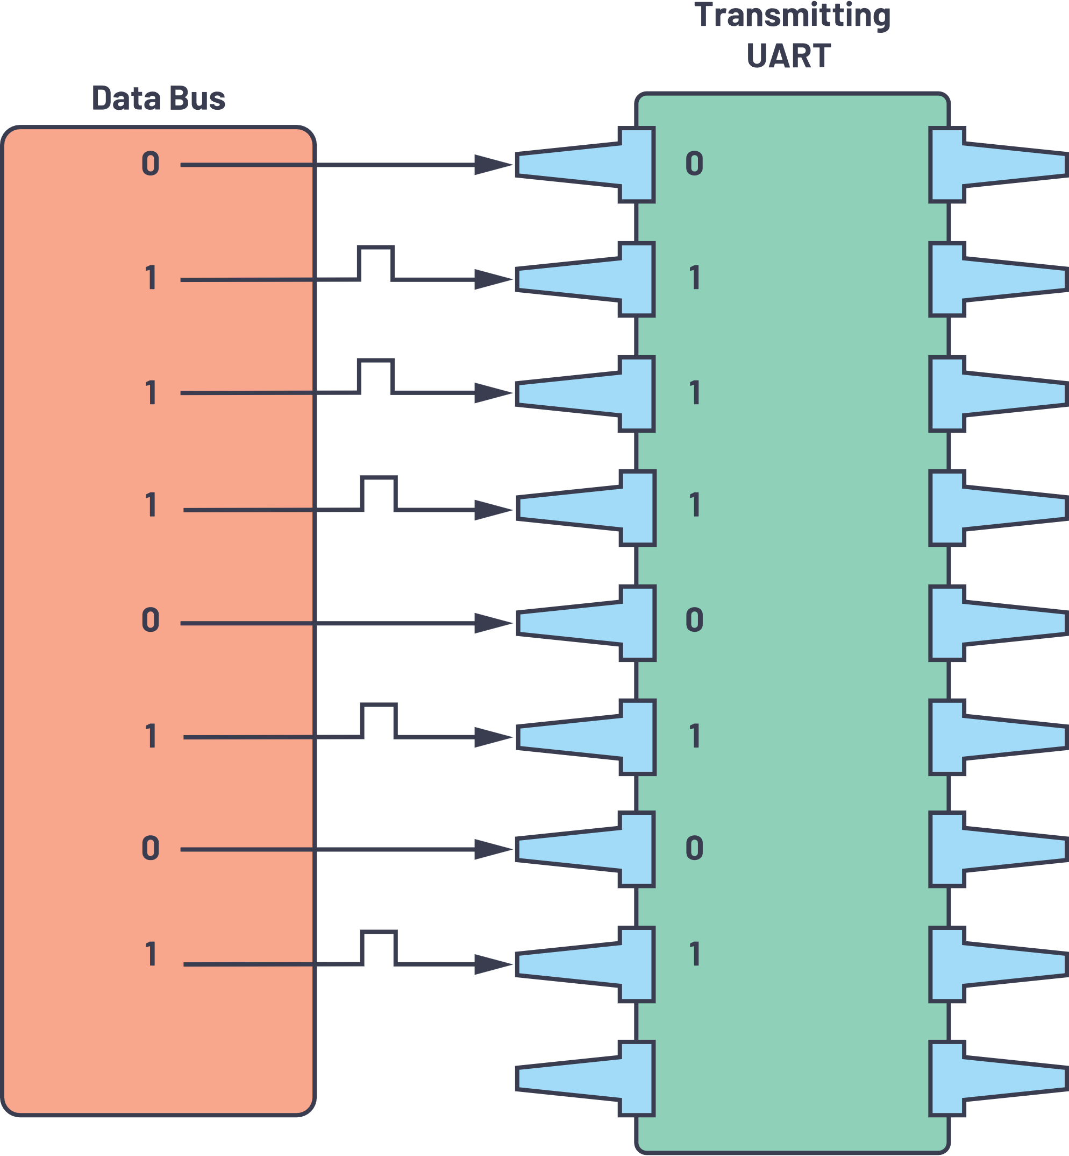
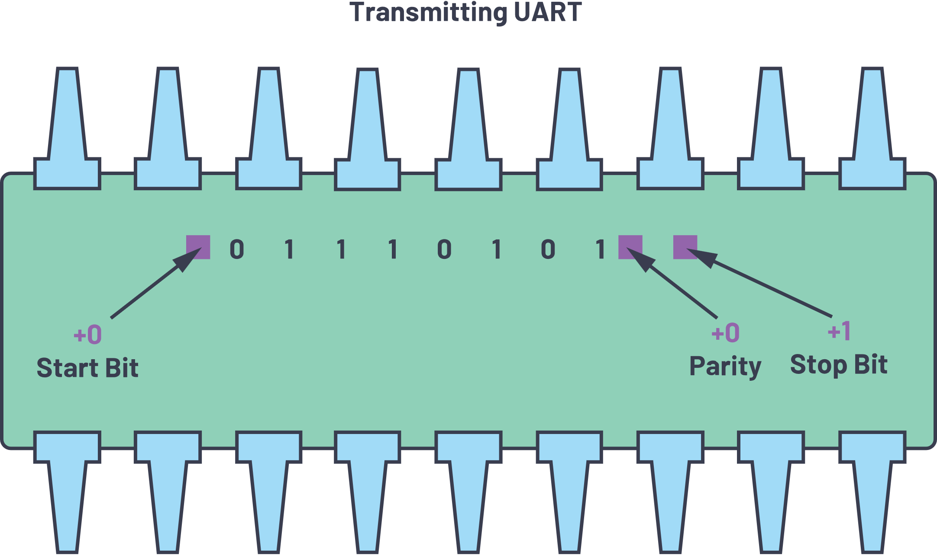

Slide 9
RX (Receiver)
Start Bit Detection: Receiver watches the RX line and detects a falling edge (start bit).
Oversampling: It uses 16× (or 8×) oversampling to accurately find the middle of each bit.
Bit Sampling: Samples each bit (data, parity, stop) at the middle of its bit period.
Data Assembly & Error Check: Collected bits form a byte; parity and framing (stop bit) are checked.
Store & Interrupt: The received byte is placed into the RX FIFO or register, and an interrupt may be generated.

Slide 10
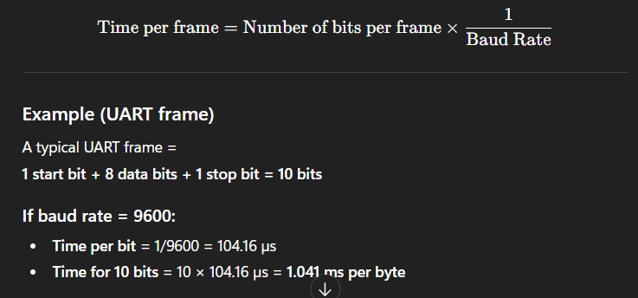
Baud Rate
Baud rate is the number of bits transmitted per second in serial communication. 9600 baud → 9600 bits are sent every second It tells how fast data is being transferred over a serial line like UART.

Slide 11
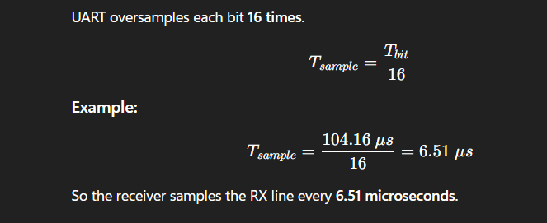
Why Sampling Is Needed
UART has no clock line, so it must recreate timing by sampling. Oversampling makes reception accurate, even if transmitter and receiver clocks are slightly different.
16x(oversampling)

Slide 12
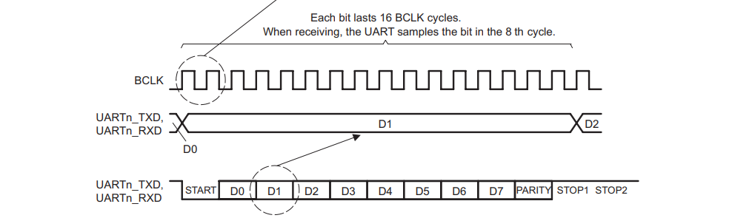
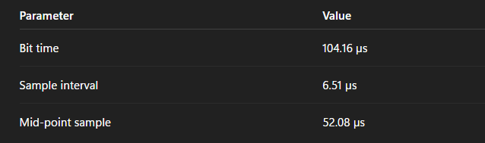
Middle Sample = 8 samples = 8 × Tsample​
Middle Sample = 8 × 6.51 μs = 52.08 μs

Slide 13
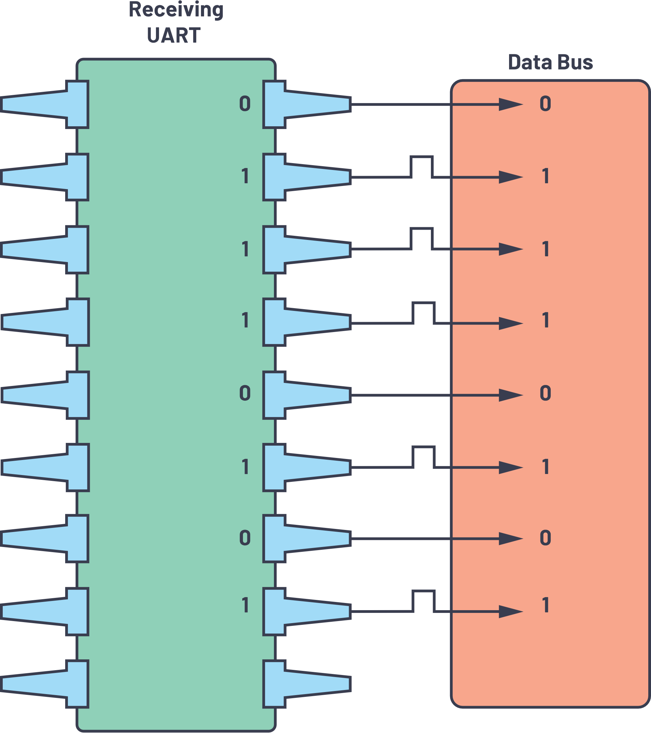
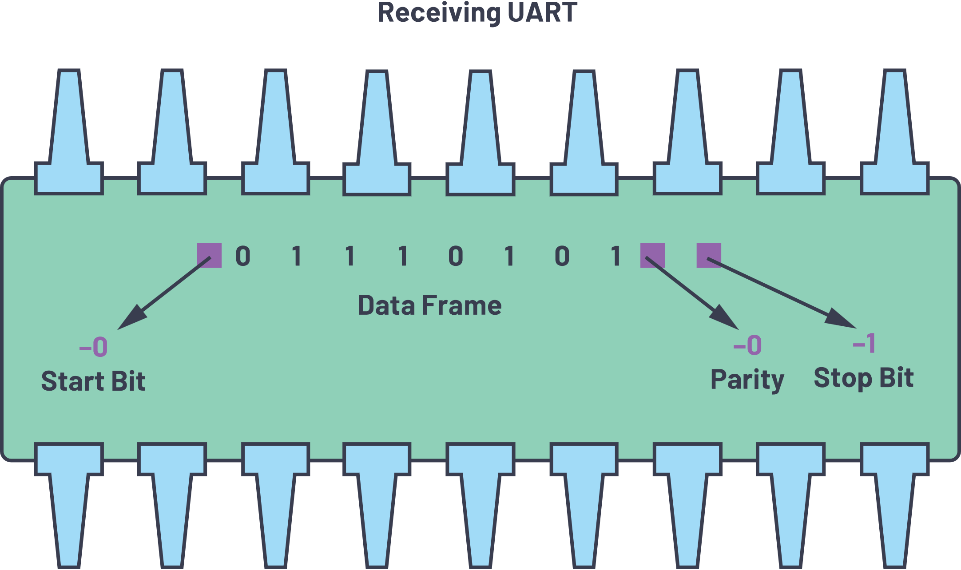

Slide 14
Control signals for tx and rx
RTS (Request to Send)
Output from the device.
Indicates the device is ready to receive data.
When RTS = LOW → “I am ready, send data.”
2. CTS (Clear to Send)
Input to the device.
Tells the transmitter when it is allowed to send.
CTS = LOW → “You may transmit now.”
(This pair supports hardware flow control.)

Slide 15
advantages
Simple and low-cost
– Needs only TX and RX lines, reducing wiring and hardware complexity.
Asynchronous communication
– No clock line needed; devices only need to match baud rate.
Full-duplex operation
– Can transmit and receive data simultaneously.
Configurable format
– Adjustable baud rate, data bits, parity and stop bits for flexibility.
Built-in error detection
– Supports parity checks and framing error detection for reliable data transfer.
Widely supported
– Available in almost all microcontrollers and easy to interface with PCs (via USB-UART).

Slide 16
Drawbacks
Limited data speed
– Much slower compared to SPI or USB; not suitable for high-speed communication.
Short distance without drivers
– Basic UART signals cannot travel long distances without RS-232/RS-485 converters.
Supports only point-to-point communication
– Cannot easily connect multiple devices on the same bus.
Requires matching settings
– Both devices must use the same baud rate, parity, stop bits; mismatches cause errors.
Higher overhead
– Start/stop/parity bits add extra bits, reducing effective data throughput.
Less noise immunity
– More sensitive to electrical noise compared to differential protocols like RS-485 or CAN.

Slide 17
Future scope
Continued use in embedded and IoT devices – UART will remain a standard interface for microcontrollers, sensors, and communication modules due to its simplicity and low power use.
Stronger role in debugging and system diagnostics – UART will keep being essential for firmware loading, logging, and device debugging in future embedded systems.
Improved reliability and efficiency – Future UARTs may offer better noise immunity, adaptive baud-rate control, and enhanced FIFO/DMA support for more stable communication.

Slide 18
______THANK YOU________
By
G.Chandini
AC12

