Slide 1
Dublin Housing Affordability
Analysis (2015-2025)
Team Members
Chandini Konduru (25143913) | Singireddy Sneha (24285854)| Kapa Adheeshwar Reddy (25122932)
Research Question
Is housing in Dublin becoming unaffordable relative to income over time, and how does it vary by area?
Approach
End-to-end ETL + dual databases + dashboard visualization

Slide 2
Motivation and Project Objectives
Critical Issue
The Problem
Our Objectives
Housing affordability is a critical social and policy issue in Dublin.
Price-only trends can mislead; affordability must relate price to income.
Build reproducible ETL
Use MongoDB + PostgreSQL
Derive affordability metrics
Communicate insights

Slide 3
Datasets and Data Volume
Data Sources
Data Volume
Property Price Register
CSV, structured
CSO Income API
JSON-stat, semi-structured
CSO Population API
JSON-stat, semi-structured
All sources
Public and non-Kaggle
198,057
Property rows
1,056
Income parsed rows
13,020
Population parsed rows
>1,000
Records per source (requirement met)

Slide 4
System Architecture and ETL Flow
Pipeline Flow
Core Modules
Design Focus
Extract → MongoDB raw zone
Transform → PostgreSQL curated zone
Dashboard + static figures
extract.py
transform.py, load.py
main.py, analyze.py
dashboard/app.py
Reproducibility
Traceability
Robust data quality checks

Slide 5
Raw Storage and Engineering Challenges
MongoDB Storage
Challenges Solved
Outcome
Stores both raw payloads and parsed rows for lineage.
PowerShell script parsing
Schema variability
Missing area labels
Stable pipeline behavior
Explainable transformations

Slide 6
Transformation and Feature Engineering
Data Cleaning
Metrics Derived
Area Logic
Date/price normalization
Dublin filter, 2015-2025 window
Invalid value removal
Avg/median price
Sales count
Affordability index
Year-over-year growth rates
Improved using address fallback
Where Eircode is missing

Slide 7
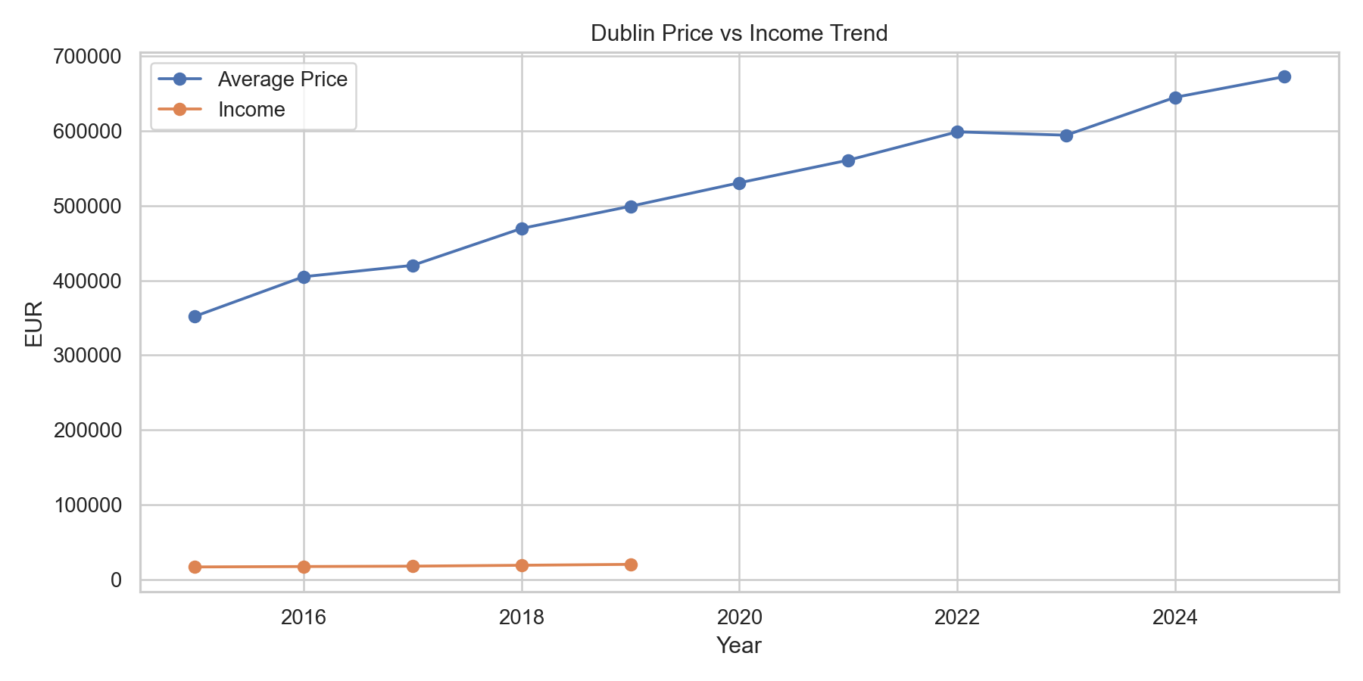
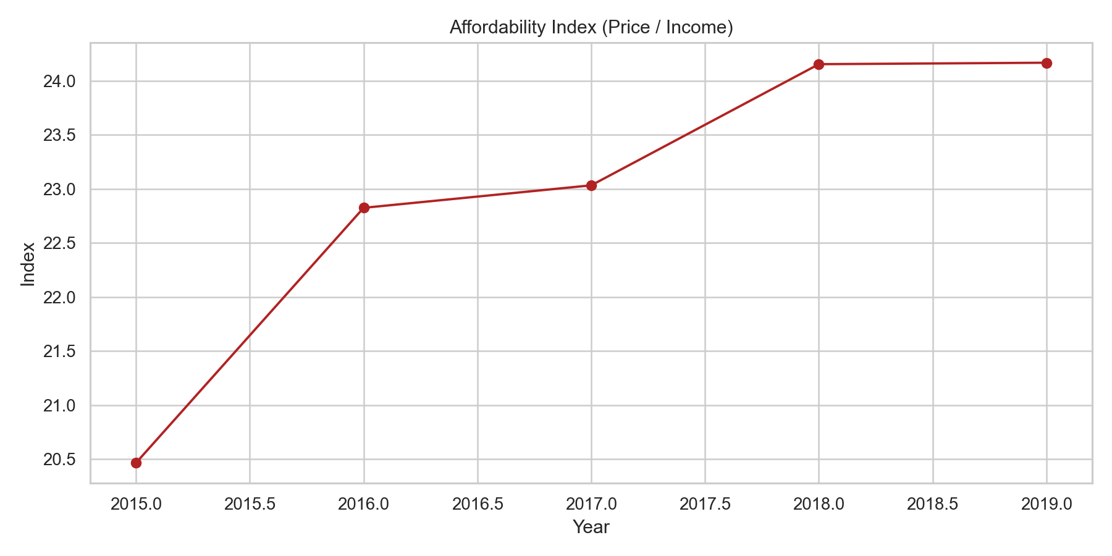
Trend Results: Price, Income, and Affordability

Slide 8
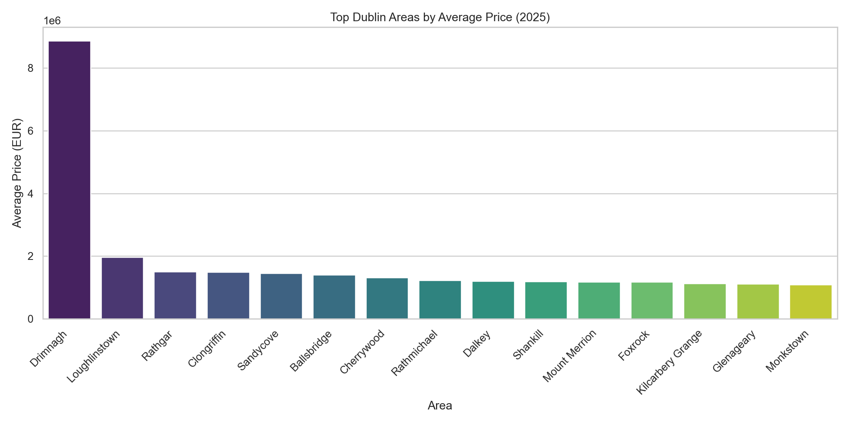
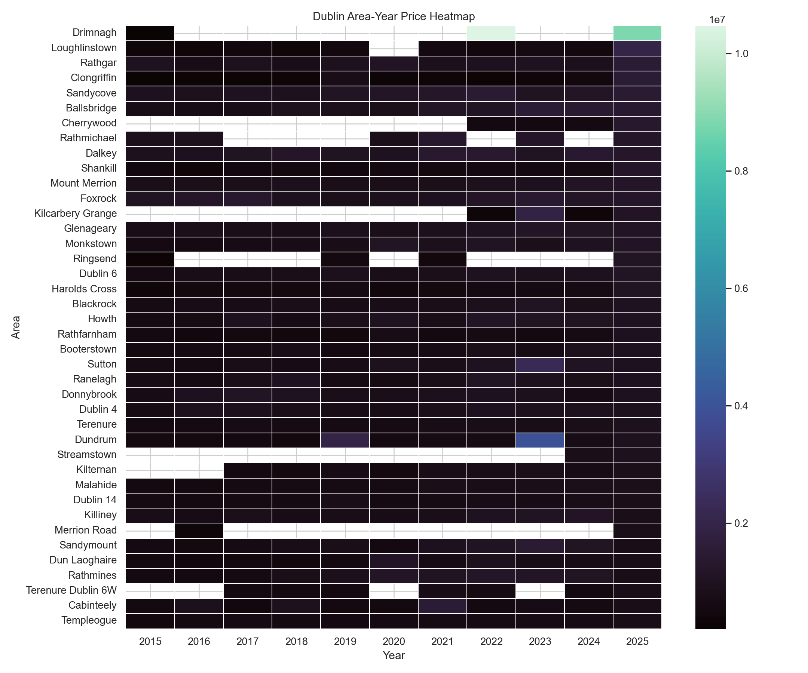
Spatial Results: Area Ranking and Heatmap

Slide 9
Evaluation, Limitations, and Learning Outcomes
Objectives Achieved
Limitations
Learning Outcomes
Full ETL pipeline
Dual DB architecture (MongoDB + PostgreSQL)
Dashboard delivery
Actionable insights
Income overlap coverage
Coarse area proxies
No inflation or mortgage adjustments
LO1 to LO5 covered
Through implementation
And critical evaluation

Slide 10
Conclusion and Future Work
Conclusion
Future Work
Dublin housing became less affordable over available overlap years, with clear area-level inequality.
Inflation-adjusted index
Geospatial enrichment
Predictive forecasting

Slide 11
Thank you — Questions and Discussion

