Slide 1

Covid-19
Presented By: Sara Khan Chandio
Data Mining Final Project

Slide 2
the Data Mining Process
1st Phase
.
2nd Phase
Explore
3rd Phase
Determine DM Task & Choose
4th Phase
Apply Methods & Select Final Model
Final Phase
Evaluate Performance & Deploy
& Clean
Data
DM Methods
.
Define
Purpose &
Obtain
Data

Slide 3
Define Purpose & Obtain Data
Research Question
What are the demographics of covid-19 patients need to get Vaccinated first?
Objectives
To classify covid-19 Patients into Dead/ Not Survived and Survived
Profiling not Survived class of Covid-19 Patients based on their demographics
To ranking records of Covid-19 patients with highest propensity of not surviving.
Identify records with significant demographic determinants.
Original data downloaded from CDC website of 3 million plus observation and 11 variables

Slide 4
Outcome variable | Original data | % | New data
Yes | 158,255 | 6 | 1,200
No | 2,662,955 | 94 | 18,800
Total | 2,821,210 | 100 | 20,000
Explore & Clean Data
variable | Description | Details
onset_dt | On set date to report symptoms Predictor- Factor -2 categories | 1= symptoms 0=no symptoms
current_status | Case status Predictor- Factor -2 categories | 1= lab confirmed 0=probable
hosp_yn | Been hospitalized Predictor- Factor -2 categories | 1= not hospitalized 0= hospitalized
death_yn | Died or not outcome- Factor -2 categories | 1= died 0= survived
Ethnicity | Predictor- Factor -2 categories | 1= Non-Hispanic 0= Hispanic
Gender | Gender of Patients Predictor- Factor -2 categories | 1= Female 0= Male
Months | February -October
Race Race 2 | Predictor- Factor -4 categories Predictor- Factor -2 categories | Black, White, others & ref=Asians 1= Others 0= White/Asians/Black
Age Age 1 | Predictor- Factor -5 categories Predictor- Factor -2 categories | 19 & below Ref 20-39, 40-59, 60- 79, 80 + 1= 60 years & above 0= 60 years & below
Summary statistics
Plotted bar charts
Created tables of each predictor in relation to out come variable
Missing Values
Duplication.
Deleted two variables
Reduced categories / levels
Created two separate columns Ethnicity and Race
Exhaustive Search

Slide 5
Determine DM Task & Choose DM Methods
Logistic Regression
K- Nearest Neighbors
Partitioned Data on random
Training [60%, 12000 Obs., 17v]
Validation [40%, 8000 Obs., 17v]
Apply Methods & Select Final Model
Model | variables | Significance | Accuracy | Balanced Accuracy
Logit Model 1 | All variables | age groups and few race levels insignificant | 0.948 | 0.78008
Logit Model 2 | All but age in 2 categories | Few insignificant race categories | 0.9469 | 0.7990
Step wise Logit | Age 2, Race 2 rest same | All significant coefficients of predictors | 0.947 | 0.82128

Slide 6
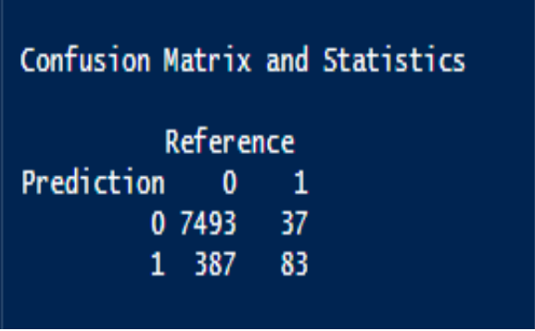
P(Not Survived)= 1/1+e^-(-2.272 -1.323(onset_dt)-0.397(Gender)-1.207(current_status)-2.453(hosp_yn) 0.732(Ethnicity)-0.759 (Race2)+ 2.772 (AGE1)
K-NN
K-NN
Odds

Slide 7
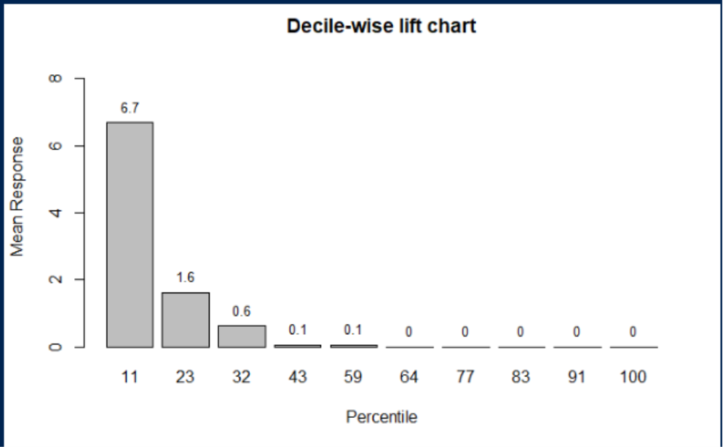
Predictive Performance

Slide 8
Predictive Performance
Logistic Model
cutoff | Balance Accuracy | Sensitivity | Specifity
0.1 | 0.6749 | 0.3642 | 0.9857
0.2 | 0.7072 | 0.4364 | 0.9779
0.3 | 0.7366 | 0.4991 | 0.9741
0.4 | 0.7442 | 0.5175 | 0.9709
0.5 | 0.7636 | 0.5644 | 0.9627
0.6 | 0.8069 | 0.6619 | 0.9519
0.7 | 0.8213 | 0.6917 | 0.9509
0.8 | 0.6707 | 0.4000 | 0.9415
0.9 | 0.9707 | 1.0000 | 0.9414
K-NN Model
k | Balance Accuracy | Sensitivity | Specificity
1 | 0.911 | 0.831 | 0.991
2 | 0.900 | 0.812 | 0.989
3 | 0.911 | 0.833 | 0.989
4 | 0.892 | 0.796 | 0.989
5 | 0.896 | 0.802 | 0.989
6 | 0.891 | 0.794 | 0.987
7 | 0.897 | 0.807 | 0.988
8 | 0.891 | 0.795 | 0.987
9 | 0.890 | 0.793 | 0.986

Slide 9
Deploy
Conclusion
Recommendations
Characteristics of Patients at High Risk
Age : 60 Years and Above
Gender :Male
Ethnicity: Hispanic
Race: Black/ White / Asian
Not hospitalized
No Symptom
Probable case
Patients with these characteristics need to get vaccine first.

Slide 10

Thank you

