Slide 1
INVESTMENT ASSIGNMENT SUBMISSION
Name: Chandirakumar Muthu

Slide 2
Abstract:
This is the assignment to find the best way to invest on the stock market, based on the historical data.
The client wants to invest 5million to 15 million USD and interested to invest in English speaking country.
The data is provided by country wise and funding types to analyse. Company table has more of company information.
Mapping table has more of investment sector information. Rounds 2 is a table has information about invested stock information like Invested amount.
After cleaning up of metadata, joining these table to get the desired answers for the questions.
And finally client wants to see the top 3 English speaking countries which does the investment amount highest.

Slide 3
Problem solving methodology>
Data Understanding
Loading Data
Reading and understand to clean
Data Cleaning
Check null values and remove
Correct the datatype according to the column
Data Analysis
Check the categorical and quantitative variables
Categorize the types of investment type and segmented univariate analysis to get broader picture
Remove unwanted columns
Check number of rows and columns and datatypes
Use flow chart

Slide 4
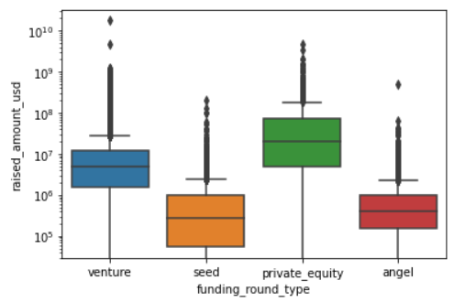
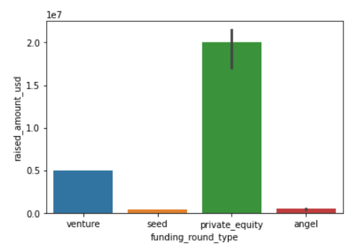
<Analysis>
The below stats is for all the countries grouped by 4 major funding types. (pic1: median, pic2: median)

Slide 5
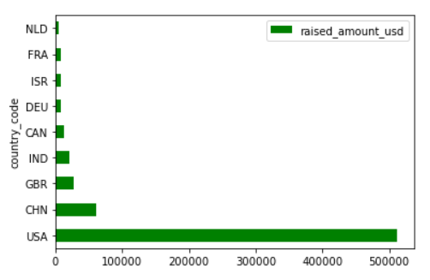
<Analysis>
Top 9 countries who invested more on the stocks [including non-English speaking countries]
Top 3 English Speaking countries:
1. USA
2. GBR
3. IND

Slide 6
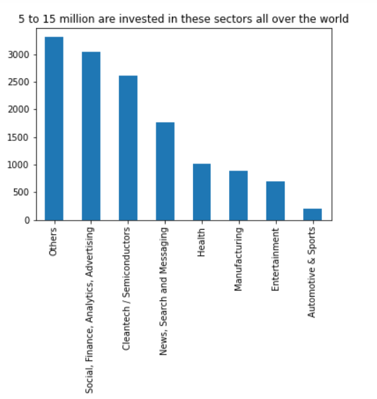
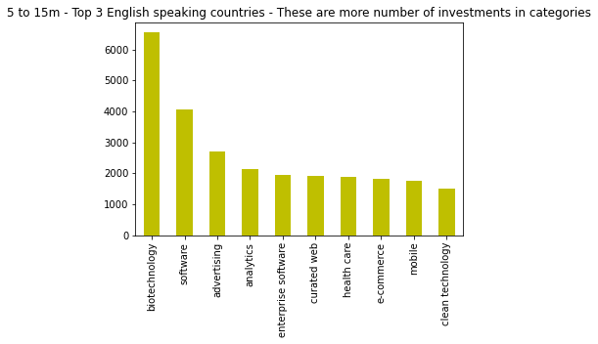
<Analysis>
Highest invested amount sectors
Highest number of rounds invested categories

Slide 7
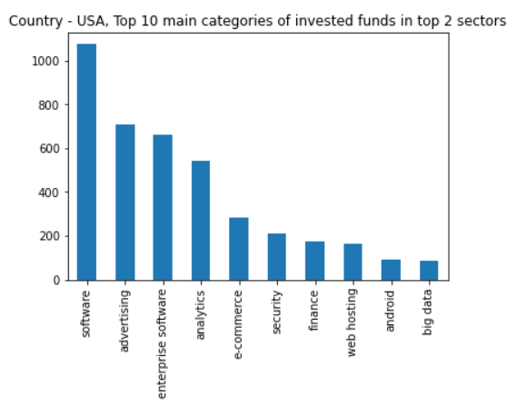
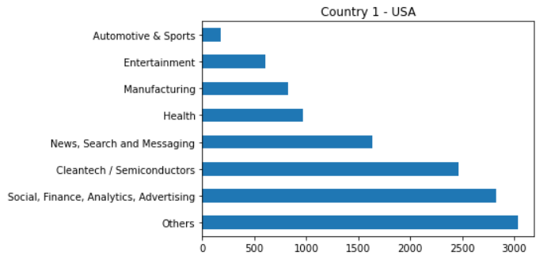
<Results>
Category wise stats of high invested stocks. Category is categorize under sector.
Sector wise stats of high invested stocks
Plot 1
Software and E-commerce takes advantage of gaining more than other categories in GBR.

Slide 8
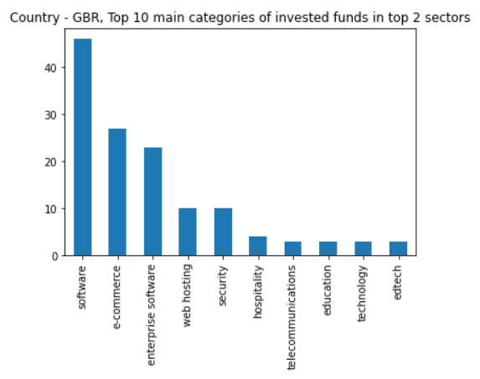
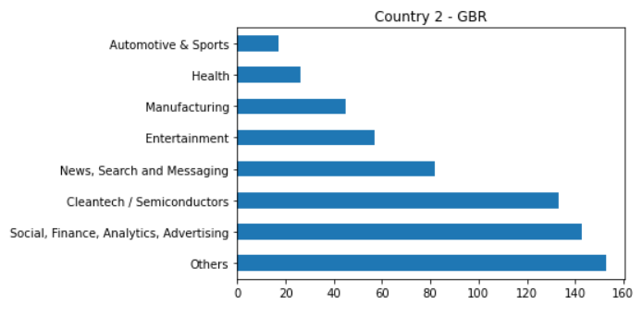
<Results>
Category wise stats of high invested stocks. Category is categorize under sector.
Sector wise stats of high invested stocks
Plot 2
Software and E-commerce takes advantage of gaining more than other categories in GBR.

Slide 9
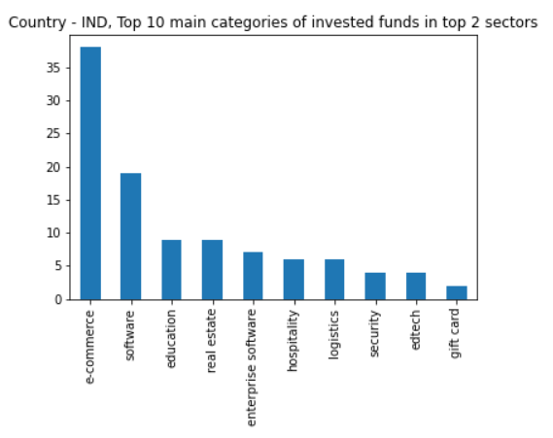
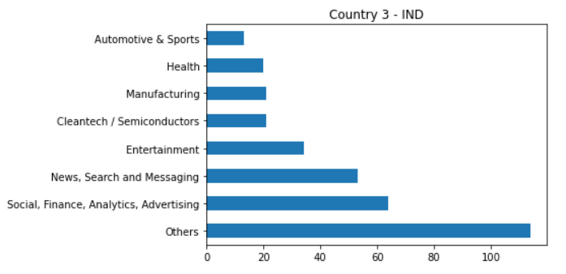
<Results>
Category wise stats of high invested stocks. Category is categorize under sector.
Sector wise stats of high invested stocks
Plot 3
E-commerce and software is performing best in India

Slide 10
<Conclusions>
Analysis Result :
Based on the data analysis performed, Sparks Funds should invest in -
Funding type - Venture.
Countries : USA, Britain & India.
Top two sectors to invest in are - Others and Social, Finance, Analytics, Advertising.

