Slide 1

#LifeKoKaroLift
Post-Graduate Diploma in ML/AI

Slide 2



Course : Machine Learning
Lecture On : Telecom Churn Case Study
Instructor : Karamjit Singh

Slide 3
Agenda
Problem Statement Overview
What is churn?
EDA
Solution Sub-components

Slide 4

Customer Churn
On average it’s cheaper and easier to retain existing customers than to acquire new ones. An increasing number of top executives are refocusing their efforts on toward customer retention. Let’s break down Telecom customer churn.
In the telecom industry, customers are able to choose from multiple service providers and actively switch from one operator to another. In this highly competitive market, the telecommunications industry experiences an average of 15-25% annual churn rate.
To reduce customer churn, telecom companies need to predict which customers are at high risk of churn.
In this project, you will analyze customer-level data of a leading telecom firm, build predictive models to identify customers at high risk of churn and identify the main indicators of churn.
There are two main models of payment in the telecom industry -
Postpaid model, when customers want to switch to another operator, they usually inform the existing operator to terminate the services, and you directly know that this is an instance of churn.
Prepaid Model, customers who want to switch to another network can simply stop using the services without any notice, and it is hard to know whether someone has actually churned or is simply not using the services temporarily

Slide 5
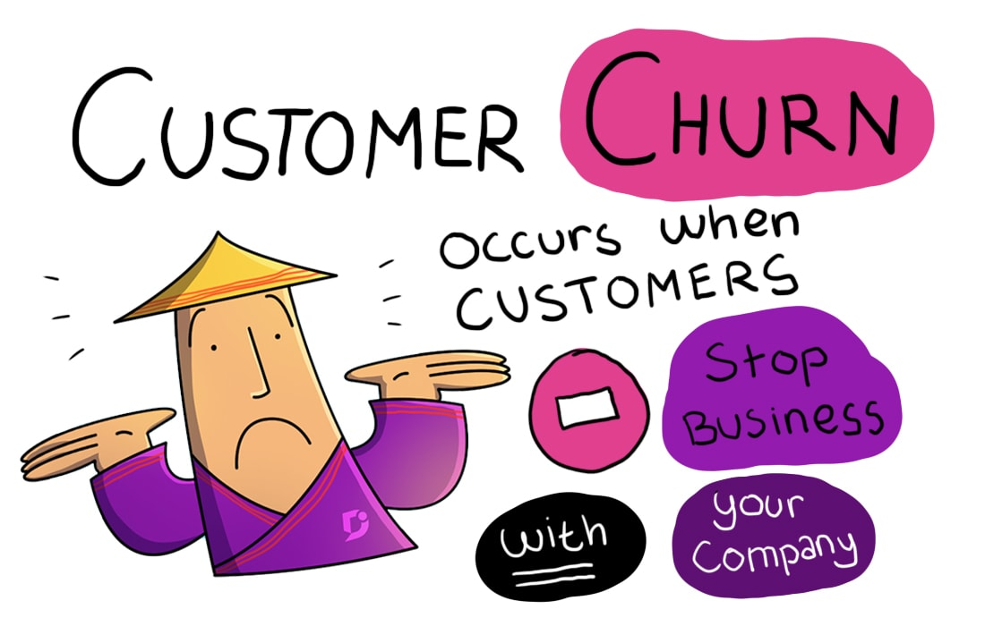
Customer Churn
There are various ways to define churn,
Revenue-based churn: Customers who have not utilized any revenue-generating facilities such as mobile internet, outgoing calls, SMS etc. over a given period of time.
Usage-based churn: Customers who have not done any usage, either incoming or outgoing - in terms of calls, internet etc. over a period of time.
In this project, you will use the usage-based definition to define churn.
Derive Churn
9th Month is our Churn Phase. Usage-based churn
Calculate total incoming and outgoing minutes of usage
Calculate 2g and 3g data consumption
Create churn variable: those who have not used either calls or internet in the month of September are customers who have churned
Check Churn percentage.
Delete columns that belong to the churn month

Slide 6
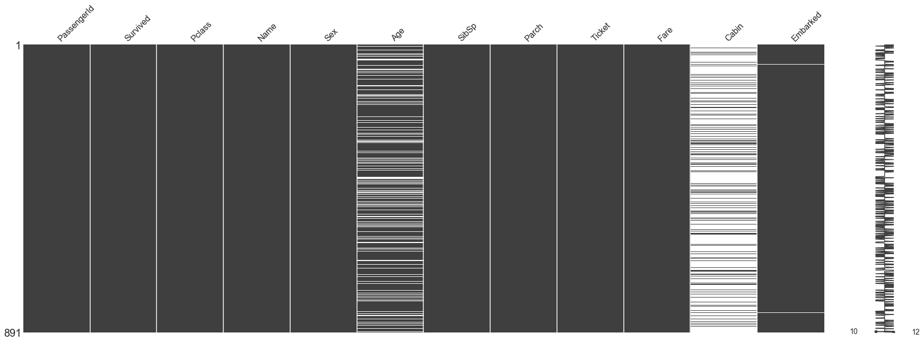
Missing Value Treatment
Data Extraction: It is possible that there are problems with extraction process. In such cases, we should double-check for correct data with data guardians. Some hashing procedures can also be used to make sure data extraction is correct. Errors at data extraction stage are typically easy to find and can be corrected easily as well.
Data collection: These errors occur at time of data collection and are harder to correct. They can be categorized in four types:
!pip install missingno
import missingno as msno
# Visualize missing values as a matrix
msno.matrix(df)

Slide 7

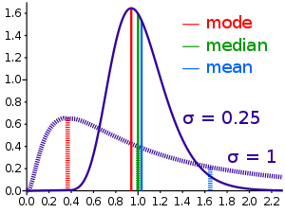
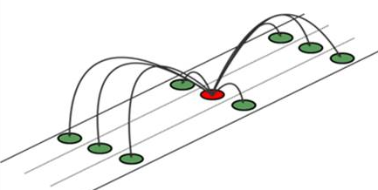
Methods to treat missing values
Data – deletion Deletion methods are used when the nature of missing data is “Missing completely at random” or we have good amount of data and the data loss would be really low ,else non-random missing values can bias the model output
Mean/ Mode/ Median Imputation Mean / Mode / Median imputation is one of the most frequently used methods. It consists of replacing the missing data for a given attribute by the mean or median (quantitative attribute) or mode (qualitative attribute) of all known values of that variable.
Prediction Model we create a predictive model to estimate values that will substitute the missing data. In this case, we divide our data set into two sets: One set with no missing values for the variable and another one with missing values. First data set become training data set of the model while second data set with missing values is test data set and variable with missing values is treated as target variable.
https://www.kaggle.com/athi94/investigating-imputation-methods

Slide 8

High Value Customers
Filter high-value customers(HVC)
Calculate total data recharge amount
calculate total recharge amount
call recharge amount( total_rech_amt ) + data recharge amount
Calculate average recharge done by customer in June and July
Look at the 70th percentile recharge amount
Retain only those customers who have recharged their mobiles with more than or equal to 70th percentile amount

Slide 9
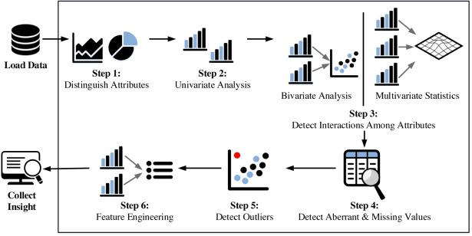
Fundamental steps of EDA process

Slide 10
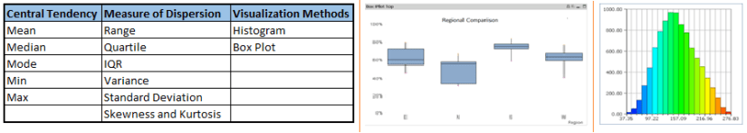
Univariate Analysis
At this stage, we explore variables one by one. Method to perform univariate analysis will depend on whether the variable type is categorical or continuous.

Slide 11
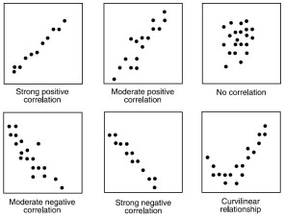
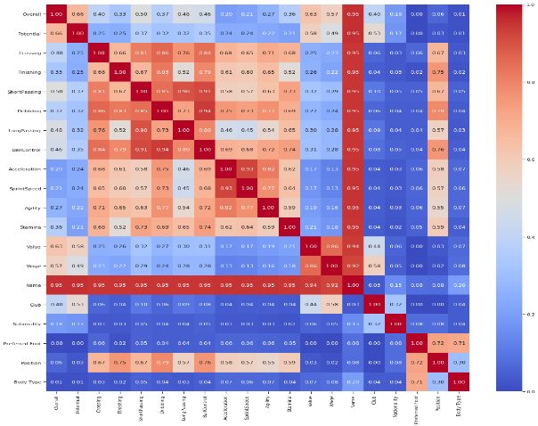
Continuous vs continuous
While doing bi-variate analysis between two continuous variables, we should look at scatter plots. It is a nifty way to find out the relationship between two variables. The pattern of scatter plot indicates the relationship between variables. The relationship can be linear or non-linear.
Scatter Plots
Correlation Heat Maps

Slide 12
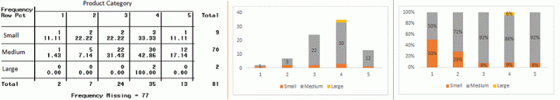
Categorical & Categorical
Two-way table: We can start analyzing the relationship by creating a two-way table of count and count%. The rows represents the category of one variable and the columns represent the categories of the other variable. We show count or count% of observations available in each combination of row and column categories.
Stacked Column Chart: This method is more of a visual form of Two-way table.

Slide 13
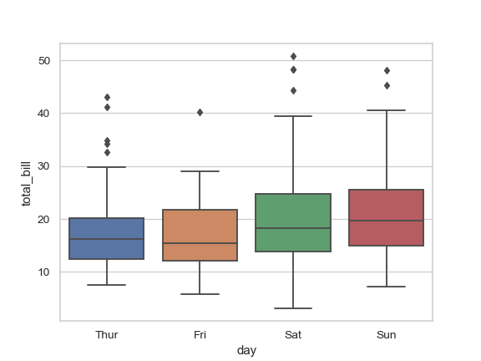
Categorical & continuous
While exploring relation between categorical and continuous variables, we can draw box plots for each level of categorical variables

Slide 14
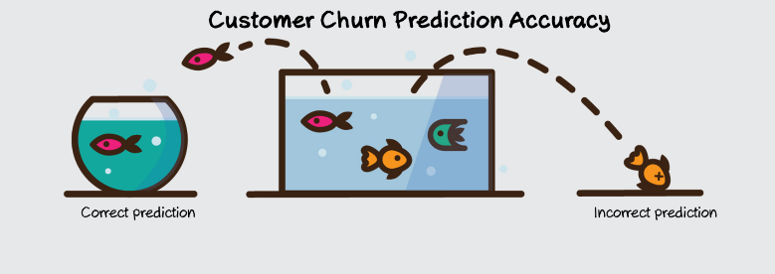
Modelling
Modelling
Need two models, one with good predictions and other with good interpretability.
Use PCA to reduce the variables.
You need to handle the imbalance class.
https://towardsdatascience.com/methods-for-dealing-with-imbalanced-data-5b761be45a18

Slide 15
#LifeKoKaroLift
Thank You!

