Slide 1



SMART INDIA HACKATHON 2026
SOFTWARE SYSTEM TO CHECK COMPLIANCE OF PACKAGED COMMODITIES
  Problem Statement ID – SIH26034
  Problem Statement Title- Software System to check compliance of Packaged Commodities under Legal Metrology(Packaged Commodities) Rules, 2011 by scanning products, images and labels.
  Theme- Miscellaneous
  PS Category- Software
  Team ID -
  Team Name -Complix

Slide 2
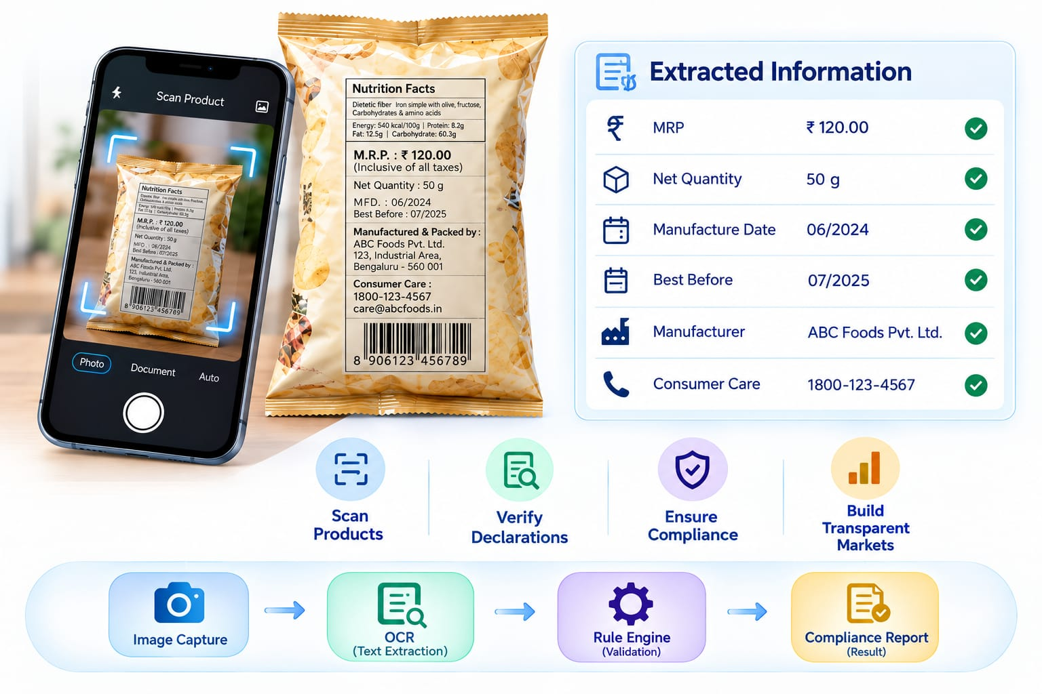
Complix
LEGITO
c
Proposed Solution:
Automated Label Scanning: Uses OCR and a rule engine to extract and validate label details against LMPC Rules, 2011.
Addressing the Problem:
Declaration & Compliance Checks: Automatically verifies mandatory package details and flags non-compliant or missing information.
Innovation:
Evidence & Report Generation: Captures image proof and exports detailed compliance or violation summaries.
Uniqueness:
Cross-Platform Access: Features web and mobile support with a dashboard to track inspection history and trends.
@SIH Idea submission- Template
2
Notes:
2

Slide 3
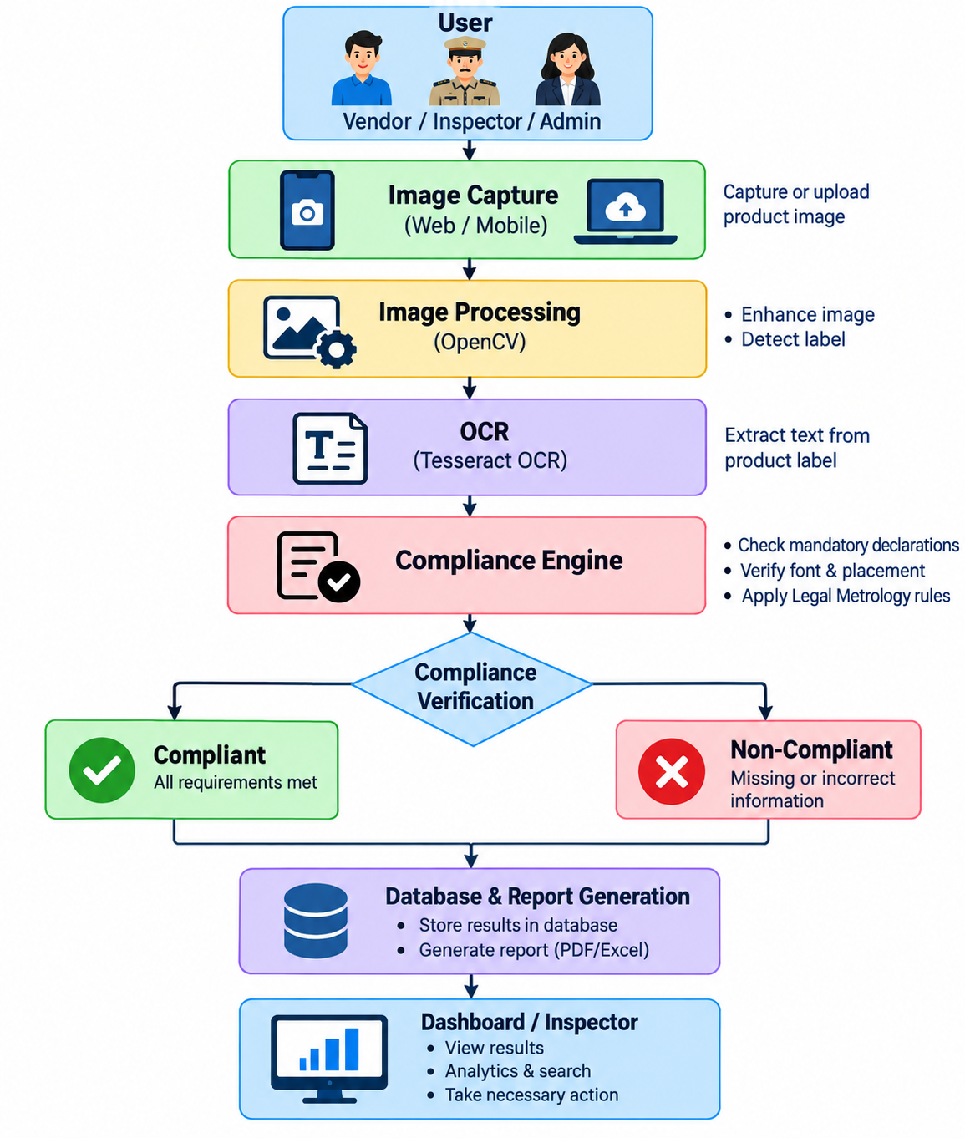
TECHNICAL APPROACH
Complix
  Work Flow:
  The system is a cloud‑native compliance platform designed for accuracy and scalability.
  It combines intuitive web/mobile interfaces with Node.js‑driven backend intelligence.
  Advanced OCR, OpenCV, and NLP modules deliver precise label analysis and validation.
  A secure MongoDB data layer with RBAC and audit logs ensures integrity and accountability.
  Deployed as microservices with CI/CD pipelines, it enables real‑time, reliable compliance enforcement.
@SIH Idea submission- Template
3
Notes:
3

Slide 4
Complix
FEASIBILITY AND VIABILITY
Automated Label Extraction: Uses OCR and Computer Vision to read labels and flag violations.
Simplified 4-Step Inspection: Capture →Extract → Validate → Report reduces manual inspection time.
Low Infrastructure Cost: Runs on existing devices without expensive hardware upgrades.
Centralized Cloud Reporting: Secure database stores evidence and tracks compliance analytics.
Image & Accuracy: Poor image quality and extraction errors lead to incorrect data or compliance issues.
Compliance & Security: Keeping up with evolving regulations and data security is challenging.
System Reliability: Technical glitches and integration issues disrupt overall operations.
Data & Complexity: Large data volumes and diverse product formats add operational complexity
Image Pre-processing: Clean and enhance image clarity to ensure accurate OCR text extractions.
OCR Validation & Rule Engine: Validate extracted text using advanced models and automated legal compliance rules.
Secure Data Storage: Keep processed data encrypted, centralized, and backed up.
Monitoring & Training: Maintain high performance through continuous feedback, user training, and role-based access.
FEASIBILITY
POTENTIAL CHALLENGES
MITIGATION STRATEGIES
@SIH Idea submission- Template
4
Notes:
4

Slide 5
IMPACT AND BENEFITS
Complix
IMPACTS
BENEFITS
Faster Inspections
Speeds up compliance checking.
Better Enforcement
Consumer Safety
Enables quick detection of violations.
Promotes accurate
product information.
Reduced Manual Effort
Simplifies inspection work.
Digital Records
Maintains organized inspection history.
Accurate Reports
Generates clear compliance reports.
Greater Transparency
Easy Label Verification
Simplifies checking of
mandatory declarations.
  Improves accountability in product compliance.
@SIH Idea submission- Template
5
Notes:
5

Slide 6
RESEARCH AND REFERENCES
Complix
Legal Metrology Act, 2009 — Department of Consumer Affairs
https://consumeraffairs.gov.in/pages/legal-metrology-act
Legal Metrology (Packaged Commodities) Rules, 2011 — Government of India
https://consumeraffairs.gov.in/public/upload/admin/cmsfiles/whatsnews/Book_on_Legal_Metrology_Packaged_Commodities_Rules%2C2011_with_all_amendments_whatsnews.pdf
Legal Metrology Overview — Department of Consumer Affairs
https://consumeraffairs.gov.in/pages/legal-metrology-overview
An Overview of the Tesseract OCR Engine — R. Smith, ICDAR 2007
https://dblp.org/rec/conf/icdar/Smith07.html
@SIH Idea submission- Template
6
Notes:
6

