Slide 1


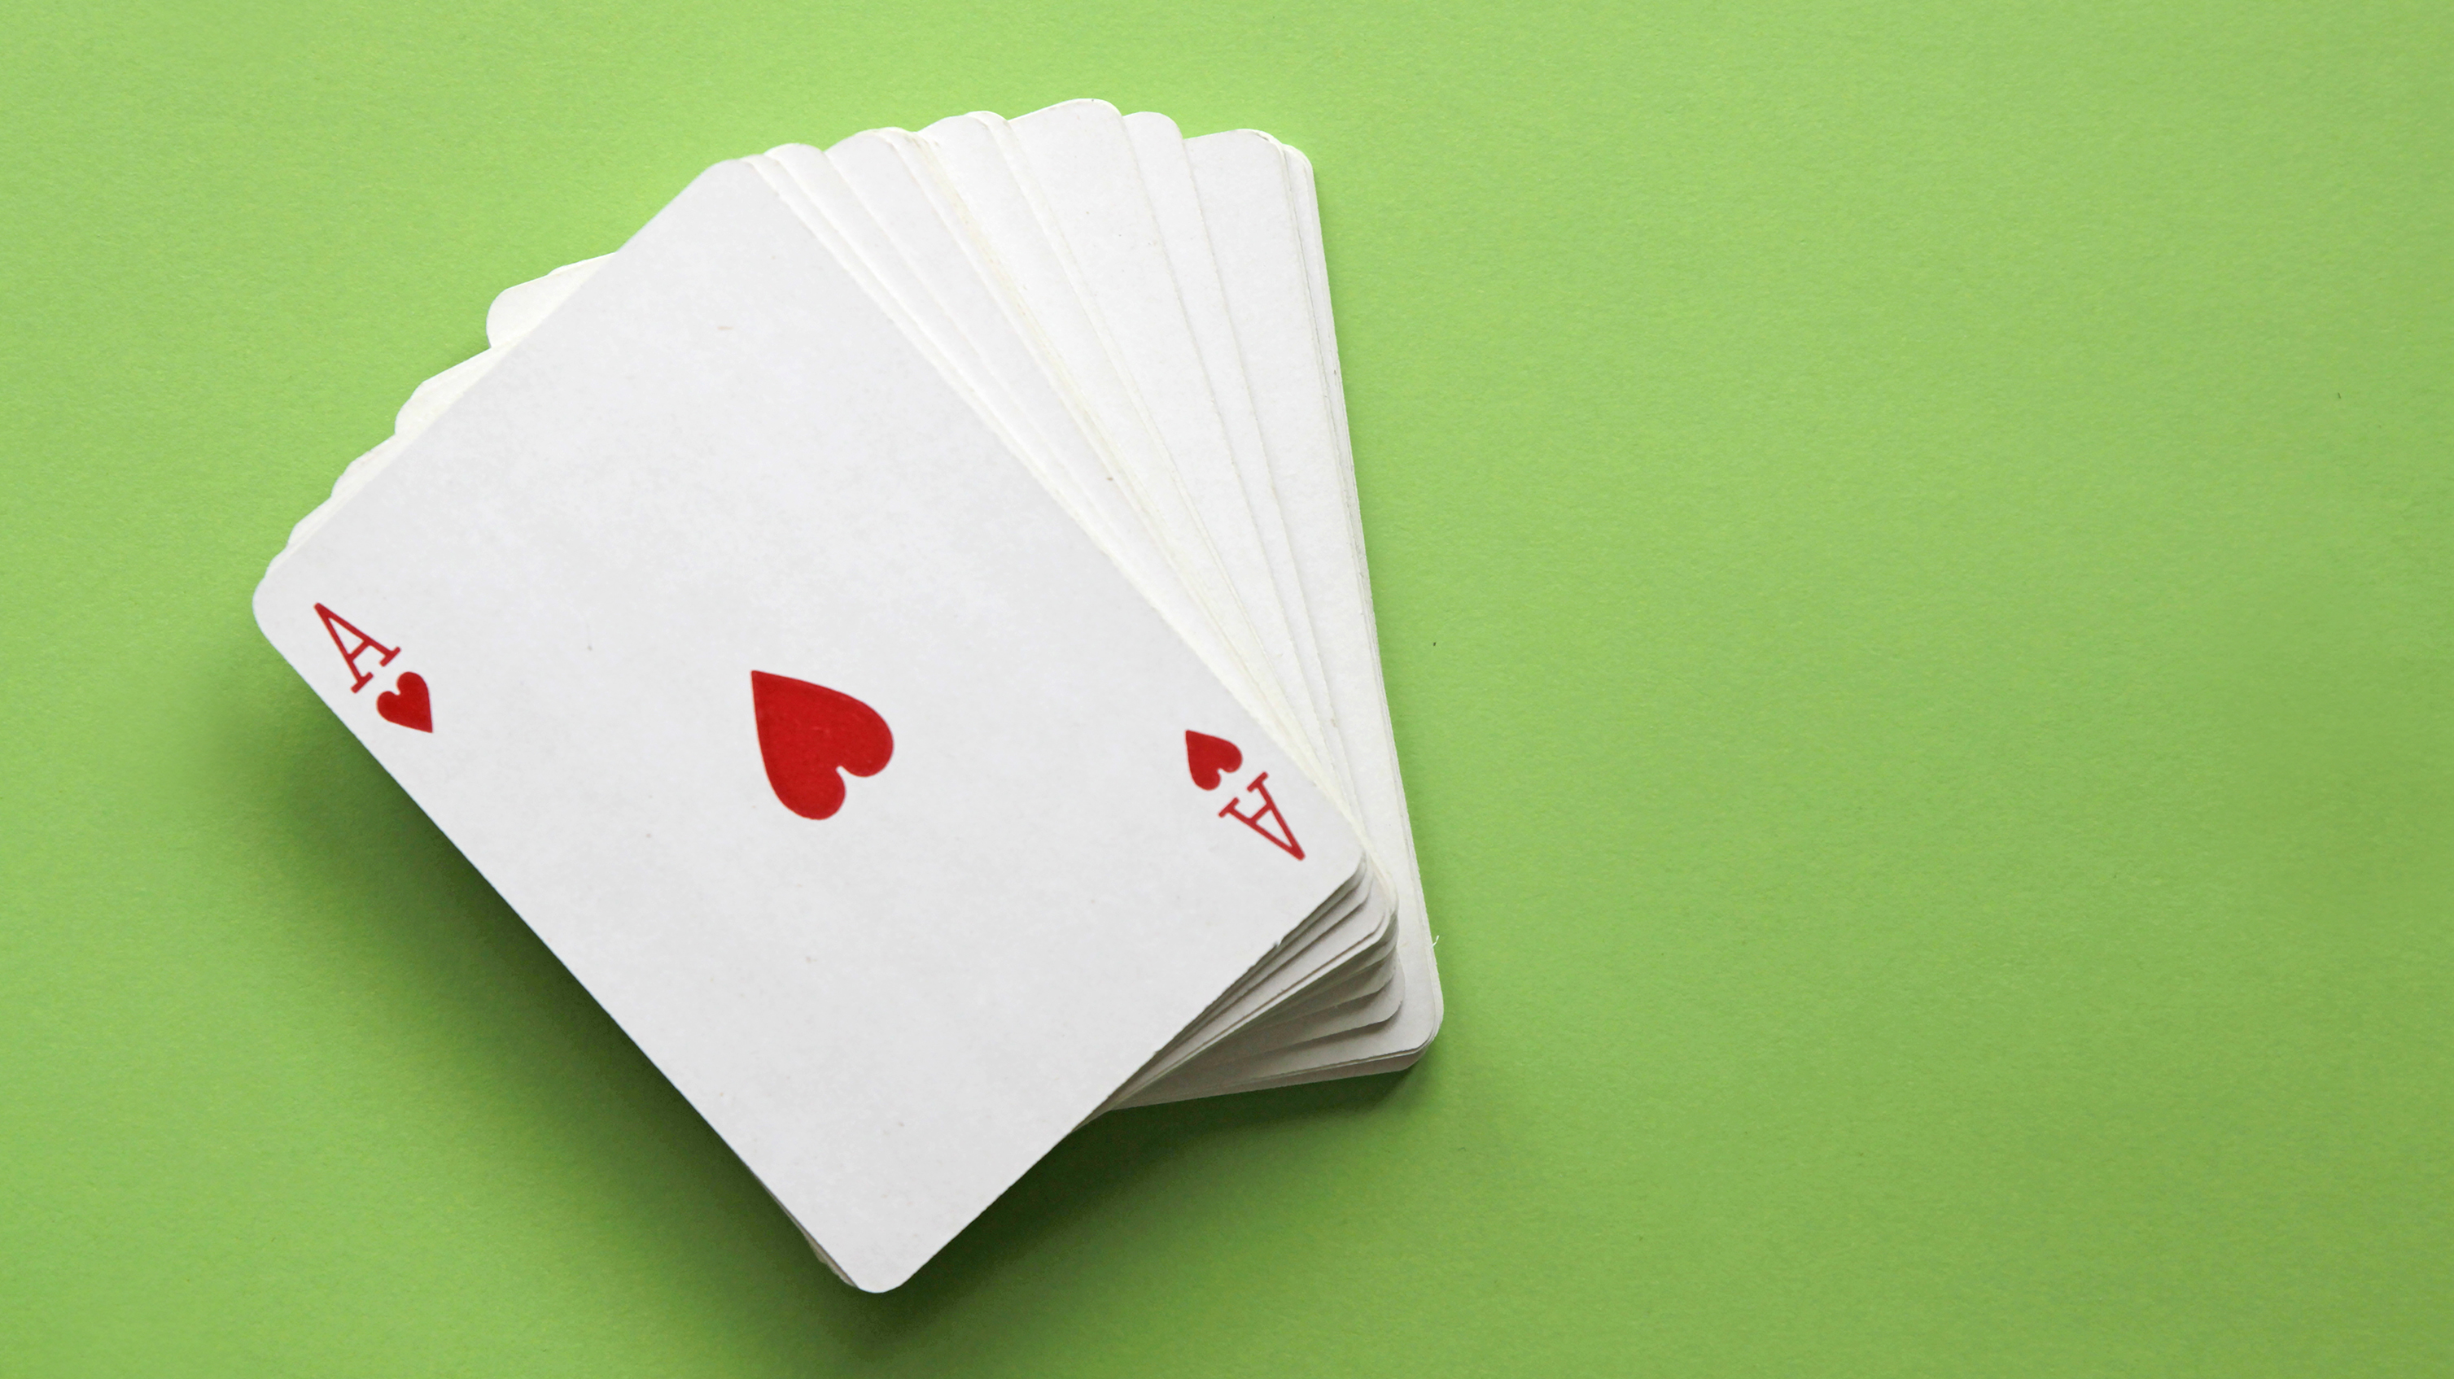
Gambler’s Anonymous
[Csc-470] Texas holdem project

Slide 2
Team Members
Chris Archer
Dakota List
Brian Callies
Chandler Ekholm

Slide 3
Project Overview
For our Software Development project, our group created a Texas Holdem program over the course of the semester
The game takes the form of a web-application that can be played with two or more players and follows the same logic of the real-life Texas Holdem poker game.

Slide 4
Project Requirements
Gameplay logic: Implement Texas Holdem gameplay logic for player hands.
Player Gameplay Actions: Implement player actions for checking, calling, raising, and folding.
Betting: Implement gameplay betting rules for pot and blind limits as well as raise limits.
Blinds: Implement big blind and small blind rotation.
Community Card Dealer Functionality: Implement dealer mechanics for dealing flop, river, and turn community cards
Game Card/Chip View: Implement the ability to view owned cards, community cards, and pot amount.

Slide 5
High- and low-Level Design
Hardware: For the server-side hardware, we will be using Microsoft Azure App service, with a database on Azure Databases for MySQL. This server will be built using C# and ASP.NET Core. For the client-side hardware, the application will be running on any user devices that are able to run React Native applications.
Architecture: The architectures involved with building this program are a combination of Client/Server Architecture and Component-Based Architecture. The client/server architecture aspect is due to the separation between the client-side frontend of React Native and the server-side backend of C# and ASP.NET Core. The Component-Based architecture aspect is due to the program being a collection of loosely based components providing services to each other, like game logic, database communication, user authentication, etc.

Slide 6
High- and low-Level Design
Security: Security measures for the web-app include secure login procedures for third-party authentication, ensuring that sensitive user data is protected. Logging of sensitive operations is limited to respect user privacy, critical actions within the app are audited to ensure accountability and to enhance security. An IP-based firewall rule is in place to secure access to the web application, only permitting traffic from trusted sources.
Data Storage: Data will be handled using the XYUL database system, a relational database known for its robustness and scalability. A high-level conceptual model of the database design is included, highlighting the tables and their primary relationships.

Slide 7
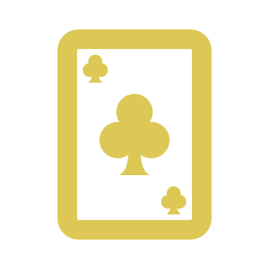
Player logic
Chandler contributed logic for the Player class, including but not limited to:
Tracking if the player has the big blind/small blind
Method to pay the blind with appropriate adjustments to chip amounts
Logic in the methods for
Checking
Calling
Raising
Folding

Slide 8
Chris’s slide (change title to something else)
Add things you contributed to the project/what your job was

Slide 9
Dakota’s slide (change title to something else)
Add things you contributed to the project/what your job was

Slide 10
Brian’s slide (change title to something else)
Add things you contributed to the project/what your job was
Maybe include a screenshot of the user interface if you want to?

Slide 11
Wrap-up/ lessons learned
Having Chris do this since he’s doing that part in the presentation

