Slide 1

Bank Customer Churn Analysis
Identifying At-Risk Segments & Driving Data-Driven Retention
Chandni Kalchuri
Tools Used:
SQL | Power BI | Excel
Dataset Size:
10,000 Customers

Slide 2

Project Objective & Problem Statement
Business Problem:
High customer churn affecting revenue and retention.
The Challenge: The bank is experiencing significant customer attrition (churn), impacting overall revenue and capital.
The Objective: To analyze a dataset of 10,000 customers to uncover the root causes of customer churn.
The Approach: Leveraging SQL for data profiling and Power BI for interactive visual analytics to identify high-risk segments.
The Goal: Provide actionable, data-driven recommendations to reduce churn and improve customer loyalty.
Objective:
Identify churn drivers and customer risk segments
Approach:
SQL + Power BI analytics

Slide 3
Data Overview
Metric | Value
Customers | 10,000
Tables Used | 6–7
Features | Demographics + Transactions
Tools | SQL, Power BI
Tables Used:
Bank_Churn
CustomerInfo
Geography
ExitCustomer

Slide 4
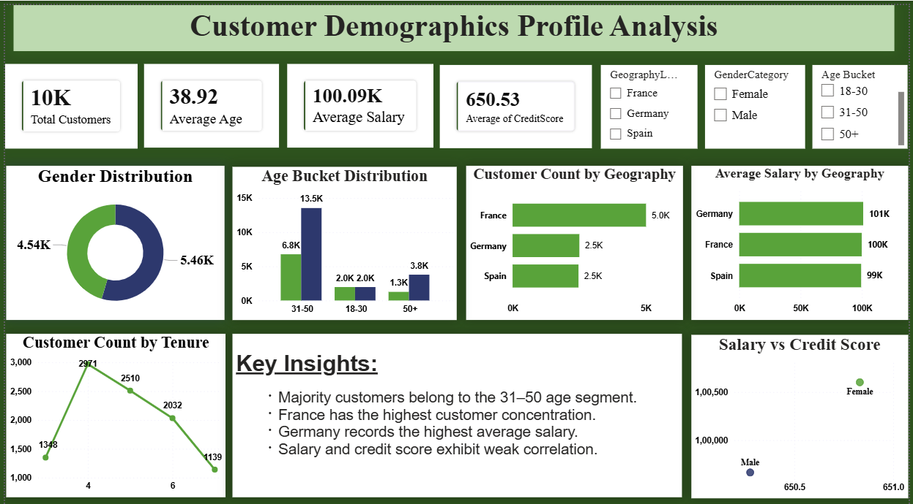
Customer Demographics tab
Key Insights:
Majority customers belong to 31–50 age group
France has highest customer concentration
Germany records highest average salary.

Slide 5
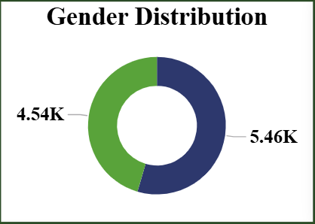
Gender Distribution Analysis
Male customers slightly dominate customer base
Distribution remains relatively balanced

Slide 6
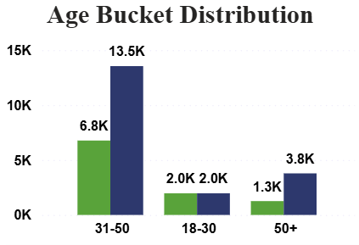
Age Bucket Distribution
31–50 segment dominates
Senior customers form smaller but riskier group

Slide 7
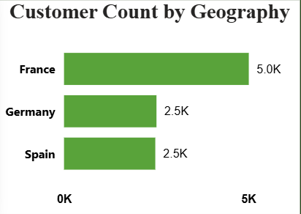
Geography Analysis
France largest customer base
Germany smaller but higher-risk market

Slide 8
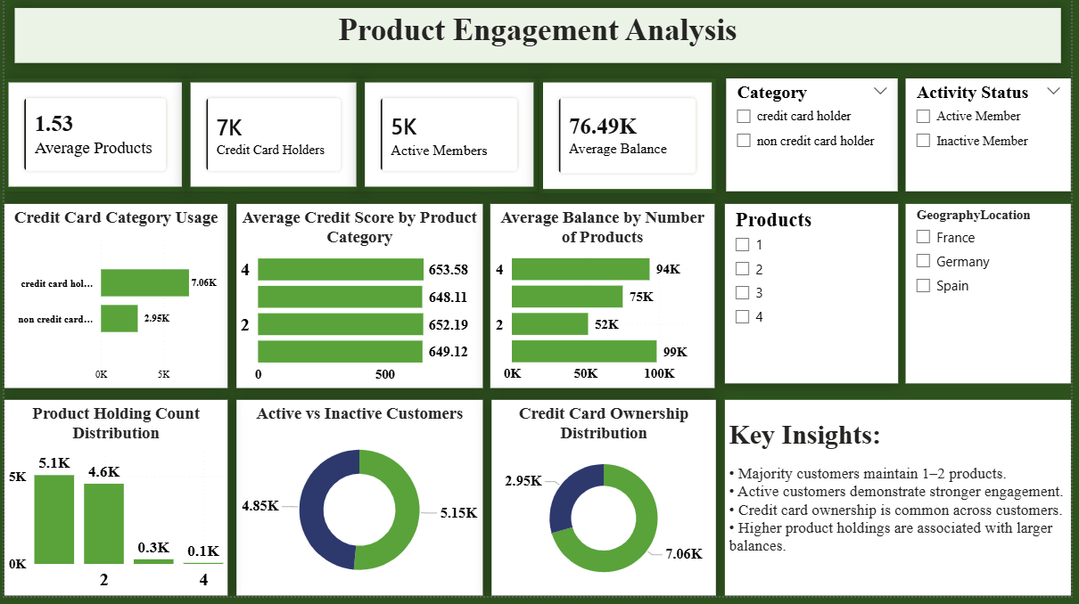
Product Engagement tab

Slide 9
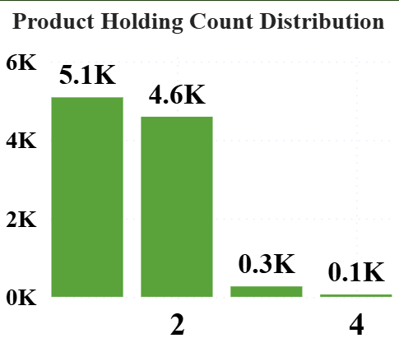
Product Holding Distribution
Most customers own 1–2 products
Higher product ownership linked with engagement

Slide 10
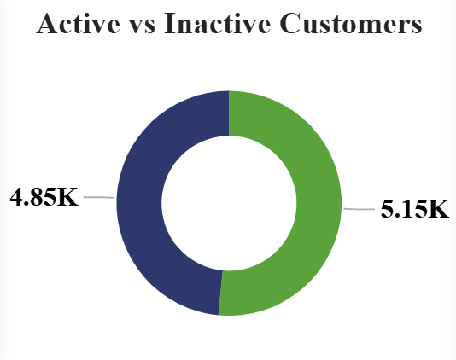
Active vs Inactive Customers
Active members show stronger engagement
Inactive users represent risk group

Slide 11
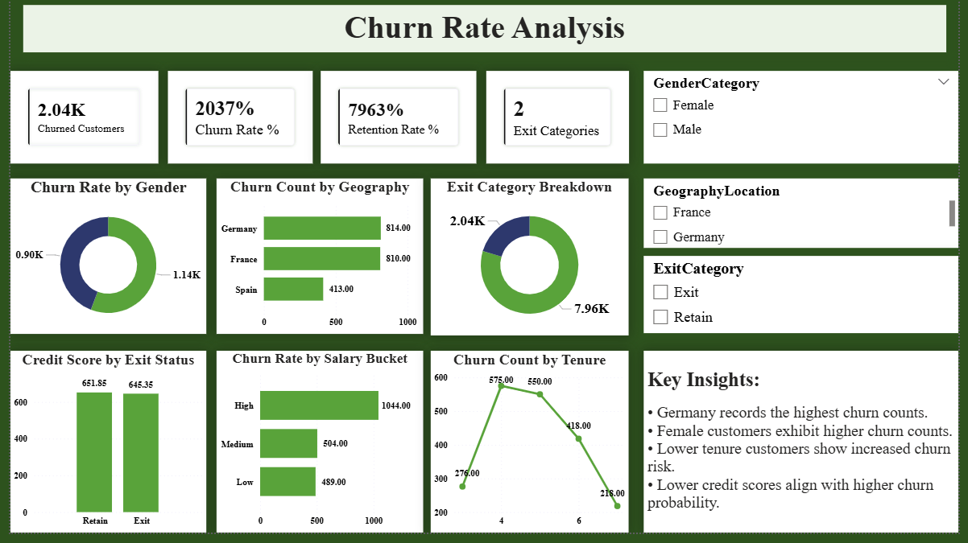
Churn Analysis tab

Slide 12
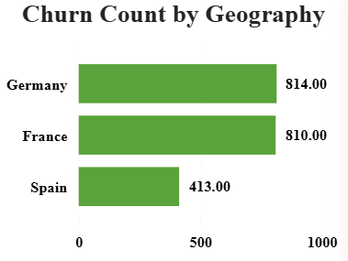
Geographical Churn Analysis
Germany shows highest churn counts
France demonstrates stronger retention

Slide 13
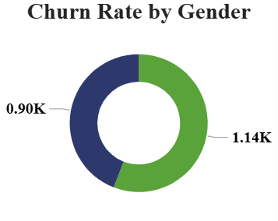
Churn by Gender
Female customers show slightly higher churn counts
Gender differences exist but are moderate

Slide 14
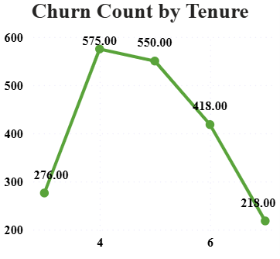
Customer Tenure Analysis
Churn persists across tenure groups
Lower tenure groups show elevated risk

Slide 15
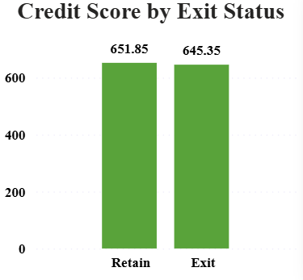
Financial Attribute Analysis
Key Insights:
Credit score difference is relatively small.
Financial attributes alone do not explain churn.
Customer engagement factors are more influential.

Slide 16
Project Conclusion
Overall churn rate is 20.37%.
Germany shows highest churn risk.
Inactive customers are more likely to churn.
Customers aged 50+ require targeted retention strategies.
Product engagement improves customer retention.

Slide 17
Recommendations
Launch targeted retention campaigns for senior customers.
Increase engagement of inactive members through rewards and offers.
Improve loyalty programs and credit card benefits.
Focus retention efforts on high-risk regions such as Germany.
Monitor churn KPIs through Power BI dashboards.

Slide 18
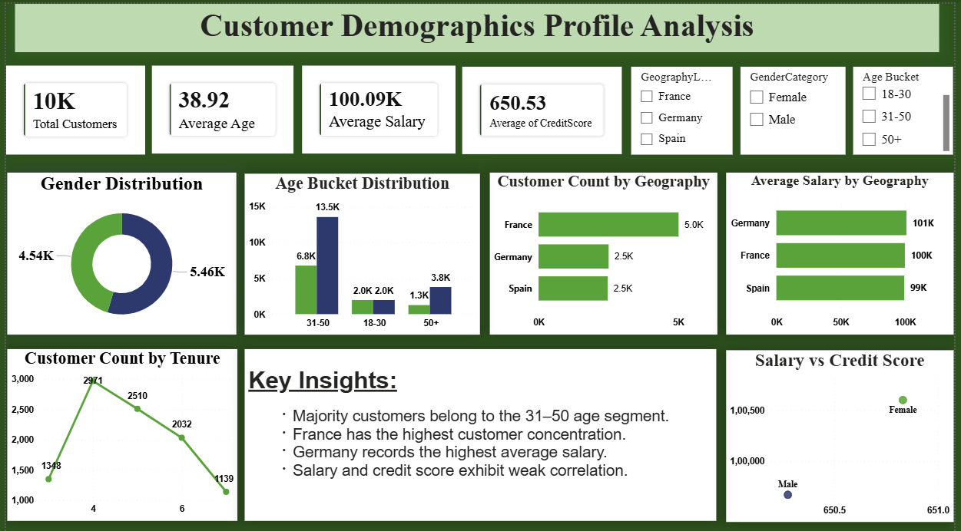
Dashboard Summary
TAB 1:- Customer Demographics

Slide 19
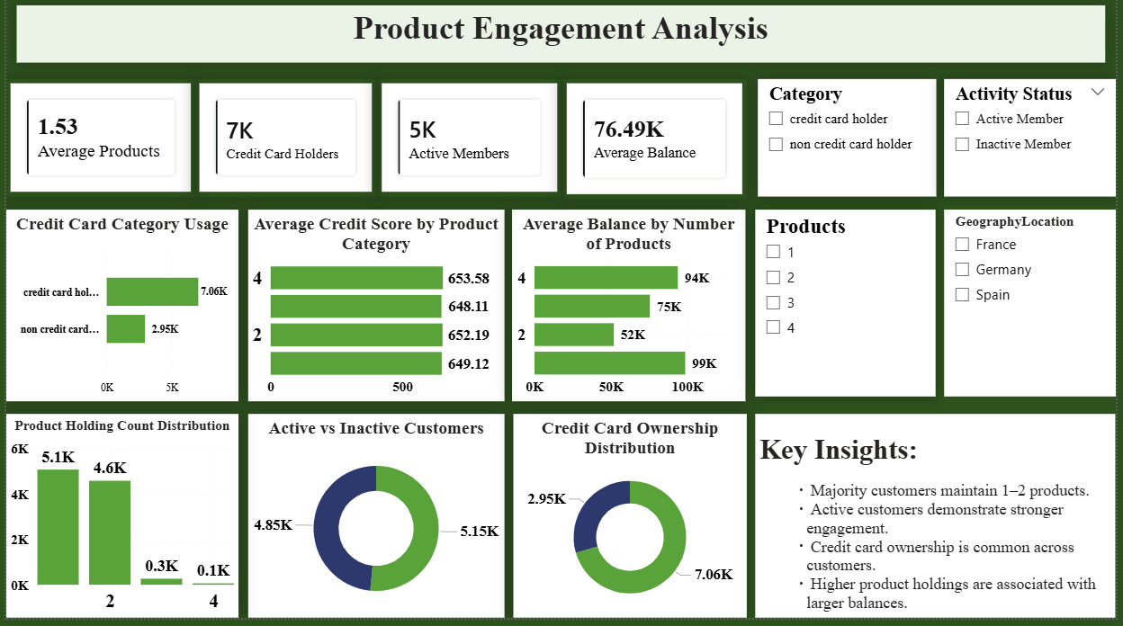
TAB 2:- Product Engagement

Slide 20
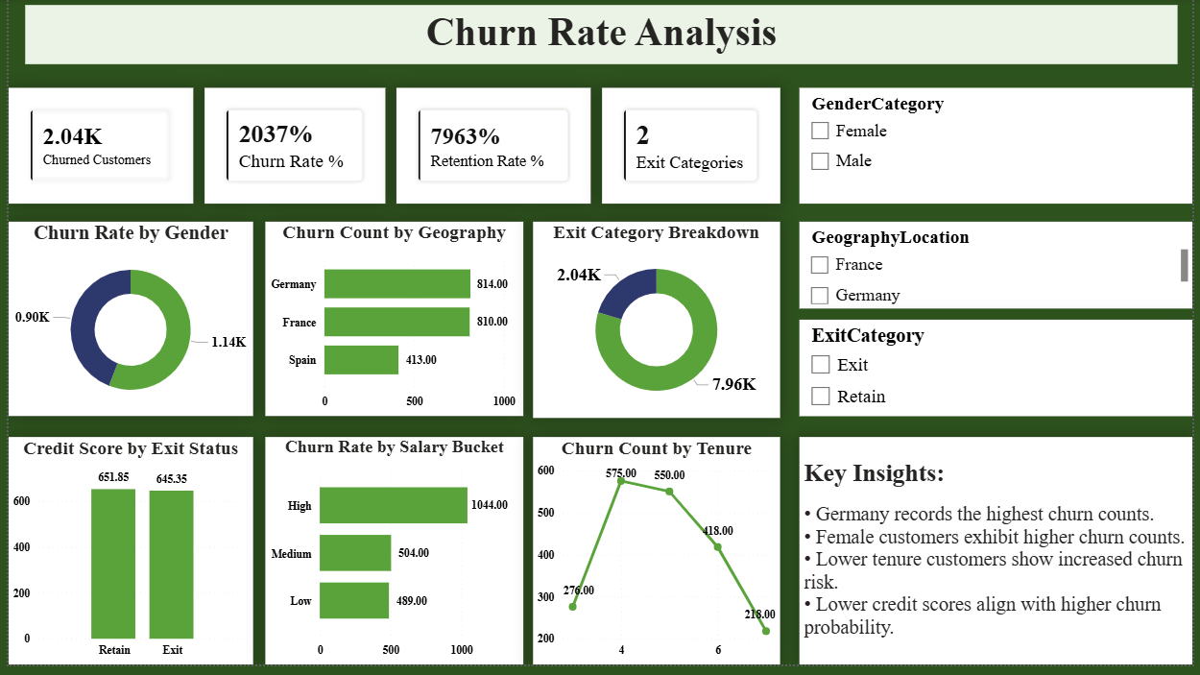
TAB 3:- Churn Analysis

Slide 21
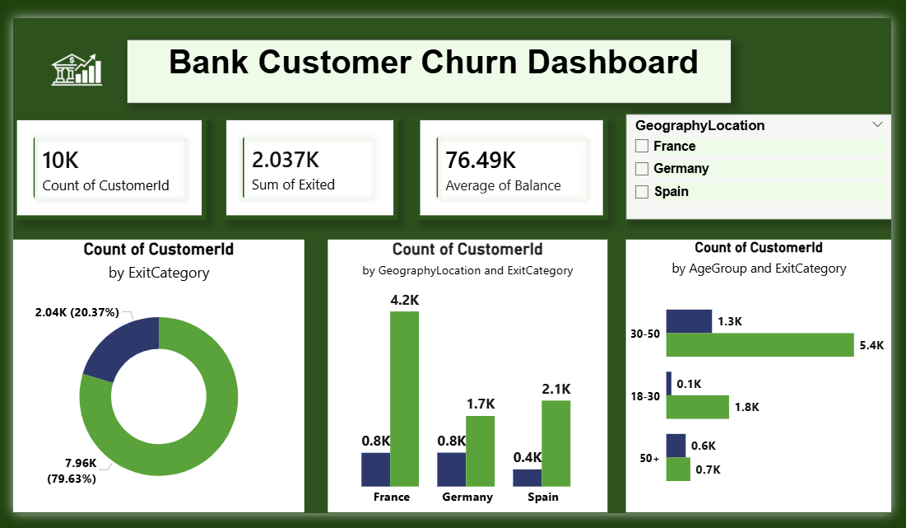
Executive Summary
Customer churn rate stands at 20.37%.
Germany represents the highest churn-risk region.
Customers aged 50+ and inactive members require targeted retention efforts.
Product engagement positively impacts customer retention.
Power BI dashboards provide actionable insights for monitoring churn and customer behavior.

Slide 22


