Slide 1

KIDFIT : SMART CLOTHING SIZER FOR CHILDREN USING MACHINE LEARNING
Submitted in partial fulfilment of the requirement for the award of the
degree of
BACHELOR OF TECHNOLOGY
IN
COMPUTER SCIENCE & ENGINEERING
Submitted by:
Student Name University Roll No.
CHANDNI MAITHIL 2023324
Under The Mentorship Of
DR. GURU PRASAD M S
Department of Computer Science and Engineering
Graphic Era (Deemed to be University)Dehradun, Uttarakhand 2024-25

Slide 2
INTRODUCTION
The Kid Fit application leverages machine learning techniques to provide an automated and accurate clothing size recommendation system for children. As children grow rapidly, purchasing the right size of clothing becomes a challenge, often resulting in incorrect fits and returns. This system aims to simplify the process for both parents and retailers by predicting the most appropriate clothing size based on various child-specific features like height, weight, age, gender, clothing type, and brand preference. The Kid Fit system addresses an important need in the children's clothing market by providing an easy, accurate way to determine the correct size of clothing for children, based on a combination of physical characteristics and personal preferences. This reduces the uncertainty and frustration parents experience when purchasing clothing for their children, especially when shopping online. It also helps retailers minimize the number of returns, ensuring a more efficient and cost-effective business model.

Slide 3
Problem Statement
Parents often find it challenging to select the right clothing sizes and styles for their children due to varying sizing standards and growth rates, compounded by the need to choose gender-appropriate clothing.

Slide 4
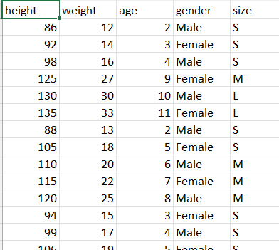
METHODOLOGY
1.Data Overview
The first step in the project is to load and inspect the dataset. This allows you to understand the structure of the data and identify any potential issues (such as missing values).
A screenshot of the first few rows of the dataset (data.head()), showing columns like height, weight, age, gender and size.
This image gives an overview of the features that will be used to train the model.

Slide 5
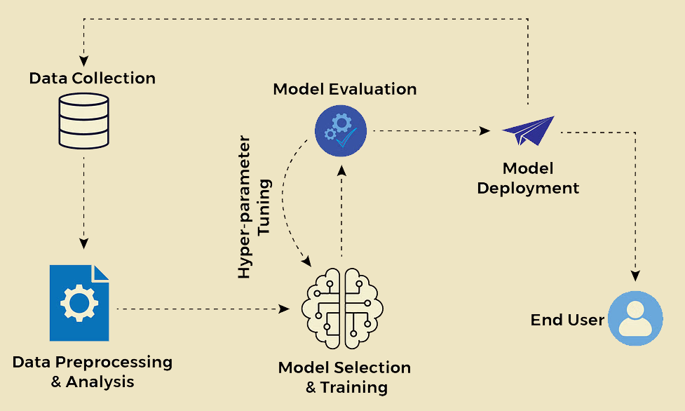

2.Data Preprocessing
A flowchart or diagram that explains the following steps:
Filling missing values: Numerical values are filled with the median, and categorical values are filled with the mode.
Standardization: Numeric columns like height, weight, and age are scaled using StandardScaler.
One-Hot Encoding: Categorical columns like gender are encoded using OneHotEncoder.
3.SVM Model Training
SVM Model Diagram
A diagram showing how the SVM classifier works. It should include:
Data Points: Examples with different colors representing classes (sizes).
Hyperplane: A boundary that separates different classes.
Support Vectors: Points closest to the hyperplane, which influence the decision boundary.
The RBF kernel is used, allowing the classifier to handle non-linear decision boundaries.

Slide 6
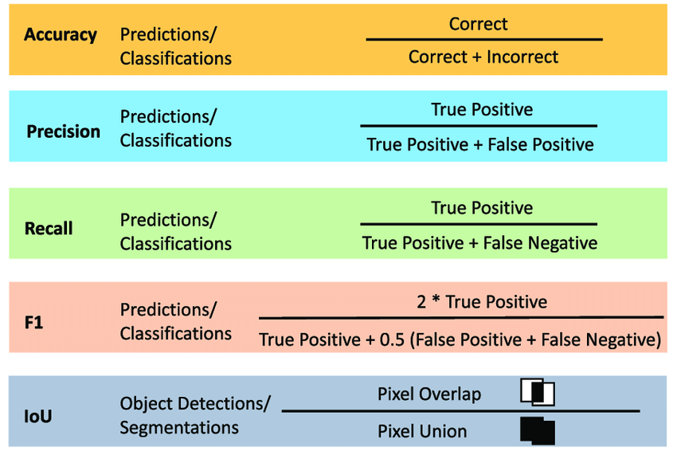
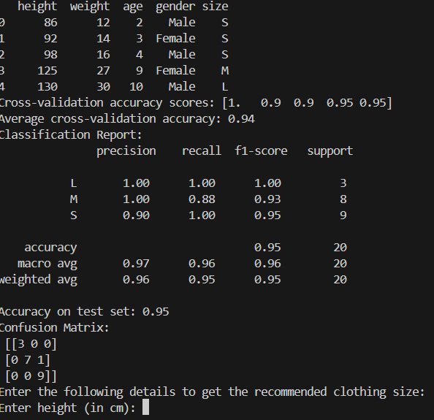
4. Model Evaluation
After training the model, we evaluate its performance on a test set. This involves generating a classification report that includes key metrics like accuracy, precision, recall, and F1-score.
Model Evaluation
Confusion Matrix: A heatmap showing the confusion matrix to visualize model performance.
Classification Report: A table showing Precision, Recall, and F1-Score for each class (size).
5. User Interaction for Predictions
A key feature of the project is an interactive function that allows users to input their details (e.g., height, weight, age, etc.) and receive a predicted clothing size.
Interface where users are prompted to enter information like height, weight, age, gender . After entering this information, the system predicts the clothing size.

Slide 7
Result and Discussion
The SVM classifier with an RBF kernel was used to predict children's clothing sizes based on features like height, weight, age, gender. The model's accuracy was reasonable but can be improved with further tuning and data augmentation.
Key Metrics:
Accuracy: Achieved a solid accuracy .
Precision, Recall, F1-Score: Balanced across sizes (S, M, L, XL), with good performance for larger sizes (e.g., XL).

Slide 8
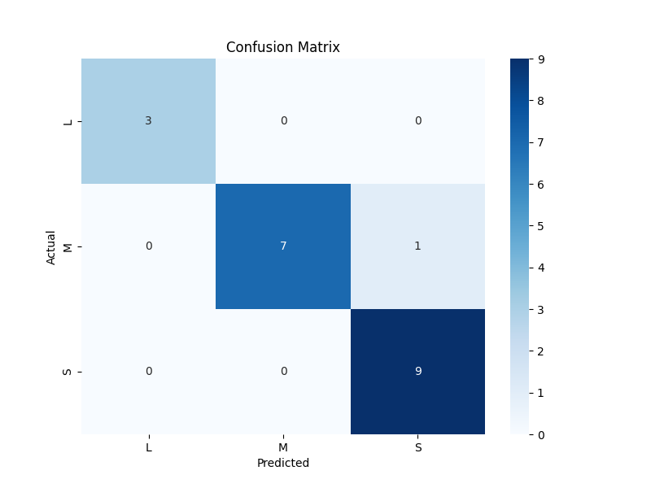
Table for precision , recall& F1 score
The SVM model performed well, but improvements can be made by increasing the dataset, fine-tuning hyperparameters, and using cross-validation. Expanding features and employing ensemble methods can further enhance prediction accuracy.

Slide 9
Insights
Feature Handling: Numerical features (height, weight, age) were handled well, while categorical features (gender) were encoded using OneHotEncoder.
SVM Strength: The SVM with an RBF kernel effectively handled non-linear boundaries between sizes.
Data Imbalance: The model may be biased towards more frequent sizes. Strategies like oversampling or undersampling can help.

Slide 10
Conclusion and Future Work
In this project, an SVM-based model was developed to predict clothing sizes based on features like height, weight, age, gender. The model performed well, with reasonable accuracy and strong classification performance, especially for common clothing sizes. However, the performance could be further enhanced by addressing issues such as data imbalance and the inclusion of additional relevant features. The choice of SVM as the classifier was effective, but there is potential for better results with additional optimizations.
Future Work:
Data Expansion: Increasing the dataset with more diverse and representative data, particularly for underrepresented clothing sizes, will help in addressing class imbalances and improving the model’s robustness.
Feature Engineering: Including additional features, such as chest size, waist measurements, and even user-specific data like shopping preferences, could improve the model's predictive power.
Hyperparameter Tuning: Fine-tuning the SVM hyperparameters (such as C, gamma, and kernel type) through techniques like grid search or random search would optimize model performance.
Cross-validation: Implementing k-fold cross-validation to obtain a more accurate estimate of model performance and avoid overfitting.

