Slide 1

Introduction to IT and Business Systems
A foundational overview of how information technology powers modern business operations — from core concepts to strategic alignment.
IT FUNDAMENTALS
BUSINESS SYSTEMS
STRATEGY

Slide 2
Course Overview
What We'll Cover
This course walks through four key areas that every IT and business professional should understand.
01
02
Fundamentals of IT
IT in Business Operations
Core concepts, hardware, software, and networks
How technology drives efficiency and decision-making
03
04
Business Systems Overview
IT & Business Strategy
ERP, CRM, and other enterprise platforms
Aligning technology with organizational goals

Slide 3
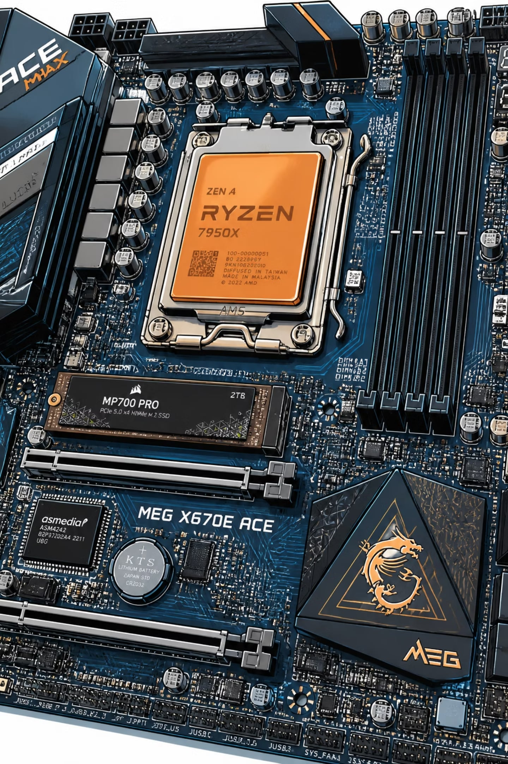
Section A
Fundamentals of Information Technology
Information Technology refers to the use of computers, networks, and software to store, retrieve, transmit, and manipulate data. IT is the backbone of modern communication and business infrastructure.
Hardware
Software
Physical devices — servers, PCs, routers, and storage systems
Applications and operating systems that run on hardware
Networks
LAN, WAN, and the internet connecting systems globally

Slide 4

Section A — Continued
Core IT Concepts Every Professional Should Know
Data & Databases
Structured storage and retrieval of business information
Cloud Computing
On-demand access to computing resources over the internet
Cybersecurity
Protecting systems, networks, and data from digital threats
Automation
Using technology to reduce manual effort and errors

Slide 5

Section B
Role of IT in Business Operations
IT is no longer just a support function — it is a strategic driver of productivity, customer experience, and competitive advantage across every department.

Slide 6
Section B — Continued
How IT Transforms Business Functions
Operations & Efficiency
Communication & Collaboration
Automated workflows and real-time data reduce costs and speed up processes.
Email, video conferencing, and shared platforms connect teams across locations.
Customer Experience
Risk & Compliance
Digital channels, personalization, and support tools improve customer satisfaction.
IT systems enforce data governance, audit trails, and regulatory compliance.

Slide 7
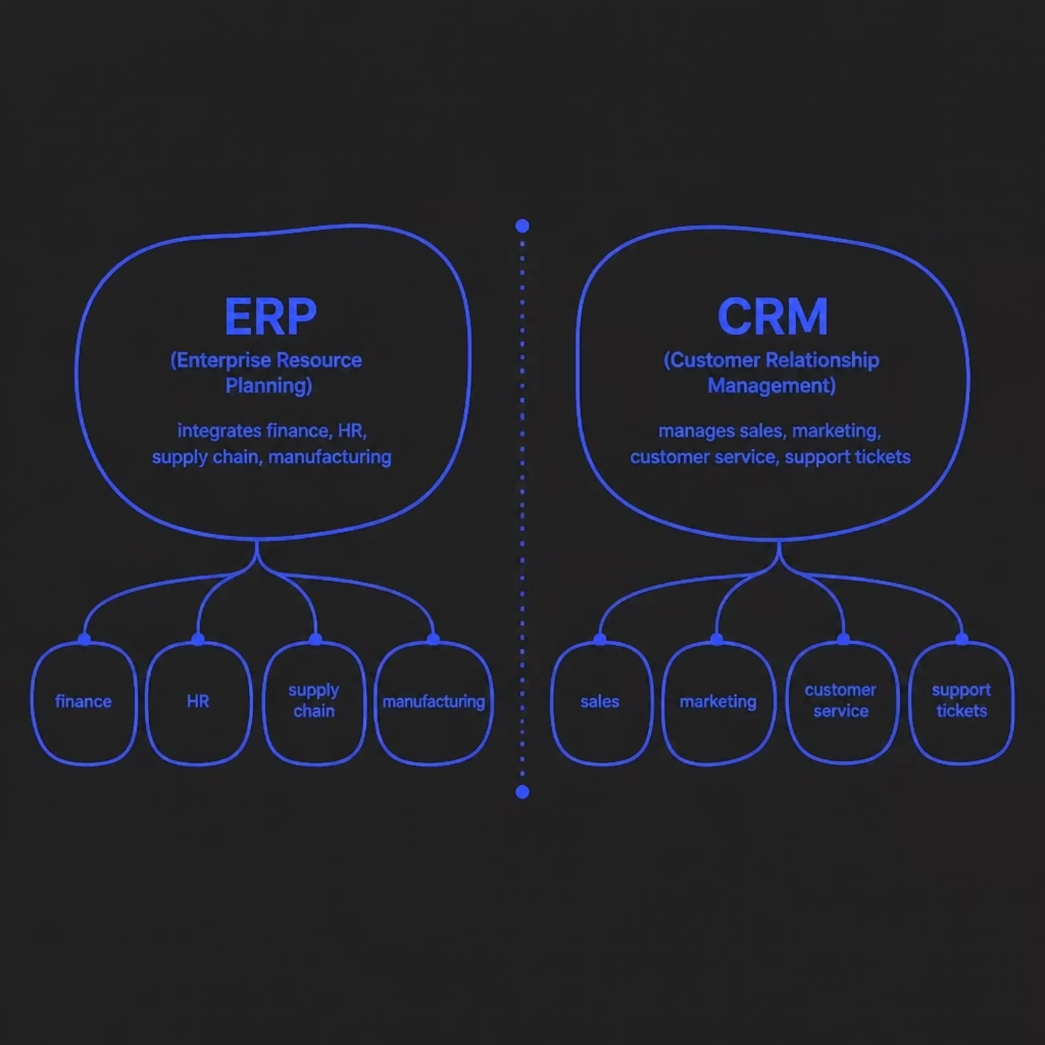
Section C
Overview of Business Systems
Business systems are integrated software platforms that manage core organizational processes. Two of the most critical are ERP and CRM.
ERP — Enterprise Resource Planning
Centralizes internal operations — finance, HR, inventory, and production — into a single unified system.
CRM — Customer Relationship Management
Tracks every customer interaction, automates sales pipelines, and improves retention through data-driven insights.

Slide 8
Section C — Continued
Other Key Business Systems
Accounting & Finance
Supply Chain Management
Tools like QuickBooks and SAP handle invoicing, payroll, and financial reporting.
Manages procurement, logistics, and inventory across the value chain.
HR Management Systems
Business Intelligence
Streamlines recruitment, onboarding, performance reviews, and benefits.
Transforms raw data into actionable insights through dashboards and reports.

Slide 9




Section D
Interplay Between IT and Business Strategy
The most successful organizations treat IT not as a cost center, but as a strategic partner. Technology decisions must align with business goals to drive real value.
Business Goals
Define objectives, market position, and growth targets
IT Strategy
Select technologies that enable and accelerate those goals
Execution
Deploy systems, train teams, and measure outcomes

Slide 10

Key Takeaways
Bringing It All Together
1
2
IT Is Foundational
IT Drives Operations
Hardware, software, networks, and data form the infrastructure of every modern business.
From communication to customer experience, technology improves efficiency at every level.
3
4
Business Systems Connect Everything
Strategy Must Lead Technology
ERP, CRM, and other platforms integrate processes into a cohesive operational whole.
IT investments deliver the most value when aligned with clear business objectives.
Next steps: Explore each module in depth, practice with real-world tools, and consider how these concepts apply to your own organization.

Slide 11

IT of Data: Types, Sources & Lifecycle
A foundational guide to understanding how data is classified, collected, managed, and maintained — the backbone of modern information systems.

Slide 12
CHAPTER 1
Understanding Data Types
Data comes in many forms. Recognizing the structure of data determines how it's stored, processed, and analyzed.
Structured
Unstructured
Semi-Structured
Organized in fixed rows and columns — think spreadsheets and relational databases.
No predefined format — includes images, videos, emails, and social media posts.
Self-describing tags without rigid schema — JSON, XML, and HTML files.

Slide 13
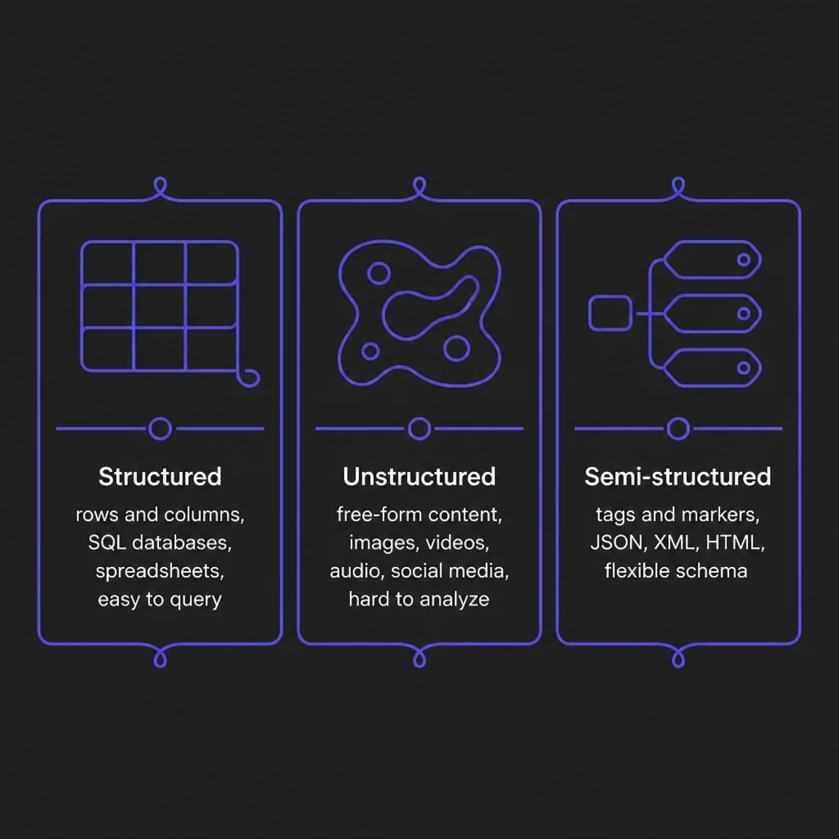
Structured vs. Unstructured vs. Semi-Structured
Why It Matters
The type of data you work with directly shapes your tools and approach.
Structured data is fast to query but rigid in format.
Unstructured data is rich in insight but requires advanced processing like NLP or computer vision.
Semi-structured data offers flexibility, bridging both worlds for modern applications.

Slide 14

CHAPTER 2
Common Data Sources
Organizations gather data from a wide range of origins. Understanding where data comes from is the first step to managing it effectively.

Slide 15
Internal vs. External Data Sources
Internal Sources
External Sources
Generated within the organization's own systems and operations.
Acquired from outside the organization to enrich internal data.
Transactional databases — sales, orders, inventory
HR systems — employee records, payroll
CRM platforms — customer interactions and history
Log files — system and application activity
APIs — real-time data feeds from third-party services
Public datasets — government, research, open data
Social media — sentiment, trends, user behavior
Web scraping — competitor pricing, market data

Slide 16
CHAPTER 3
Data Collection Methods
How data is gathered determines its accuracy, volume, and usability. Modern systems use a mix of automated and manual approaches.
Surveys & Forms
Sensors & IoT
Structured questionnaires that capture direct user input, preferences, and feedback.
Automated devices that continuously record physical data — temperature, location, motion.
Web Analytics
APIs & Integrations
Tracking user behavior on websites and apps through cookies, tags, and event logging.
Programmatic connections that pull data from external platforms in real time.

Slide 17
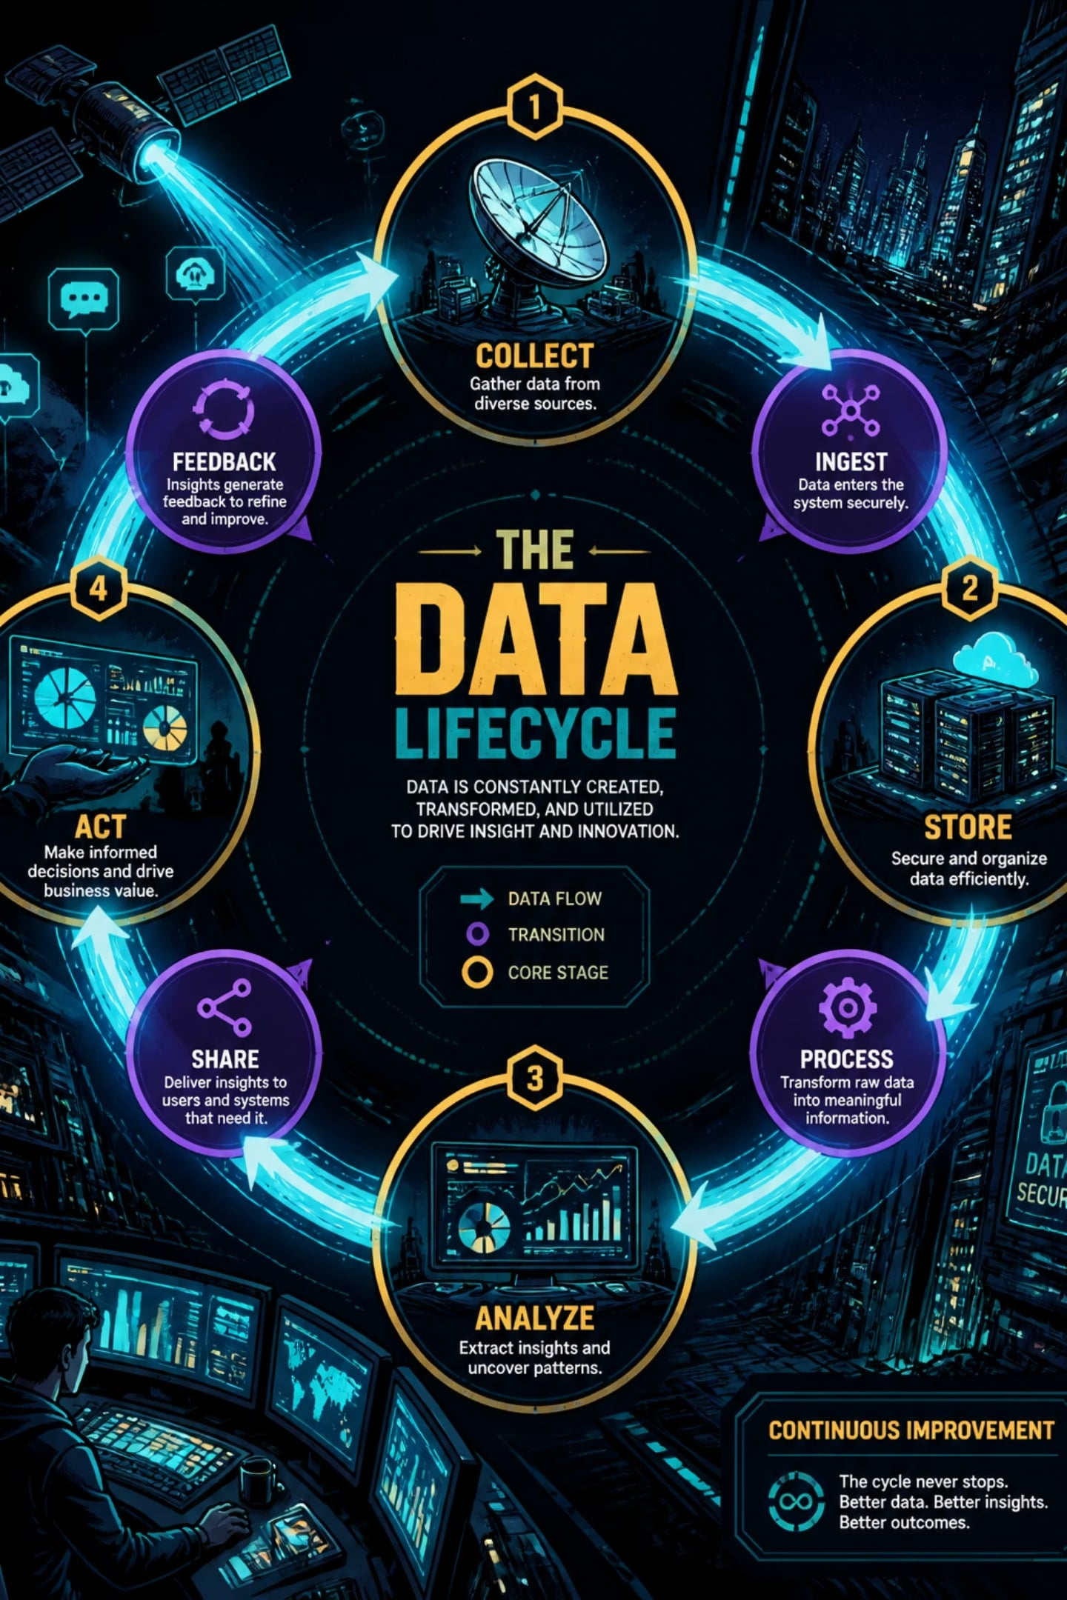
CHAPTER 4
Data Lifecycle Management
Every piece of data follows a journey — from creation to deletion. Managing each stage ensures data remains valuable, secure, and compliant.

Slide 18





The Five Stages of the Data Lifecycle
Storage
Creation
Data is saved in databases, data lakes, or warehouses.
Data is generated or captured at the source.
Usage
Data is processed, analyzed, and applied to decisions.
Deletion
Data is securely erased when no longer needed or required by law.
Archiving
Inactive data is moved to long-term, low-cost storage.
Effective lifecycle management reduces storage costs, ensures regulatory compliance (e.g., GDPR), and keeps active data clean and accessible.

Slide 19
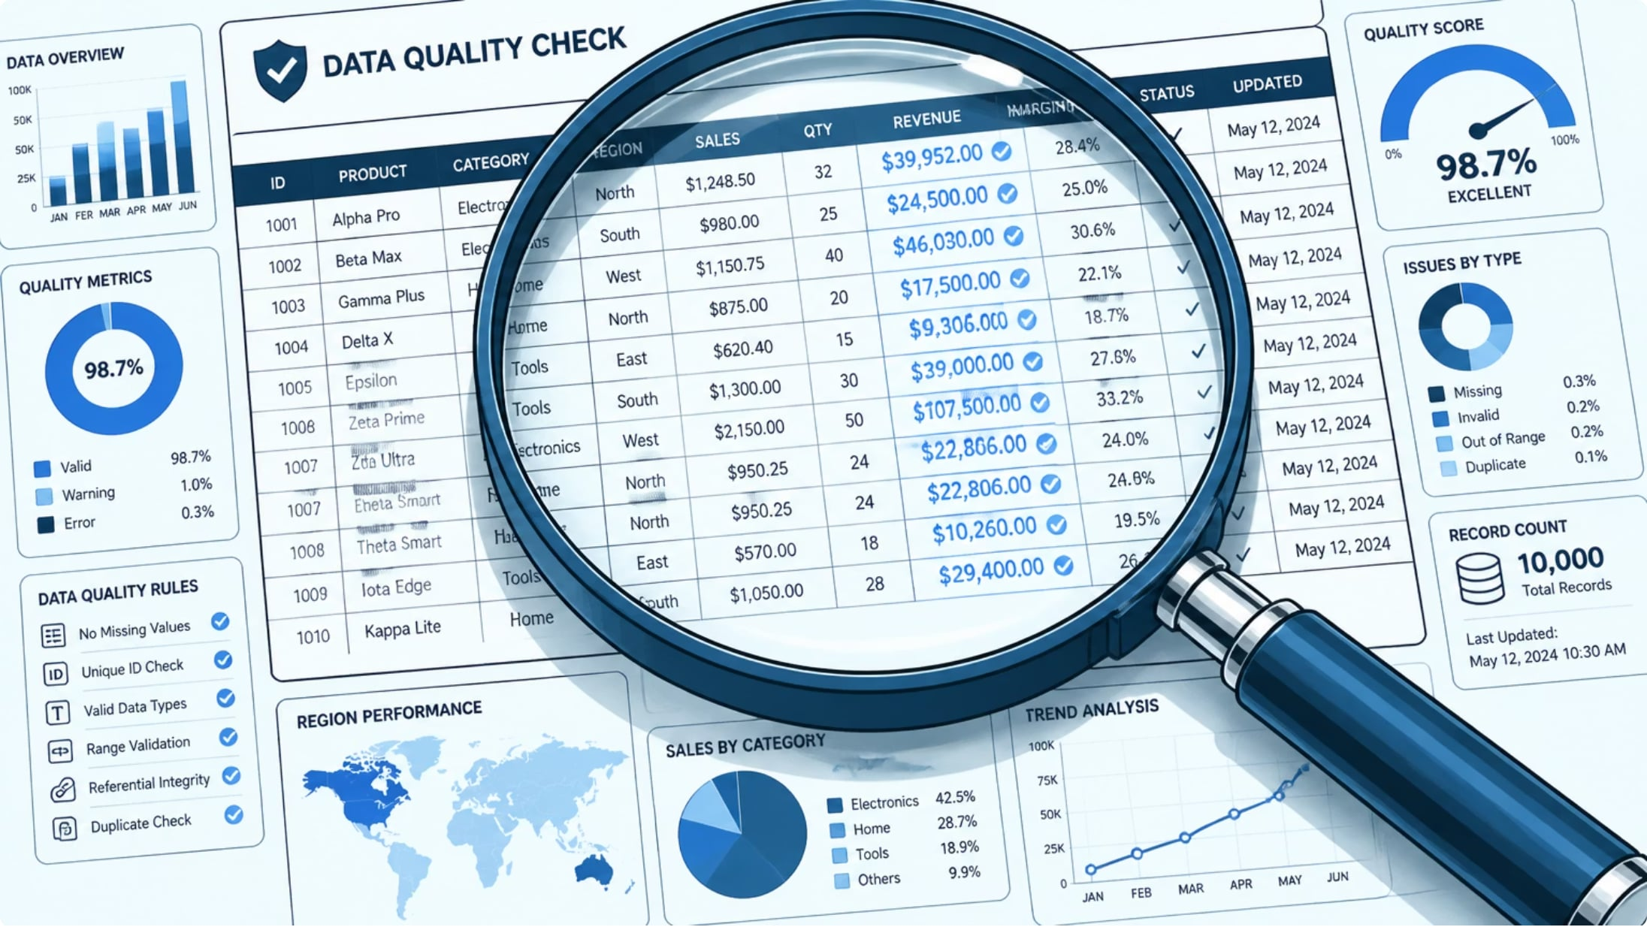
CHAPTER 5
Data Quality & Integrity
What Is Data Quality?
Data quality measures how well data serves its intended purpose. Poor data leads to flawed decisions, wasted resources, and compliance risks.
Key Dimensions
Accuracy
Completeness
Consistency
Timeliness
Data correctly reflects real-world values.
No critical fields are missing.
Data matches across all systems.
Data is up-to-date when needed.

Slide 20
Key Takeaways
A strong foundation in data fundamentals empowers better decisions across every role in an organization.
1
Know Your Data Type
2
Map Your Sources
Structured, unstructured, and semi-structured data each require different tools and strategies.
Internal and external sources — including APIs and sensors — feed your data ecosystem.
3
Manage the Full Lifecycle
4
Prioritize Data Quality
From creation to deletion, every stage requires governance, security, and compliance.
Accurate, complete, and timely data is the foundation of trustworthy analysis and business outcomes.

Slide 21

Introduction to the Business Analyst Role
A foundational guide to understanding what Business Analysts do, the skills they need, the methodologies they use, and how they manage stakeholders to drive business success.
IT FUNDAMENTALS
BUSINESS ANALYSIS

Slide 22
What We'll Cover
Course Overview
01
02
Definition & Responsibilities
Key Skills
What a Business Analyst is and what they do
Communication, analytical thinking, and problem-solving
03
04
Methodologies
Stakeholder Management
Agile, Waterfall, and other frameworks
Engaging and aligning key project stakeholders

Slide 23


Section A
What Is a Business Analyst?
A Business Analyst (BA) is a professional who acts as a bridge between business stakeholders and technical teams. They analyze business processes, identify problems, and recommend solutions that align with organizational goals.
BAs don't just document requirements — they shape the direction of projects and help organizations make smarter, data-driven decisions.

Slide 24
Section A — Responsibilities
Core Responsibilities of a Business Analyst
Requirements Gathering
Process Analysis
Interview stakeholders and document what the business truly needs from a project or system.
Map existing workflows, identify inefficiencies, and propose improvements.
Solution Design
Stakeholder Liaison
Translate business needs into clear, actionable technical specifications.
Facilitate communication between business units and development teams.

Slide 25
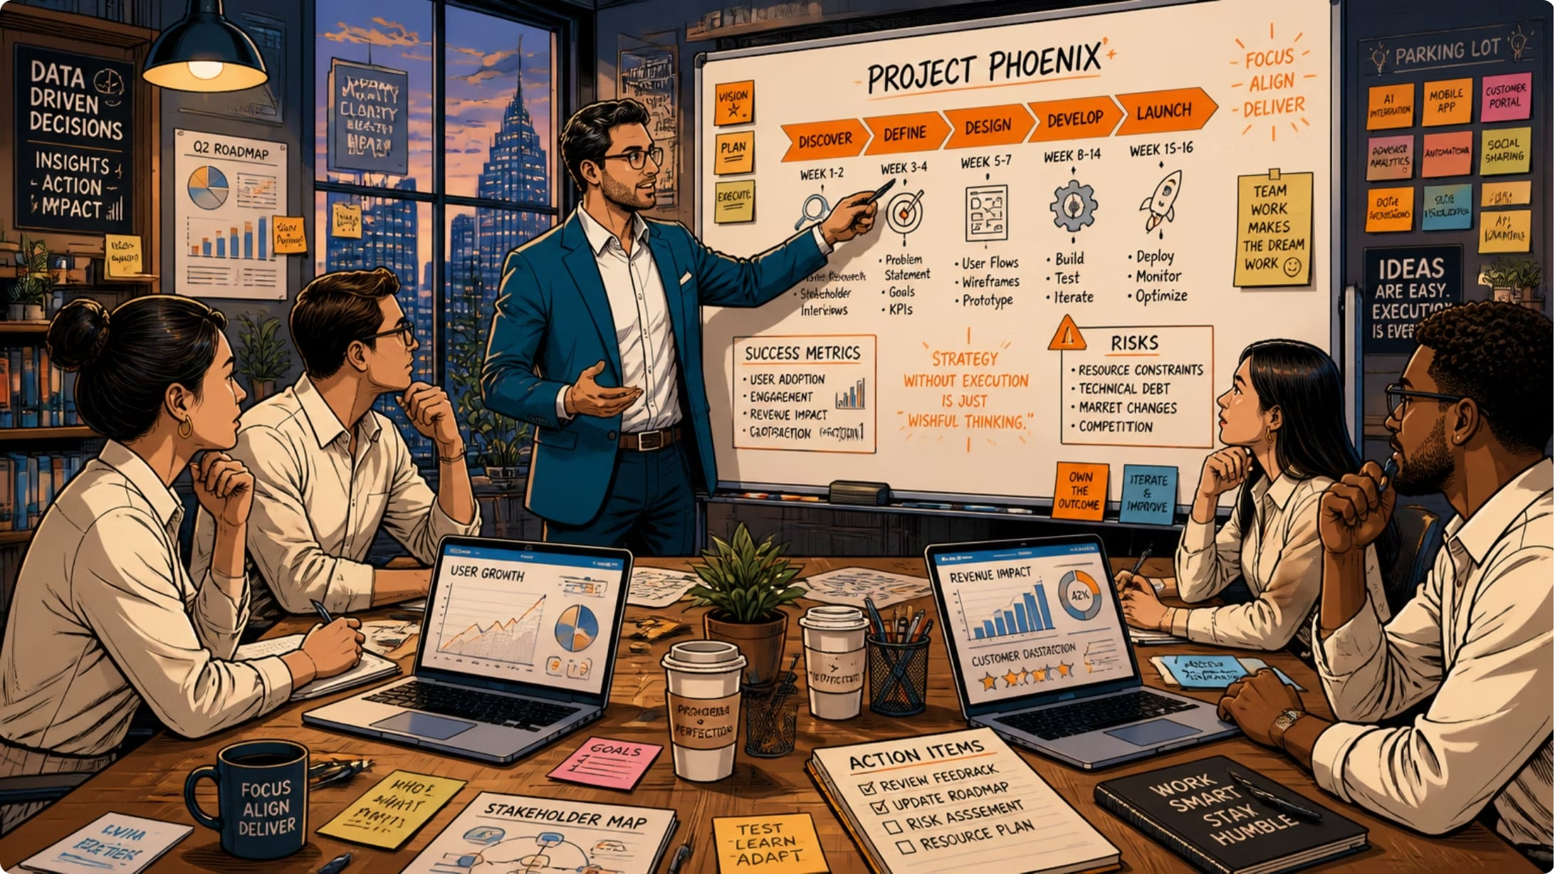
Section B — Skills
Key Skills Every Business Analyst Needs
Communication
Clearly articulate requirements in writing and verbally to both technical and non-technical audiences.
Analytical Thinking
Break down complex problems, interpret data, and draw meaningful conclusions.
Problem-Solving
Identify root causes and develop practical, scalable solutions under constraints.

Slide 26

Section B — Skills in Action
How These Skills Come Together
Analyze & Document
Structure requirements clearly for shared understanding.
Listen & Understand
Recommend & Deliver
Gather stakeholder needs through active listening.
Propose solutions and validate outcomes iteratively.
Great BAs don't rely on one skill in isolation — they blend communication, analysis, and problem-solving into a continuous cycle that drives project success from start to finish.

Slide 27
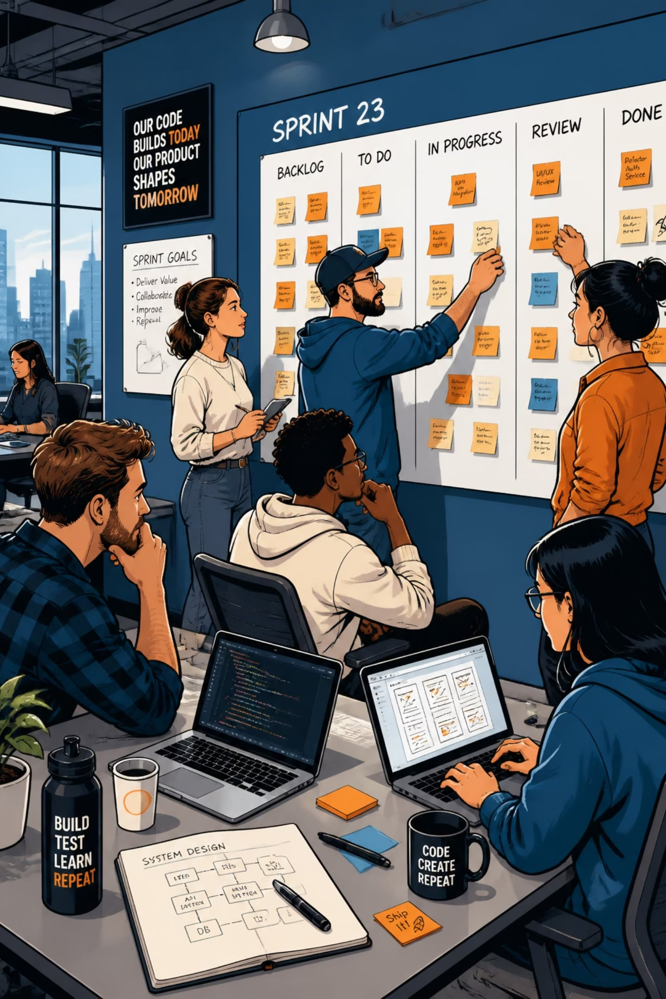
Section C — Methodologies
Agile Methodology
Agile is an iterative approach where requirements and solutions evolve through collaboration between self-organizing, cross-functional teams. BAs in Agile environments work in short cycles called sprints, continuously refining the product backlog and adapting to change.
Scrum
Fixed-length sprints with defined roles (BA, Product Owner, Scrum Master)
Kanban
Visual workflow management with continuous delivery and WIP limits

Slide 28
Section C — Methodologies
Waterfall & Other Frameworks
Waterfall
When to Use Which?
A linear, sequential approach where each phase must be completed before the next begins. BAs gather all requirements upfront, making it ideal for projects with stable, well-defined scopes.
Agile — when requirements are expected to change and fast feedback is needed.
Waterfall — when the scope is clear, stable, and documentation-heavy.
Many organizations use a hybrid approach, blending both methodologies.
Requirements → Design → Implementation → Testing → Deployment
Best for regulated industries or fixed-scope contracts

Slide 29
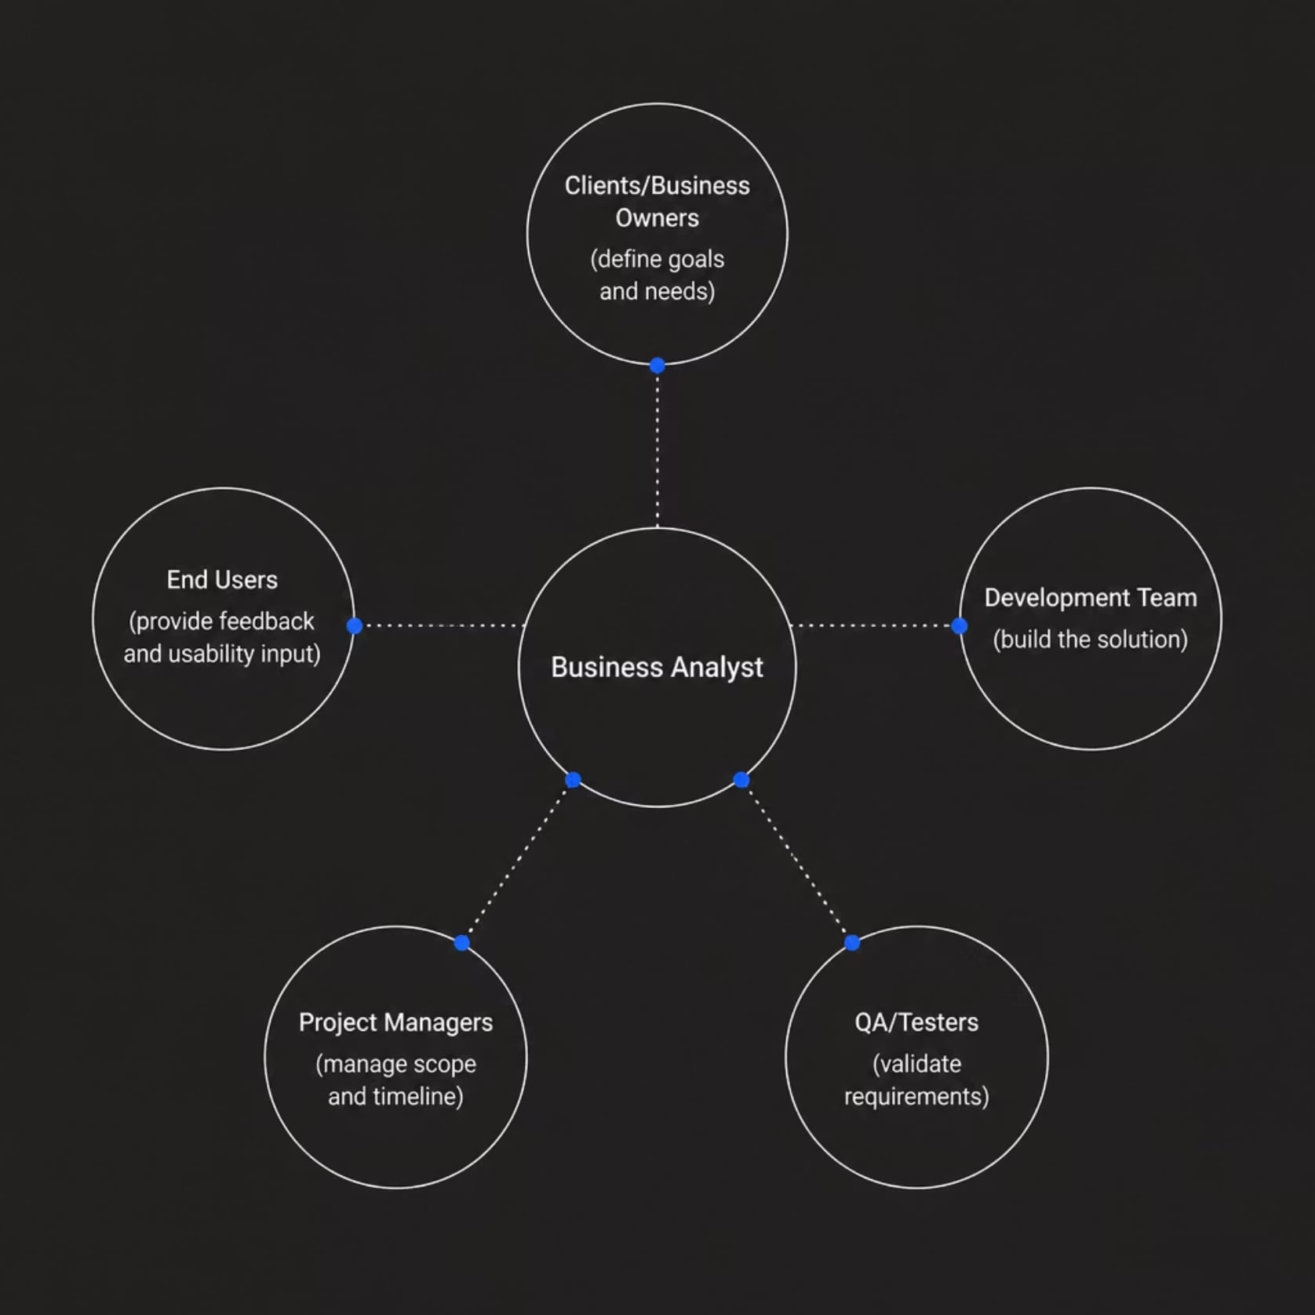
Section D
Stakeholder Management
Stakeholder management is the practice of identifying, engaging, and aligning everyone who has an interest in a project. BAs must balance competing priorities, manage expectations, and ensure all voices are heard throughout the project lifecycle.
Effective stakeholder management reduces scope creep, builds trust, and leads to solutions that truly meet business needs.

Slide 30
Key Takeaways
1
2
BA = Business Bridge
Skills Are Interconnected
BAs translate business needs into technical solutions, connecting stakeholders and development teams.
Communication, analytical thinking, and problem-solving work together — not in isolation.
3
4
Methodology Matters
Stakeholders Drive Success
Agile and Waterfall each have strengths — choose based on project context and organizational culture.
Engaging stakeholders early and often ensures solutions deliver real business value.

Slide 31

Data vs. Information
Understanding the journey from raw facts to meaningful insight — the foundation of every smart decision in business and technology.
IT FUNDAMENTALS · 2 UNITS

Slide 32
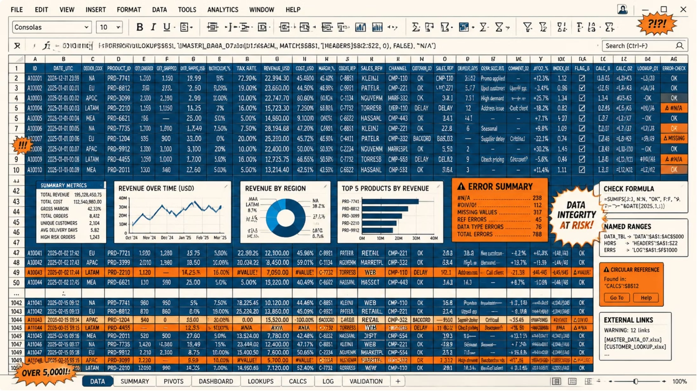

UNIT A
What Is Raw Data?
Data refers to unprocessed, unorganized facts and figures collected from the real world. On its own, data has no meaning or context.
Data alone cannot guide action — it must be processed first.
Examples
Temperature readings: 98, 101, 97
Sales numbers: 450, 320, 510
Survey responses: Yes, No, Maybe

Slide 33

UNIT A
What Is Information?
From Data to Meaning
Information is data that has been processed, organized, or structured in a way that gives it meaning and relevance for a specific purpose.
Context
Relevance
Structure
Data is placed in a situation that explains what it represents.
Information answers a question or supports a decision.
Organized formats like charts, reports, and summaries.

Slide 34
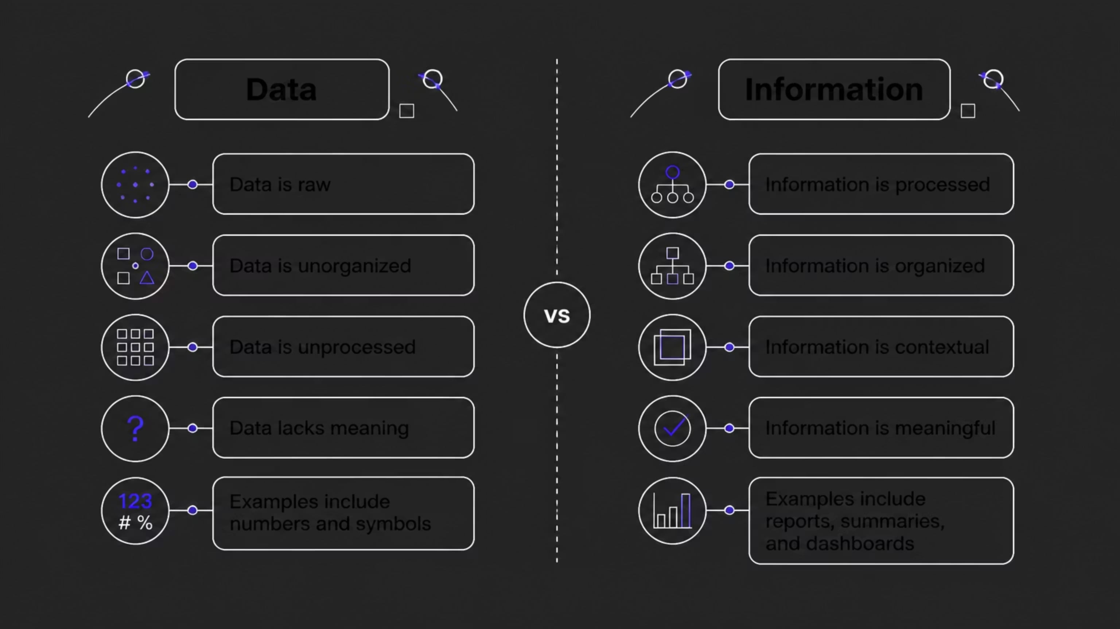
UNIT A
Data vs. Information: Key Differences
Think of data as ingredients in a kitchen — useful, but not yet a meal. Information is the prepared dish: organized, contextual, and ready to serve a purpose.

Slide 35

UNIT B
The Transformation Process
Every useful insight in business or technology follows a predictable path — from raw observation to structured understanding to actionable wisdom.

Slide 36
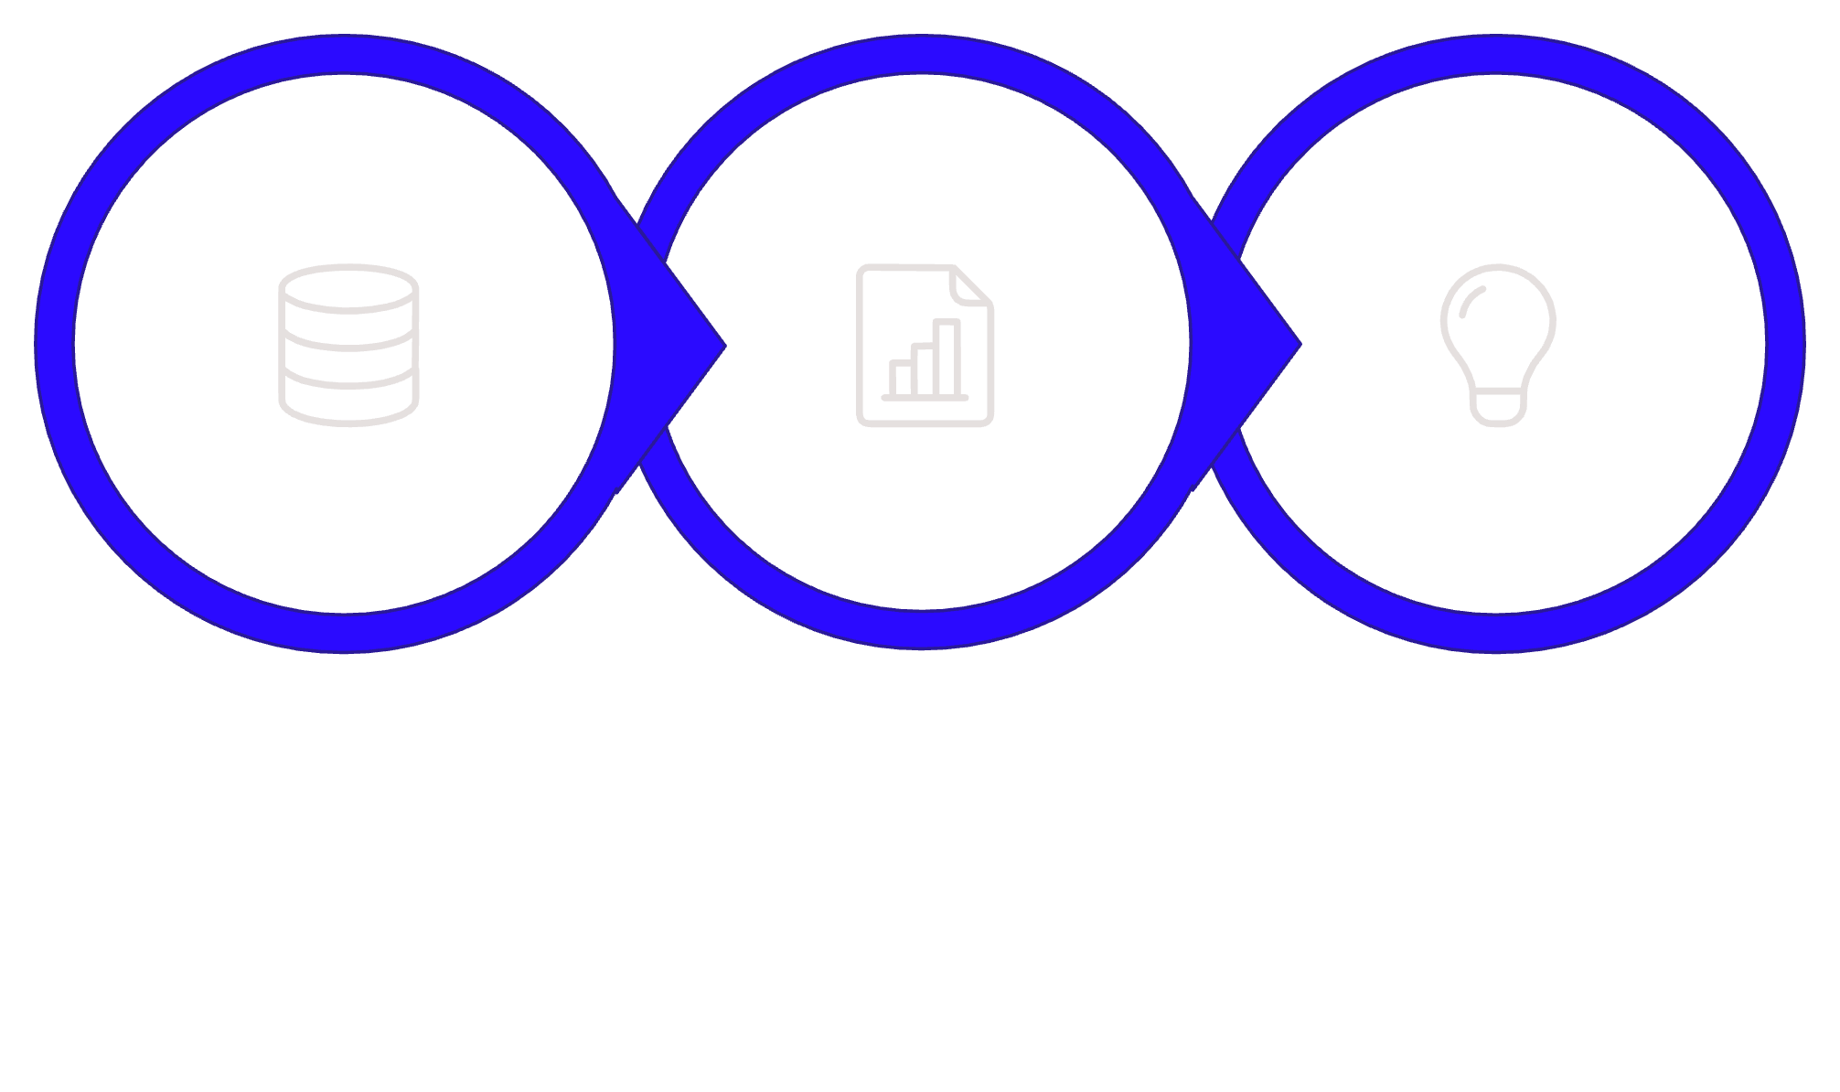
UNIT B
Data → Information → Knowledge
Data
Information
Knowledge
This hierarchy is known as the DIK Pyramid. Each stage adds value: data becomes useful when processed, and information becomes powerful when understood and applied.

Slide 37



UNIT B
Real-World Example: Retail Sales
📦 Data
📊 Information
💡 Knowledge
Individual transactions: $45, $120, $38, $200 recorded at checkout
Weekly sales report showing a 20% increase in electronics vs. last month
Manager decides to increase electronics inventory before the holiday season

Slide 38

UNIT D
Why Information Has Value
Information is a strategic asset. Organizations that transform data into reliable information gain a competitive edge.
Reduces Uncertainty
Saves Time & Cost
Drives Innovation
Clear information narrows the gap between guesswork and confident action.
Accurate information prevents costly mistakes and redundant effort.
Patterns in information reveal opportunities that raw data hides.

Slide 39
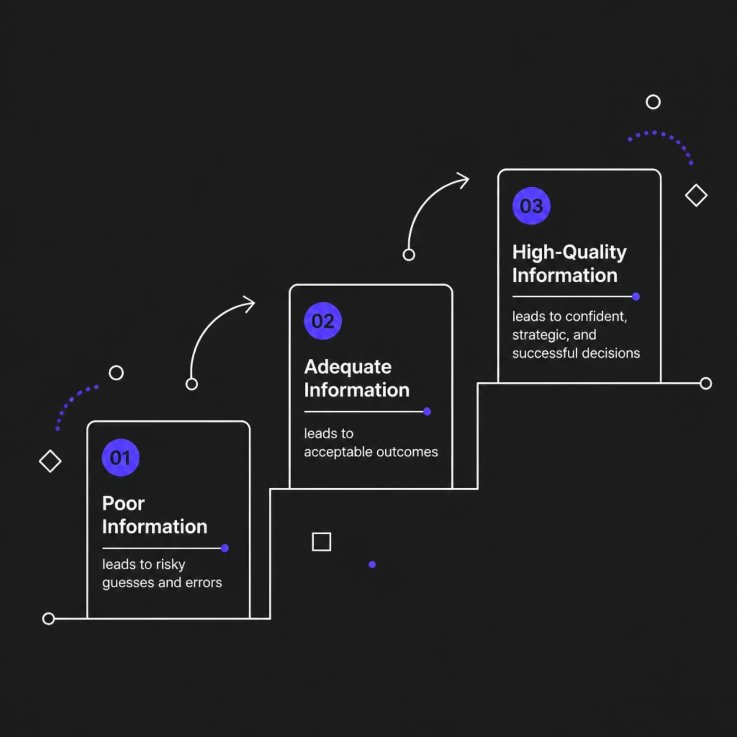
UNIT D
Information in Decision Making
The Decision-Making Cycle
01
Identify the Problem
Define what decision needs to be made.
02
Gather Information
Collect and process relevant data into usable form.
03
Evaluate Options
Compare alternatives using the information available.
04
Act & Review
Make the decision and measure outcomes.

Slide 40

Key Takeaways
1
Data is raw
Unprocessed facts with no inherent meaning on their own.
2
Information is processed data
Organized, contextual, and relevant to a specific purpose.
3
Knowledge is applied insight
Information understood and used to make decisions and take action.
4
Quality information drives better decisions
The more accurate and timely the information, the stronger the outcome.

Slide 41

Overview of Data-Driven Decision Making
How organizations use data to make smarter, faster, and more confident decisions — from principles to practice.
IT FUNDAMENTALS
BUSINESS SYSTEMS

Slide 42
What You'll Learn
Course Roadmap
01
02
Principles
Benefits
Core foundations of data-driven thinking
Why data outperforms intuition alone
03
04
Process Steps
Challenges
A structured approach from question to action
Pitfalls to recognize and avoid

Slide 43

What Is Data-Driven Decision Making?
Data-driven decision making (DDDM) is the practice of basing strategic and operational choices on analyzed data rather than intuition, tradition, or guesswork. It transforms raw information into actionable insight — giving teams a factual foundation for every decision they make.
DDDM is not about replacing human judgment — it's about empowering it with evidence.

Slide 44
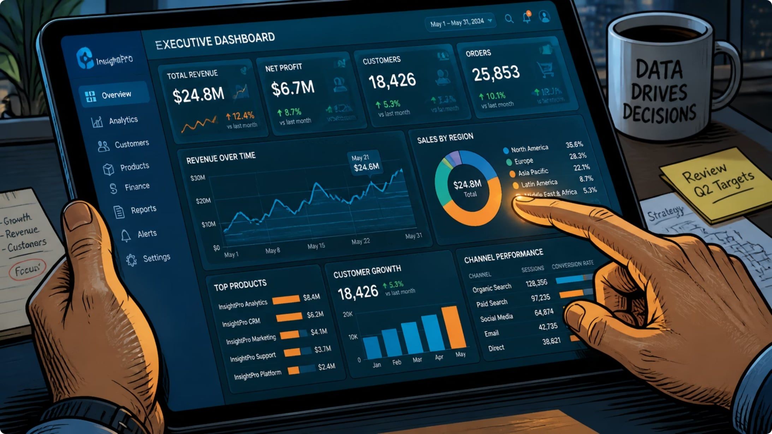
Section A
Principles of Data-Driven Decision Making
Start With a Clear Question
Define the problem before collecting data.
Use Reliable Data Sources
Trustworthy data is the foundation of sound decisions.
Analyze Objectively
Let the data speak — avoid cherry-picking results.
Act and Iterate
Decisions lead to actions, which generate new data.

Slide 45
Section B
Benefits of Using Data for Decisions
Greater Accuracy
Faster Decisions
Reduces errors caused by assumptions and bias.
Real-time data enables quicker, more confident responses.
Improved Performance
Accountability
Organizations that use data outperform peers on key metrics.
Data creates a transparent record of why decisions were made.

Slide 46
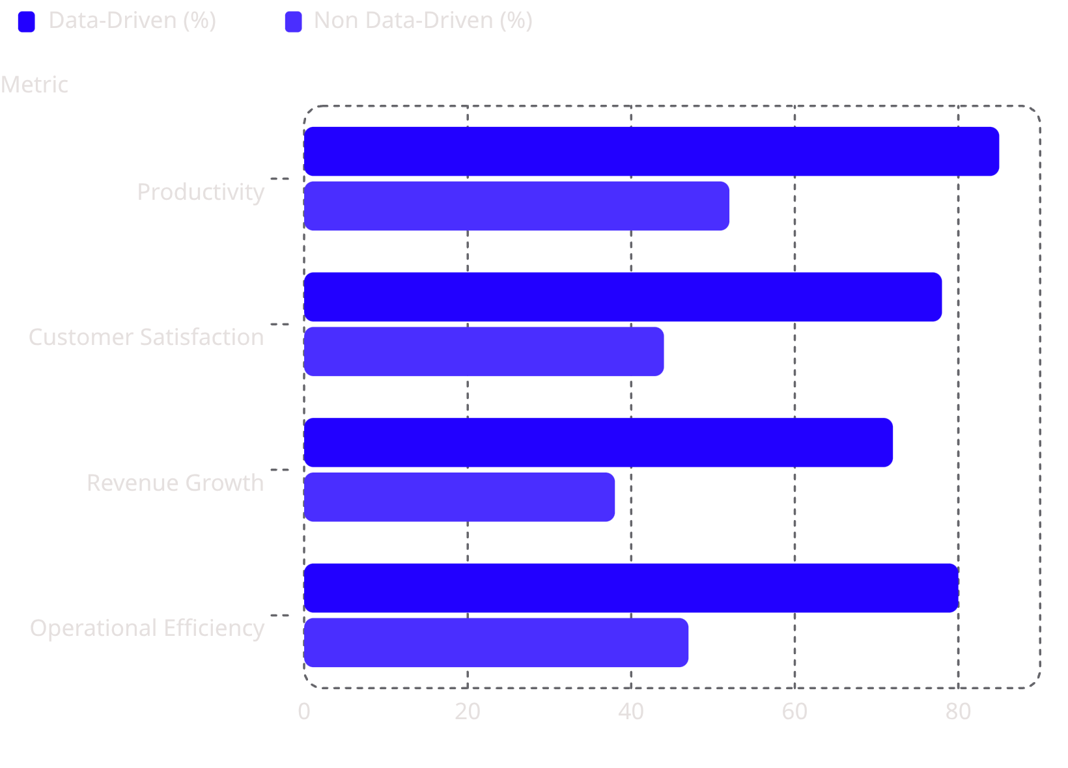
Section B — Impact
Data-Driven Organizations Lead the Way
Research consistently shows that organizations embedding data into their decision culture significantly outperform those relying on intuition alone — across productivity, growth, and customer outcomes.
Key insight: Data-driven companies are 5x more likely to make faster decisions than competitors.

Slide 47
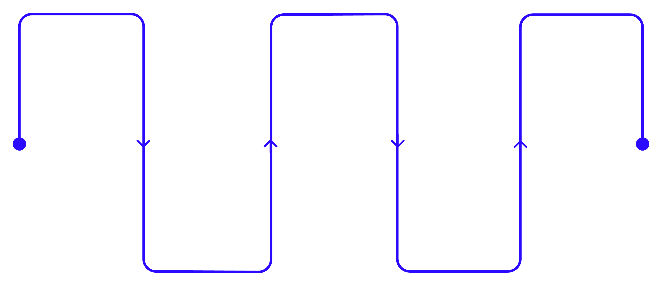
Section C
Steps in the Data-Driven Decision Process
Define Problem
Clean & Prepare
Decide
Select action based on evidence
Clarify objectives and scope
Validate and transform data
Collect Data
Analyze
Gather relevant sources
Interpret results and insights
Each step builds on the last. Skipping steps — especially data cleaning — is one of the most common causes of poor outcomes in DDDM.

Slide 48
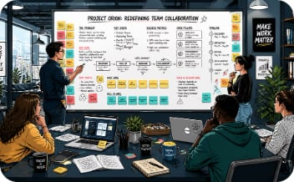

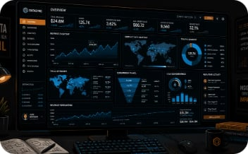

Section C — Deep Dive
Key Steps Explained
Define the Problem
Clean & Prepare Data
Analyze & Interpret
Monitor & Iterate
Frame a specific, answerable question. Vague goals produce vague results.
Remove duplicates, fix errors, and standardize formats before analysis.
Use statistical tools and visualizations to uncover patterns and insights.
Track outcomes after acting. Use new data to refine future decisions.

Slide 49
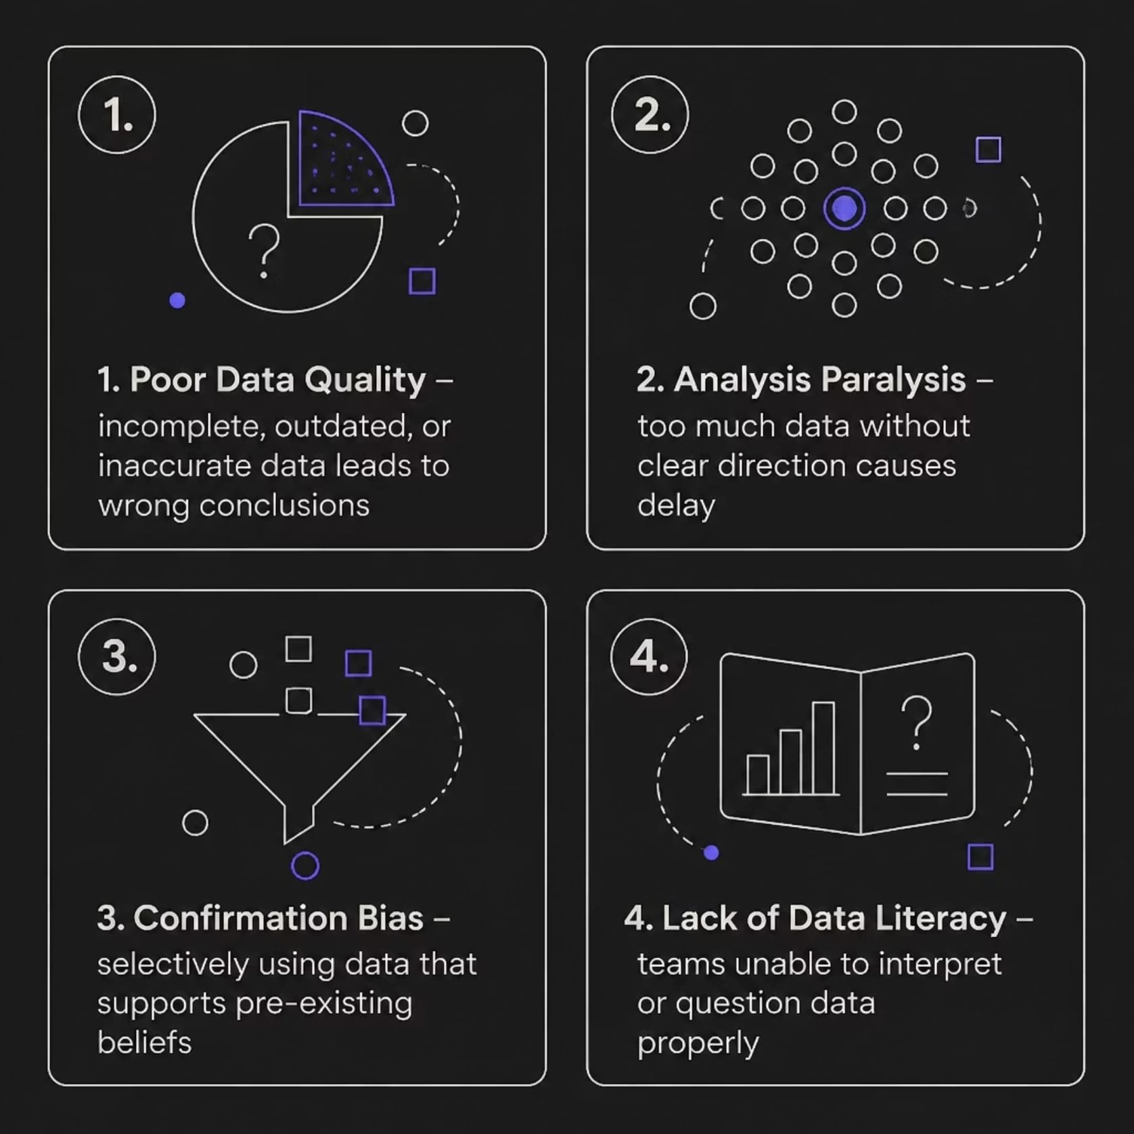
Section D
Challenges and Pitfalls in Data-Driven Approaches
Even well-intentioned data initiatives can fail when these common pitfalls are overlooked. Building a strong data culture means addressing both technical and human challenges.
Remember: Bad data + good analysis = bad decisions. Data quality always comes first.

Slide 50

Key Takeaways
🎯 Start With a Question
Every data effort should begin with a clear, specific problem to solve.
📊 Trust the Process
Follow the six-step cycle — define, collect, clean, analyze, decide, iterate.
⚠️ Watch for Pitfalls
Poor data quality, bias, and low data literacy are the biggest risks.
🚀 Data + Judgment
The best decisions combine data insights with human experience and context.

Slide 51

IT in Business: Real-Life Lessons and Strategic Success
How leading organizations transformed technology from a cost center into a competitive weapon — and what you can learn from their journeys.
DATA GOVERNANCE
DATA ETHICS
IT STRATEGY

Slide 52

The Evolution of IT Strategy
Beyond Cost Center
The "I" is the Asset
IT is no longer just a utility — it is a strategic weapon that shapes competitive positioning and drives business outcomes.
The Information in IT is the true competitive asset. Data quality, governance, and accessibility determine organizational intelligence.
Management Leadership
Business-smart organizations are built when leaders drive IT strategy — not when IT operates in isolation from business goals.

Slide 53


CASE STUDY
The Frito-Lay Fortress
Frito-Lay sustained 50% market share through a massive field sales army empowered by technology. A $140M handheld tech investment transformed how salespeople operated in the field — increasing productivity and customer engagement.
CEO Mandate: Increase revenue at constant cost by fundamentally changing management processes — not just buying new tools.

Slide 54
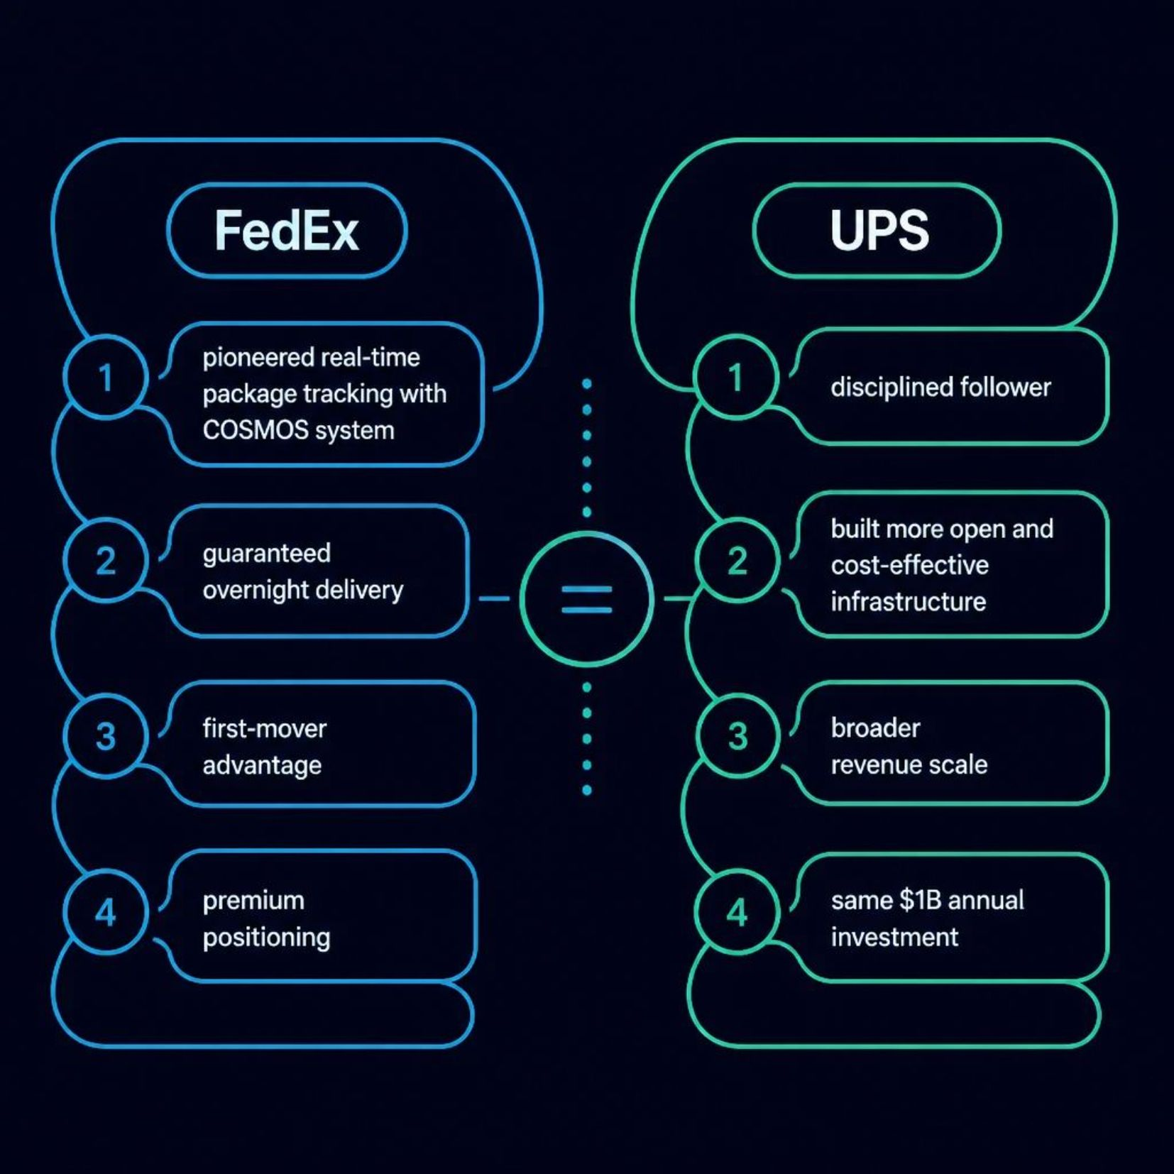
FedEx vs. UPS: First-Mover vs. Follower
Two Strategies, One Investment Level
Both companies invested roughly $1 billion annually in IT, yet achieved different outcomes. FedEx led with innovation; UPS followed with efficiency. The lesson: strategy matters more than spend.

Slide 55

CEMEX: Digital Innovation in a Commodity Industry
The Challenge
Delivering wet concrete within 90-minute windows in chaotic, unpredictable urban environments — where delays mean wasted product and lost revenue.
The Solution
Satellite systems and GPS-enabled rerouting allowed dispatchers to redirect trucks in real-time based on live site conditions and traffic.
The Payoff
Delivery windows shrank from 3 hours to 20 minutes with 98% reliability — a commodity business transformed by digital intelligence.

Slide 56
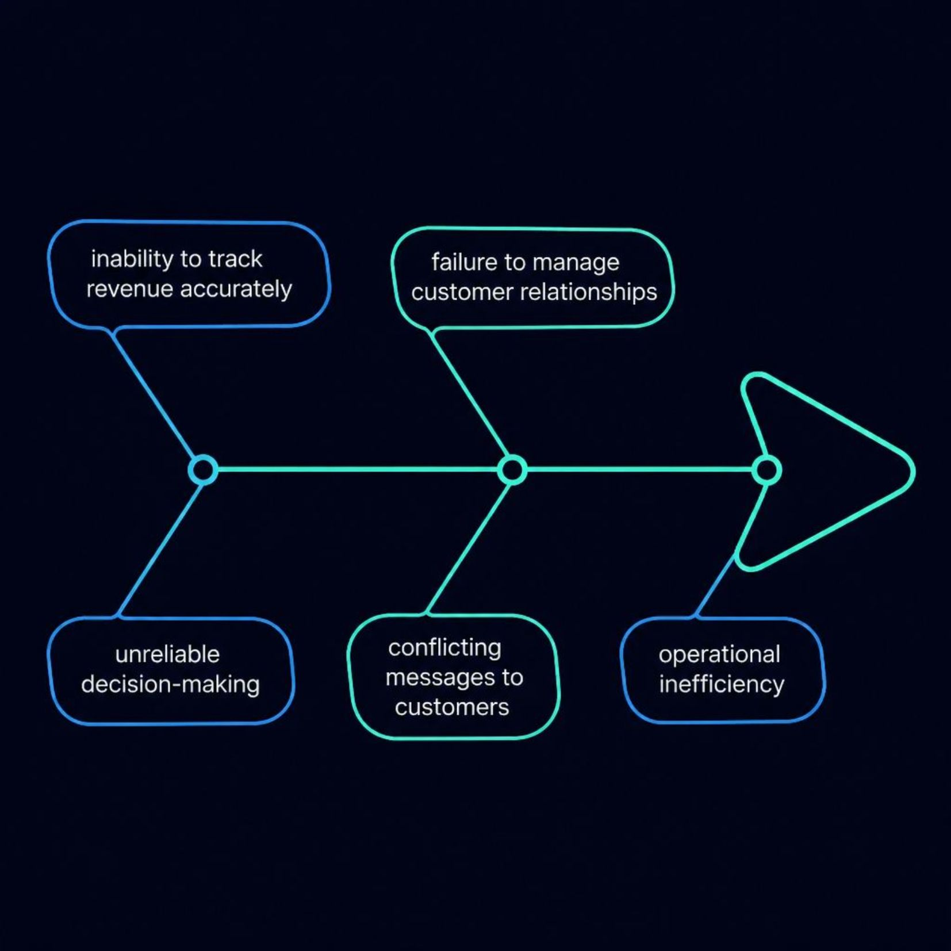
The Cost of Information Quality
Westpac Financial: A Cautionary Tale
Failed information standards led to conflicting customer messages across channels — eroding trust and creating operational chaos.
Low-quality data stems from four root causes:
Intentional user errors during data entry
Mismatched system formats across platforms
Operator accidents and process gaps
Faulty third-party inputs from external sources

Slide 57
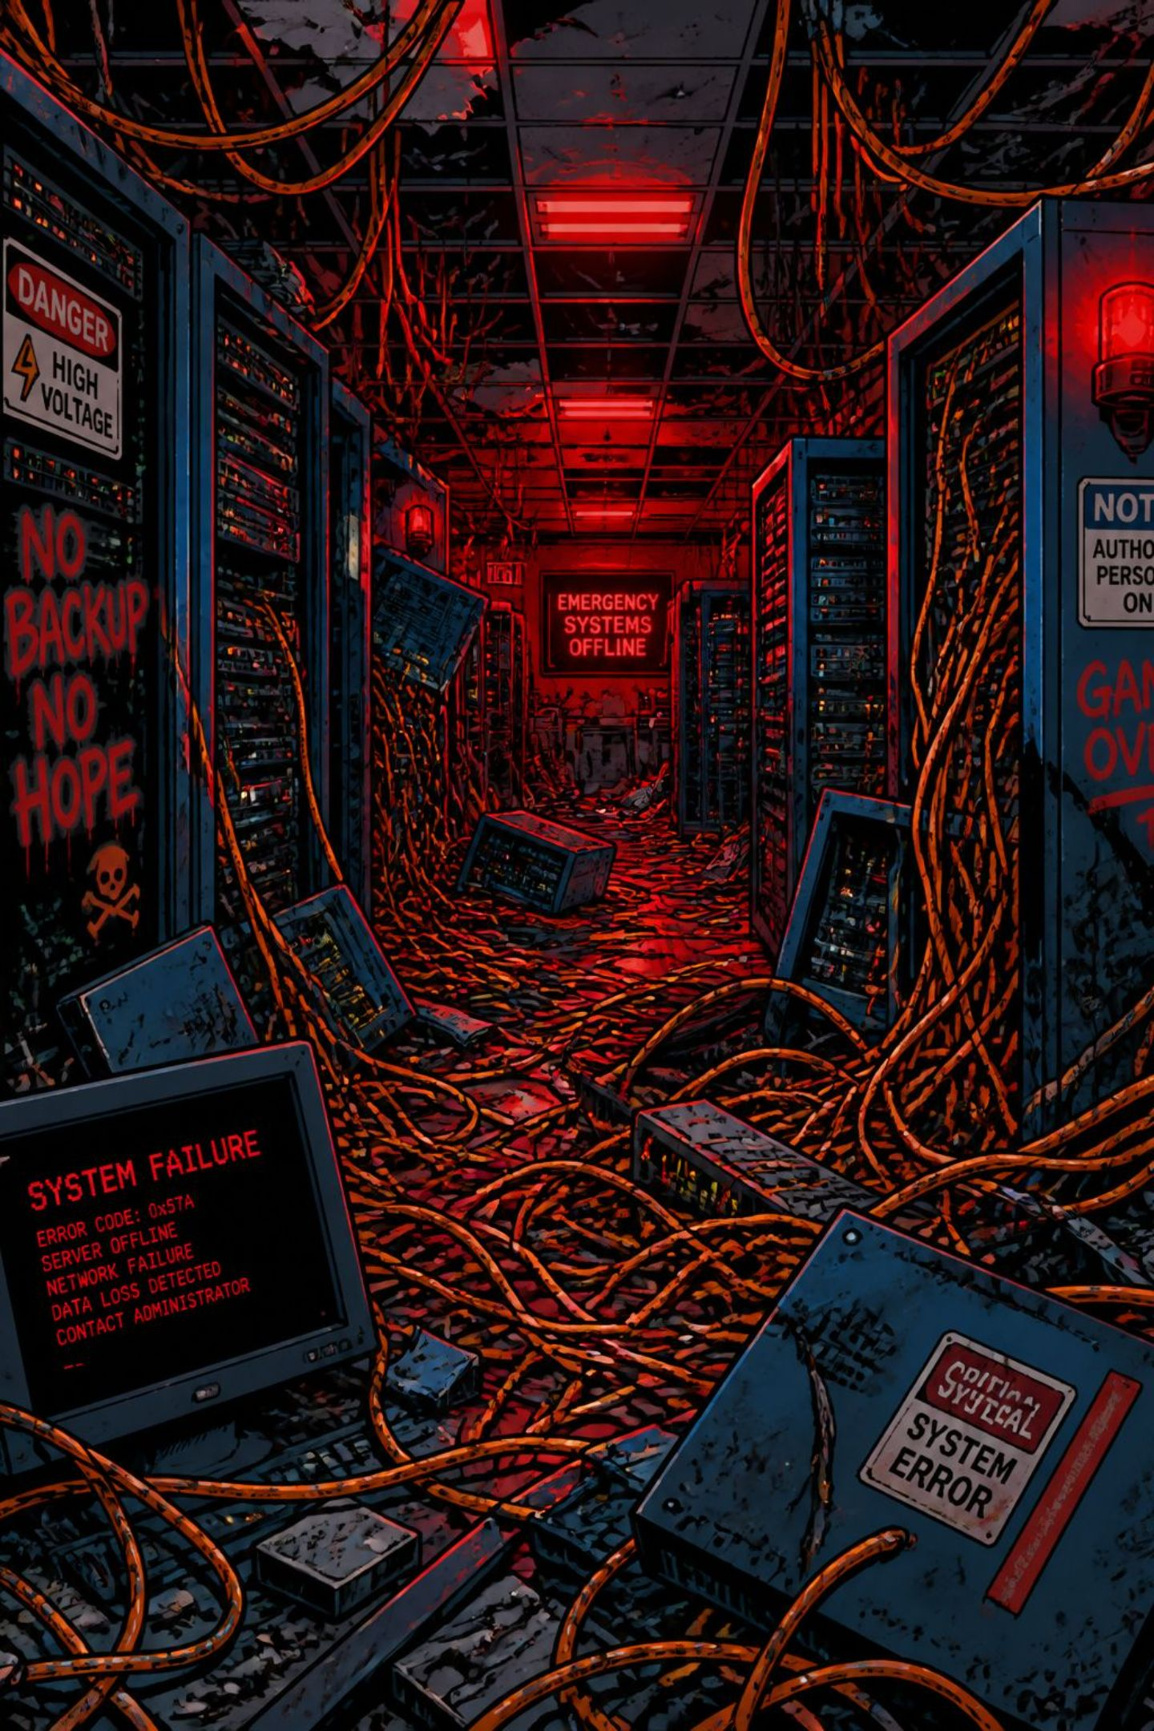
When IT Projects Fail
1
2
Hershey's ERP Disaster
VWoA Alignment Challenges
A rushed ERP implementation caused significant financial loss during peak season — a textbook case of prioritizing timelines over readiness.
Supply flow projects failed without proper prioritization and cross-functional alignment between IT and business units.
3
The Common Denominator
IT systems deliver little value unless coupled with redesigned business processes. Technology alone cannot fix broken workflows.

Slide 58
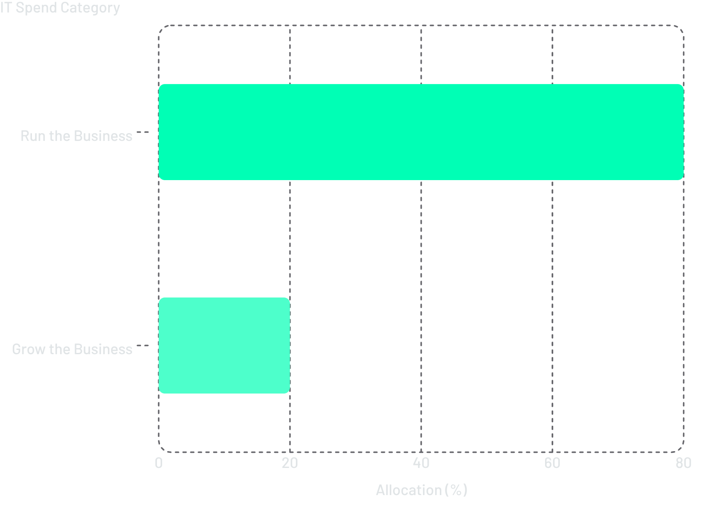
Managing the IT Portfolio
The 80-20 Rule
Most organizations spend 80% of IT budget on maintaining existing systems and only 20% on innovation. Shifting this balance is a strategic imperative.
CIO in the Boardroom
Avoid "IT Out and Back"
Governance requires the CIO to be part of the top management team, not a back-office function.
The MONY insurance experience shows the danger of outsourcing core IT without retaining strategic oversight.

Slide 59
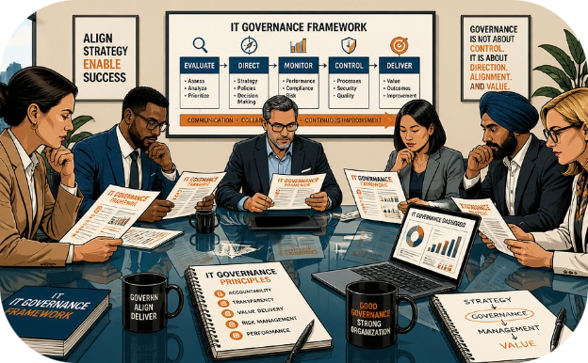
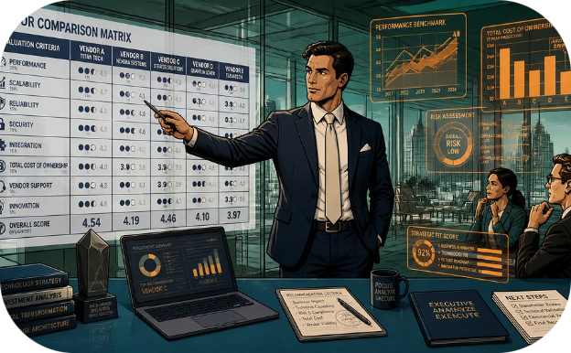

Strategic Frameworks for Success
Val IT & CoBIT
Technology Investment Management
Business-Led Accountability
Industry frameworks that align IT investments with business goals, ensuring every rupee spent drives measurable value.
Business leaders — not IT — must own the organizational changes required when new systems are deployed.
Assess flexibility, complexity costs, and vendor viability before committing to any technology platform or partnership.

