Slide 1
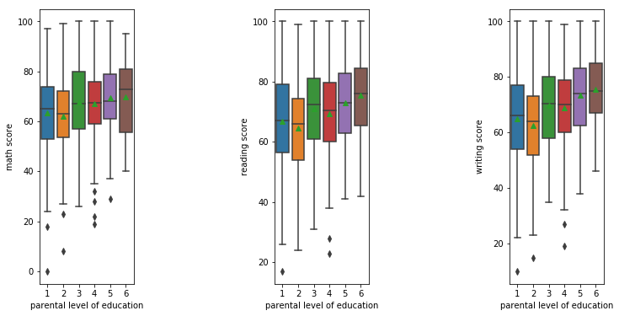
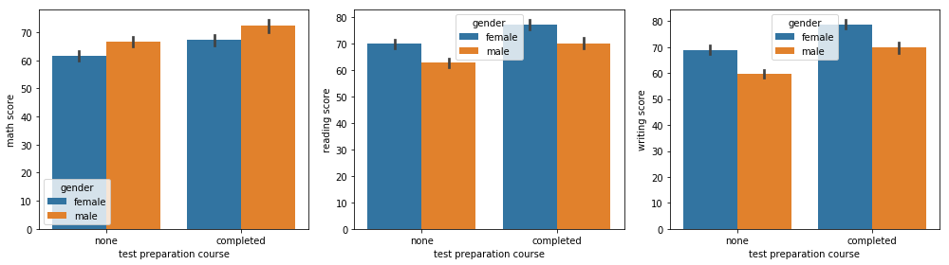
Student Performance
Vipul Chandoor
S530459@nwmissouri.edu
Introduction & Goals
Visualization
Conclusion
Data set consists of student performance which means marks, meal plans, race, gender and parent level of study. Main goal is to find the student average of marks based on parental level of study and gender based on the test preparation course.
Fig. 1 Individual Course score based on parental level of study
Fig.2 Test preparation course based on gender.
Overall, Students education will depends on parental level of education.
Average scores in reading are almost same but not in writing and math’s.
Female students are high in test preparation course for courses reading and writing.
Male students are bit higher in test preparation course for math's based on scores.
Material/Methods
Features:
Average of scores for 3 subjects based on parental level of study.
Students who have completed the Test Preparation Course have scores higher in all three categories than those who haven't taken the course
Project Links
GitHub Link: https://github.com/44-599-machine-learning-S19/machine-learning-project-vipulchandoor.git
Data Set Link: https://www.kaggle.com/spscientist/students-performance-in-exams
For more details: s530459@nwmissouri.edu
Additional Information
Acknowledgement
This data set consists of Gender, Race, Parental level of study, Math score, Reading score, Writing Score and Test preparation course.
Dr. Hoot

