Slide 1
Next Section: Pointer Analysis
Outline:
  What is pointer analysis
  Intraprocedural pointer analysis
  Interprocedural pointer analysis (Wilson & Lam)
  Unification based interprocedural pointer analysis (Steensgaard)

Slide 2
Pointer and Alias Analysis
Aliases: two expressions that denote the same memory location.
Aliases are introduced by:
  pointers
  call-by-reference
  array indexing
  C unions

Slide 3
Useful for what?
Improve the precision of analyses that require knowing what is modified or referenced (eg const prop, CSE …)
Eliminate redundant loads/stores and dead stores.
Parallelization of code
  can recursive calls to quick_sort be run in parallel? Yes, provided that they reference distinct regions of the array.
Identify objects to be tracked in error detection tools
x := *p;
...
y := *p; // replace with y := x?
*x := ...;
// is *x dead?
x.lock();
...
y.unlock(); // same object as x?

Slide 4
Kinds of alias information
Points-to information (must or may versions)
  at program point, compute a set of pairs of the form p ! x, where p points to x.
  can represent this information
  in a points-to graph
Alias pairs
  at each program point, compute the set of of all pairs (e₁,e₂) where e₁ and e₂ must/may reference the same memory.
Storage shape analysis
  at each program point, compute an
  abstract description of the pointer structure.
x
z
p
y
p

Slide 5






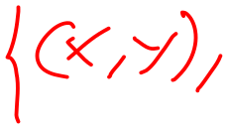









Intraprocedural Points-to Analysis
Want to compute may-points-to information
Lattice:

Slide 6
Flow functions
in
F_{x := k}(in) =
x := k
out
in
F_{x := a+b}(in) =
x := a + b
out

Slide 7


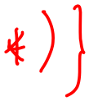

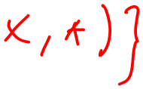
Flow functions
in
F_{x := k}(in) =
x := k
out
in
F_{x := a+b}(in) =
x := a + b
out

Slide 8
Flow functions
in
F_{x := y}(in) =
x := y
out
in
F_{x := &y}(in) =
x := &y
out

Slide 9
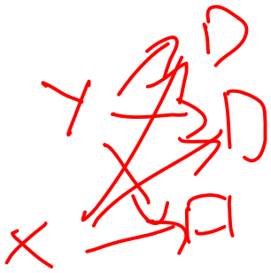




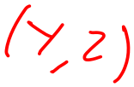


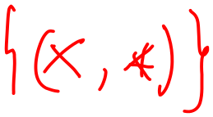
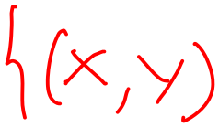



Flow functions
in
F_{x := y}(in) =
x := y
out
in
F_{x := &y}(in) =
x := &y
out

Slide 10
Flow functions
in
F_{x := *y}(in) =
x := *y
out
in
F_{*x := y}(in) =
*x := y
out

Slide 11






























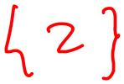
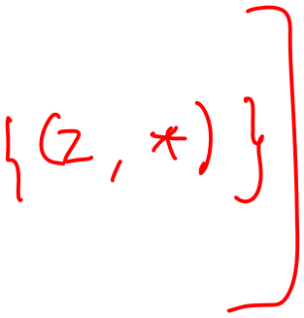


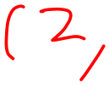


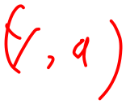


Flow functions
in
F_{x := *y}(in) =
x := *y
out
in
F_{*x := y}(in) =
*x := y
out

Slide 12
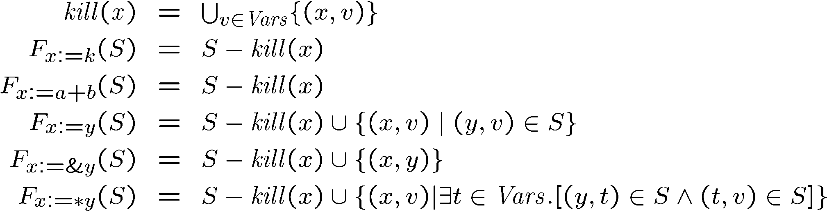
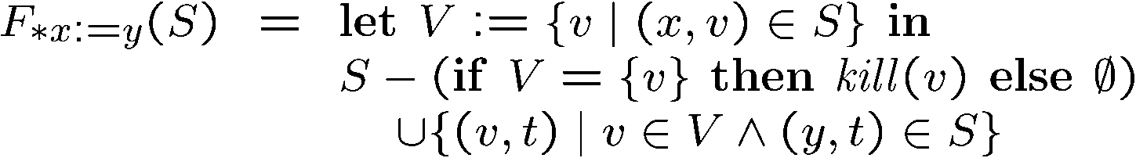
Intraprocedural Points-to Analysis
Flow functions:

Slide 13
Example of using points-to information
In constant propagation:

Slide 14
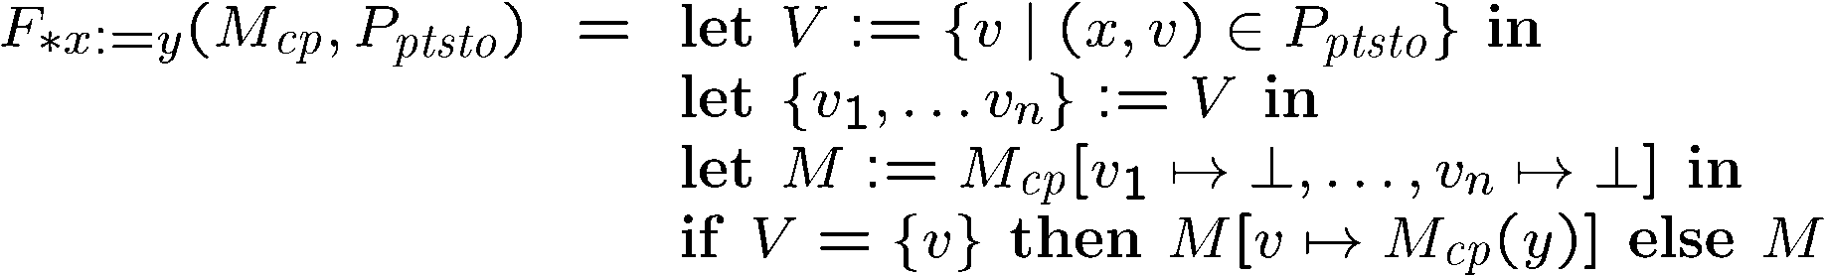
Example of using points-to information
In constant propagation:

Slide 15

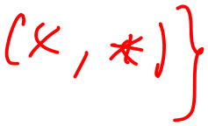
Pointers to dynamically-allocated memory
Handle statements of the form: x := new T
One idea: generate a new variable each time the new statement is analyzed to stand for the new location:

Slide 16


Example
lst := new Cons
p := lst
t := new Cons
*p := t
p := t

Slide 17

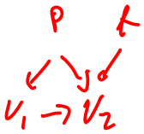









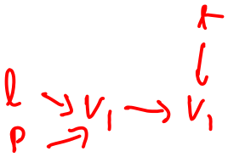
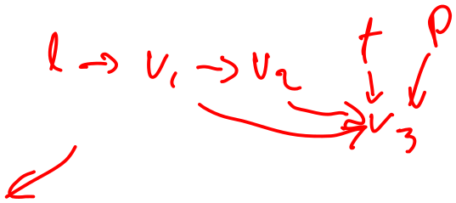


Example
lst := new Cons
p := lst
t := new Cons
*p := t
p := t

Slide 18
Example solved
l := new Cons
p := l
l
p
t
V1
p
l
V1
V2
t := new Cons
l
p
t
V1
t
V2
p
l
V1
V2
V3
*p := t
p
t
t
l
V1
V2
l
V1
V2
V3
p
p := t
p
t
p
t
l
V1
V2
l
V1
V2
V3

Slide 19




What went wrong?
Lattice was infinitely tall!
Instead, we need to summarize the infinitely many allocated objects in a finite way.
  introduce summary nodes, which will stand for a whole class of allocated objects.
For example: For each new statement with label L, introduce a summary node loc_{L} , which stands for the memory allocated by statement L.
Summary nodes can use other criterion for merging.

Slide 20
Example revisited
S1: l := new Cons
p := l
S2: t := new Cons
*p := t
p := t

Slide 21



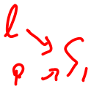




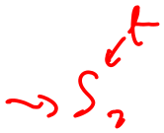








Example revisited
S1: l := new Cons
p := l
S2: t := new Cons
*p := t
p := t

Slide 22
Example revisited & solved
S1: l := new Cons
Iter 1
Iter 2
Iter 3
p := l
p
t
l
p
t
S1
l
S1
S2
p
l
S1
S2
S2: t := new Cons
p
t
p
t
l
S1
t
S2
l
S1
L2
l
L1
L2
p
*p := t
t
p
t
p
t
l
S1
S2
l
S1
S2
l
S1
S2
p
p := t
p
t
p
t
p
t
l
S1
S2
l
S1
S2
l
S1
S2

Slide 23
Array aliasing, and pointers to arrays
Array indexing can cause aliasing:
  a[i] aliases b[j] if:
    a aliases b and i = j
    a and b overlap, and i = j + k, where k is the amount of overlap.
Can have pointers to elements of an array
  p := &a[i]; ...; p++;
How can arrays be modeled?
  Could treat the whole array as one location.
  Could try to reason about the array index expressions: array dependence analysis.

Slide 24
Summary
We just saw:
  intraprocedural points-to analysis
  handling dynamically allocated memory
  handling pointers to arrays
But, intraprocedural pointer analysis is not enough.
  Sharing data structures across multiple procedures is one the big benefits of pointers: instead of passing the whole data structures around, just pass pointers to them (eg C pass by reference).
  So pointers end up pointing to structures shared across procedures.
  If you don’t do an interproc analysis, you’ll have to make conservative assumptions functions entries and function calls.

Slide 25
Conservative approximation on entry
Say we don’t have interprocedural pointer analysis.
What should the information be at the input of the following procedure:
global g;
void p(x,y) {
...
}
x
y
g

Slide 26
Conservative approximation on entry
Here are a few solutions:
global g;
void p(x,y) {
...
}
x
y
g
x,y,g &
locations
from alloc
sites prior
to this
invocation
locations
from alloc
sites prior
to this
invocation
They are all very conservative!
We can try to do better.

Slide 27
Interprocedural pointer analysis for C
We’ll look at Wilson & Lam PLDI 95, and focus on two problems solved by this paper:
  how to represent pointer information in the presence of casts, pointer arithmetic, unions, and all the rest of C.
  how to perform context-sensitive pointer analysis interprocedurally in a way that provides good precision at reasonable costs.

Slide 28
Representing pointer information for C
Problem:
  C types can be subverted by type casts: an int can in fact be a pointer.
  Pointer arithmetic can lead to subobject boundaries being crossed.
So, ignore the type system and subobject boundaries. Instead use a representation that decides what’s a pointer based on how it is used.
Treat memory as composed of blocks of bits:
  each local, global variable is a block
  each malloc returns a block.
Assume that casts and pointer arithmetic do not cross object boundaries.

