Slide 1
Systematic Software Testing:
The Korat Aproach
(ACM SIGSOFT Impact Paper Award)
Chandrasekhar Boyapati (Google)
Sarfraz Khurshid (University of Texas)
Darko Marinov (University of Illinois)
FSE 2012
Cary, NC
November 15, 2012

Slide 2
Outline
Korat overview
  Example
  Technique
  Results
Follow-up research
History and lessons learned

Slide 3
Examples of Structurally Complex Data
root
1
city
service
accessability
0
3
washington
camera
public
2
building
data-type
resolution
whitehouse
picture
640 x 480
wing
west
Event 0
room
oval-office
Event 1
Event 2
module meta_spec
sig Signature
sig Test
static sig S1 extends Test
static sig S0 extends Signature
fun Main() {}
run Main for 3
toplevel Event_0 ;
Event_0 pand Event_1 Event_2 ISeq_0 ISeq_1 FDep_0 FDep_1 ;
Event_1 be replication = 1 ;
Event_2 be replication = 1 ;
ISeq_0 seq Event_0 ;
ISeq_1 seq Event_1 ;
FDep_0 fdep trigger = Event_0 Event_1 ;
FDep_1 fdep trigger = Event_1 Event_2 ;
Event_1 dist=exponential rate=.0004 cov=0 res=.5 spt=.5 dorm=0 ;
Event_2 dist=exponential rate=.0004 cov=0 res=.5 spt=.5 dorm=.5 ;

Slide 4
Running Example
class BST {
Node root;
int size;
static class Node {
Node left, right;
int value;
}
}
B₀: 3
root
N₀: 2
left
right
N₁: 1
N₂: 3
…

Slide 5
Example Valid Inputs
Trees with exactly 3 nodes
B₀: 3
B₀: 3
B₀: 3
B₀: 3
B₀: 3
root
root
root
root
root
N₀: 2
N₀: 1
N₀: 1
N₀: 3
N₀: 3
left
right
right
right
left
left
N₁: 1
N₂: 3
N₁: 2
N₁: 3
N₁: 1
N₁: 2
right
left
right
left
N₂: 3
N₂: 2
N₂: 2
N₂: 1

Slide 6
Running Example
class BST {
Node root;
int size;
static class Node {
Node left, right;
int value;
}
}
B₀: 3
root
N₀: 2
left
right
N₁: 1
N₂: 3
…

Slide 7
Example Invalid Inputs
Object graphs violating some validity property
B₀: 3
B₀: 3
B₀: 2
root
root
root
N₀: 2
N₀: 3
N₀: 2
left
right
left
right
left
right
N₁: 1
N₂: 3
N₁: 1
N₂: 2
N₁: 1
N₂: 3

Slide 8
Running Example
class BST {
Node root;
int size;
static class Node {
Node left, right;
int value;
}
}
B₀: 3
root
N₀: 2
left
right
N₁: 1
N₂: 3
…

Slide 9
Key Challenges
How to formally describe valid inputs?
How to make they input space finite?
How to generate valid inputs?

Slide 10
Example Predicate
boolean repOk(BST t) {
return isTree(t) && isOrdered(t) && hasCorrectSize(t);
}
boolean isTree(BST t) {
if (t.root == null) return true; // empty tree
Set visited = new HashSet(); visited.add(t.root);
List workList = new LinkedList(); workList.add(t.root);
while (!workList.isEmpty()) {
Node current = (Node)workList.removeFirst();
if (current.left != null) {
if (!visited.add(current.left)) return false; // sharing
workList.add(current.left); }
if (current.right != null) {
if (!visited.add(current.right)) return false; // sharing
workList.add(current.right); }
}
return true; // no sharing
}

Slide 11
Example Predicate
boolean repOk(BST t) {
return isTree(t) && isOrdered(t) && hasCorrectSize(t);
}
boolean isTree(BST t) {
if (t.root == null) return true; // empty tree
Set visited = new HashSet(); visited.add(t.root);
List workList = new LinkedList(); workList.add(t.root);
while (!workList.isEmpty()) {
Node current = (Node)workList.removeFirst();
if (current.left != null) {
if (!visited.add(current.left)) return false; // sharing
workList.add(current.left); }
if (current.right != null) {
if (!visited.add(current.right)) return false; // sharing
workList.add(current.right); }
}
return true; // no sharing
}

Slide 12
Input Space
All possible object graphs with a BST root
B0: 3
B0: 2
root
root
N₀: 2
N₀: 2
left
right
left
right
B0: 3
B0: 1
B0: 3
N₁: 1
N₂: 3
N₁: 1
N₂: 3
root
N₀: 2
N₀: 3
N₀: 1
root
root
left
right
left
N₁: 1
N₂: 3
N₁: 1
N₂: 2
left
right
B0: 1
B0: 1
B0: 0
N₀: 1
N₀: 1
root
root
left
right
B0: 3
B0: 1
B0: 3
N₀: 1
N₀: 3
N₀: 1
root
root
root
right
N₁: 2
N₁: 2
right
left
N₂: 3
B0: 3
B0: 3
N₂: 1
right
left
N₀: 1
N₀: 3
root
root
N₁: 3
N₁: 1
right
left
N₂: 2
left
N₂: 2
right

Slide 13
Key Challenges
How to formally describe valid inputs?
How to efficiently generate valid inputs?

Slide 14
Example Input Space
1 BST object, 3 Node objects: total 11 fields
B₀
B₀
N₀
N₀
N₂
N₁
N₂
N₁
root
root
size
size
left
left
right
right
value
value
left
left
right
right
value
value
left
left
right
right
value
value
N₀
3
N₁
N₁
2
null
null
1
null
null
3
null
3
null
null
1
null
null
1
null
null
1
N₀
N₀
N₀
2
N₀
N₀
2
N₀
N₀
2
N₁
N₁
N₁
3
N₁
N₁
3
N₁
N₁
3
N₂
N₂
N₂
N₂
N₂
N₂
N₂
4 * 1 * (4 * 4 * 3)³ > 2¹⁸ inputs, only 5 valid

Slide 15
Bounded-Exhaustive Generation
Given
  Predicate
  Finitization that bounds input space
Generate
  All nonisomorphic valid inputs up to given bound
Simple “solution”
  Enumerate entire input space
  Run predicate on each input
  Generate input if predicate returns true
  Infeasible for sparse input spaces (#valid<<#total)

Slide 16
Bounded-Exhaustive Generation
Given
  Predicate
  Finitization that bounds input space
Generate
  All nonisomorphic valid inputs up to given bound
Naïve approach
  Enumerate entire input space
  Run predicate on each input
  Generate input if predicate returns true
  Infeasible for sparse input spaces (#valid<<#total)

Slide 17
Example Input
Each input is a valuation of fields
B₀
N₀
N₁
N₂
root
size
left
right
value
left
right
value
left
right
value
N₀
3
N₁
N₁
2
null
null
1
null
null
3
B₀: 3
root
N₀: 2
left
right
N₁: 1
N₂: 3

Slide 18
Example Execution
boolean repOk(BST t) {
return isTree(t) && …;
}
boolean isTree(BST t) {
if (t.root == null) return true;
Set visited = new HashSet(); visited.add(t.root);
List workList = new LinkedList(); workList.add(t.root);
while (!workList.isEmpty()) {
Node current = (Node)workList.removeFirst();
if (current.left != null) {
if (!visited.add(current.left)) return false;
workList.add(current.left); }
if (current.right != null) {
if (!visited.add(current.right)) return false;
workList.add(current.right); }
}
return true;
}
B₀: 3
root
N₀: 2
left
right
N₁: 1
N₂: 3
field accesses:
[ ]
[ B₀.root, N₀.left, N₀.right ]
[ B₀.root ]
[ B₀.root, N₀.left ]

Slide 19
Failed Execution
Failed after few accesses for a concrete input
Would fail for all inputs with partial valuation
B₀
N₀
N₁
N₂
root
size
left
right
value
left
right
value
left
right
value
N₀
3
N₁
N₁
2
null
null
1
null
null
3

Slide 20
Failed Execution
Failed after few accesses for a concrete input
Would fail for all inputs with partial valuation
B₀
N₀
N₁
N₂
root
size
left
right
value
left
right
value
left
right
value
N₀
3
N₁
N₁
2
null
null
1
null
null
3

Slide 21
Failed Execution
Failed after few accesses for a concrete input
Would fail for all inputs with partial valuation
B₀
N₀
N₁
N₂
root
size
left
right
value
left
right
value
left
right
value
N₀
3
N₁
N₁
2
null
null
1
null
null
3
B₀
N₀
N₁
N₂
root
size
left
right
value
left
right
value
left
right
value
N₀
-
N₁
N₁
-
-
-
-
-
-
-
1 * 3 * 4 * 4 * 3 * 4 * 4 * 3 > 2¹²

Slide 22
Key Idea
Monitor execution of predicate
Record field accesses
Prune large chunks of input space on each failed execution
Use backtracking to efficiently enumerate valid inputs

Slide 23
Results for Structure Generation
Results from the original paper [ISSTA’02]
benchmark | size | input space | candidate inputs | valid inputs | time [sec]
BST | 8 12 | 2⁵³ 2⁹² | 54418 12284830 | 1430 208012 | 2 234
HeapArray | 6 8 | 2²⁰ 2²⁹ | 64533 5231385 | 13139 1005075 | 2 43
java.util.LinkedList | 8 12 | 2⁹¹ 2¹⁵⁰ | 5455 5034894 | 4140 4213597 | 2 690
java.util.TreeMap | 7 9 | 2⁹² 2¹³⁰ | 256763 50209400 | 35 122 | 9 2149
java.util.HashSet | 7 11 | 2¹¹⁹ 2²¹⁵ | 193200 39075006 | 2386 277387 | 4 927
IntentionalName | 5 | 2⁵⁰ | 1330628 | 598358 | 63

Slide 24
Outline
Korat overview
Follow-up research
  Research projects
    Tool embodiment in academia and industry
  Ph.D. dissertations
History and lessons learned

Slide 25
Since Korat: Research projects
Lazy initialization in generalized symbolic execution [TACAS’03]
Data structure repair [SPIN’05, ASE’07, OOPSLA’07]
Glass-box testing [OOPSLA’06,’08,’10]
Parallel Korat [FSE’07 – with Google, ICST’09]
Ranged symbolic execution [OOPSLA’12]
Dynamic programming [FSE’12]
Publicly available Korat tool [ICSE Demo’07]
http://korat.sourceforge.net/
Korat part of AsmLT/SpecExplorer from MSR

Slide 26
Generalized symbolic execution
[TACAS’03: Khurshid, Pasareanu, Visser]
Symbolic execution for primitives
Concrete execution for references using lazy initialization on access, e.g., consider “t.next”
  Originally implemented using Korat code
    Source to source translation
    Shadow boolean fields to monitor field accesses
    Bound on number of objects for exhaustive generation
  Recently included in UC-KLEE [Ramos+CAV’11]
next
next
E0
E1
t
next
next
next
next
next
next
next
E0
E1
null
E0
E1
E0
next
E1
E0
E1
?
t
t
next
t
t

Slide 27
Data structure repair
[SPIN’05: Khurshid, Garcia, Suen]
[ASE’07: Elkarablieh, Garcia, Suen, Khurshid]
[OOPSLA’07: Elkarablieh, Khurshid, Vu, McKinley]
[ISSTA’08: Elkarablieh, Marinov, Khurshid]
Goal: recover from runtime errors
Approach: repair corrupt structure w.r.t. the violated repOk – Korat + symbolic execution
binary search tree
binary search tree
1
4
2
3
2
5
6
5
4
1
3
6

Slide 28
Glassbox testing
[OOPSLA’06: Boyapati, Darga]
[OOPSLA’08: Roberson, Harries, Darga, Boyapati]
[OOPSLA’10: Roberson, Boyapati]
Check inputs that take same execution path together
insert(3,x)
insert(3,x)
insert(3,x)
5
5
5
2
6
2
2
6
1
4
4
7
1
4
PRUNED
5
5
5
2
6
2
2
6
1
4
1
4
4
7
3
3
3

Slide 29
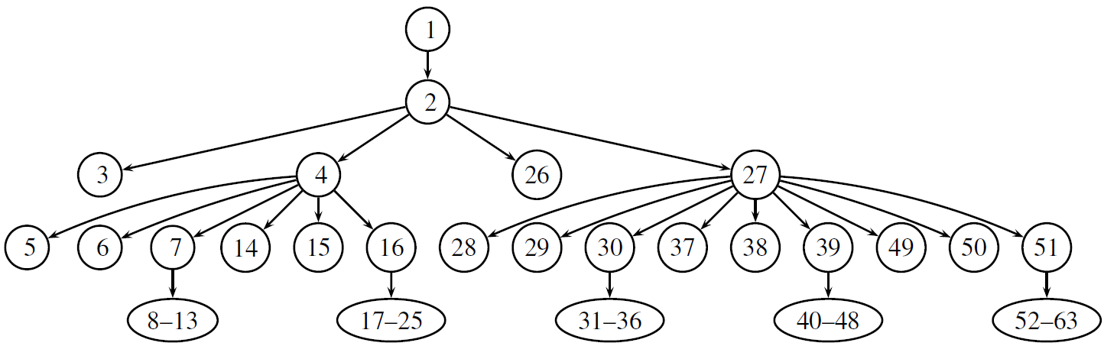
Parallel Korat
[FSE’07: Misailovic, Milicevic, Petrovic, Khurshid, Marinov]
[ICST’09: Siddiqui, Khurshid]
Problem: Korat search is mostly sequential
  Search tree is highly imbalanced
Solutions for load balancing
  Randomized candidate selection
  Dynamic work stealing

Slide 30
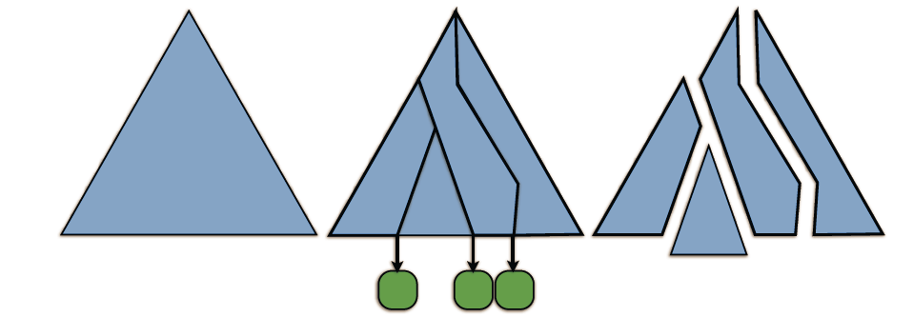


Ranged symbolic execution
[OOPSLA’12: Siddiqui, Khurshid]
A concrete input encodes the state of a run of symbolic execution analysis
Two (in-order) inputs range the analysis run
explored
unexplored
test

Slide 31
Dynamic programming
[FSE’12: Zaeem, Khurshid]
Writing constraints using recursive repOk’s
Solve constraints using dynamic programming
Iter. 0:
Iter. 1:
Iter. 2:
Null
Null
Null
Null
Null
Null
Null
Null
Null

Slide 32
Korat at Microsoft Research
Korat reimplemented as part of AsmL test tool in Foundations of Software Engineering group
  Predicates in Abstract state machine Language (AsmL), not in Java or C#
Some extensions
  (Controlled) non-exhaustive generation
  Generation of complete tests from partial tests
  Library for faster generation of common datatypes
Enabled finding numerous errors
  XML tools, web-service protocols, SSLStream, MSN Authentication, …

Slide 33
Some Comments from Microsoft Users
Positive comments on AsmL and Korat
  “So far our stateless AsmL models are pretty successful.”
  “AsmL parameter generation tool is quite convenient and powerful.”
Negative comments on AsmL not Korat
  “Most of our testers prefer to write as much C# as possible.”
  “Very difficult to debug AsmL.”
Result: SpecExplorer tool for C#
Korat is
Korat

Slide 34
Since Korat: Ph.D. dissertations
Bassem Elkarablieh [UT Austin Ph.D.’09, Google]
“Assertion-based Repair of Complex Data Structures”
Michael Roberson [U. Mich. Ph.D.’11, Microsoft]
“Glass Box Software Model Checking”
Junaid Haroon Siddiqui [UT Austin, Ph.D.’12, LUMS]
“Improving Systematic Constraint-driven Analysis using Incremental and Parallel Techniques”

Slide 35
Outline
Korat overview
Follow-up research
History and lessons learned

Slide 36
Before Korat: TestEra
TestEra [SOFTMC’01,ASE’01] described input validity properties using Alloy by Jackson et al.
Example
    pred isTree(BST t) {
    all n : t.root.*(left+right) {
    n !in n.^(left+right)
    lone n.~(left+right)
    no n.left & n.right
    }
    }
Advantages
  Much more succinct than repOk in Java
  Existing tool for generation (Alloy Analyzer/SAT)
Challenge: requires learning a new language

Slide 37
Korat: Use Implementation Language
Problem origin
  Darko presented TestEra at a group meeting
  Chandra asked if Java could be used instead of Alloy for writing predicates
    The name repOk is from Barbara Liskov’s book/class
Advantages
  Familiar language
  Existing development tools
  Predicates often already present
Challenge: generate tests from predicates

Slide 38
A Bit of Korat Trivia: Name Origin
Considered names for testing with Alloy
  TestAlloy, AlloyTest, ATest, TestA…
  TestEra
    Testing tool (Tester) using Alloy
    Precursor of CheckEra or VerifyEra
    Also: “saw” (the tool for cutting wood) in Darko’s native language
Natural progression to testing with Java
  Korat
    “Saw” in one of Chandra’s native languages
    Not a breed of cats

Slide 39


Acknowledgements
We are extremely grateful for the freedom that our advisors gave us to work on Korat
Others: Alexandr Andoni, Dumitru Daniliuc, Michael Ernst, Viktor Kuncak, Alexandru Salcianu, Ilya Shlyakhter, Mandana Vaziri
Martin Rinard
(Chandra’s and Darko’s advisor)
Daniel Jackson
(Sarfraz’ advisor)

Slide 40
Korat: Some Lessons Learned
Communicate
  There would be no Korat without an internal talk
Collaborate
  There would be no Korat without three students working together
  We never worried about getting “credit”
Persevere
  Some early criticism: static analysis (in particular shape analysis) can check the same properties
  Other “criticism”: Korat paper was first rejected
  There would be no Korat without a resubmission

