Slide 1
Lazy Modular Upgrades in Persistent Object Stores
Chandrasekhar Boyapati, Barbara Liskov, Liuba Shrira, Chuang-Hue Moh, Steven Richman
MIT CSAIL
October 2003

Slide 2
Persistent Object Store
Stores objects with methods
  Objects belong to classes
  Classes implement types
Persistent Root

Slide 3
Transactions
Objects are accessed within transactions
  Transactions mask concurrency and failures
Persistent Root
Client 1
Client 2

Slide 4
Upgrades
Upgrades are needed to
  Correct errors
  Improve performance
  Meet changing requirements

Slide 5
Outline
Defining upgrades
Upgrade execution
Upgrade modularity conditions
Performance

Slide 6
Defining Upgrades
Upgrade must preserve persistent state
  E.g., set implementation changes from vector to hash table
A class-upgrade is
  <old-class, new-class, TF>
TF: old-class → new-class
  TF changes representation of objects
  System preserves identity

Slide 7
Completeness
Upgrades can be
  Compatible
  Incompatible
An upgrade is a set of class-upgrades
  must contain all class-upgrades needed to maintain type correctness

Slide 8
System executes Upgrades
Requires transforming all old-class objects
Goal: don’t interfere with applications
  Don’t stop the world
Goal: be efficient in space and time
  Don’t copy the database or use versions
Goal: be expressive
  Don’t limit expressive power of TFs

Slide 9
Solution: Lazy, Just in Time
Applications continue to run
  Objects are transformed just before first use
Later upgrades run in parallel with earlier ones
  If x has two pending transforms, they run in upgrade order

Slide 10
How System Works
When application accesses x
  Interrupt the application
  Run earliest pending transform for x
  Each transform runs in its own transaction
Application continues after transform commits
Transforms can be interrupted too

Slide 11
Example
…; U1; … TF(x); A1; … TF(y); A2; …
U1 is installed
A1 starts to run, accesses x
TF(x) runs and commits
A1 continues and commits
A2 starts to run, accesses y
TF(y) runs and commits
A2 continues and commits

Slide 12
Example
…; U1; … TF(x); A1; … TF(y); A2; …
U1 is installed
A1 starts to run, accesses x
TF(x) runs and commits
A1 continues and commits
A2 starts to run, accesses y
TF(y) runs and commits
A2 continues and commits
Problem: suppose TF(y) accesses x

Slide 13
Modular Reasoning
Want to support modular reasoning:
  Programmer can reason about TF as if it were an extra method of the old-class
  Programmer can assume same old-class interfaces and invariants
X
TF

Slide 14
Desired Semantics
Upgrades appear to run when installed
  Serialized before all later application transactions
Upgrades appear to run in upgrade order
Within an upgrade, transforms run as if each was the first to run

Slide 15
Order within an Upgrade
Consider x and y due to be upgraded
If TF(y) uses x (transitively) then if [TF(x); TF(y)], this must have same effect as [TF(y); TF(x)]
Y
X

Slide 16
Ensuring Correct Behavior
Based on encapsulation: An object must encapsulate every object it depends on
X
A TF is well-behaved if it uses only encapsulated sub-objects

Slide 17
Approach
Analyze TFs
Usually they will be well-behaved
Otherwise notify user
  User can use triggers to control order
  Or, we maintain versions
Z
X
Y

Slide 18
Performance
Implemented in Thor
Analyzed overhead
Clients
App
App
FE
FE
OR
OR

Slide 19
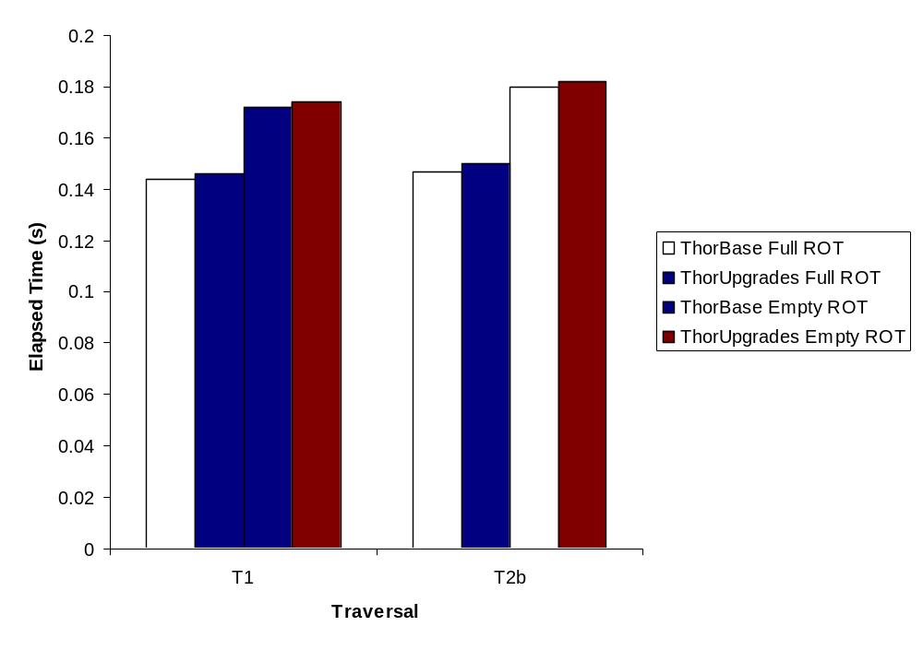
Baseline Overhead

Slide 20
Transform Overhead
Time per object (μs) | T1 | T2b
Transform | 11.3 | 11.5
Commit | 19.9 | 1.0

Slide 21
Conclusions
Correctness conditions for any upgrade system
  Support modular reasoning
Our lazy implementation approach
  Correct and efficient
Future work: upgrades in distributed systems

