Slide 1
Inlining pros and cons (discussion)

Slide 2
Inlining pros and cons
Pros
  eliminate overhead of call/return sequence
  eliminate overhead of passing args & returning results
  can optimize callee in context of caller and vice versa
Cons
  can increase compiled code space requirements
  can slow down compilation
  recursion?
Virtual inlining: simulate inlining during analysis of caller, but don’t actually perform the inlining

Slide 3
Which calls to inline (discussion)
What affects the decision as to which calls to inline?

Slide 4
Which calls to inline
What affects the decision as to which calls to inline?
  size of caller and callee (easy to compute size before inlining, but what about size after inlining?)
  frequency of call (static estimates or dynamic profiles)
  call sites where callee benefits most from optimization (not clear how to quantify)
  programmer annotations (if so, annotate procedure or call site? Also, should the compiler really listen to the programmer?)

Slide 5
Which calls to inline
The above metrics vary in how easy/hard they are to quantify
Even if one were able to quantify all of them accurately, how does one put them together to make a decision?
Inlining heuristics

Slide 6
Inlining heuristics
Strategy 1: superficial analysis
  examine source code of callee to estimate space costs, use this to determine when to inline
  doesn’t account for post-inlining optimizations
How can we do better?

Slide 7
Inlining heuristics
Strategy 2: deep analysis
  perform inlining
  perform post-inlining analysis/optimizations
  estimate benefits from opts, and measure code space after opts
  undo inlining if costs exceed benefits
  better accounts for post-inlining effects
  much more expensive in compile-time
How can we do better?

Slide 8
Inlining heuristics
Strategy 3: amortized version of 2
  [Dean & Chambers 94]
  perform strategy 2: an inlining “trial”
  record cost/benefit trade-offs in persistent database
  reuse previous cost/benefit results for “similar” call sites

Slide 9
Inlining heuristics
Strategy 4: use machine learning techniques
For example, use genetic algorithms to evolve heuristics for inlining
  fitness is evaluated on how well the heuristics do on a set of benchmarks
  cross-populate and mutate heuristics
Can work surprisingly well to derive various heuristics for compilres

Slide 10
Another way to remove procedure calls
inf f(...) {
if (...) return g(...);
...
return h(i(....), j(...));
}

Slide 11
Tail call eliminiation
Tail call: last thing before return is a call
  callee returns, then caller immediately returns
Can splice out one stack frame creation and destruction by jumping to callee rather than calling
  callee reuses caller’s stack frame & return address
  callee will return directly to caller’s caller
  effect on debugging?

Slide 12
Tail recursion elimination
If last operation is self-recursive call, what does tail call elimination do?

Slide 13
Tail recursion elimination
If last operation is self-recursive call, what does tail call elimination do?
Transforms recursion into loop: tail recursion elimination
  common optimization in compilers for functional languages
  required by some language specifications, eg Scheme
  turns stack space usage from O(n) to O(1)

Slide 14
Addressing costs of procedure calls
Technique 1: try to get rid of calls, using inlining and other techniques
Technique 2: interprocedural analysis, for calls that are left

Slide 15
Interprocedural analysis
Extend intraprocedural analyses to work across calls
Doesn’t increase code size
But, doesn’t eliminate direct runtime costs of call
And it may not be as effective as inlining at cutting the “precision cost” of procedure calls

Slide 16
A simple approach (discussion)

Slide 17
A simple approach
Given call graph and CFGs of procedures, create a single CFG (control flow super-graph) by:
  connecting call sites to entry nodes of callees (entries become merges)
  connecting return nodes of callees back to calls (returns become splits)
Cons:
  speed?
  separate compilation?
  imprecision due to “unrealizable paths”

Slide 18
Another approach: summaries (discussion)

Slide 19
Code examples for discussion
global a;
f(p) {
*p := 0;
}
g() {
a := 5;
f(&a);
b := a + 10;
}
h() {
a := 5;
f(&b);
b := a + 10;
}
global a;
a := 5;
f(...);
b := a + 10;

Slide 20
Another approach: summaries
Compute summary info for each procedure
Callee summary: summarizes effect/results of callee procedures for callers
  used to implement the flow function for a call node
Caller summaries: summarizes context of all callers for callee procedure
  used to start analysis of a procedure

Slide 21
Issues with summaries
Level of “context” sensitivity:
  For example, one summary that summarizes the entire procedure for all call sites
  Or, one summary for each call site (getting close to the precision of inlining)
  Or ...
Various levels of captured information
  as small as a single bit
  as large as the whole source code for callee/callers
How does separate compilation work?

Slide 22
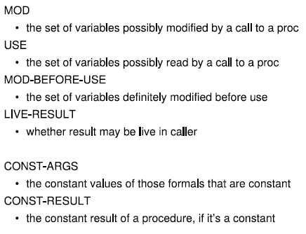
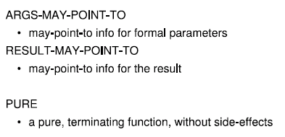
Examples of summaries

Slide 23
How to compute summaries
Using Iterative analysis
Keep the current solution in a map from procs to summaries
Keep a worklist of procedures to process
Pick a proc from the worklist, compute its summary using intraprocedural analysis and the current summaries for all other nodes
If summary has changed, add callers/callees to the worklist for callee/caller summaries

Slide 24
How to compute callee summaries
let m: map from proc to computed summary
let worklist: work list of procs
for each proc p in call graph do
m(p) := ?
for each proc p do
worklist.add(p)
while (worklist.empty.not) do
let p := worklist.remove_any;
// compute summary using intraproc analysis
// and current summaries m
let summary := compute_summary(p,m);
if (m(p) ≠ summary)
m(p) := summary;
for each caller c of p
worklist.add(c)

Slide 25
Examples
Let’s see how this works on some examples
We’ll use an analysis for program verification as a running example

Slide 26
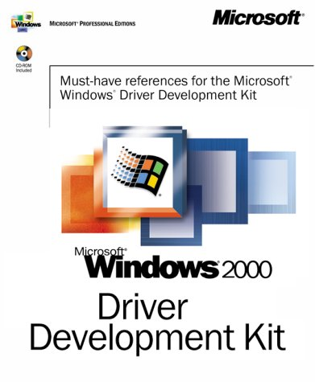

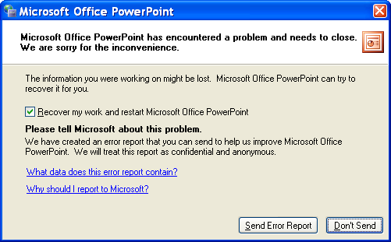
Protocol checking
Interface usage rules in documentation
  Order of operations, data access
  Resource management
  Incomplete, wordy, not checked
Violated rules ) crashes
  Failed runtime checks
  Unreliable software

Slide 27
FSM protocols
These protocols can often be expressed as FSMs
For example: lock protocol
*
Error
unlock
lock
lock
Unlocked
Locked
unlock

Slide 28
FSM protocols
Alphabet of FSM are actions that affect the state of the FSM
Often leave error state implicit
These FSMs can get pretty big for realistic kernel protocols

Slide 29
FSM protocol checking
Goal: make sure that FSM does not enter error state
Lattice:

Slide 30
Lock protocol example
main() {
g();
f();
lock;
unlock;
}
f() {
h();
if (...) {
main();
}
}
g() {
lock;
}
h() {
unlock;
}

Slide 31
Lock protocol example
main() {
g();
f();
lock;
unlock;
}
f() {
h();
if (...) { main(); }
}
g() { lock; }
h() { unlock; }
main
f
g
h

Slide 32
Lock protocol example
main() {
g();
f();
lock;
unlock;
}
f() {
h();
if (...) { main(); }
}
g() { lock; }
h() { unlock; }
main
f
g
h
u
;
;
;
;
;
;
;
”
”
”
”
u
”
”
”
”
”
”
”
”
l
”
”
”
”
l
”
”
”
”
”
”
”
”
”
”
”
l
”
”
”
”
”
”
”
”
u
”
”
”
u
”
”
”
”
”
u
”
”
”
”
”
”
”
”
”
u
”
”
”
”

Slide 33
Another lock protocol example
main() {
g();
f();
lock;
unlock;
}
f() {
g();
if (...) {
main();
}
}
g() {
if(isLocked()) {
unlock;
}
else {
lock;
}
}

Slide 34
Another lock protocol example
main() {
g();
f();
lock;
unlock;
}
f() {
g();
if (...) { main(); }
}
g() {
if(isLocked()) {
unlock;
} else { lock; }
}
main
f
g

Slide 35
Another lock protocol example
main() {
g();
f();
lock;
unlock;
}
f() {
g();
if (...) { main(); }
}
g() {
if(isLocked()) {
unlock;
} else { lock; }
}
main
f
g
u
;
;
;
;
;
”
”
”
”
u
”
”
”
”
”
”
l
”
”
l
”
”
”
”
”
”
”
{u,l}
”
”
”
”
”
”
{u,l}
”
”
{u,l}
{u,l}
”
”
{u,l}
{u,e}
”
”
”
”

Slide 36
What went wrong?

Slide 37
What went wrong?
We merged info from two call sites of g()
Solution: summaries that keep different contexts separate
What is a context?

Slide 38
Approach #1 to context-sensitivity
Keep information for different call sites separate
In this case: context is the call site from which the procedure is called

Slide 39
Example again
main() {
g();
f();
lock;
unlock;
}
f() {
g();
if (...) { main(); }
}
g() {
if(isLocked()) {
unlock;
} else { lock; }
}
main
f
g

Slide 40
Example again
main() {
g();
f();
lock;
unlock;
}
f() {
g();
if (...) { main(); }
}
g() {
if(isLocked()) {
unlock;
} else { lock; }
}
main
f
g

Slide 41
How should we change the example?
How should we change our example to break our context sensitivity strategy?
main() {
g();
f();
lock;
unlock;
}
f() {
g();
if (...) {
main();
}
}
g() {
if(isLocked()) {
unlock;
}
else {
lock;
}
}

Slide 42
Answer
main() {
h();
f();
lock;
unlock;
}
f() {
h();
if (...) {
main();
}
}
h() { g() }
g() {
if(isLocked()) {
unlock;
}
else {
lock;
}
}

Slide 43
In general
Our first attempt was to make the context be the immediate call site
Previous example shows that we may need 2 levels of the stack
  the context for an analysis of function f is: call site L₁ where f was called from AND call site L₂ where f’s caller was called from
Can generalize to k levels
  k-length call strings approach of Sharir and Pnueli
  Shiver’s k-CFA

Slide 44
Approach #2 to context-sensitivity

Slide 45
Approach #2 to context-sensitivity
Use dataflow information at call site as the context, not the call site itself

Slide 46
Using dataflow info as context
main() {
g();
f();
lock;
unlock;
}
f() {
g();
if (...) { main(); }
}
g() {
if(isLocked()) {
unlock;
} else { lock; }
}
main
f
g

Slide 47
Transfer functions
Our two pairs of summaries look like functions from input information to output information
We call these transfer functions
Complete transfer functions
  contain entries for all possible incoming dataflow information
Partial transfer functions
  contain only some entries, and continually refine during analysis

Slide 48
Top-down vs. bottom-up
We’ve always run our interproc analysis top down: from main, down into procs
For data-based context sensitivity, can also run the analysis bottom-up
  analyze a proc in all possibly contexts
  if domain is distributive, only need to analyze singleton sets

Slide 49
Top-down vs. bottom-up
What are the tradeoffs?

Slide 50
Top-down vs. bottom-up
What are the tradeoffs?
  In top-down, only analyze procs in the context that occur during analysis, whereas in bottom-up, may do useless work analyzing proc in a data context never used during analysis
  However, top-down requires analyzing a given function at several points in time that are far away from each other. If the entire program can’t fit in RAM, this will lead to unnecessary swapping. On the other hand, can do bottom-up as one pass over the call-graph, one SCC at a time. Once a proc is analyzed, it never needs to be reloaded in memory.
  top-down better suited for finite domains

Slide 51
Bottom-up example
main() {
g();
f();
lock;
unlock;
}
f() {
g();
if (...) { main(); }
}
g() {
if(isLocked()) {
unlock;
} else { lock; }
}
main
f
g

Slide 52
Bottom-up example
main() {
g();
f();
lock;
unlock;
}
f() {
g();
if (...) { main(); }
}
g() {
if(isLocked()) {
unlock;
} else { lock; }
}
main
f
g
?
?
?
u ! l
l ! u
”
”
”
u ! l
l ! u
”
u ! u
l ! e
”
”
u ! {l,e}
l ! u
”
”
u ! u
l ! e

