Slide 1
Interprocedural pointer analysis for C
We’ll look at Wilson & Lam PLDI 95, and focus on two problems solved by this paper:
  how to represent pointer information in the presence of casts, pointer arithmetic, unions, and all the rest of C.
  how to perform context-sensitive pointer analysis interprocedurally in a way that provides good precision at reasonable costs.

Slide 2
Representing pointer information for C
Problem:
  C types can be subverted by type casts: an int can in fact be a pointer.
  Pointer arithmetic can lead to subobject boundaries being crossed.
So, ignore the type system and subobject boundaries. Instead use a representation that decides what’s a pointer based on how it is used.
Treat memory as composed of blocks of bits:
  each local, global variable is a block
  each malloc returns a block.
Assume that casts and pointer arithmetic do not cross object boundaries.

Slide 3
Location sets
Location set is a triple (block,offset,stride), which represents the set of locations:
  { offset + i £ stride | i 2 Ints}
Expression | Location Set
scalar | (scalar,0,0)
struct.F | (struct,offs(F),0)
array[i] | (array,0,elmtSize)
array[i].F | (array,offs(F),elmtSize)
*(&p + X) | (p,0,1)
F
F
F
offset
stride
stride
This representation distinguishes between different fields within a structure, but not the different elements of an array.

Slide 4




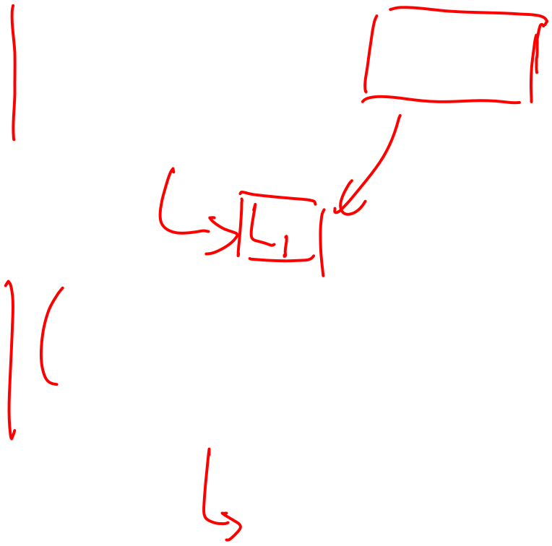





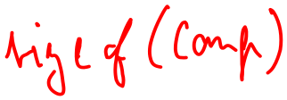


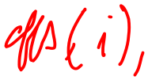
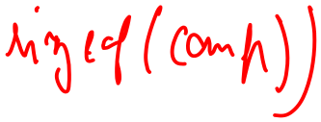

Points-to graphs with locations sets
struct Complex {
real* r;
real* i;
}
void f(int u,int v,
Complex a[]) {
L1: a[u].r := new real;
L2: a[u].i := new real;
p := a[v].r;
L3: ...
}
Points-to graph at L3:

Slide 5
Points-to graphs with locations sets
struct Complex {
real* r;
real* i;
}
void f(int u,int v,
Complex a[]) {
L1: a[u].r := new real;
L2: a[u].i := new real;
p := a[v].r;
L3: ...
}
Points-to graph at L3:
(a,offs(r),
sizeof(Complex))
(p,0,0)
(S1,0,0)
(a,offs(i),
sizeof(Complex))
(S2,0,0)

Slide 6
Interprocedural pointer analysis
Context-insensitive
  Smears effects of callers together. We can do better than that!
Context-sensitive: total transfer function (bottom up approach)
  Must summarize the effect of a procedure on all possible incoming alias patterns!
  It can be difficult to actually generate all the possible alias patterns.
  It can also be expensive to compute such summaries.

Slide 7
Wilson & Lam approach: PTFs
Compute partial transfer functions (PTFs), instead of total transfer functions.
A PTF for a procedure stores pairs (in,out) for those inputs in that have been seen during analysis.

Slide 8



Examples of (in,out) pairs
f(p,q,r) { *p = *q; *q = *r; }
PTF for f
in | out
… | …
p
*p
**p
p
*p
**p
q
*q
**q
q
*q
**q
r
*r
**r
r
*r
**r
p
p
*p
**p
*p
**p
r
r
q
*q
**q
q
*q
**q

Slide 9
Examples of (in,out) pairs
f(p,q,r) { *p = *q; *q = *r; }
PTF for f
in | out
… | …
p
*p
**p
p
*p
**p
q
*q
**q
q
*q
**q
r
*r
**r
r
*r
**r
p
p
*p
**p
*p
**p
r
r
q
*q
**q
q
*q
**q

Slide 10
Wilson & Lam algorithm
The analysis is done top-down:
  start from main()
  when a function call to f is hit, see if the current context matches any of the (in,out) pairs in f’s summary.
  If so, the info after the call is the out part of the pair (after appropriate renaming)
  Otherwise, analyze f in the current context curr to get the result res after the call. Also, update the summary for f with the pair (curr, res)

Slide 11
Example
f(p,q,r) {
*p = *q;
*q = *r;
}
main() {
x := &a; y:= &b; z := &b;
xp := &x; yp := &y; zp = &z;
if (...)
L1: f(&xp,&yp,&zp);
else
L2: f(&zp,&xp,&yp);
}

Slide 12







































Call site L1
 | caller | map | callee
in at L1
out at L1
PTF for f
in | out

Slide 13
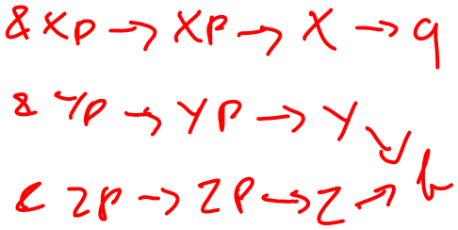


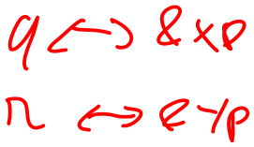



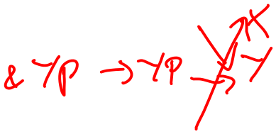





Call site L2
 | caller | map | callee
in at L1
out at L1
PTF for f
in | out

Slide 14
Call site L1
 | caller | map | callee
in at L1
out at L1
&xp
xp
x
a
p $ &xp
q $ &yp
r $ &zp
*p $ xp
**p $ x
*q $ yp
**p $ y
*r $ zp
**r $ z
p
*p
**p
&yp
yp
y
q
*q
**q
b
&zp
zp
z
r
*r
**r
&xp
xp
x
a
p
*p
**p
&yp
yp
y
q
*q
**q
b
&zp
zp
z
r
*r
**r
PTF for f
in | out
Add to summary
p
*p
**p
p
*p
**p
q
*q
**q
q
*q
**q
r
*r
**r
r
*r
**r

Slide 15
Call site L2
 | caller | map | callee
in at L2
out at L2
p $ &zp
q $ &xp
r $ &yp
*p $ zp
**p $ z
…
&xp
xp
x
a
&yp
yp
y
Use summary
b
&zp
zp
z
&xp
xp
x
a
&yp
yp
y
b
&zp
zp
z
PTF for f
in | out
p
*p
**p
p
*p
**p
q
*q
**q
q
*q
**q
r
*r
**r
r
*r
**r

Slide 16
Additional issues
Want the (in,out) pair to be as reusable as possible:
  compute the input context in on demand as the procedure is being analyzed
How does one determine that the input context matches one of the (in,out) pairs of the PTF?
How does one translate the information from the callee to the caller?

Slide 17
Comparison of PTF and total transfer fns
Total transfer functions:
  bottom up.
  summaries are complete.
  can discard a procedure once its summary has been computed.
  Keep one strongly connected component in memory at a time, or use a worklist of functions.
Partial transfer functions:
  top down, demand driven.
  may be less expensive, because summaries are computed only for those contexts that arise during analysis.
  Keep the whole program in memory, or use a worklist of functions.

Slide 18
Wilson & Lam experimental results
On benchmarks < 5,000 LOC:
  at most 16 secs to run the analysis
    “These times do not include the overhead for reading the procedures from the input files, building flow graphs, and computing dominance frontiers. Neither do they include the time required to write the results to the SUIF output files”
  average number of pairs in each PTF: 1.4
Used the pointer information to parallelize two benchmarks
  speedups vary from 1.42 to 3.5 depending on the benchmark and the number of processors (2 or 4)
How will analysis time scale with the number of fns?
How useful is the pointer info for other opts?

Slide 19
Steensgaard: almost linear time points-to analysis
Wilson & Lam algorithm doesn’t scale to millions of lines of code.

Slide 20
Example revisited
Cost:
  space: store one fact at each prog point
  time: iteration
S1: l := new Cons
Iter 1
Iter 2
Iter 3
p := l
p
t
l
p
t
S1
l
S1
S2
p
l
S1
S2
S2: t := new Cons
p
t
p
t
l
S1
t
S2
l
S1
L2
l
L1
L2
p
*p := t
t
p
t
p
t
l
S1
S2
l
S1
S2
l
S1
S2
p
p := t
p
t
p
t
p
t
l
S1
S2
l
S1
S2
l
S1
S2

Slide 21
New idea: store one dataflow fact
Store one dataflow fact for the whole program
Each statement updates this one dataflow fact
  use the previous flow functions, but now they take the whole program dataflow fact, and return an updated version of it.
Process each statement once, ignoring the order of the statements
This is called a flow-insensitive analysis.

Slide 22
Flow insensitive pointer analysis
S1: l := new Cons
p := l
S2: t := new Cons
*p := t
p := t

Slide 23
Flow insensitive pointer analysis
S1: l := new Cons
p := l
l
S1
p
S2: t := new Cons
l
S1
t
S2
p
*p := t
t
l
S1
S2
p
p := t
p
t
l
S1
S2

Slide 24
What went wrong?

Slide 25
What went wrong?
What happened to the link between p and S1?
  Can’t do strong updates anymore!
  Need to remove all the kill sets from the flow functions.
What happened to the self loop on S2?
  We still have to iterate!

Slide 26
Flow insensitive pointer analysis
S1: l := new Cons
p := l
S2: t := new Cons
*p := t
p := t

Slide 27
Flow insensitive pointer analysis: fixed
This is Andersen’s algorithm ’94
Final result
S1: l := new Cons
Iter 1
Iter 2
Iter 3
p := l
p
t
l
p
t
S1
l
S1
S2
p
l
S1
S2
S2: t := new Cons
p
t
p
t
l
S1
t
S2
l
S1
L2
l
L1
L2
p
*p := t
t
p
t
p
t
l
S1
S2
l
S1
S2
l
S1
S2
p
p := t
p
t
p
t
p
t
l
S1
S2
l
S1
S2
l
S1
S2

Slide 28
Flow insensitive loss of precision
Flow insensitive analysis leads to loss of precision!
main() {
x := &y;
...
x := &z;
}
Flow insensitive analysis tells us that x
may point to z here!
However:
  uses less memory (memory can be a big bottleneck to running on large programs)
  runs faster

Slide 29
Worst case complexity of Andersen
x
y
*x = y
x
y
a
b
c
d
e
f
a
b
c
d
e
f
Worst case: N² per statement, so at least N³ for the whole program. Andersen is in
fact O(N³)

Slide 30
New idea: one successor per node
Make each node have only one successor.
This is an invariant that we want to maintain.
x
y
*x = y
a,b,c
d,e,f

Slide 31
New idea: one successor per node
Make each node have only one successor.
This is an invariant that we want to maintain.
x
y
x
y
*x = y
a,b,c
d,e,f
a,b,c
d,e,f

Slide 32
More general case for *x = y
x
y
*x = y

Slide 33
More general case for *x = y
x
y
x
y
x
y
*x = y

Slide 34
Handling: x = *y
x
y
x = *y

Slide 35
Handling: x = *y
x
y
x
y
x
y
x = *y

Slide 36
Handling: x = y (what about y = x?)
x
y
x = y
Handling: x = &y
x
y
x = &y

Slide 37
Handling: x = y (what about y = x?)
x
y
x
y
x
y
x = y
get the same for y = x
Handling: x = &y
x
y
x
y
x
x = &y
y,…

Slide 38
Our favorite example, once more!
S1: l := new Cons
1
p := l
2
S2: t := new Cons
3
*p := t
4
p := t
5

Slide 39
Our favorite example, once more!
1
l
2
l
p
S1: l := new Cons
1
S1
S1
3
p := l
2
l
p
t
l
p
t
S2: t := new Cons
4
3
S1
S2
S1
S2
5
*p := t
4
l
p
t
l
p
t
p := t
5
S1
S2
S1,S2

Slide 40
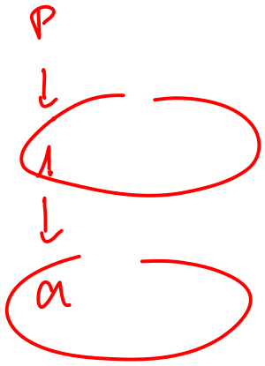


Another example
bar() {
i := &a;
j := &b;
foo(&i);
foo(&j);
// i pnts to what?
*i := ...;
}
void foo(int* p) {
printf(“%d”,*p);
}
1
2
3
4

Slide 41




Another example
p
bar() {
i := &a;
j := &b;
foo(&i);
foo(&j);
// i pnts to what?
*i := ...;
}
void foo(int* p) {
printf(“%d”,*p);
}
1
i
2
i
j
3
i
j
1
2
a
a
b
a
b
3
4
4
p
p
i
j
i,j
a
b
a,b

Slide 42
Steensgaard & beyond
A well engineered implementation of Steensgaard ran on Word97 (2.1 MLOC) in 1 minute.
One Level Flow (Das PLDI 00) is an extension to Steensgaard that gets more precision and runs in 2 minutes on Word97.
CLA (Heintze and Tardieu PLDI 01) shows how to run Andersen in 1 second on 1 million lines of C code.

