Slide 1
MCA681 – Industry Project Presentation – I
Health care facility system
Chandralekha S
2147143
Industry Guide Name: Grace Lydia Institution Guide Name: Dr. Loganayaki
Designation and Affiliation: HR Ops Manager Designation and Affiliation: Professor

Slide 2
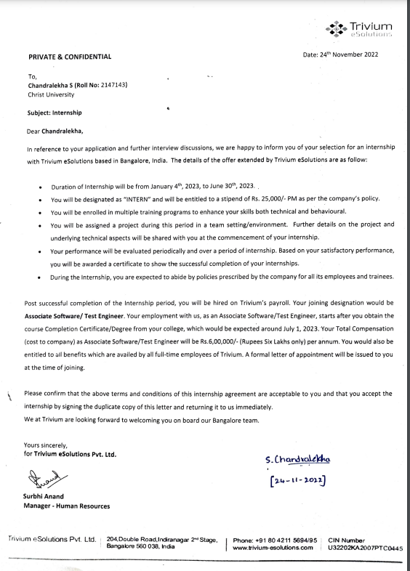
Offer Letter
2

Slide 3
About the Organization
Organization Name: Trivium e-solutions
Consulting - Software Development - Industrial IoT For your digital future.
Trivium eSolutions helps you shape your digital future with Consulting and Software Development services. We accompany our customers in all phases of the digital transformation. Our portfolio of services spans design, software architecture, technology consulting, project management and agile software development.
With a deep understanding of digitalization and the Industrial IoT domain, we help our customers to build scalable software applications that are innovative, secure, robust and user-oriented. Our teams of experts span our office locations in Germany and India and provide a unique combination of technology competence, innovativeness, quality, agility and competitiveness to our customers.
3

Slide 4
About the Project Domain
Project Domain: Health care facility system
A lot of small scale health care centers don't have a proper management system to store patient details, appointment booking facilities, inventory management, etc and cloud based services are also would not be affordable to these small scale health care centers, Thus this project is java based Management system for a health care facility, This project includes Registration module for patients to register, appointment booking module to book an appointment for patient, functionalities to store patients records, Billing module for pharmacy, and pharmacy inventory control. with this project every small-scale health care centers can automate their process in a cost-effective way.
4

Slide 5
About the Project
This project contains different functionalities:
Registration of patients
Making appointments
Storing patient records
Billing in the pharmacy
Pharmacy stock controlling
5

Slide 6
About the Roles and Responsibilities
Currently working as a full stack developer on this project but focusing more on the functionality part of the project, considering the Backend design, Frontend functionalities.
6

Slide 7
Tasks Completed
Tasks completed during the period
Task - 1: Understood the project requirements
Registration of patients
Making appointments
Billing in the pharmacy
7

Slide 8
Tasks Completed
Tasks completed during the period
Task - 2: Defined all the classes with abstract methods to implement it later
Task - 3: Loaded the JDBC Drivers for Backend connection into the project
Task - 4: Explored on JDBC (Java Database Connectivity) it’s Drivers, Classes, Methods
Task - 5: Explored on Maven project build which is a part of devOps for version control within the project and building the project
8

Slide 9
Tasks Completed
Tasks completed during the period
Task - 6: Explored on Junit which is a part of devOps for test automation, which helps in unit testing while developing the application, this would maintain the documentation part with ease.
Task - 7: Explored on Git and Github for version control of the code
Task - 8: Also Working on mysql connection using JDBC
9

Slide 10
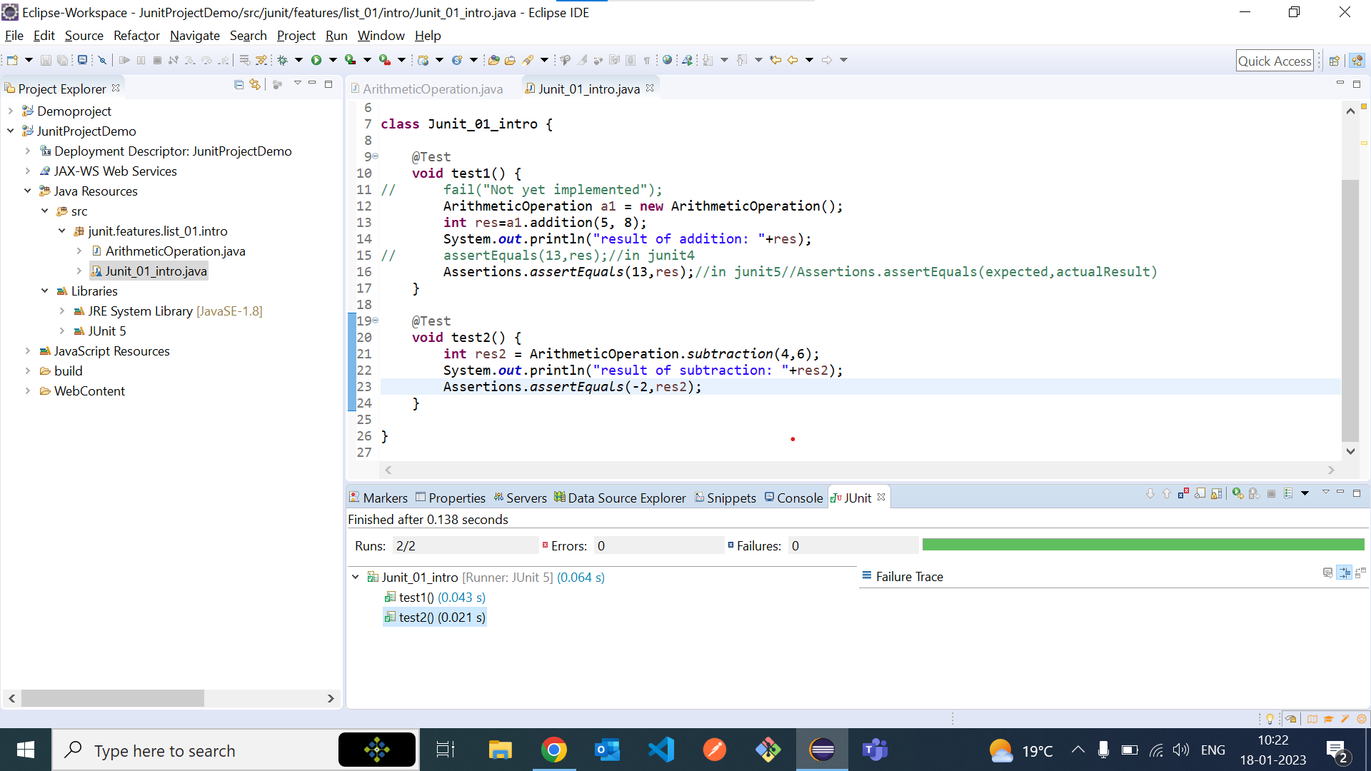
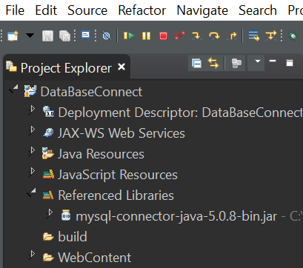
Tasks Completed
Tasks completed during the period
10

Slide 11
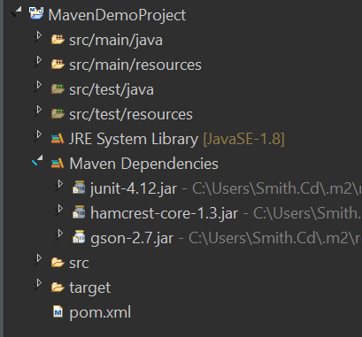
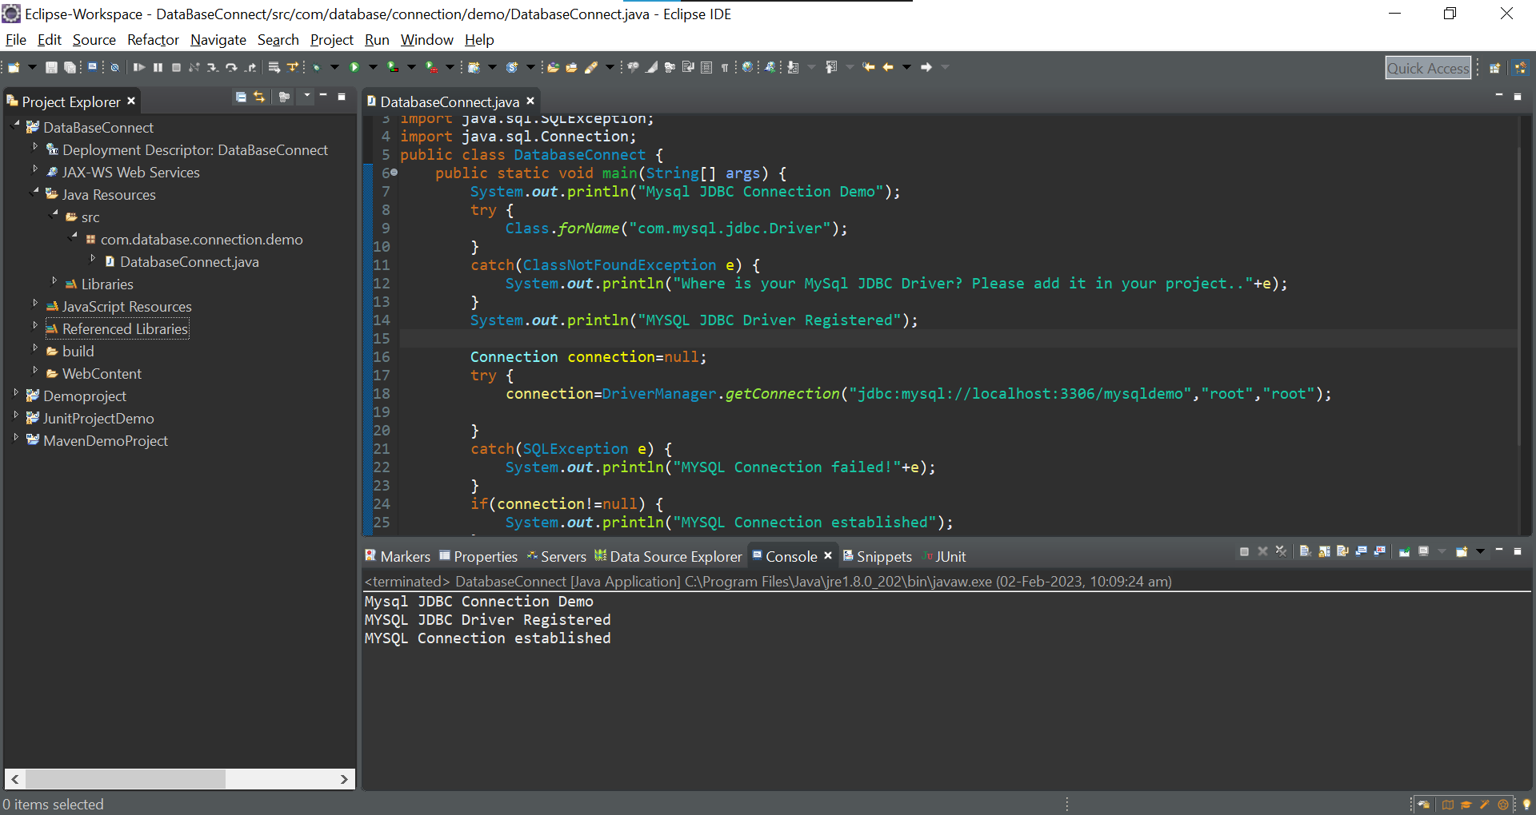
Tasks Completed
Tasks completed during the period
11

Slide 12
Tasks On-Going / Planned
Tasks ongoing / planning for the subsequent period
Task - 1: Defining all the Abstract methods.
Task - 2: Implementing all the interfaces.
Task - 3: Building a Maven project.
Task - 4: Writing test cases for test automation simultaneously.
12

Slide 13
Conclusion
Learning's / findings during the period
Understood JDBC which will be helpful for the front end and back-end connectivity.
Got to know the industry standards in various parts of development of an application
13

Slide 14
THANK YOU!!!
14

