Slide 1
SMART RECHARGE
A Console-Based Recharge Application
Presented by:
T.CHANDRA SIDDHARTHA
R.JAI

Slide 2
Introduction
Purpose: Simulate a mobile recharge system using C.
Features:
- Plan browsing (data, roaming, special).
- State and SIM selection.
- UPI PIN entry using stack.
- Dynamic plan handling with linked lists.

Slide 3
Key Components
- PlanCategories Struct: Holds linked lists for 4 recharge types.
- Plan Struct: Linked list node for each plan.
- Stack Struct: For UPI PIN input (LIFO).

Slide 4
Workflow Steps
1. Enter mobile number.
2. Choose state.
3. Choose SIM provider.
4. Choose plan category.
5. Select plan.
6. Enter UPI PIN.
7. Confirm and display recharge success.

Slide 5
Data Structures Used
- Linked List:
To store and display plans dynamically.
- Stack:
To mask and verify 6-digit UPI PIN input.

Slide 6
Sample Code Snippets
Plan Node Definition:
typedef struct Plan {
char description[100];
float price;
struct Plan* next;
} Plan;
Stack for UPI:
typedef struct {
int top;
char digits[MAX];
} Stack;

Slide 7
Plan Initialization
void initializePlans(PlanCategories* pc) {
pc->dataPacks = addPlan(...);
pc->intlRoaming = addPlan(...);
...
}
- Adds predefined plans to linked lists.

Slide 8
UPI PIN Handling
- UPI entered digit by digit.
- Stored in stack.
- Displayed as masked * during verification.

Slide 9
Memory Management
Frees all allocated memory for plans at the end.
Example:
while (categories.dataPacks) {
temp = categories.dataPacks;
...
free(temp);
}

Slide 10
Conclusion
- Demonstrates real-life use of:
- Linked lists
- Stack
- Modular programming
- Can be extended with:
- File handling
- GUI or Web interface
- Database integration

Slide 11
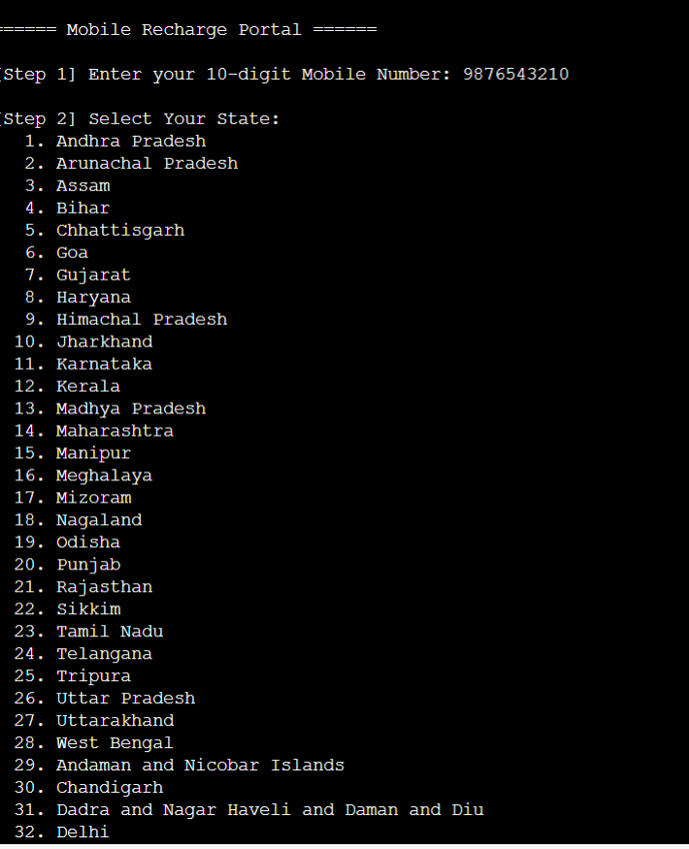
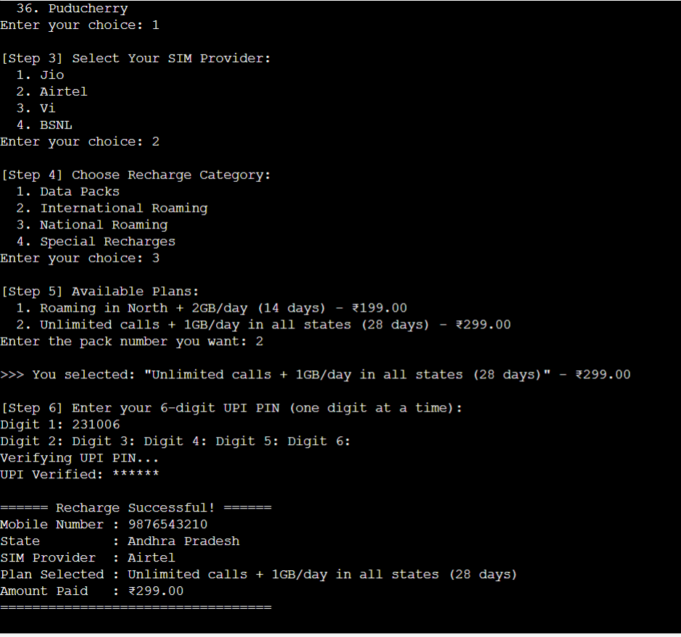
Final Output
- Recharge success message.
- Displays:
- Mobile number
- State and SIM
- Selected plan and price

Slide 12
THANK YOU

