Slide 1
Brain Tumor Segmentation Using Convolutional Neural Networks in MRI Images
Guided by
Assistant Professor Mrs.M. BLESSY QUEEN MARY
Submitted by
CHANDRALEKHA S(1418107)
RUCKSHANA S(1418138)
SUBHASHRI J(1418147)
SWATHI S(1418148)

Slide 2
OBJECTIVE:
To detect the brain tumors with the highest mortality rate and prevalence.
ALGORITHM:
Deep convolution neural network.

Slide 3
INTRODUCTION:
A Deep convolutional Neural Network (DCNN) is comprised of one or more convolutional layers and then followed by one or more fully connected layers.
The DCNN is designed to take advantage of the 3D filter of an input image.

Slide 4
Existing system Challenges:
MRI images are altered by the bias ﬁeld distortion. This makes the intensity of the same tissues to vary across the image.
It can vary even if the image of the same patient is acquired in the same scanner in different time.

Slide 5
Overview of the proposed system:
..

Slide 6
Image acquisition
Training Set
Test Set
Feature Extraction
Test Image
Image
Database
Feature Extraction
Neural Networks Learning
Similarity Function
Image classification rate

Slide 7
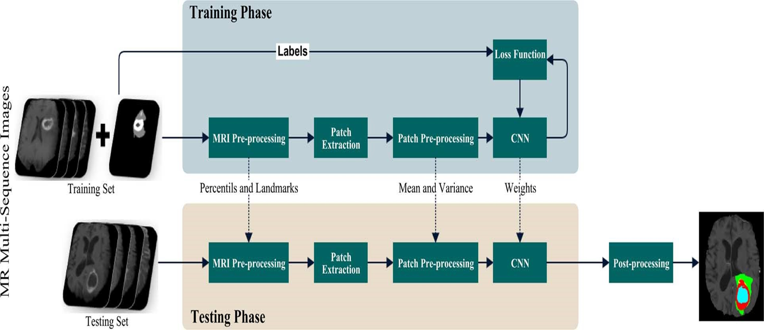

Slide 8
THREE STAGES:
Preprocessing:
After normalizing compute the mean intensity value and standard deviation across all training patches extracted for each sequence.
Convolution neural network:
In CNN image with kernels to obtain feature maps. So map is connected to the previous layer through the weights of the kernels.
Post processing:
Removing clusters in the segmentation obtained by the CNN that are smaller than a predeﬁned threshold .

Slide 9
MODULES
1.Preprocessing
2.Feature extraction
3.Image Recognition

Slide 10
MODULE-1
Start
Images
Apply intensity Normalization Method
After normalizing , compute Mean and standard deviation
After computing ,normalize each sequence to have zero mean and unit variance
Stop

Slide 11
PREPROCESSING:
MEAN FORMULA:
X=X-MEAN(X(:))
VARIANCE:
X=X/STD(X(:))

Slide 12
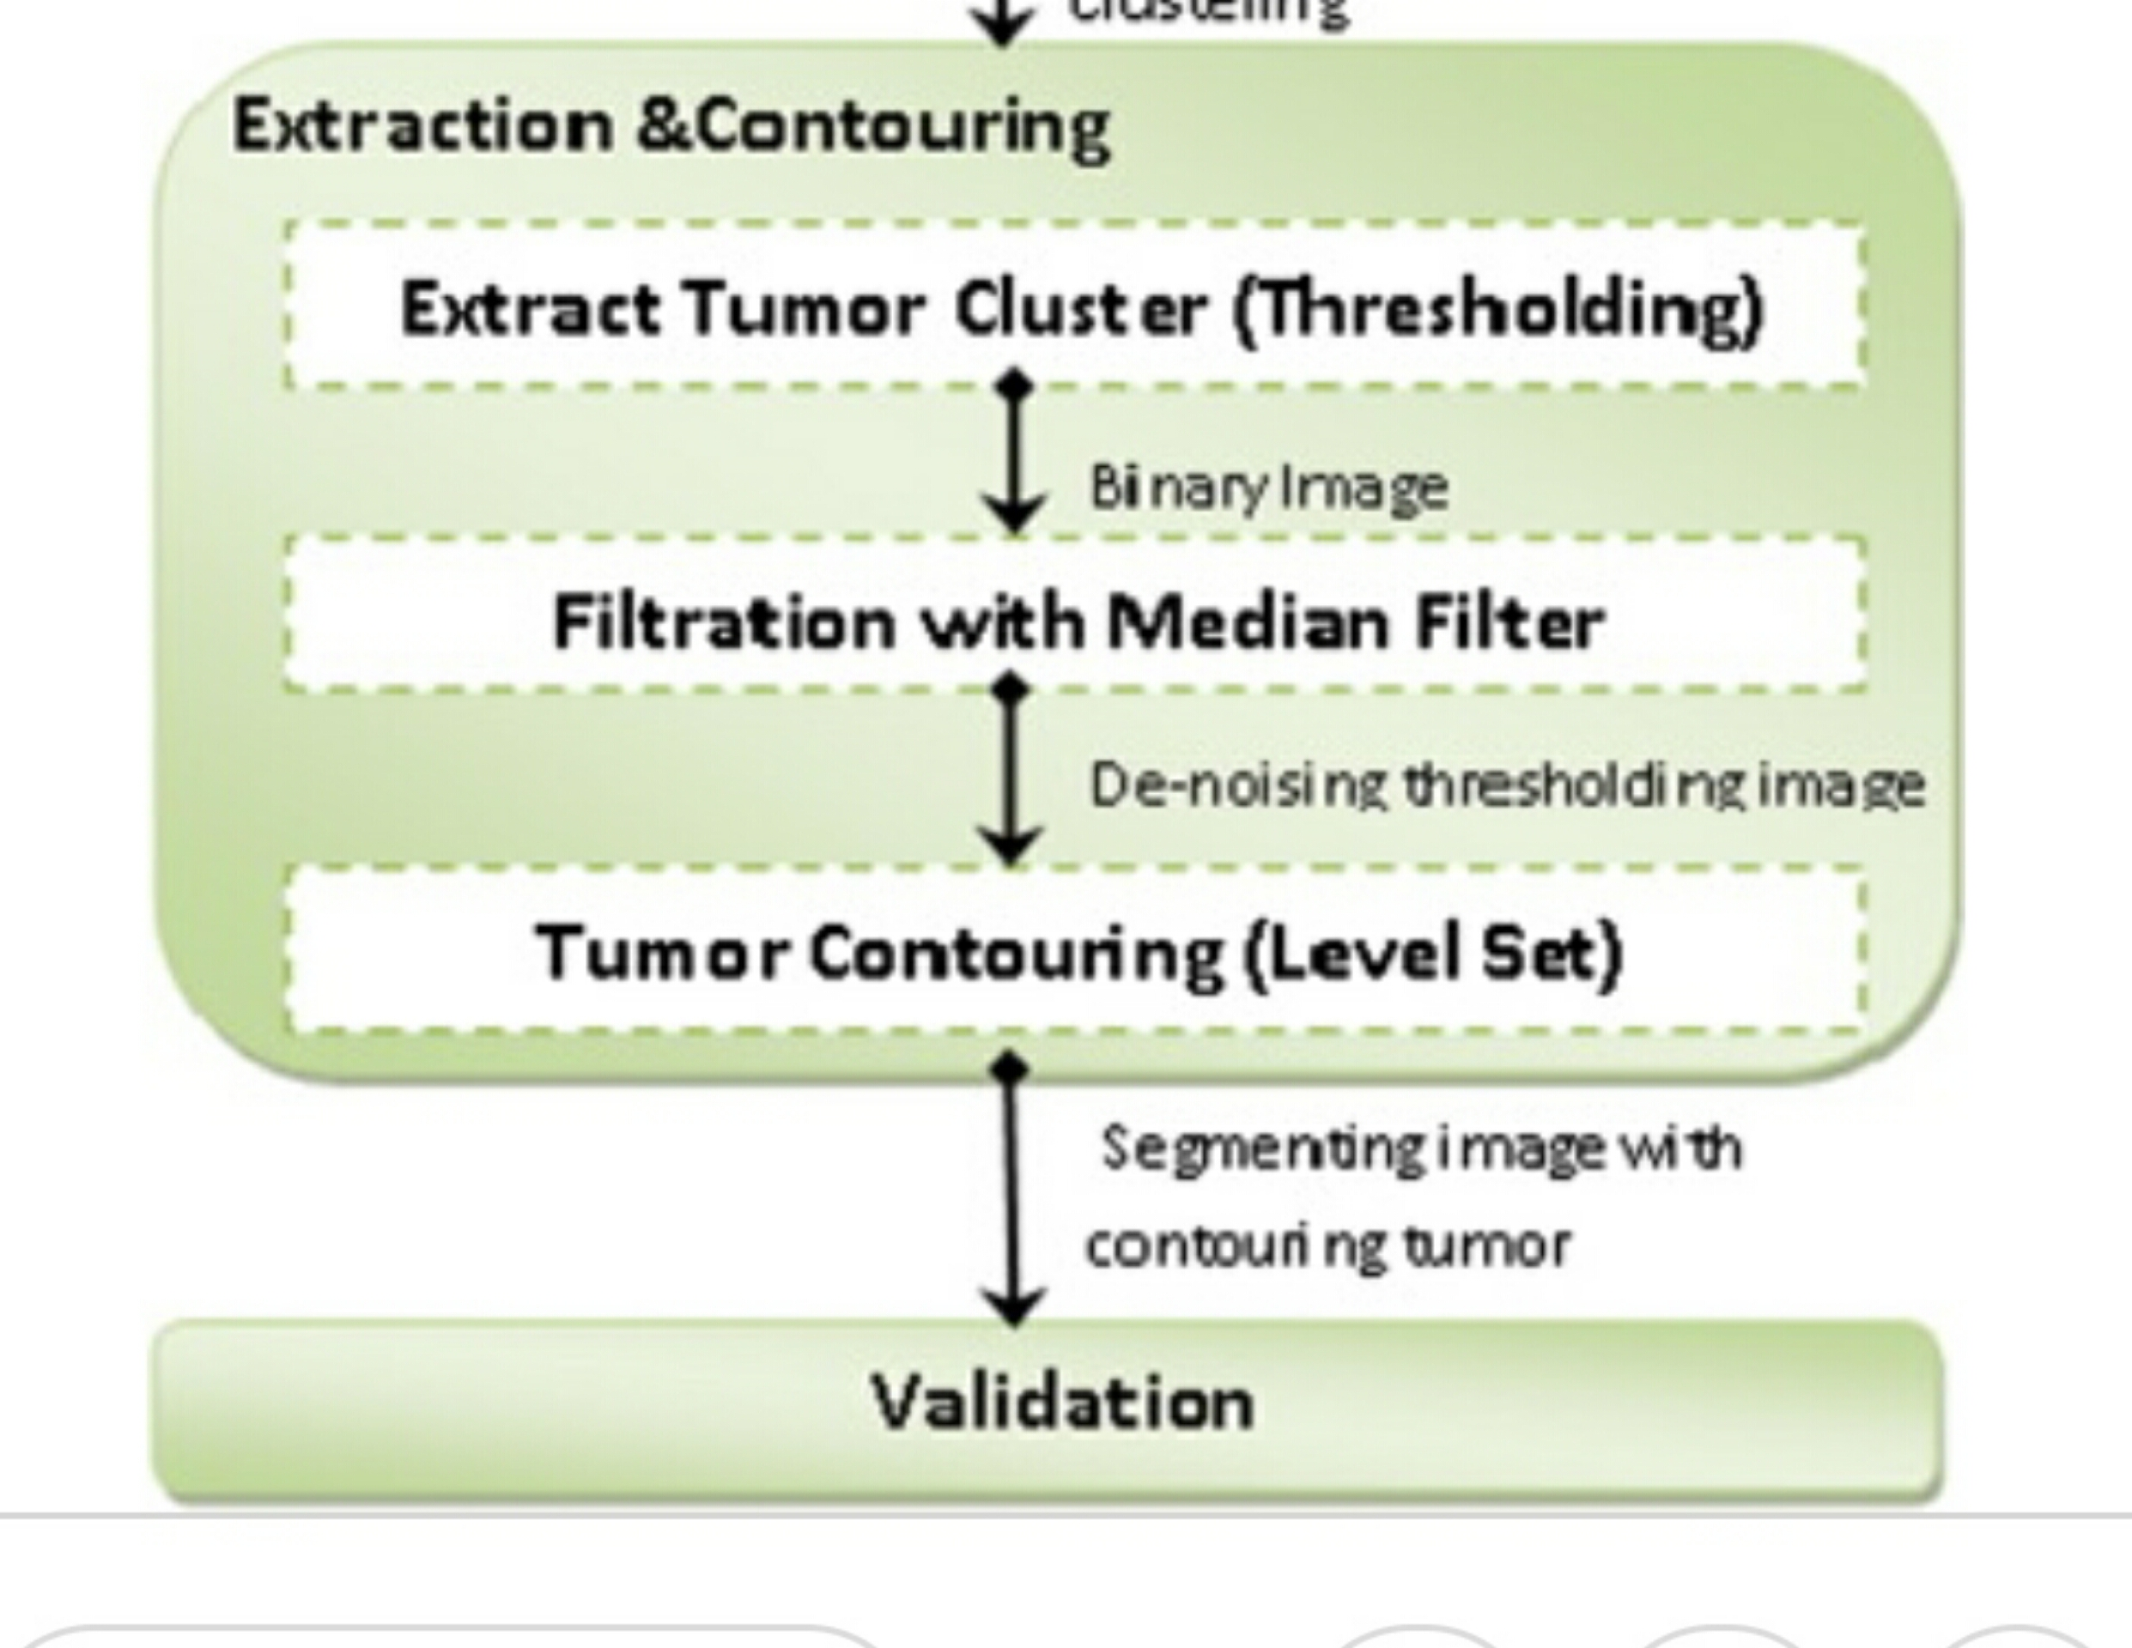
MODULE-2

Slide 13
MODULE-3
yes
Start
Get the extracted image
Classification
Is extracted image is normal
No
Tumor is identified
No tumor occur
Stop

Slide 14
THANK YOU!!!

