Slide 1


ISG Area: Sales & Marketing Idea Title: AIMAX- Marketing Optimizer Problem Statement: Our AIMAX Tool helps Brand and Marketing teams to take informed strategic and tactical marketing decisions by providing actionable insights to develop effective promotional strategies. With use of AI/ML, the application has built-in cognitive capability to determine the principal components influencing relation between promotion type and growth, define appropriate customer segments using both potential and behavior features, perform dynamic market sizing with prospective view considering future events and eventually provide recommendations for optimal marketing mix to maximize effectiveness and generate the highest return on promotional investment.
Team Captain ID/Name: 785552- Akshara Venkatesan Team Member ids: 174230, 434896, 584961, 578289, 672190
Team name: Team AIMAX ;Account Name: Merck Date: 25-Sep, 2020

Slide 2
How to Use This Document
The following template will help you craft your business case/idea proposal-Solution presentation. Replace the instructions with your own information.
Add additional sliders in main section as necessary.
Add the Working sliders of User Journey / User Persona / Questions that you have framed during Discover phase etc in Appendix section
Please use the file naming convention recommended: IH2020_IdeaTitle_TeamCaptainID_Teamname/individualname
Ex. IH2020_MAXTOOL_180386_TeamDragon or IH2020_MAXTOOL_180386_Divya
Do mail the updated solution deck to Arunaa/Divya (180386;164041) on or before Sep 25th 2020.
What next:
Post your submission, a peer presentation to larger audience - core team, Delivery LT and peers would be organized. As per your choice for prototyping , the prototype phase starts from Sep 28th - mid Oct.
For any clarifications, reach out to Arunaa/Divya.

Slide 3
Table of Contents
Vision statement
Executive Summary
Business Need—Statement & Analysis
Solution & Stakeholders- Primary and Secondary Users
Architectural diagram
Innovation / Business Impact
Benefits- include all key points
Process/ Architecture View – The target state process flow / use case view
Business to Technology Mapping
Prototype Readiness
Possible implementation Schedule
Risks
Financials—Costs
Financials—ROI
Summary of Solution – Key Highlights

Slide 4
Vision Statement
Industry and Solution Group: Sales & Marketing
Theme category: Campaign Management
Sub theme: Multichannel Mix, Channel/Campaign Deep Dive, Investment and ROI
Our AIMAX Tool helps Brand and Marketing teams to take informed strategic and tactical marketing decisions by providing actionable insights to develop effective promotional strategies. With use of AI/ML, the application has built-in cognitive capability to determine the principal components influencing relation between promotion type and growth, define appropriate customer segments using both potential and behavior features, perform dynamic market sizing with prospective view considering future events and eventually provide recommendations for optimal marketing mix to maximize effectiveness and generate the highest return on promotional investment.

Slide 5
Executive Summary
Problem /Mission Statement: Our AIMAX Tool helps Brand and Marketing teams to take informed strategic and tactical marketing decisions by providing actionable insights to develop effective promotional strategies. With use of AI/ML, the application has built-in cognitive capability to determine the principal components influencing relation between promotion type and growth, define appropriate customer segments using both potential and behavior features, perform dynamic market sizing with prospective view considering future events and eventually provide recommendations for optimal marketing mix to maximize effectiveness and generate the highest return on promotional investment.
Solution: AIMAX is a comprehensive Marketing Analytics solution that serves as the hub for Marketing Planning, Analysis and Optimization processes. It enables developing the best multi-channel promotional strategies along with the return on investment, by analyzing a multitude of factors and their interplay. AIMAX identifies and recommends the optimal channel-wise marketing mix while also predicting the performance of a product and its competitors in future, thereby enabling effective decision making.
Benefits to Client:
Holistic view of multi-channel marketing KPIs with strategic action recommendations for channel selection and budget allocation
Sophisticated analytics on traditional and digital marketing data for better ROI
Modular approach with flexibility to deploy specific analysis based on customer requirement
Easy deployment/customization- scalable solution for changing market dynamics

Slide 6
Executive Summary
Critical Features
Innovative AI/ML approach and analytical methodologies
Determine the channel-wise impact of promotions on brand sales and growth
Helps identify the right engagement channels and optimal marketing mix for best results
Recommendations to improve ROI by Optimizing marketing budget allocation and spends across marketing channels
Simulate the future market scenario and predict performance of a product and its competitors
Technology Stack: R, RShiny, DBMS to be aligned based on client infrastructure
Scalability / Reusability /Sustainability
Light solution which can be easily deployed across markets/geographies/countries
Data integration across platforms for holistic customer and business performance view
Adaptable prediction mechanism based on data availability and quality
Why should your client invest in this solution?
As our client has a portfolio of both Launch and LOE products, a Marketing Analysis and Optimization enabler shall greatly help streamline and standardize planning and implementation of Marketing activities and investments to yield a higher return on promotional investment

Slide 7
Business Need—Statement & Analysis
Purpose:
Over the past few years, Sales & Marketing spend has been equal to/greater than R&D spend for major pharma players, showing the importance of the function in a company’s growth.
Customer engagement models and channels are constantly evolving, with the line between traditional and digital marketing blurring.
There is immense pressure for differentiation, with marketers feeling that connecting with their customers through the right engagement channels is their biggest challenge, while marketers also experience the challenge of having to demonstrate high return on investment (ROI) from a diverse portfolio of marketing programs.
In general, marketing mix is decided by the brand marketing team based on hunch/experience and industry practices, allowing room for a better analysis-based method.
Most of the existing analytics tools in the market work in silos or concentrate majorly on few primary channels like Sales Force Promotions, Campaigns, while Digital channels are clubbed together as one unit. As a result, the analysis are unable to accurately determine the channel (sub)-wise impact of promotion on brand sales and the optimal marketing mix required for achieving better results.
Thus, there is a need to standardize KPIs across multiple engagement channels and provide holistic view of promotions by standardizing traditional and digital media marketing. This will help take effective marketing decisions to maximize effectiveness and increase return on promotional investment.
These necessitate the need for a one-stop solution to function as an optimizer to help plan marketing activities and investments across multiple channels through data-driven decision-making. This shall help marketers to keep track of both strategic and tactical elements, and build better/optimize brand strategy.

Slide 8

AIMAX Solution & Stakeholders
AIMAX- Marketing Optimizer
A comprehensive AI/ML enabled Marketing Analytics tool to function as a one-stop solution for Marketing planning and optimization processes- to help plan marketing activities and investments across multiple channels, enabling data-driven decision-making for best results
AIMAX will help answer key questions that marketers face while devising Brand Strategies
Users: Brand and Marketing Managers of pharmaceutical companies
shall be the main users of the solution.
Some of the analysis can also be utilized by senior
management.
How to identify right engagement channels and optimal mix for better results
What is the channel-wise impact of promotions on brand sales and growth
How can I improve ROI by Optimizing marketing budget allocation across marketing channels
How to target specific competitors by strategizing channel wise spend in order to gain market share
What would be the future market scenario and growth trajectory of a brand

Slide 9








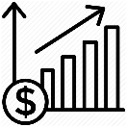

Features and Capability Overview
AIMAX- advanced marketing analytics solution that leverages a thorough data strategy coupled with advanced analytics methodologies to derive insights for marketing
Holistic approach that takes into account all available and meaningful information and turns customer interactions & activities across channels into actionable insights
Customer Data Center
Advanced Analytics & Insights
Personalization
Strategic Approach
Omni-channel data integration for holistic customer and business performance view
Sophisticated analytics to deepen customer and business insights for better ROI
Redefine the way to engage and drive top-line revenues through personalization
360°view of market and brand to enable proper planning and execution
Advanced Analytics Reusable Assets
Channel Impact
Right Channel Mix Identification
Promotional Spend Optimization
Brand Performance Analysis
Market Forecasting
Measure the impact of each marketing channels and identify right engagement channels for marketing strategy
Identify the optimal Multi - Channel Mix for promotion activities
Evaluate channels for promotion response and optimize the spend across the channels
Competitor analysis to show the performance of a brand in a particular therapy area
Leverage past promotion data and predict how proposed promotions may affect the future

Slide 10

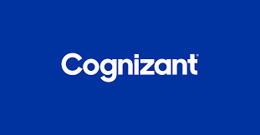





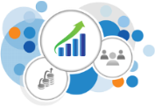



High-level Process Overview
1
2
3
Franchise owners/team sends customization request to Cognizant as per their brand requirement
Cognizant does the necessary customization in solution/models and shares back the version.
Data Input: Brand teams uploads data for analysis
4
Optimization Models
Channel Deep-dive: Analysis of KPIs of Traditional & Digital Marketing
Channel Impact Simulator: Shows the effect of each channel on Brand Sales
5
ROI Analysis: Determine ROI of marketing programs and channels
Tracking performance: Portfolio Owners can assess the performance and take strategic decisions.
Brand & Market Forecasting : using time-series forecasting
NBA/NBP: Recommendation for Optimal Marketing Mix
Brand Performance Analysis: Depict brand’s competitive position with recommendation to improve sales

Slide 11





High level Solution Architecture
AIMAX leverages data from digital & traditional channels and applies advanced analytics methodologies to drive insights for customer centric marketing
Data Layer
Processing
Analysis
Digital data
Data Integration
Marketing Mix Analysis
Digital media channels Campaign-
Activity & response Data
Data Validation
ROI Analysis
Business rules implementation
Traditional data (Offline data)
Market Simulator
Traditional marketing channels data
KPI framework
Sales data
Brand Performance Analysis
Advanced Marketing Analytics models
Promotional Spending data
Market Rx data
Market & Brand Forecast
Platforms
Flat Files
SQL Lite

Slide 12


Pre-Post Assessment – User Journey Map
Pre-AIMAX
Information Gathering
Analysis
Marketing Mix Planning
Marketing Performance Analysis
Post-AIMAX
Marketing Mix Planning
Marketing Performance Analysis
Information Gathering
Analysis

Slide 13


User Journey Map – Post AIMAX
Stage
Information Gathering
Analysis
Marketing Mix Planning
Marketing Performance Analysis
Mindset
Look to gather maximum data to serve as a base for analyses to take effective decisions
Try to derive maximum insights from data collected.
Look out for trends and competitor’s marketing patterns for potential benchmarking
Look to design the ideal marketing mix for target sales and brand growth by optimizing the marketing activities and investments across the multiple channels
Determine the success of marketing programs by choosing the correct metrics and measuring the ROI
Activity
Data Gathering from Primary & secondary sources
Sales data of brand and competitors
Information of Multi-channel marketing activities and investments of own brand and competitors
Market Performance data
Analysis of Sales and marketing data to identify trends and patterns
Lookout for best performing campaigns and their impact
Identify key customer segments and responsive channels for marketing
Identify brand goals from Marketing, based on brand vision and strategy
Develop multi-channel marketing mix based on analyses & brand strategy
Plan out individual campaigns/activities for each channel to ensure better engagement
Identify suitable metrics- KPIs to evaluate and track performance of marketing activities
Determine the ROI of marketing activities along with effectiveness of each channel
AIMAX’s Role
Parse and process the input data
Identify the right engagement channels for each customer type and identify trends
Analyze the market and brand’s competitive performance
Evaluate the channel-wise impact of promotions on brand sales
Recommend optimal marketing mix
Calculate the ROI of marketing activities and suggest further optimizations to improve promotional ROI
Forecast future market performance
Emotion

Slide 14
Innovation / Business Impact
Beneficiary : Brand/Franchise Teams within Pharma organization
Area of Innovation: Business (Market facing)
Considering that AIMAX will be a niche analytics/data science solution, most of the benefits are intangible benefits which help standardize and improve marketing strategies and promote the brand sales.
Following are 3 specific use case slides which showcase Client benefits we can derive from the solution. But the overall objective of the solution will not be limited to these
The solution will enable Value Creation and Performance Improvement by recommending optimal marketing activities and investments, driving greater yield on promotional investment.
For computation of tangible benefits, given that this will be a universal solution for all brands, the tangible benefit will vary based on Brand (blockbuster, generics) and the market conditions

Slide 15



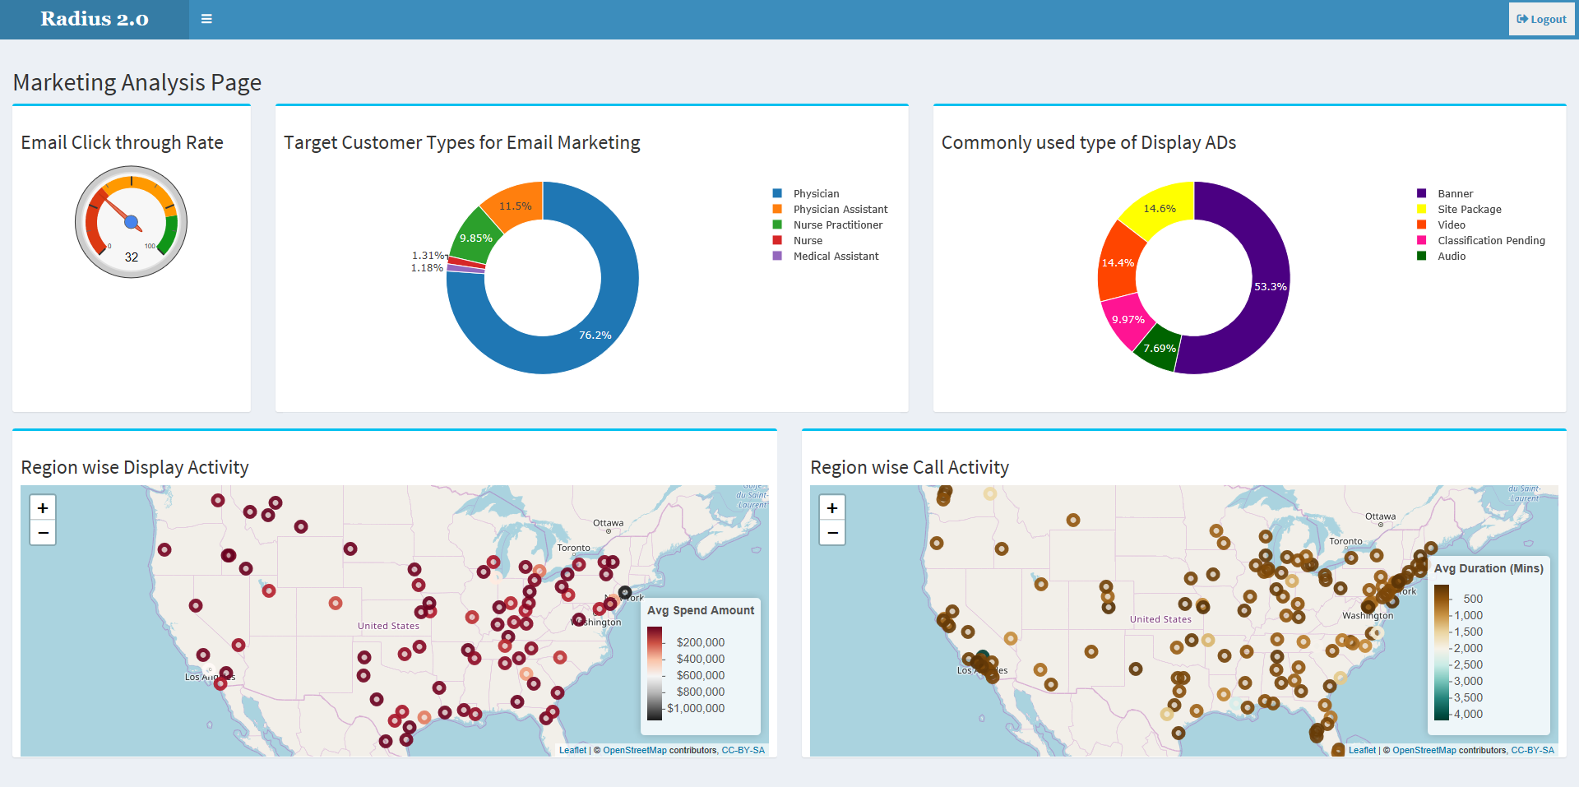
Use case 1: Optimal Promotional Channel Marketing Mix with AI-based recommendation
Leverage the data from promotional channels along with their return on promotional investment to recommend optimal marketing mix to achieve target sales
Situation: Pharmaceutical companies allocate the marketing budget in multiple promotional channels varyingly, being unable to identify the optimal Marketing Mix
Solution: Perform channel (sub) deep-dive and use AI/ML-based recommendation engine to generate the optimal Marketing Mix to promote growth and enhance ROI
Inputs
Approach
Output/Result
Aggregate the product level monthly sales and promotional spend data for all channels
Analyze multiple KPIs to conduct detailed analyses on the nature of multi-channel promotions and investment made on each channel Deficit
Build a regression model to determine and measure the impact of channel-wise promotions on total product sales Impact assessment is weak/unavailable
Perform ROI Analysis on each promotional channel to identify the best performing channels Check
Build a model to give optimal Marketing Mix to achieve the target Sales with highest ROI
Multi-channel promotional data for identified products and it’s related market basket
Sales data of brand
Summary of promotional spending on different channels along with determining the effect of marketing programs/campaigns Descriptive Analytics
Identify a benchmark for measuring the marketing performance weak
Recommendation on optimal Marketing Mix that can generate target brand sales which can simulate changing scenarios sales target needs to be defined
Improve ROI by Optimizing marketing budget allocation and spends across marketing channels check
Efficient method to plan marketing investments across multiple channels for greater ROI Key takeaways missing

Slide 16
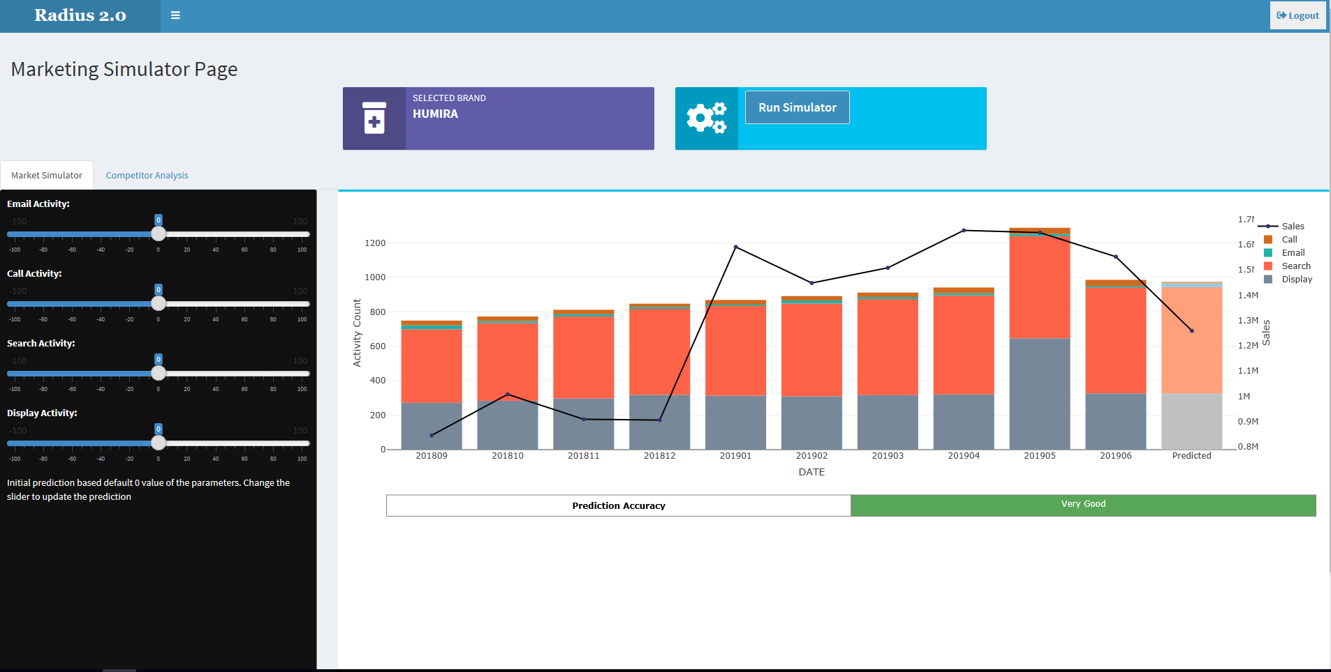
Use case 2: Channel-Impact Simulator
Leverage the data from promotional channels to determine the channel-wise effectiveness and impact on Sales
Situation: Pharmaceutical companies allocate the marketing budget in multiple promotional channels where the returns/impact are difficult to measure
Solution: To develop the best multi-channel promotional strategies by identifying the most responsive channels using AI/ML-based simulator
Inputs
Approach
Output/Result
Aggregate the product level monthly sales and promotional spend data for all channels
Build a regression model to determine and measure the impact of channel-wise promotions on total product sales Impact measurement unavailable
Develop an interactive Simulator to show the impact of each channel on brand Sales Key objective/outcome of simulator unavailable
Increasing/Decreasing promotional channel activity will lead to the prediction of future sales using appropriate regression model with a marginal utility effect baked in
Multi-channel promotional data for different products and markets
Sales data of brand
Helpful for pharma clients to analyze conversions from multiple channels and understand how they are evolving and spreading highlight key outcome
Understand the promotional spending based on different promotional channels and its effect in overall sales of product recommendation needs to be added
Simulate the impact of varying Marketing Mix on Brand Sales Impact Analysis Sell point

Slide 17

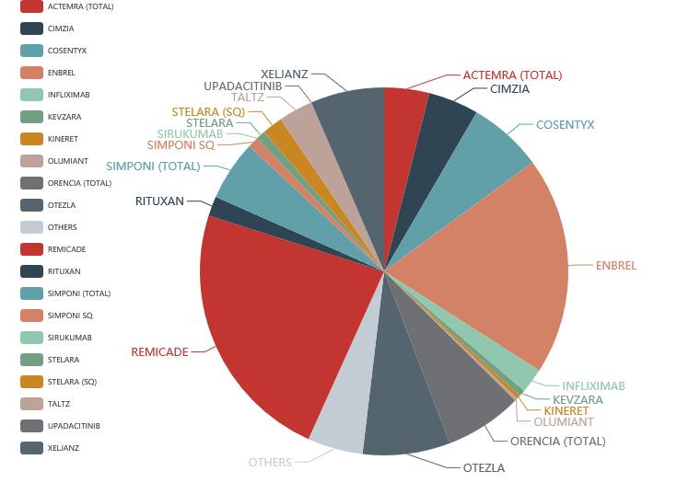
Use case 3: Brand Performance Analysis with Market Simulator for forecasting future performance
Leverage past promotion and sales data and simulate the future outcomes
Situation: Brand teams would like have an outlook about the marketing investment for future to plan for long term need.
Solution: Build a forecast model to generate drug sales simulating the future market situation including appropriate market conditions including promotions and competitors performance
Inputs
Approach
Output/Result
Aggregate brand level monthly sales and promotional spend data for all channels
Determine competitive performance of a brand in its franchise visibility
Forecast the product sales on the basis of historical data where promotional channel spending is taken as input variable and Market Rx?? is taken as output variable
The historical data from Market Rx of competitor as well as own product is used for time series analysis Rx Dollars is an imp performance index, need to push this up
Aggregation of all the product sales from individual market will lead to determination of overall market scenario in the future Geography dimension addition
Monthly Brand Rx
Monthly spend on each promotional channel
Market Performance data
Competitor Analysis data
This type of time series analysis may aid in
Determining how past promotions affected the historical sales key shortfalls/outcomes
Predicting how proposed promotions may influence the future highlight key outcomes
Recommendation of marketing strategies on the basis of appropriate chosen promotional mix visibility
Forecasting the future market scenario on the basis of existing marketing strategy

Slide 18
Prototype Readiness
What critical feature of the solution you would want to showcase as a working prototype as part of Idea Harvest 2020?
AI/ML model-based Channel Impact Simulator, Market Forecaster, Marketing Analysis and Recommendation for Marketing Mix
Is there a lab or technical support or any other support you are looking for in developing the above as a prototype?
Webserver to host the application
Have you communicated to your client about this particular solution and is he interested?
We have not yet communicated to our client as we are mostly engaged in commercial reporting and analytics. We would like to get some information on their Marketing Analytics needs before moving forward. However this solution has appeal in other clients as well.
Would you be willing to showcase the prototype as part of Idea Harvest presentation if your client is invited as one of the panelists? Or are there any reservations?
As mentioned above, we need to have more information on Client landscape in this area before presenting the solution

Slide 19
Recommended implementation schedule
Program Plan | Description | Activities / Feature | Timeline
Prototype Development | Develop AI/ML modules for Marketing Analysis, Recommendation Engine for Marketing Mix and Market Simulator | Data Input and Consolidation Feature | 25-Sep- 29-Sep ’20
 |  | Channel deep-dive | 29-Sep – Mid-Oct
 |  | Channel Impact Simulator | 29-Sep – Mid-Oct
 |  | Brand Performance Analysis | 29-Sep – Mid-Oct
 |  | Marketing Mix Recommendation Engine | 29-Sep – Mid-Oct
 |  | Market Forecaster | 29-Sep – Mid-Oct

Slide 20
Risks
As there are few Marketing Analytics tools already available in the market, until we address core business problems of any client and show real time benefits, the solution might be hard to sell at onset. As the problem differs from one to another client, we also need to be nimble in our planning
Client might want us to implement only few of our modules on top of any other existing platform which they might be using. We need to plan and make our solution flexible enough to be deployed in parts, and be able to interact with other applications
Since our solution/application is to be used by Business Users (Brand & Marketing Team), it needs to be user friendly, else the adoption will be low and it will defeat the purpose

Slide 21
Financials—Costs
Cost for Tool (Licensing Cost) : $150 - $250K (yearly cost per brand per implementation)
SME Consulting support: $125 per hour for onsite / $45 per hour offshore
Model 1: SaaS: Annual Licensing Cost + Set up cost ( 1 Developer for 1M) + Configuration Support (1 DS for 1M)
Model 2: Annual Licensing Cost + Set up cost ( 1 Developer for 1M) + Annual SME Support (Onsite/Offshore model based on Customer requirement). Configuration Cost to waived off.
Assumptions:
The application to be hosted in Client’s environment. Incase Client needs support of Cognizant infrastructure, the cost logistics will be estimated separately
Consulting support will be on fixed capacity basis (based on work volume , market mix model refresh cycles , and customer adhoc requirements)
Any customization with the application post deployment has to be done through separate CR
* Please note all the figures are currently high level estimates and may change post prototype development

Slide 22
Financials—ROI
Why should Cognizant invest in this solution?
With our experience in this field and also through some research, there is no AI/ML based Multi-Channel Marketing Mix and Promotion tool which covers the extent of business problems as we intend to target through our solution. Cognizant currently doesn't have any Marketing Mix Optimizing solution with AI/ML capabilities. This solution would use an hybrid solution approach and would enable Cognizant to showcase traditional and non-traditional promotional channel optimization capabilities
Why should your client invest in this solution?
The absence of a unified Marketing Analytics tool to act as a hub for Marketing planning and optimization processes is a major pain point for Brand Managers and Marketers. Most of the existing analytics tools in the market work in silos or concentrate majorly on few primary channels, as a result, they are unable to accurately determine the channel (sub)-wise impact of promotion on brand sales and the optimal marketing mix required for achieving better results.
Since our client has portfolio of both Launch and LOE products, a Marketing Analysis and Optimization enabler shall greatly help streamline and standardize planning and implementation of Marketing activities and investments, thereby yielding a greater return on promotional investment.

Slide 23
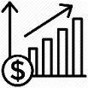
Summary- Key Highlights
With the ever-increasing focus on Sales & Marketing by Pharma companies, there is a need for a one-stop solution to function as an optimizer to help plan marketing activities and investments across multiple channels through data-driven decision-making. This shall help marketers to keep track of both strategic and tactical elements, and build better/optimize brand strategy.
AIMAX is this enabler for Brand & Marketing teams, which will answer key questions that arise while devising brand strategies. It is an AI/ML-based advanced marketing analytics solution that leverages a thorough data strategy coupled with advanced analytics methodologies to derive insights for marketing and provide recommendations to help take effective marketing decisions to get the highest return on promotional investment.
Key Value Levers:
Strategic action recommendations for channel selection and budget allocation
Holistic market insights- 360° view of market and product to enable proper Marketing planning and execution
Boost revenue potential through data-driven decision making
Channel Impact
Right Channel Mix Identification
Promotional Spend Optimization
Brand Performance Analysis
Market Forecasting
Measure the impact of each marketing channel and identify right engagement channels for marketing strategy
Identify the optimal Multi - Channel Mix for promotion activities
Evaluate channels for promotion response and optimize the spend across the channels
Competitor analysis to show the performance of a brand in a particular therapy area
Leverage past promotion data and predict how proposed promotions may affect the future

Slide 24
Thank you
Appendix

Slide 25
Business Need—Statement & Analysis
Purpose: Establish a sense of urgency for the opportunity or solution.
Over the past few years, Sales & Marketing spend has been equal to/greater than R&D spend for major pharma players, showing the importance of the function in a company’s growth. Customer engagement models and channels are constantly evolving, with the line between traditional and digital marketing blurring.
There is immense pressure for differentiation, with marketers feeling that connecting with their customers through the right engagement channels is their biggest challenge, while marketers also experience the challenge of having to demonstrate high return on investment (ROI) from a diverse portfolio of marketing programs. Currently, marketing mix is decided by the team based on hunch/experience and industry practices, allowing room for a better analysis-based method.
These necessitate the need for a one-stop solution to function as an optimizer to help plan marketing activities and investments across multiple channels through data-driven decision-making. This shall help marketers to keep track of both strategic and tactical elements, and build better/optimize brand strategy.
Purpose: Flesh out what’s causing the problem.
The absence of a unified Marketing Analytics tool to act as a hub for Marketing planning and optimization processes is a major pain point for Brand Managers and Marketers. Most of the existing analytics tools work in silos or concentrate majorly on few primary channels like Promotions, Campaigns while Digital channels are clubbed. As a result, they are unable to accurately determine the channel (sub)-wise impact of promotion on brand sales and the optimal marketing mix required for achieving better results. Thus, there is a need to standardize KPIs across multiple engagement channels and provide holistic view of promotions by standardizing traditional and digital media marketing. This will help take effective marketing decisions to maximize effectiveness and increase return on promotional investment.

Slide 26
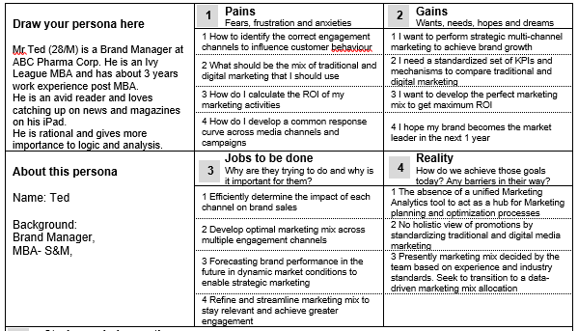
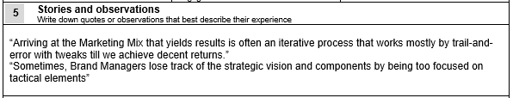

Activity 1: User Persona / Experience

Slide 27

Activity 2: User Journey Map – Template
Stage
Information Gathering
Analysis
Marketing Mix Planning
Marketing Performance Analysis
Mindset
Look to gather maximum data to serve as a base for analyses to take effective decisions
Try to derive maximum insights from data collected.
Look out for trends and competitor’s marketing patterns for potential benchmarking
Look to design the ideal marketing mix for target sales and brand growth by optimizing the marketing activities and investments across the multiple channels
Determine the success of marketing programs by choosing the correct metrics and measuring the ROI
Activity
Data Gathering from Primary & secondary sources
Sales data of brand and competitors
Information of Multi-channel marketing activities and investments of own brand and competitors
Market Performance data
Analysis of Sales and marketing data to identify trends and patterns
Lookout for best performing campaigns and their impact
Identify key customer segments and responsive channels for marketing
Identify brand goals from Marketing, based on brand vision and strategy
Develop multi-channel marketing mix based on analyses & brand strategy
Plan out individual campaigns/activities for each channel to ensure better engagement
Identify suitable metrics- KPIs to evaluate and track performance of marketing activities
Determine the ROI of marketing activities along with effectiveness of each channel
Experience
Necessary step for efficient data-driven marketing. Need to ensure data availability to perform complex analysis
Effort-taking but insightful activity to gain major inferences to plan marketing programs
Key step forming the pillar for all marketing activities- important to align tactical elements with strategic vision to prevent Marketing Myopia
Rewarding and enriching experience to put a framework in place to perform effective marketing
Emotion
Opportunity
Monthly data subscription portals with push alerts having slice-and-dice options
Marketing analytics tool to identify the right engagement channels for each customer type and identify trends and best practices
Marketing Analytics tool to recommend optimal marketing mix by considering the channel-wise impact of promotions
Marketing Analytics tool to calculate the ROI of marketing activities and suggest further optimizations to improve promotional ROI and thus brand performance

Slide 28
Draw the User Journey Map
Step 1 : Detail the Touch points
Step 2 : Place the Touchpoints appropriately
Step 3 : Draw the Journey Map across all the Touchpoints
Information Gathering
Analysis
Marketing Mix Planning
Marketing Performance Analysis

Slide 29
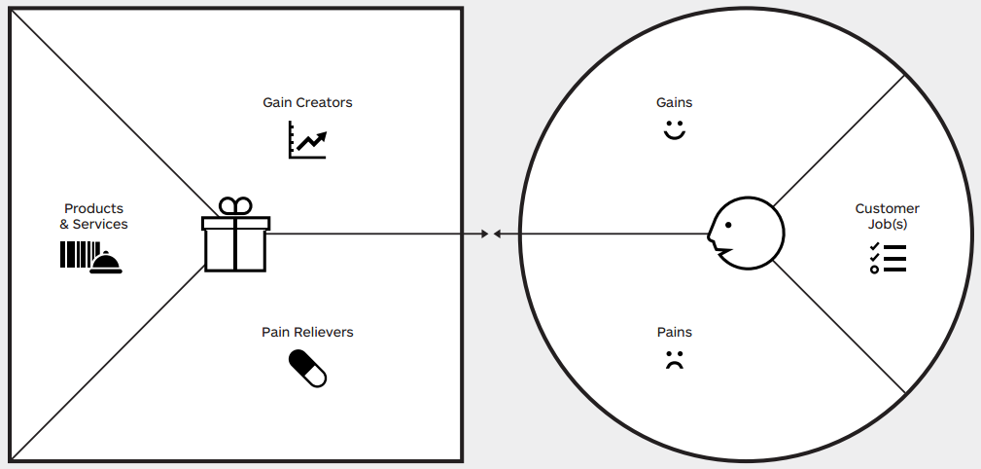
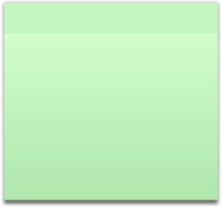
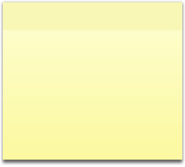

Value Proposition Canvas – Sample Template
Value Proposition of proposed solution
Customer Profile Overview
Recommendation on optimal Marketing Mix for greater ROI
Identification of channel-wise impact of promotions on brand sales
Comprehensive tool for strategic and tactical marketing
Determine the relation between promotion type (channel & activity) and brand growth
Identify the right engagement channels for brand promotions
Analysis-based optimal marketing plans for greater ROI
Recommendation on optimal multi-channel Marketing Mix for each customer type
Develop optimal marketing mix
FIT
Actionable insights & recommendations to develop effective multi-channel promotional strategies
No holistic view of promotions for offline and online marketing
Determine impact and ROI of each channel
Brand-wise and channel-wise ROI calculator to evaluate marketing programs performance
Accurate forecasting of brand performance to help plan strategic marketing initiatives
Marketing Optimizer for comprehensive data-driven decision making
Dynamic Market Sizing to forecast brand performance in the future
Absence of standardized KPIs to evaluate multi-channel marketing performance

Slide 30
Executive Summary
Target Audience: Brand and Marketing teams of Pharma Companies
Unique Value Proposition: Our AIMAX Tool helps Brand and Marketing teams to take informed strategic and tactical marketing decisions by providing actionable insights to develop effective promotional strategies. With use of AI/ML, the application has built-in cognitive capability to determine the principal components influencing relation between promotion type and growth, define appropriate customer segments using both potential and behavior features, perform dynamic market sizing with prospective view considering future events and eventually provide recommendations for optimal marketing mix to maximize effectiveness and generate the highest return on promotional investment.
What is not considered in scope for solutioning? Data Gathering is out-of-scope. The solution analyses and provides recommendations based on the data provided by the users
What is the support required: Any webserver where the application can be hosted
Who are your most important customers (Is it Med devices, Bio Tech or Bio Pharma companies)? Who can be the early adopters?: All Pharma Companies including Bio Tech
Will your client be interested to have a solution for the identified opportunity? Yes, since our client has portfolio of both Launch and LOE products, a Marketing Analysis and Optimization enabler shall greatly help streamline and standardize planning and implementation of Marketing activities and investments, thereby yielding a greater return on promotional investment.

