Slide 1





OLD High level Solution Architecture
AIMAX leverages data from digital & traditional channels and applies advanced analytics methodologies to drive insights for customer centric marketing
Data Layer
Processing
Analysis
Digital data
Data Integration
Marketing Mix Analysis
Digital media channels Campaign-
Activity & response Data
Data Validation
ROI Analysis
Business rules implementation
Traditional data (Offline data)
Market Simulator
Traditional marketing channels data
KPI framework
Sales data
Brand Performance Analysis
Advanced Marketing Analytics models
Promotional Spending data
Market Rx data
Market & Brand Forecast
Platforms
Flat Files
SQL Lite

Slide 2

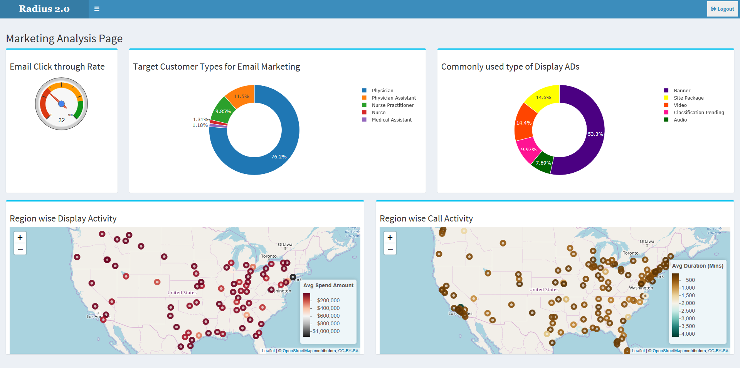
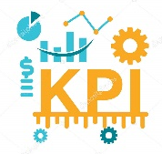


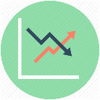


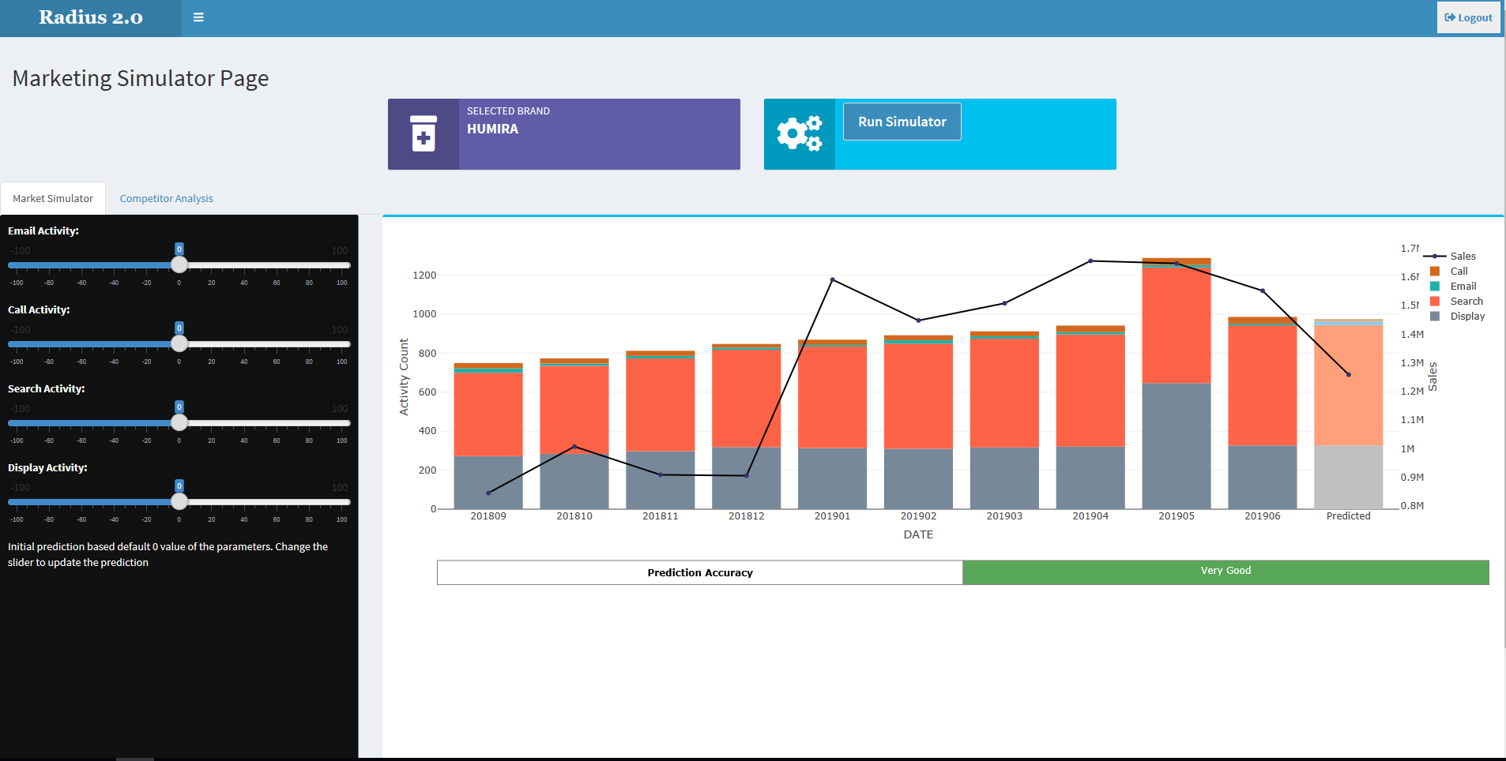
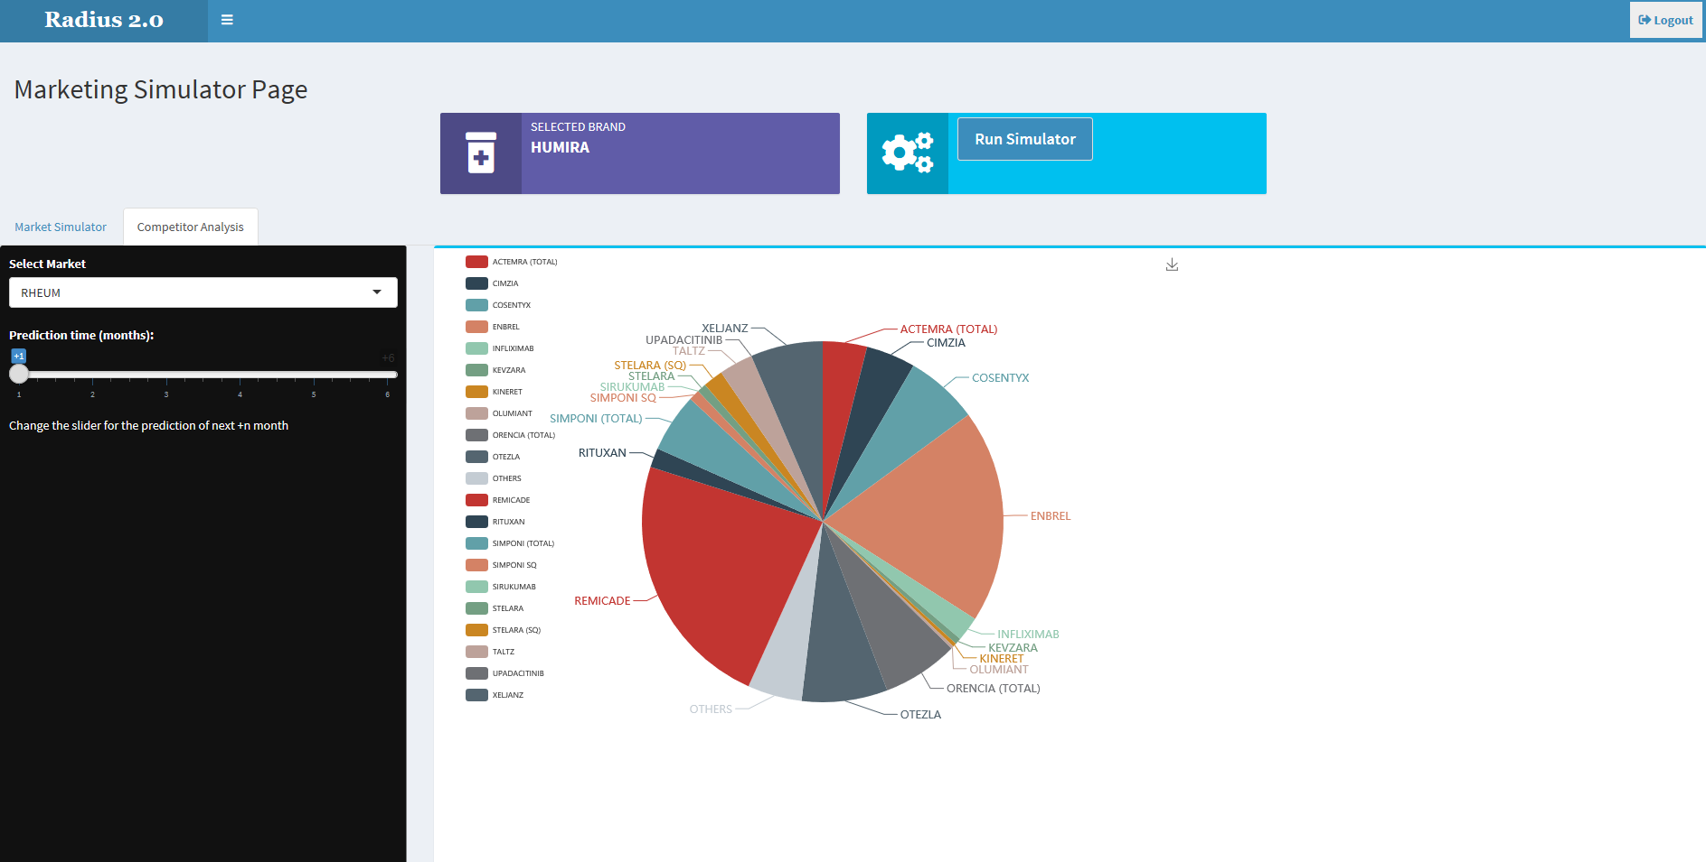
High level Solution Architecture
AIMAX leverages data from digital & traditional channels and applies advanced analytics methodologies to drive insights for customer centric marketing
Data Layer
Business Logic
Model & Analysis
Data Components
Data Preprocessing
KPI
Algorithm Development
Marketing Mix Analysis
Digital Channels
Optimal Marketing Mix
Data Ingestion
Validation & Ingestion.
Identifying Right Channel Mix
Promotional Spend Optimization
Brand Performance Analysis
Market Forecasting
Advanced Analytics
Designing ML algorithms
AI recommendation Engine
Prescriptive Analytics
Forecasting
Quantiles
ROI
Campaign
Activity
Response
Etc..
ROI: for individual/mix of channels
Traditional Data Warehouse
Market Simulator
Marketing Channels
Sales data
Promotional Spending
Market Rx
Etc..
Channel Effectiveness & Forecast
Brand Performance
Recommendation Engine
Information Flow

Slide 3



Use case 1: Optimal Promotional Channel Marketing Mix with AI-based recommendation
Leverage the data from promotional channels along with their return on promotional investment to recommend optimal marketing mix to achieve target sales
Situation: Pharmaceutical companies allocate the marketing budget in multiple promotional channels varyingly, being unable to identify the optimal Marketing Mix
Solution: Perform channel (sub) deep-dive and use AI/ML-based recommendation engine to generate the optimal Marketing Mix to promote growth and enhance ROI
Inputs
Approach
Output/Result
Aggregate the product level monthly sales and promotional spend data for all channels
Analyze multiple KPIs to conduct detailed analyses on the nature of multi-channel promotions and investment made on each channel Deficit: text to added in app Saikiran/Vishwadeep
Build a regression model to determine and measure the impact of channel-wise promotions on total product sales Impact assessment is weak/unavailable: Ananya to help out on recommendation engine.
Perform ROI Analysis on each promotional channel to identify the best performing channels All graphs to be combined in 1 gragh when ROI are normalized
Step1: Akshara to support ROI normalization
Step2: Merging graphs in 1 and write text/download recommendation (Siddharth/Saikiran/Vishwadeep)
Build a model to give optimal Marketing Mix to achieve the target Sales with highest ROI
Multi-channel promotional data for identified products and it’s related market basket
Sales data of brand
Summary of promotional spending on different channels along with determining the effect of marketing programs/campaigns Descriptive Analytics
Identify a benchmark for measuring the marketing performance weak: modify the statement (Akshara)
Recommendation on optimal Marketing Mix that can generate target brand sales which can simulate changing scenarios sales target needs to be defined clearly: options to enter target sales include model from Ananya with some inputs on display OR modify the points (Akshara)
Improve ROI by Optimizing marketing budget allocation and spends across marketing channels ROI pieces to be sufficient here
Efficient method to plan marketing investments across multiple channels for greater ROI ROI pieces shall be sufficient

Slide 4
Use case 2: Channel-Impact Simulator
Leverage the data from promotional channels to determine the channel-wise effectiveness and impact on Sales
Situation: Pharmaceutical companies allocate the marketing budget in multiple promotional channels where the returns/impact are difficult to measure
Solution: To develop the best multi-channel promotional strategies by identifying the most responsive channels using AI/ML-based simulator
Inputs
Approach
Output/Result
Aggregate the product level monthly sales and promotional spend data for all channels
Build a regression model to determine and measure the impact of channel-wise promotions on total product sales Impact measurement unavailable: text boxes + entry of sales input, checkboxes (Saikiran)
Develop an interactive Simulator to show the impact of each channel on brand Sales Key objective/outcome of simulator unavailable: need more info for a sell point (some sort of heatmap). Akshara to support on pieces and Vishwadeep/Siddharth to work on them further
Increasing/Decreasing promotional channel activity will lead to the prediction of future sales using appropriate regression model with a marginal utility effect baked in
Multi-channel promotional data for different products and markets
Sales data of brand
Helpful for pharma clients to analyze conversions from multiple channels and understand how they are evolving and spreading highlight key outcome
Understand the promotional spending based on different promotional channels and its effect in overall sales of product recommendation needs to be added
Simulate the impact of varying Marketing Mix on Brand Sales Impact Analysis Sell point

Slide 5

Use case 3: Brand Performance Analysis with Market Simulator for forecasting future performance
Leverage past promotion and sales data and simulate the future outcomes
Situation: Brand teams would like have an outlook about the marketing investment for future to plan for long term need.
Solution: Build a forecast model to generate drug sales simulating the future market situation including appropriate market conditions including promotions and competitors performance
Inputs
Approach
Output/Result
Aggregate brand level monthly sales and promotional spend data for all channels
Determine competitive performance of a brand in its franchise visibility
Forecast the product sales on the basis of historical data where promotional channel spending is taken as input variable and Market Rx?? is taken as output variable
The historical data from Market Rx of competitor as well as own product is used for time series analysis Rx Dollars is an imp performance index, need to push this up
Aggregation of all the product sales from individual market will lead to determination of overall market scenario in the future Geography dimension addition
Monthly Brand Rx
Monthly spend on each promotional channel
Market Performance data
Competitor Analysis data
This type of time series analysis may aid in
Determining how past promotions affected the historical sales key shortfalls/outcomes
Predicting how proposed promotions may influence the future highlight key outcomes
Recommendation of marketing strategies on the basis of appropriate chosen promotional mix visibility
Forecasting the future market scenario on the basis of existing marketing strategy

