Slide 1
Design and Simulation of a Smart Parking Slot Availability and Entry Control System Using Combinational Logic
Module 2 – Making Decisions & Doing Maths: Combinational Logic
Team Members:
2620030600 – JETHENDRA VARDHAN
2620030602 – LAXMI PRAGYA
2620030606 – VEDA CHANDRA
2620030636 – CHANDRA PAUL
2620030675 – SRIKRISHNA
This project demonstrates how combinational logic can detect parking-slot availability and automatically control vehicle entry using the current sensor inputs.

Slide 2
Problem Statement & Proposed Solution
Problem
Drivers waste time searching for vacant parking spaces
Manual monitoring is inefficient and error-prone
Entry should be blocked when all parking slots are occupied
A digital controller can automatically make entry decisions
Signal Flow: Parking Sensors (S1–S4) → Availability Logic → Parking Available (A) → Entry Request (E) → Entry Control Logic → Entry Allowed / Denied (G)
Proposed Solution
S1–S4: Parking-slot sensors (0 = available, 1 = occupied)
E: Vehicle entry request (0 = no request, 1 = request)
A: Parking availability signal
G: Entry permission signal

Slide 3
Combinational Logic & Boolean Design
Definition: Combinational logic produces outputs based only on present input values. It does not store previous states.
Input Definitions
S1–S4: 0 = Slot available, 1 = Slot occupied
E: 0 = No entry request, 1 = Vehicle requests entry
Boolean Equations
Parking Availability:
A = ¬(S1 · S2 · S3 · S4)
Entry Permission:
G = E · A
Entry is allowed only when a vehicle requests entry AND at least one parking slot is available.

Slide 4
Truth Table & K-Map Simplification
Truth Table for Entry Control (G = E · A)
E | A | G
0 | 0 | 0
0 | 1 | 0
1 | 0 | 0
1 | 1 | 1
Benefits of K-Map Simplification
Fewer gates required
Lower hardware complexity
Reduced propagation delay
Lower power consumption
Easier circuit implementation
Karnaugh maps provide a systematic method for simplifying Boolean functions before implementing them with logic gates.

Slide 5
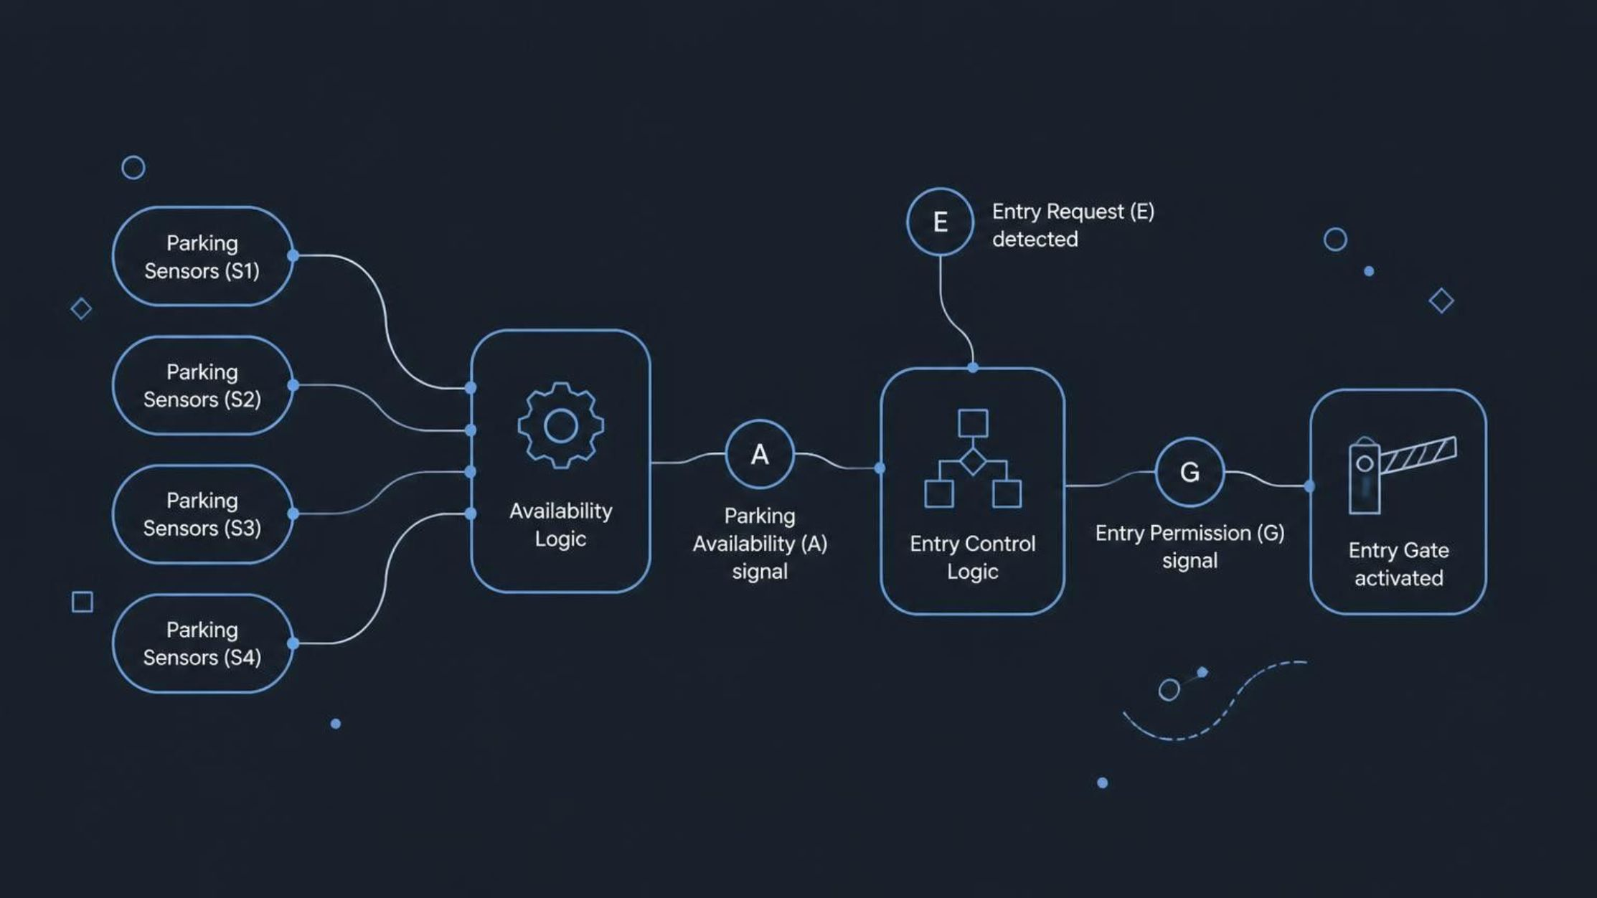
System Overview: End-to-End Workflow
Our smart parking system operates through a seamless sequence of sensing, logical processing, and actuated control, ensuring efficient parking management and vehicle flow.
This diagram visualizes the complete signal path from raw sensor input to the final gate control, driven by the combinational logic we designed.
1. Sensor Input
2. Availability Logic
3. Entry Request
Occupancy sensors (S1-S4) continuously monitor each parking slot, transmitting its status (occupied or available).
The system's logic module evaluates sensor inputs to determine overall parking availability (A). If at least one slot is free, A is true.
A vehicle approaching the entrance triggers an entry request signal (E), indicating a desire to enter the parking facility.
4. Entry Control Logic
5. Gate Control Output
This module processes both the entry request (E) and parking availability (A) using Boolean logic .
Based on the logic output (G), the entry gate is either opened (permission granted) or remains closed (permission denied).

Slide 6
Logic-Gate Circuit Implementation & Simulation
Inputs
Availability Logic
S1, S2, S3, S4 (parking sensors) and E (entry request)
A = ¬(S1 · S2 · S3 · S4) — NAND of all slot sensors
Entry Control
Output
G = E · A — AND of entry request and availability
G = 1 (Entry Allowed) or G = 0 (Entry Denied)

Slide 7
Simulation, Testing & Results
Test Cases & Results
S1 | S2 | S3 | S4 | E | Result
0 | 0 | 0 | 0 | 1 | ALLOW
1 | 0 | 1 | 1 | 1 | ALLOW
1 | 1 | 1 | 0 | 1 | ALLOW
1 | 1 | 1 | 1 | 1 | DENY
1 | 1 | 1 | 1 | 0 | DENY
Key Results
Available slots are detected correctly
Entry is allowed when availability and entry request are both active
Entry is denied when all slots are occupied
Output depends only on present inputs (combinational logic verified)
Simulation confirms the design meets specifications

Slide 8
Conclusion & Future Scope
Future Scope
Conclusion
Increase the number of parking slots
Add a digital display for available spaces
Add vehicle counting and occupancy tracking
Add RFID/QR-based entry authentication
Integrate real parking sensors and actuators
Interface with a microcontroller or FPGA
Add multiplexers, decoders and comparators for larger systems
The Smart Parking Slot Availability and Entry Control System demonstrates how combinational logic can convert parking-sensor inputs into automatic entry decisions.
Design Flow
01
02
Specification
Truth Table
03
04
Boolean Expression
K-Map
05
06
Logic Circuit
Simulation & Testing

