Slide 1
WEATHER FORECASTING APPLICATION USING PYTHON
By
GAUTAM SIDDHARTH (M22AI1005) & AVINISH CHANDRA(M20AIE224)
IIT JODHPUR

Slide 2
INTRODUCTION
Weather forecasting is the application of science and technology to predict the state of the atmosphere for a given location.
Ancient weather forecasting methods usually relied on observed patterns of events, also termed pattern recognition.
For example, it might be observed that if the sunset was particularly red, the following day will be bright
However, not all of these predictions prove reliable.
Here this system will predict weather there will be Rainfall or not
.

Slide 3
MODULES AND PROJECT DESCRIPTION
In this Module we have two Modules
Data Gathering and pre-processing
2) Applying Algorithm for Prediction

Slide 4
ALOGORITHM AND ITS TECHNIQUES
Linear Regression is a machine learning algorithm based on supervised learning. It performs
a regression task. Regression models a target prediction value based on independent
variables. It is mostly used for finding out the relationship between variables and forecasting.
Different regression models differ based on – the kind of relationship between dependent and
independent variables, they are considering and the number of independent variables being used.

Slide 5
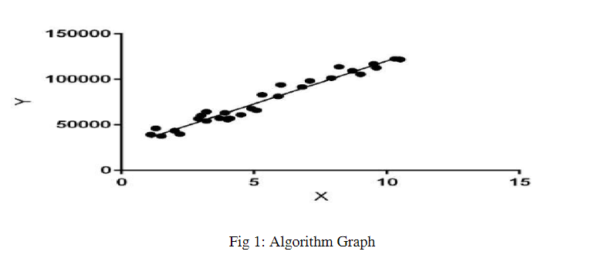
Algorithm Graph

Slide 6
Linear regression performs the task to predict a dependent variable value (y) based on a given independent variable (x). So, this regression technique finds out a linear relationship between x (input) and y(output).
Hence, the name is Linear Regression.In the figure above, X (input) is the work experience and Y (output) is the salary of a person. The regression line is the best fit line for our model.
Hypothesis function for Linear Regression :
Y = MX+C
Where Y is the response variable. X is the predictor variable.
m and c are constants which are called the coefficients.

Slide 7
IMPLEMENTATION
A day (in red) having precipitation of about 2 inches is tracked across multiple parameters(the same day is tracker across multiple features such as temperature, pressure, etc). The x-axis denotes the days and the y-axis denotes the magnitude of the feature such as temperature, pressure, etc.
From the graph, it can be observed that rainfall can be expected to be high when the temperature is high and humidity is high.

Slide 8
Importing Libraries and Dataset
Python libraries make it easy for us to handle the data and perform typical and complex tasks with a single line of code.
Pandas – This library helps to load the data frame in a 2D array format and has multiple functions to perform analysis tasks in one go.
Numpy – Numpy arrays are very fast and can perform large computations in a very short time.
Matplotlib/Seaborn – This library is used to draw visualizations.
Sklearn – This module contains multiple libraries are having pre-implemented functions to perform tasks from data preprocessing to model development and evaluation.
XGBoost – This contains the eXtreme Gradient Boosting machine learning algorithm which is one of the algorithms which helps us to achieve high accuracy on predictions.
Imblearn – This module contains a function that can be used for handling problems related to data imbalance.

Slide 9
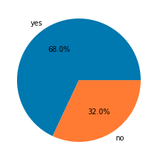
Exploratory Data Analysis
EDA is an approach to analyzing the data using visual techniques. It is used to discover trends, and patterns, or to check assumptions with the help of statistical summaries and graphical representations. Here we will see how to check the data imbalance and skewness of the data.
plt.pie(df['rainfall'].value_counts().values,
labels = df['rainfall'].value_counts().index,
autopct='%1.1f%%')
plt.show()

Slide 10
Here we can clearly draw some observations:
maxtemp is relatively lower on days of rainfall.
dewpoint value is higher on days of rainfall.
humidity is high on the days when rainfall is expected.
Obviously, clouds must be there for rainfall.
sunshine is also less on days of rainfall.
windspeed is higher on days of rainfall.
The observations we have drawn from the above dataset are very much similar to what is observed in real life as well.

Slide 11
Model Training
Now we will separate the features and target variables and split them into training and testing data by using which we will select the model which is performing best on the validation data.

Slide 12
Model Evaluation
From the above accuracies, we can say that Logistic Regression and support vector classifier are satisfactory as the gap between the training and the validation accuracy is low. Let’s plot the confusion matrix as well for the validation data using the SVC model.

Slide 13
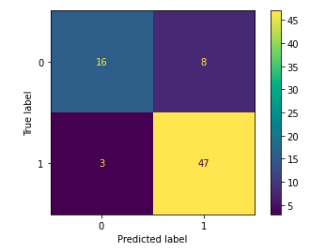
Final Output
metrics.plot_confusion_matrix(models[2], X_val, Y_val)
plt.show()

Slide 14
Conclusion
We successfully predicted the rainfall using the linear regression but here this is not very accurate only sometimes any way it depends upon the climate changes to season to season. Here we are taking only summer season weather data set it only useful to predict rainfall in summer season.

Slide 15
Thank You
Any Suggestion

