Slide 1

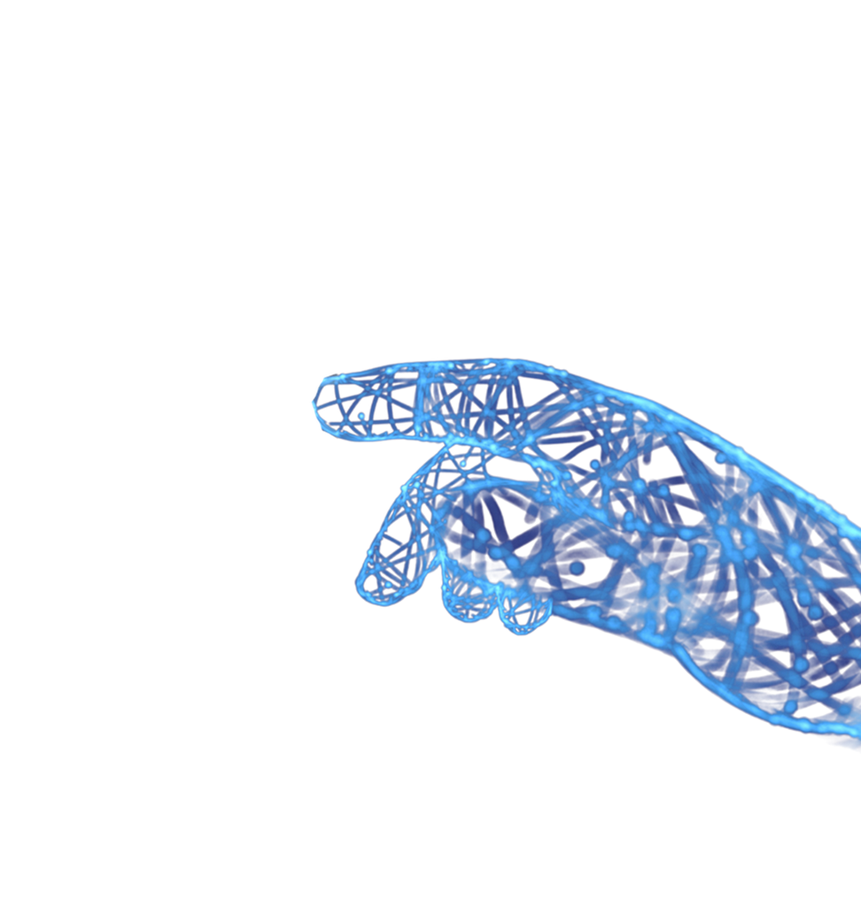
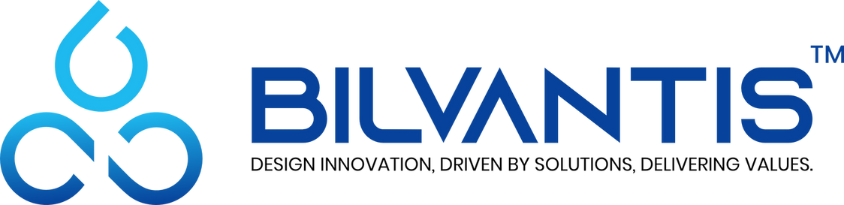
www.bilvantis.io
linkedin.com/bilvantistechnologies
TRANSFORMING BUSINESS OUTCOMES WITH INNOVATIVE SOLUTIONS

Slide 2
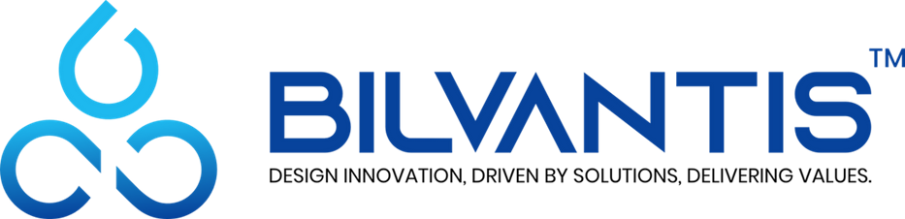
AI-Powered Test Automation Platform
Bilvantis Solution for AI Automation
Record | Enhance | Execute | Self-Heal | Report
Playwright CRX Enhanced v2.0 | January 2025

Slide 3
The Challenge
Why Traditional Test Automation Falls Short
High Maintenance Overhead
Slow Test Creation
Limited Coverage
60-80% of QA time spent maintaining flaky tests due to UI changes and brittle locators
Manual script writing is time-consuming, error-prone, and requires specialized skills
Teams struggle to achieve comprehensive test coverage across UI, API, and data scenarios
No Self-Recovery
Test Data Complexity
Poor Visibility
Tests fail completely when elements change, requiring immediate manual intervention
Creating diverse test datasets for boundary, security, and edge cases is manual and tedious
Lack of real-time execution insights, analytics, and actionable reporting
Business Impact:
Delayed releases, increased costs, reduced quality confidence, and team burnout from repetitive maintenance

Slide 4
Our Solution
Enterprise-Grade AI-Powered Test Automation
AI Script Enhancement
Self-Healing Tests
Visual Recording
GPT-4o analysis improves locators, adds waits, assertions, and best practices automatically
95%+ recovery rate with intelligent locator strategies: TestID, ARIA, CSS, XPath, Text
Chrome extension captures interactions and generates code in 6+ languages
Data-Driven Testing
API Testing Suite
Database Testing
AI generates boundary, positive, negative, and security test data automatically
Record network requests, build test suites, validate responses with assertions
Unit, integration, performance, and security testing for database operations
Key Differentiators:
Real-time WebSocket updates | Allure report integration | Multi-language (JS, TS, Python, Java, C#, Robot) Visual regression with AI | Enterprise security (JWT, RBAC) | Cloud-native scalable architecture

Slide 5
Platform Architecture
Hybrid Microservices with AI Integration
CLIENT LAYER
API LAYER
AI SERVICES
Chrome Extension - Test Recorder - Player/Executor - Self-Healing UI Web Dashboard (React 18 + Vite)
Node.js Backend :3001 - Express.js REST API - WebSocket Server - JWT Authentication - Prisma ORM
Analysis Service :8000 - Python FastAPI - Script Enhancement - XPath Deep Analysis Genie API (GPT-4)
DATA LAYER
DEVOPS & INFRASTRUCTURE
PostgreSQL :5433 | Prisma ORM | Allure Reports Users, Scripts, TestRuns, SelfHealingLocators, Projects, TestData
Docker Containers | PM2 Process Manager | Nginx Reverse Proxy CI/CD Pipelines | Winston Logging | Prometheus Metrics
Technology Stack:
Frontend: React 18, TypeScript, Vite, Tailwind CSS, Monaco Editor | Backend: Node.js 20, Express, Prisma, JWT AI: Python FastAPI, OpenAI GPT-4o | Database: PostgreSQL 15 | Reporting: Allure, Recharts

Slide 6
Key Capabilities
Self-Healing Tests
AI-Powered Enhancement
When locators fail, AI automatically: 1. Analyzes DOM structure 2. Tries 6 healing strategies: - data-testid attributes - ARIA labels / CSS selectors - XPath / Text content matching 3. Calculates confidence score 4. Auto-applies if >80% confidence 5. Saves healed locator for future runs
AI analyzes scripts to: - Locator Improvement Convert fragile selectors to robust ones - Intelligent Waits Add explicit waits for dynamic content - Assertion Enhancement - Page Object Refactoring - Error Handling & Retry Logic
AI Test Data Generation
Visual Regression
Analytics & Reporting
- Boundary Value Analysis - Positive/Negative Testing - Security Testing (SQLi, XSS) - Equivalence Partitioning
- Baseline Screenshot Mgmt - Pixel-by-Pixel Comparison - AI-Powered Diff Detection - Multi-Viewport Testing
- Allure HTML Reports - Real-time Dashboards - Trend & Failure Analysis - Performance Metrics
Supported Languages:
JavaScript | TypeScript | Python | Java | C# (.NET) | Robot Framework

Slide 7
Business Impact
Measurable ROI and Operational Efficiency for Relm Insurance
70%
5x
90%
50%
95%+
Reduction in Test Maintenance
Faster Test Creation
Improvement in Test Reliability
Reduction in QA Time
Self-Healing Success Rate
Cost Savings
Quality Improvement
Team Productivity
Reduced manual effort, fewer test failures blocking releases, lower infrastructure costs with efficient execution
Comprehensive coverage with AI-generated data, self-healing prevents false failures, visual regression catches UI bugs
QA focuses on strategy not maintenance, developers get faster feedback, non-technical users can record tests
Key Outcomes for Relm Insurance:
Accelerated Release Cycles - Tests run reliably without constant maintenance intervention Enterprise Security - JWT authentication, role-based access, audit logging for compliance requirements Scalable Architecture - Cloud-native design supports unlimited concurrent test executions Actionable Insights - Real-time analytics and Allure reports drive continuous improvement

Slide 8
Playwright + MCP Integration
Model Context Protocol - AI-Native Browser Automation
What is MCP?
AI-Driven Capabilities
Model Context Protocol (MCP) is an open standard that enables AI assistants to seamlessly connect with external tools, data sources, and services. Playwright MCP Server provides browser automation capabilities directly to AI agents.
- Natural language test generation - Autonomous test execution by AI agents - Context-aware element selection - Intelligent error recovery and debugging - Real-time browser state awareness
Browser Control
DOM Snapshots
Console & Network
File Operations
Navigate, click, type, screenshot via AI commands. Full Playwright API exposed through MCP protocol.
Accessibility tree snapshots for AI understanding. AI can reason about page structure and elements.
Access browser console logs and network requests. AI can debug issues and monitor API calls.
Upload files, handle downloads, manage sessions. Complete test data management through AI.
Benefits for Relm Insurance:
AI-Assisted Test Creation - Describe tests in plain English, AI writes and executes them automatically Reduced Learning Curve - No Playwright expertise required, AI handles technical complexity Faster Debugging - AI analyzes failures, suggests fixes, and can auto-repair broken tests Future-Ready Architecture - Positions Relm for next-generation AI-native testing workflows

Slide 9

www.bilvantis.io
THANK YOU!
Narasimha Rao Vadde
Founder & CEO
E: narasimha@bilvantis.io
M: +1 943 888 1238
+91 98666 01238
India
The Square, 110, Block B, 3rd Floor, Financial District, Hyderabad, Telangana 500032, IN.
USA
5601 Executive Dr,
Suite 500, Office-513,
Irving, Texas 75038, US
LEADING-EDGE IT SOLUTIONS PROVIDER THAT
DELIVERS ADVANCED RAPID TRANSFORMATIONS
linkedin.com/bilvantistechnologies

