Slide 1
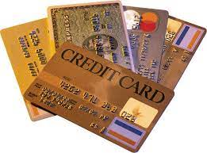
CREDIT CARD FRAUD DETECTION USING MACHINE LEARNING

Slide 2
PROBLEM STATEMENT
Credit Card Fraud Detection with Machine Learning
Data Collection: Collect data on credit card transactions, including the transaction amount, timestamp, and location. You can obtain this data from your financial institution or from sources like Kaggle.
Data Cleaning and Preprocessing: Clean the data by removing duplicates, filling missing values, and removing outliers. Then preprocess the data by transforming it into a usable format, such as changing categorical data to numerical data and scaling the data.
Build a model to predict credit card fraud based on the transaction data. This could include classification models like logistic regression, decision trees, or random forests.
Model Evaluation: Evaluate the model's performance using metrics like accuracy, precision, and recall. This will help you determine if the model is effective and if you need to make any adjustments.
Results Interpretation: Interpret the results of the analysis and present them in a clear and concise way. This could include creating visualizations, writing a report, or presenting the findings to stakeholders.

Slide 3
ABSTRACT
Fraudulent banking transactions are quite a common occurrence today.However, it is not feasible (in terms of cost involved and efficiency) to investigate every transaction for fraud, translating to a poor customer service experience .
Machine Learning in finance can automatically build super-accurate predictive maintenance models to identify and prioritize all kinds of possible fraudulent activities. Businesses can then create a data-based queue and investigate the high priority Incidents. Further, it also helps you optimize customer satisfaction by protecting their accounts and not challenging valid transactions. Such fraud detection using machine learning can help banks and financial organizations save money on disputes/chargebacks as one can train Machine Learning models to flag transactions that appear fraudulent based on specific characteristics.
The widespread use of credit cards for online transactions has made them a target for fraudsters, leading to a significant increase in credit card fraud cases in recent years.Machine learning algorithms have shown great promise in detecting fraudulent credit card transactions with high accuracy. Therefore, the proposed project "Credit Card Fraud Detection using Machine Learning" aims to develop an automated system that can accurately detect fraudulent credit card transactions in real-time using machine learning techniques.

Slide 4
INTRODUCTION
The project "Credit Card Fraud Detection using Machine Learning" aims to develop an automated system that can accurately detect fraudulent credit card transactions in real-time using machine learning algorithms. The proposed system will use a dataset of credit card transactions with both legitimate and fraudulent transactions, pre-process the data, and employ feature engineering techniques to select relevant features.
The pre-processed data will be split into training and testing sets, and various machine learning algorithms such as logistic regression, decision trees, random forests, and support vector machines,K-Nearest neighbours(KNN),Naïve bayes will be trained and evaluated based on their performance metrics like their accuracy, precision, recall, and F1-score on the testing set
The best model will be selected and deployed to detect fraudulent transactions in real-time.Once the best model is selected based on its performance metrics, it will be deployed to detect fraudulent transactions in real-time.

Slide 5

Methodoligies used
LOGISTIC REGRESSION
DECISION TREES
RANDOM FOREST
KNN
NAÏVE BAYES
SVM

Slide 6
Logistic Regression
Logistic Regression is a statistical technique used for binary classification problems, where the target variable is categorical and has only two possible outcomes, such as "yes" or "no," "true" or "false," etc
It is a type of generalized linear model that uses a logistic function to model the relationship between the dependent variable and one or more independent variables.The logistic function or sigmoid function maps any real-valued number to a value between 0 and 1, which can be interpreted as a probability
The sigmoid function is referred to as an activation function for logistic regression and is defined as:
f(x)=1/1+e^-x
where,
e = base of natural logarithms
value = numerical value one wishes to transform

Slide 7
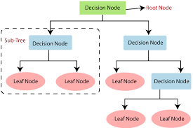
DECISION TREE
A decision tree is a type of supervised machine learning algorithm used for both classification and regression problems.
It is a tree-like model that represents a sequence of decisions and their possible consequences, resulting in a set of rules for making predictions.
Decision trees are interpretable and can handle both categorical and continuous input variables.In a decision tree, each internal node represents a test on an attribute or feature, and each branch represents the outcome of the test.
Information Gain= Entropy(S)- [(Weighted Avg) *Entropy(each feature)
Entropy(s)= -P(yes)log2 P(yes)- P(no) log2 P(no)
Where,
S= Total number of samples
P(yes)= probability of yes
P(no)= probability of no

Slide 8
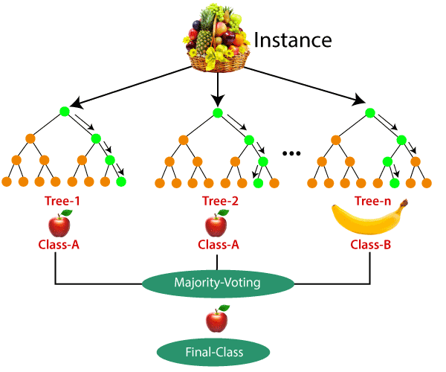
RANDOM FOREST
Random Forest is a supervised machine learning algorithm.
It can be applied to ML problems involving both classification and regression.
It is built on the idea of ensemble learning, which is a method of integrating various classifiers to address difficult issues and enhance model performance.
Random Forest is an ensemble learning algorithm that combines multiple decision trees to improve the accuracy and stability of predictions.
It is widely used for both classification and regression tasks and has become one of the most popular machine learning algorithms.

Slide 9
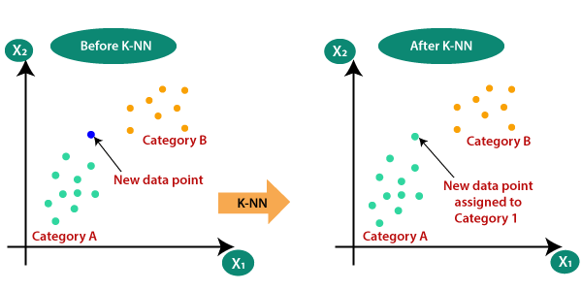
KNN
K-Nearest Neighbors (KNN) is a simple yet effective algorithm used for classification and regression problems
It is a non-parametric and instance-based learning algorithm, which means that it does not make any assumptions about the underlying distribution of the data and uses the training instances directly to make predictions
The KNN algorithm works by finding the K nearest neighbors of a new data point in the training data, based on some distance metric such as Euclidean or Manhattan distance. The value of K is a hyperparameter that determines the number of neighbors to consider.

Slide 10
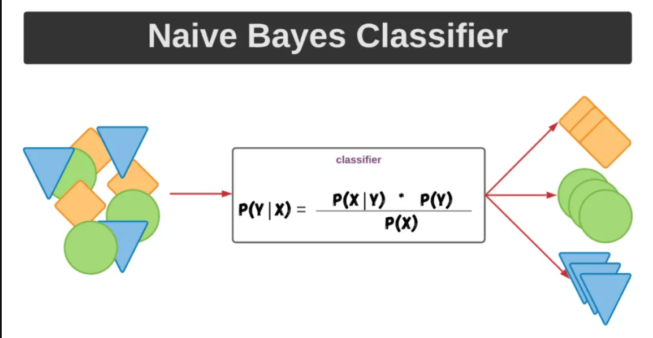
NAÏVE BAYES
Naive Bayes is a simple yet powerful machine learning algorithm used for classification problems.
. It is based on Bayes' theorem and assumes that the features are independent of each other, hence the name "naive“.
The Naive Bayes algorithm works by calculating the probability of each class given the input features and selecting the class with the highest probability as the predicted class.
The algorithm uses a probabilistic model to estimate the likelihood of each feature given the class and the prior probability of each class. Bayes' theorem is then used to calculate the posterior probability of each class given the input features

Slide 11
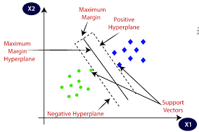
SVM
Support Vector Machines (SVMs) are a powerful machine learning algorithm used for classification and regression problems
. SVMs aim to find the hyperplane that separates the data into different classes in a way that maximizes the margin between the closest points of each class.
In a binary classification problem, the hyperplane is defined as the line that separates the two classes in the input space. The SVM algorithm works by finding the optimal hyperplane that maximizes the margin between the two closest points of each class. The points closest to the hyperplane are called support vectors and are used to define the margin

Slide 12
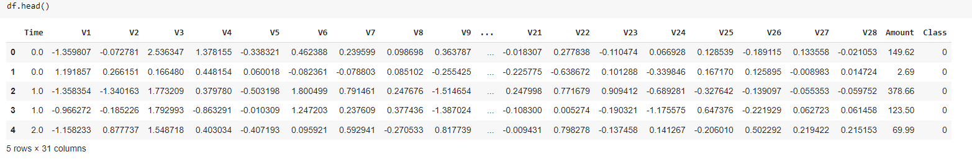
DATASET OVERVIEW
The dataset used is “credit card fraud dataset”
It contains 284808 rows and 31 columns

Slide 13
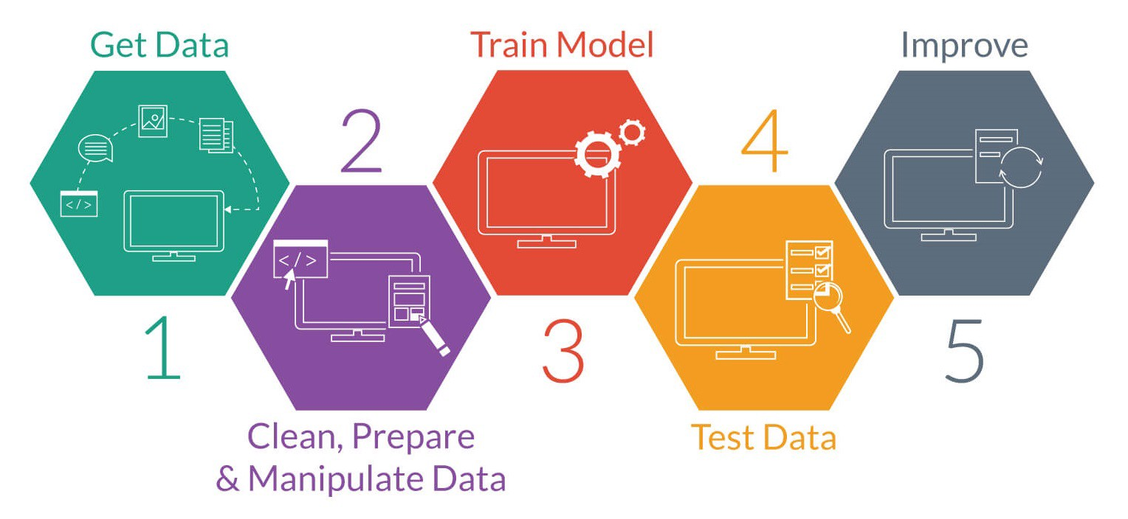
IMPLEMENTATION process
We have implemented this project using python in Google colab

Slide 14
Work flow
Collect data
Load data
Preprocess the data
Visualize the data
Evaluate the model using Testing data
Train the data using any ML model
Split the dataset into training and testing

Slide 15
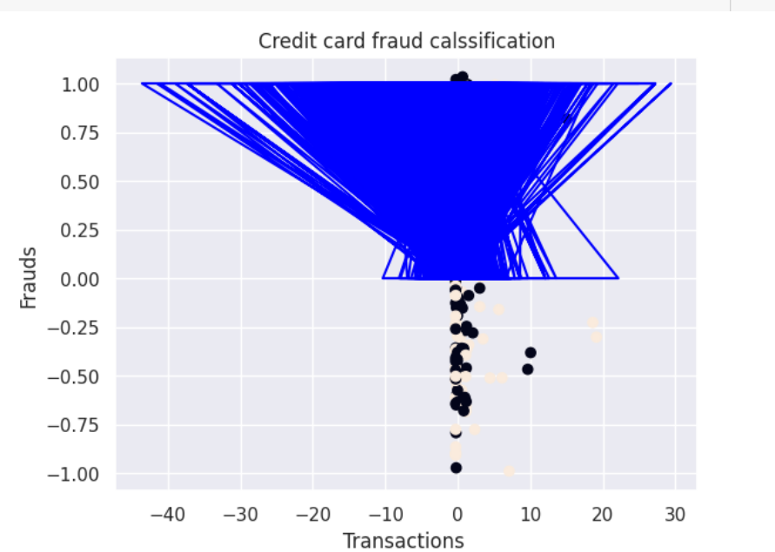
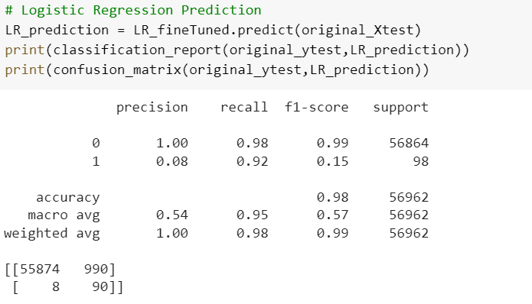
OUTPUT RESULTS OF DIFFERENT ALGORITHMS
Logistic Regression
Logistic Regression has a trainning accuracy score of 93.0 %
Roc score of Logistic Regression: 0.9504786931655048
Evaluation metrics of Logistic Regression

Slide 16
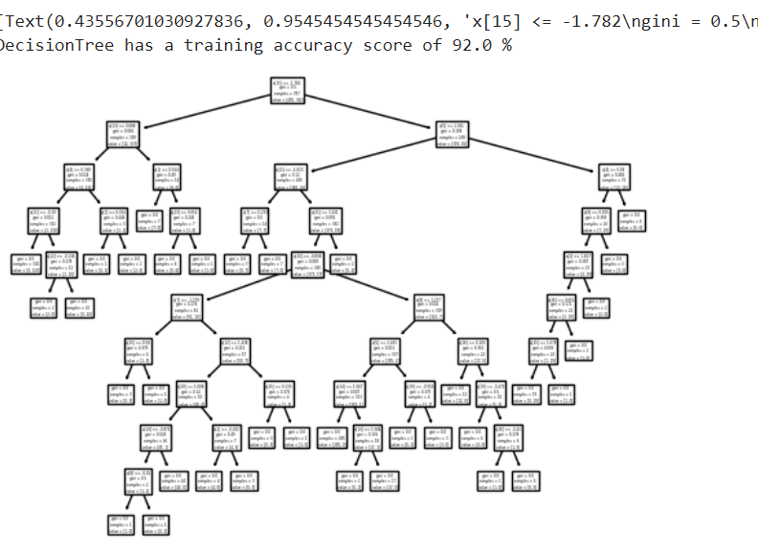
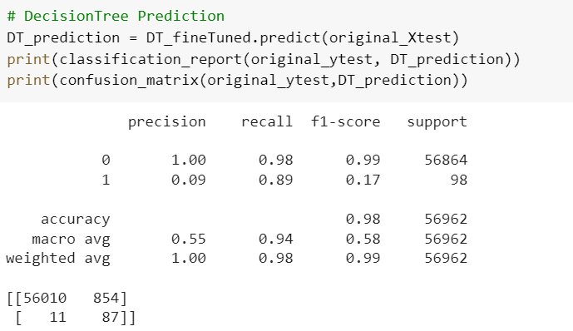
continue
Decision tree:
Decision Tree has a training accuracy score of 91.0 %
Roc score of Decision Tree Classifier: 0.9363684063946344.
Evaluation metrics of Logistic Regression

Slide 17
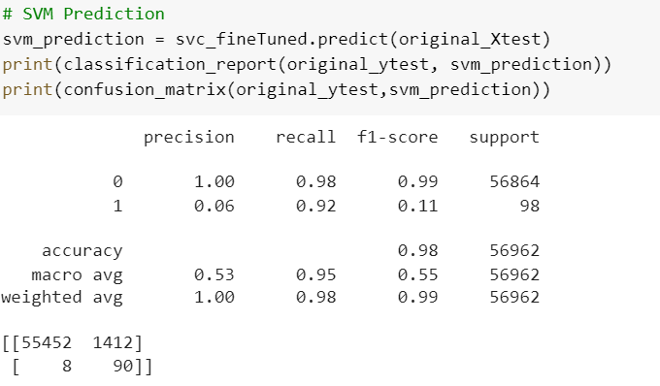
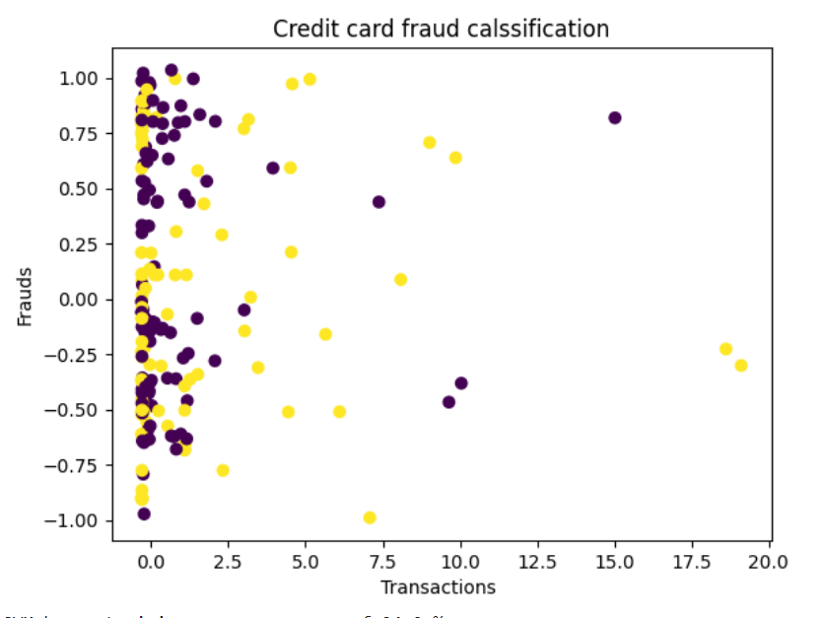
Continue..
SVM:
SVM has a training accuracy score of 93.0 %
Roc score of Support Vector Classifier: 0.9467680853996071
Evaluation metrics of svm are

Slide 18
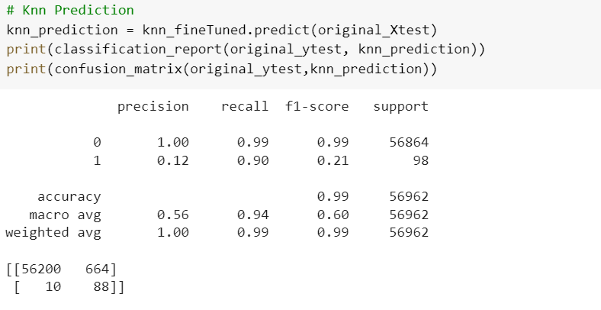
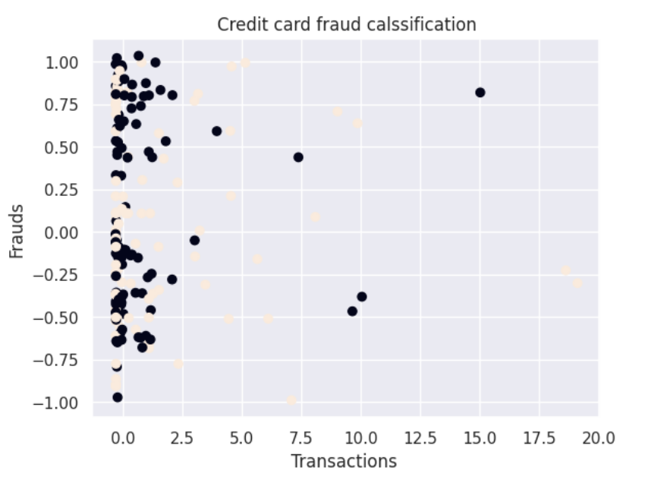
Continue..
KNN:
Knn has a training accuracy score of 93.0 %
Roc score of K-Nearst Neighbors: 0.9431410999965546
Random forest:
Random Forest has a training accuracy score of 94.0 %
Naïve bayes:
Naïve bayes Model accuracy score: 0.8883
Evaluation metrics of KNN is

Slide 19
Conclusion
In conclusion, machine learning algorithms are an effective way to detect credit card fraud. With the rise of online transactions, credit card fraud has become a significant concern for individuals and businesses. Machine learning algorithms can analyze large amounts of data and identify patterns and anomalies that indicate fraud. By using techniques such as supervised and unsupervised learning, feature engineering, and data preprocessing, machine learning algorithms can achieve high accuracy in detecting credit card fraud. Furthermore, with the continuous advancements in technology, these algorithms can be continuously improved to stay ahead of evolving fraud tactics. Overall, the application of machine learning in credit card fraud detection has the potential to save businesses and consumers billions of dollars each year while ensuring a safer and more secure financial system.Among the different algorithms used Random forest has showed highest accuracy score of 94%.

Slide 20
REFERENCES
https://www.google.com/search?q=credit+card+dataset+description&rlz=1C1CHBF_enIN974IN974&oq=cre&aqs=chrome.0.69i59j69i57j35i39j0i512j69i60l3j69i65.1871j0j7&sourceid=chrome&ie=UTF-8
https://www.google.com/search?q=logistic+regression+equation&rlz=1C1CHBF_enIN974IN974&oq=lo&aqs=chrome.0.69i59l2j69i57j69i59j0i67i650j69i60l3.2150j0j7&sourceid=chrome&ie=UTF-8
https://www.google.com/search?q=svm+formula&rlz=1C1CHBF_enIN974IN974&oq=sv&aqs=chrome.0.69i59l2j69i57j0i20i131i263i433i512j0i20i263i512j69i60l3.2000j0j9&sourceid=chrome&ie=UTF-8
https://www.google.com/search?q=random+forest+classifier+formula&rlz=1C1CHBF_enIN974IN974&oq=ran&aqs=chrome.0.69i59l4j69i57j69i61j69i60l2.2758j0j9&sourceid=chrome&ie=UTF-8

Slide 21


