Slide 1

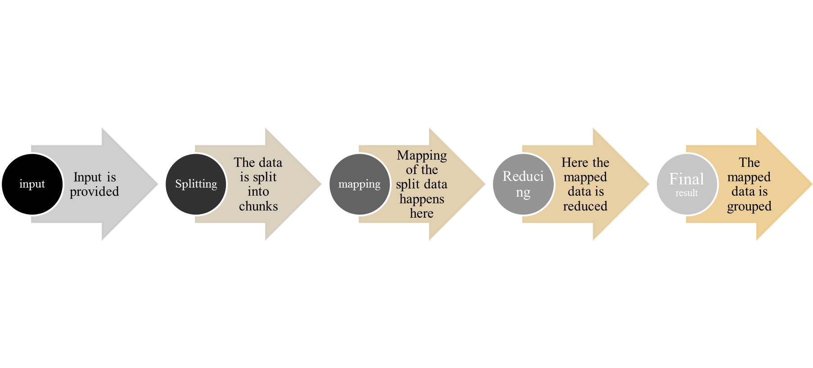
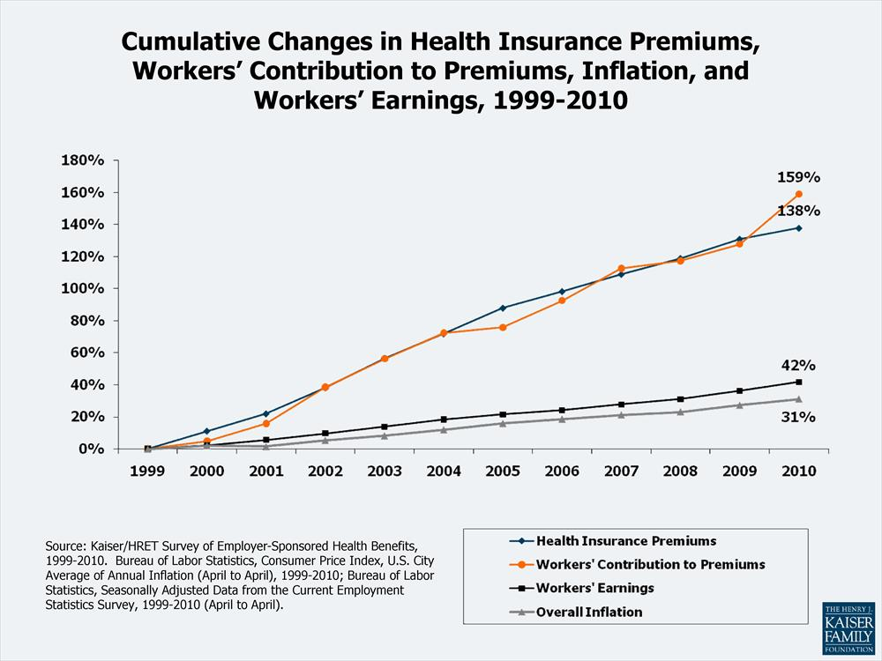
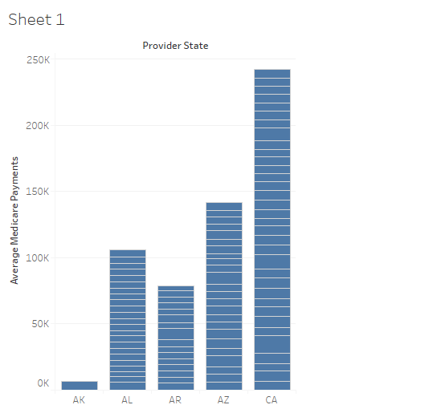
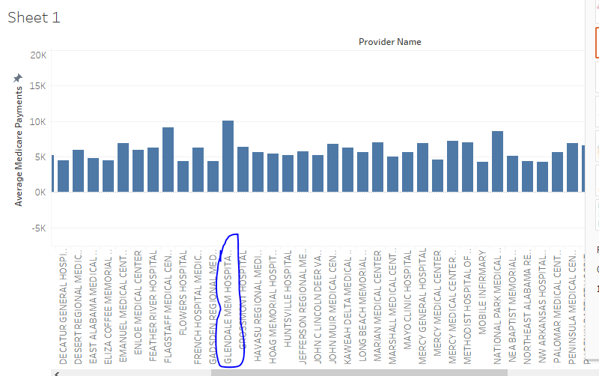
CPSC 651 – Big Data and Data Analytics
INPATIENT PROSPECTIVE PAYMENT SYSTEM DATA ANALYTICS.
^{DILEESH CHANDRA BIKKASANI}
Department of Technology Management
University of Bridgeport, Bridgeport, CT
Abstract
MapReduce:
The main aim of this paper is to analyze the data on inpatient prospective payment system which is a payment system used in hospitals to record the data of the payments for patients. The data used for analysis is from data.gov. This paper provides an in-depth sight of how MapReduce is used to analyze the data, details of implementation are provided clearly. For comparing and evaluating the results, Implementation of Hadoop Eco System tools like spark and Hive are done. Finally, this paper provides an insight to various patterns in the data selected after analysis.
Figure 2: Process showing the MapReduce execution phases.
Introduction
Now after the development of the three classes is done the entire code of the MapReduce will be exported as a JAR file and which will be placed in a Hadoop Distributed File System, using the workflow scheduler the job will be scheduled.
The inpatient prospective payment system is a mechanism of payment which is used to reimburse the hospitals by a rate which is predetermined for the treatment of only some specific illnesses. This type of system is developed by Federal government of the U.S for treating of Medicare recipients,
To eliminate the payments of hospitals as scheduled by The Deficit Reduction Act which are because of certain complications of the inpatients, the payment system has been developed which is named for hospital-acquired conditions (HAC). “The Medicare centers defined that there are 11 types of complications based on several components, and the hospital-acquired conditions are not considered and removed from severity of Medicare which is termed as DRG diagnosis related groups” {Fuller, 2011 #1} [1].
Results and Evaluation
I have analyzed the data using the tools like HDFS using the virtual machine of the Cloudera and uploaded the data into it. Using the putty manager, I have connected the local host and VM virtual machine.
I have created schema for PIG to load input data and to perform some validation on top of it.
As validation from the Tableau tool provides the highest provider for a single state and who is the highest provider.
Figure 1: cumulative changes in health care coverage
Data and Problem definition.
Conclusion
The data I got is from data.cms.gov, below is the link.
https://www.data.gov/health/highlights
The Health care has been one of the most underrated field, with almost many terabytes of data being generated every month, some of the problems that are being faced this health care system is that some of the treatments that patients get will remain uncompensated, medical education and payments have been losing the balance between themselves.
“Thus, the incentive was to provide any all services that had some benefit to the patient” {Sloan, 1988 #11} [2].
The data in the field of health care is ever growing these days due to the complication of the health care procedures, such data should be processed and analyzed for better results. IPPS payment system should be considered for covering the uncompensated care. By evaluating the results, the providers can identify and fix certain amount for covering the care of patients, initially the patients should be paying some co-pay amount which will later be covered in the care. The DRG system which is developed should have some benefits using the results in this paper. The service quality can be increased by using the results in the paper, which is the way in which the patients get reimbursed.
“we projected nationwide cost savings from eliminating payments associated with conditions that occurred after admission” (Lezzoni 2009) [3]
References:
[1] Fuller, R. L., et al. (2011). "A New Approach to Reducing Payments Made to Hospitals with High Complication Rates."
[2] Iezzoni, L. I. (2009). "Reinvigorating the Quality Improvement Incentives of Hospital Prospective Payment."
[3] Sloan, F. A., et al. (1988). "Effects of the Medicare Prospective Payment System on Hospital Cost Containment: An Early Appraisal”.

