Slide 1
Big Data(CPSC-651-6T1)
Project – 1
Phase – 5
Topic: Inpatient Prospective Payment System.
Submitted by:
Dileesh Chandra Bikkasani.
Student id: 1004827.

Slide 2
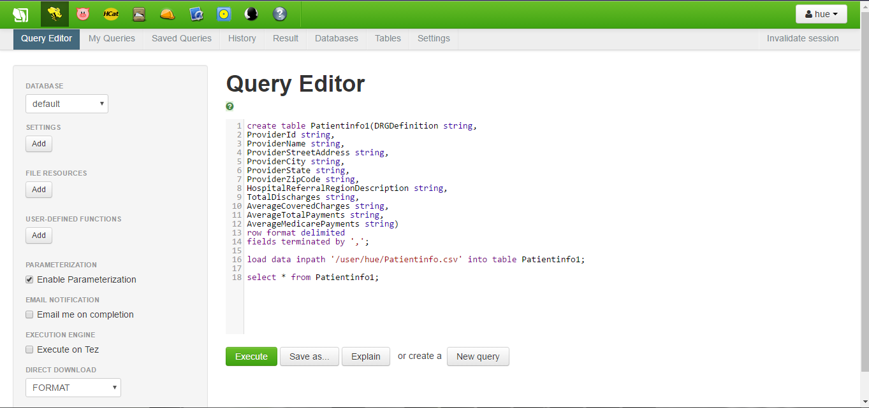
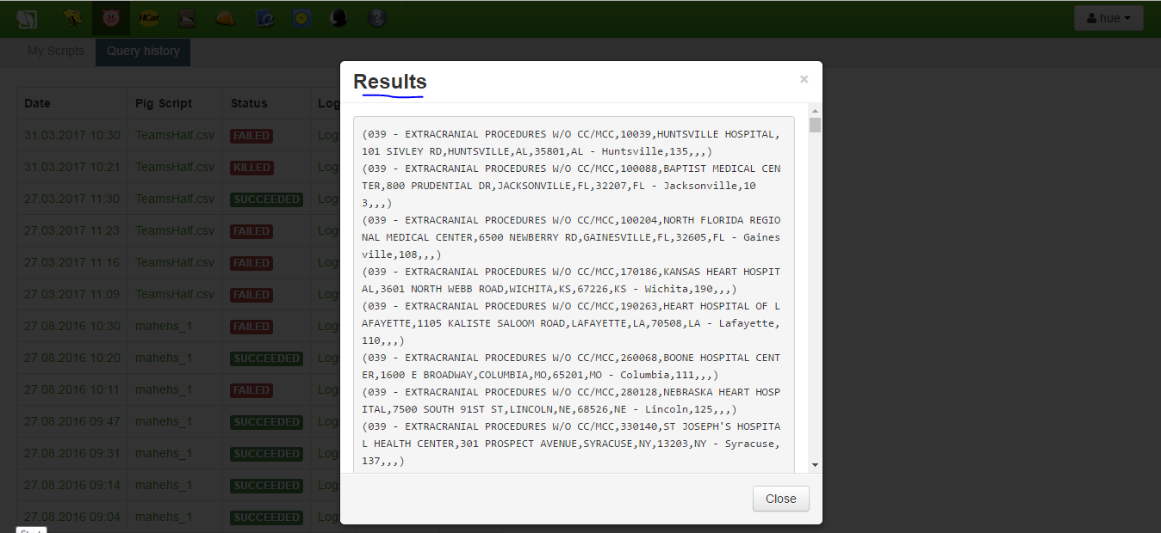
Above are the results obtained after the execution of Hive

Slide 3
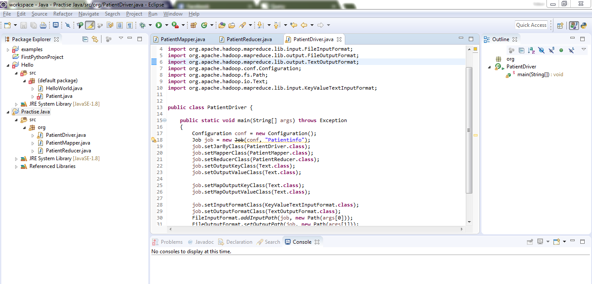
To write a map reduce code using java in eclipse MapReduce Driver Program

Slide 4
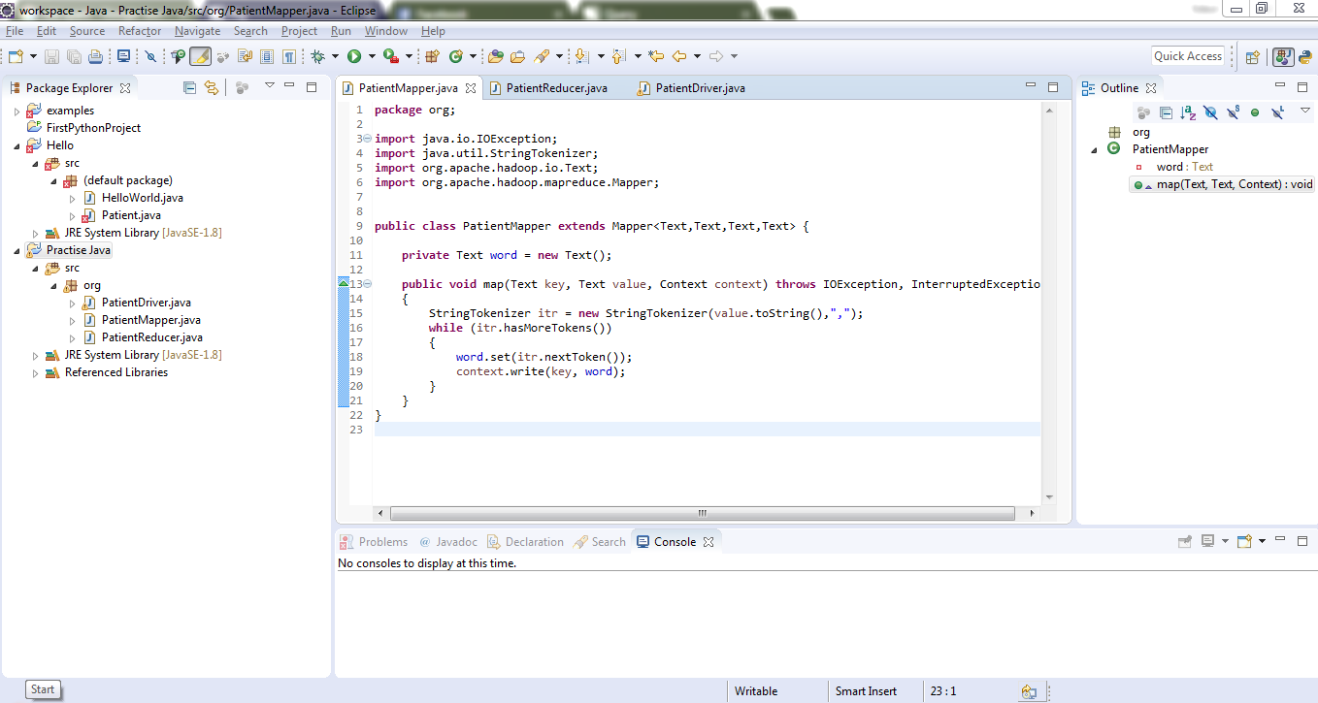
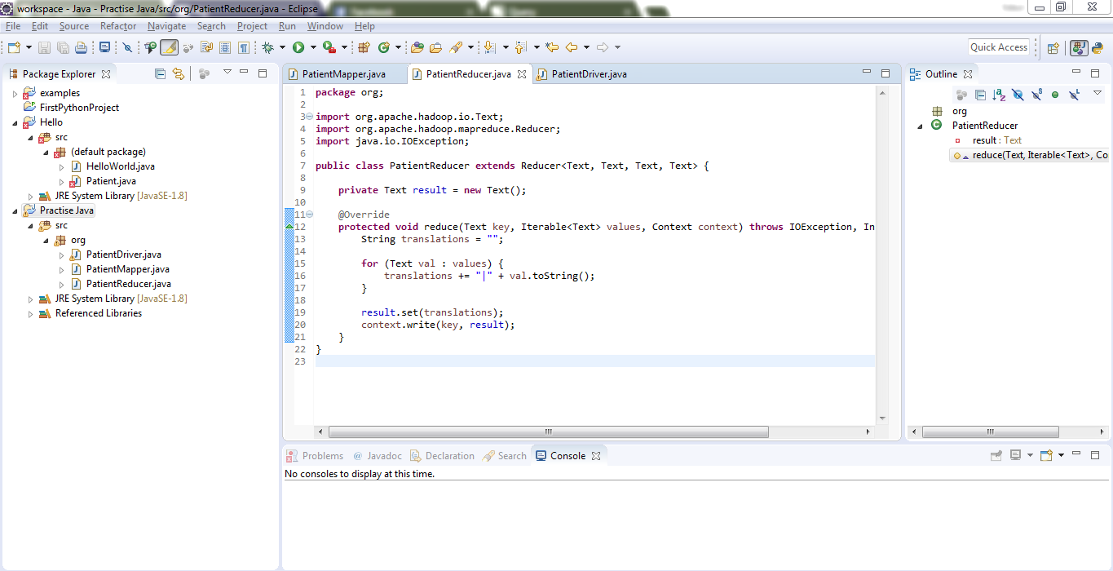
Above is MapReduce Mapper & Reducer program.

Slide 5
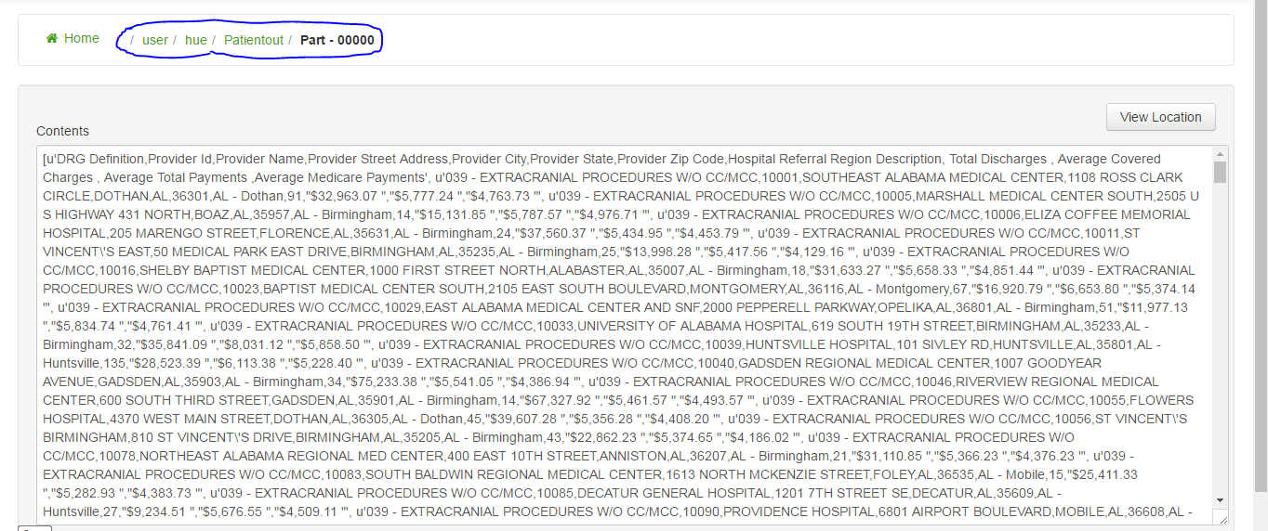
Capturing the MapReduce output.

Slide 6
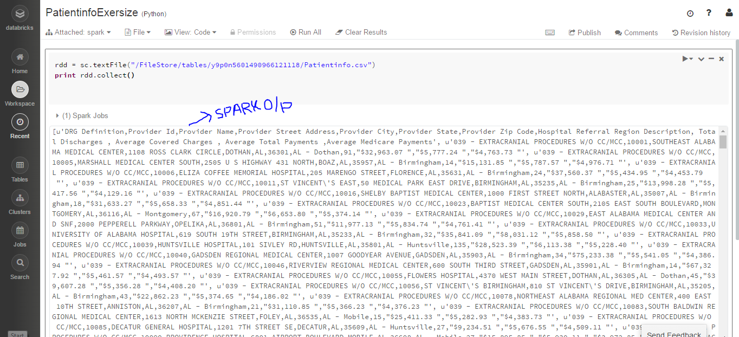
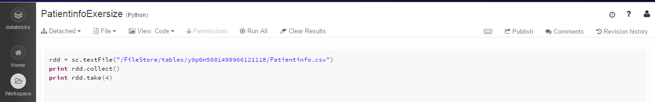
Above Are the snaps of my SPARK execution.

Slide 7
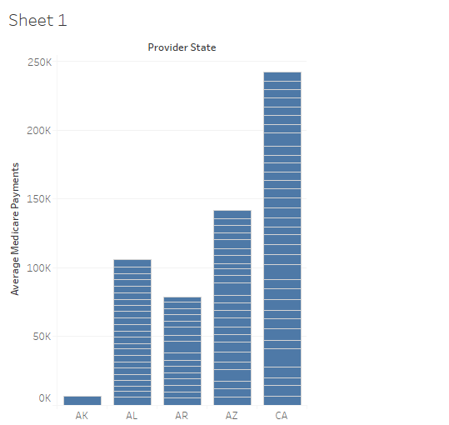
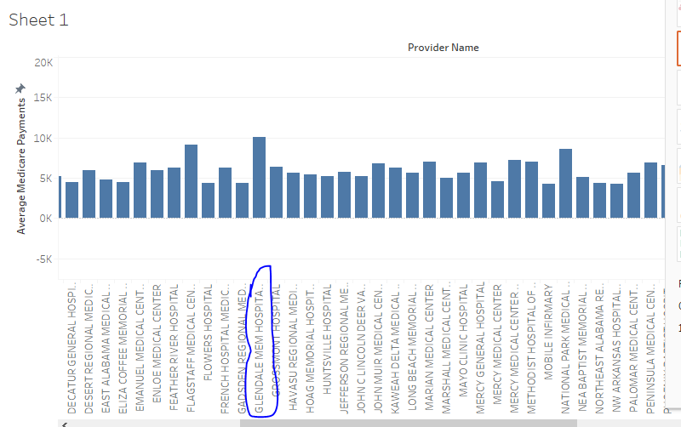
Above are the visualizations I got after the data is uploaded to Tabluea.

Slide 8


