Slide 1
Big Data(CPSC-651-6T1)
Project – 1
Phase – 4
Topic: Inpatient Prospective Payment System.
Submitted by:
Dileesh Chandra Bikkasani.
Student id: 1004827.

Slide 2
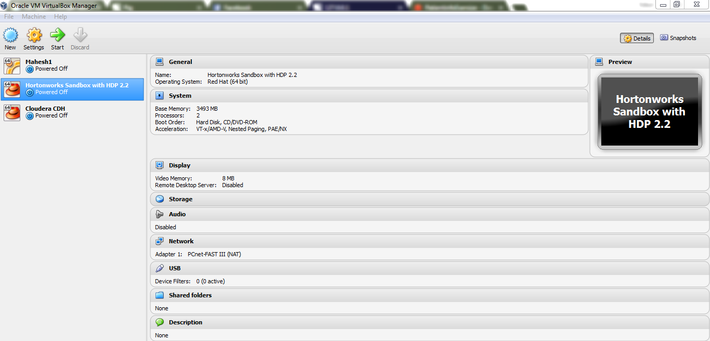
To Analyze the input file using below Hadoop components...
PIG
Hive
MapReduce and
Spark.

Slide 3
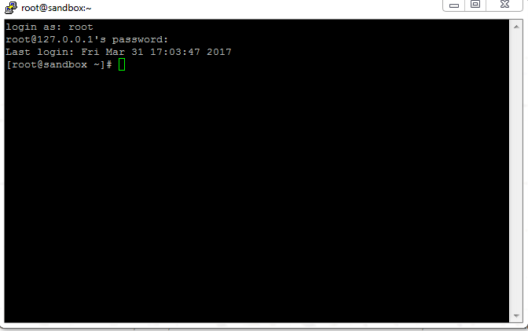
Install Hortonworks Sandbox in Oracle VM Virtual box manager
Connect local host and VM using putty software.

Slide 4
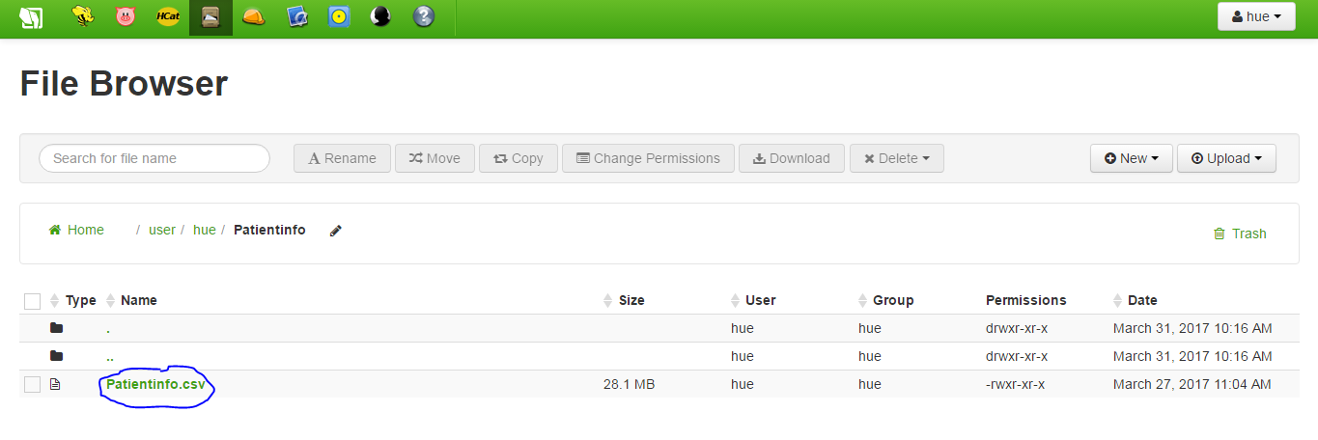
Launch Hadoop User Interface
Upload the input file which is having 160k records.

Slide 5
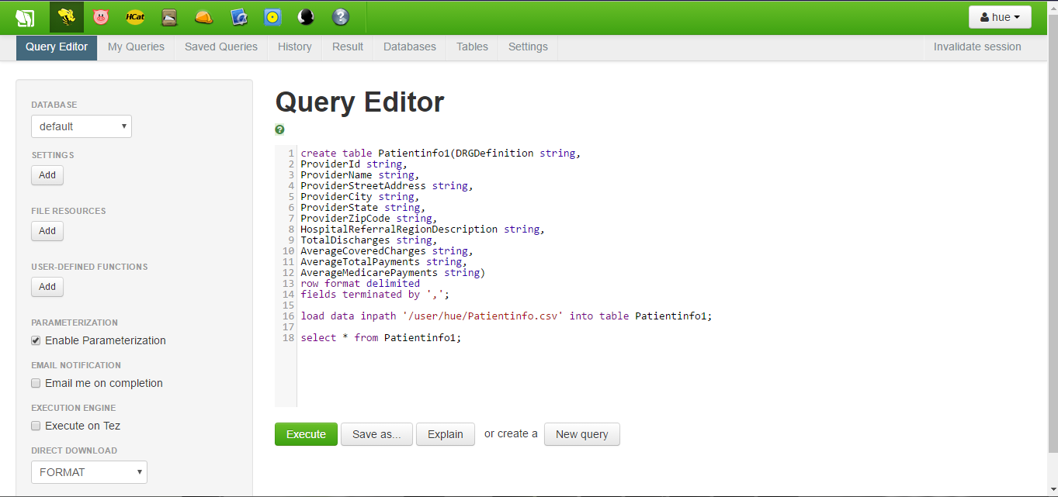
To create the schema for all components in Hadoop
Start with hive

Slide 6
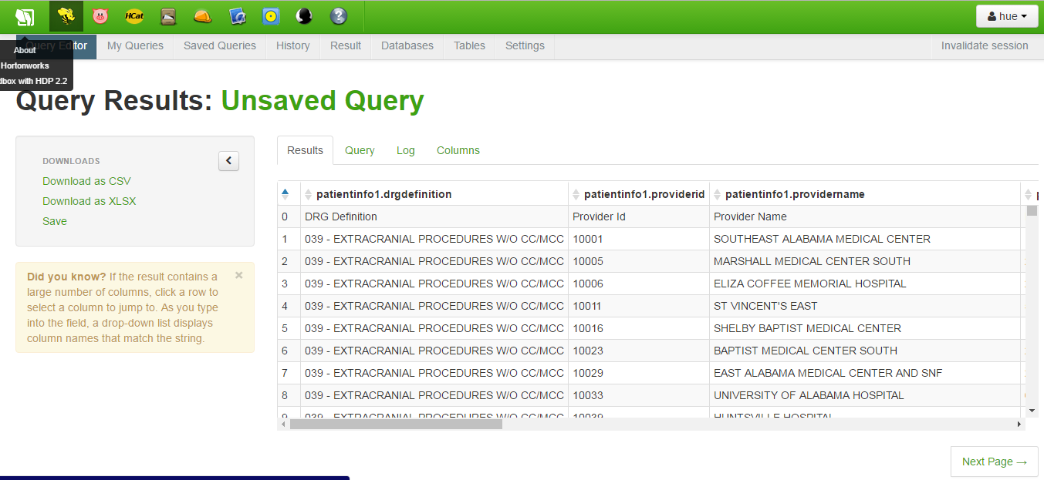
Execution. below snip is my output.

Slide 7
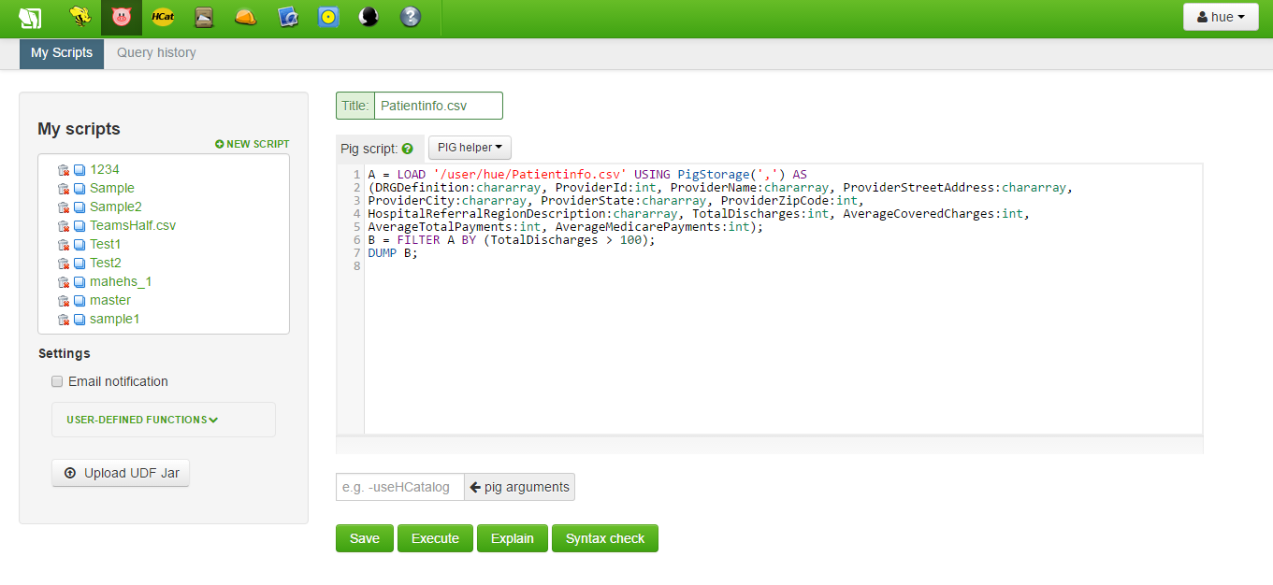
Create schema for PIG to load input data and perform some validation on top of it.

Slide 8
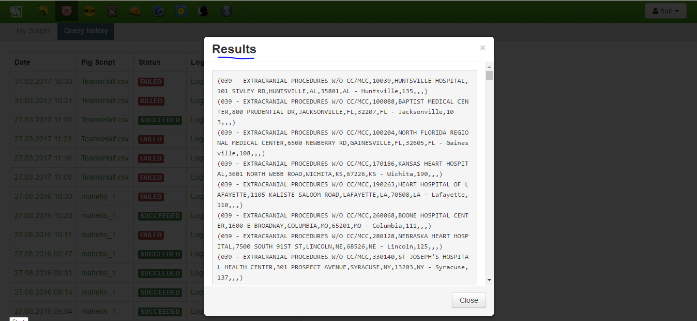
After execution below snip is my output.

Slide 9
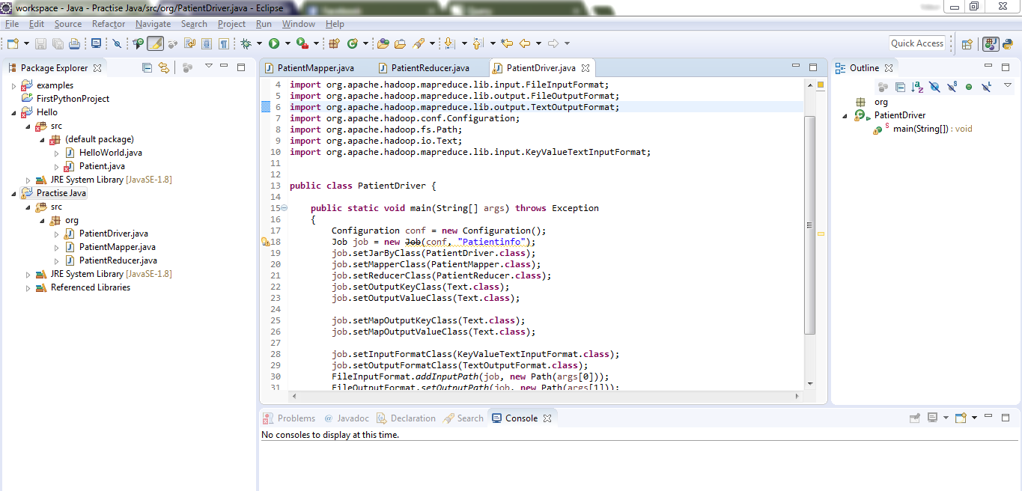
To write a map reduce code using java in eclipse MapReduce Driver Program

Slide 10
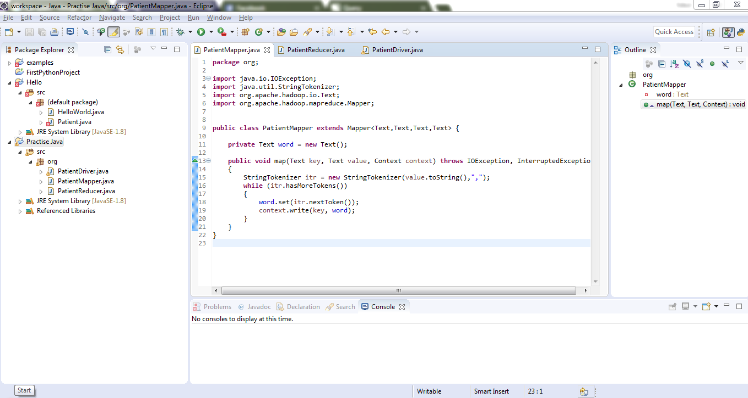
Below is MapReduce Mapper program.

Slide 11
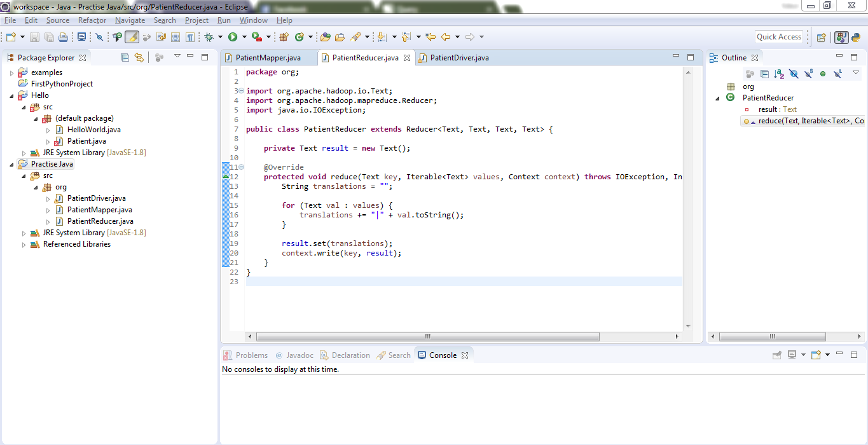
Below is MapReduce Reducer program

Slide 12
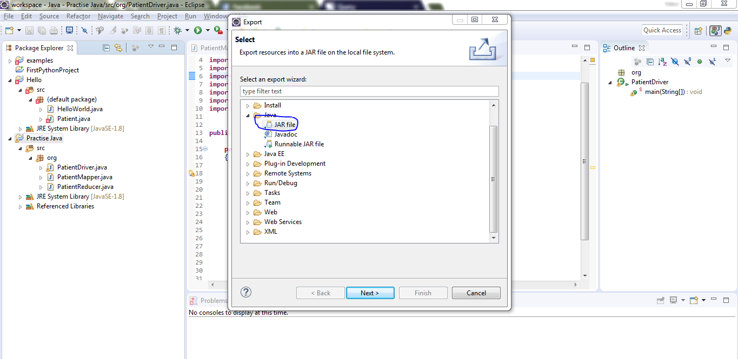
Exporting the entire code.

Slide 13
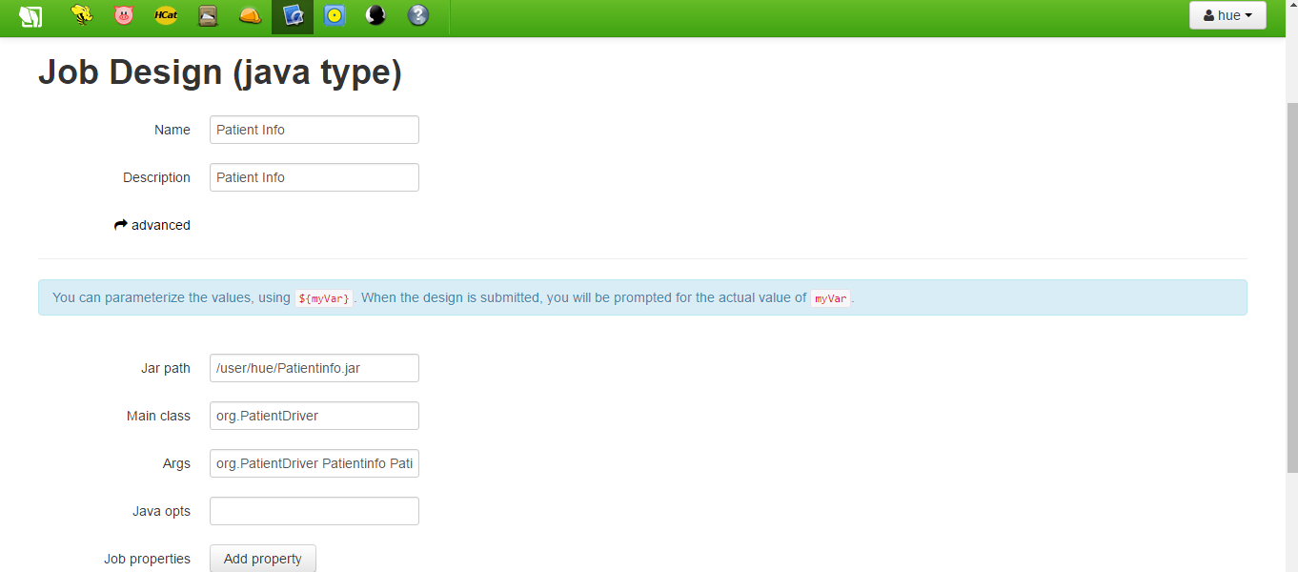
Scheduling the job using OOZIE workflow scheduler

Slide 14
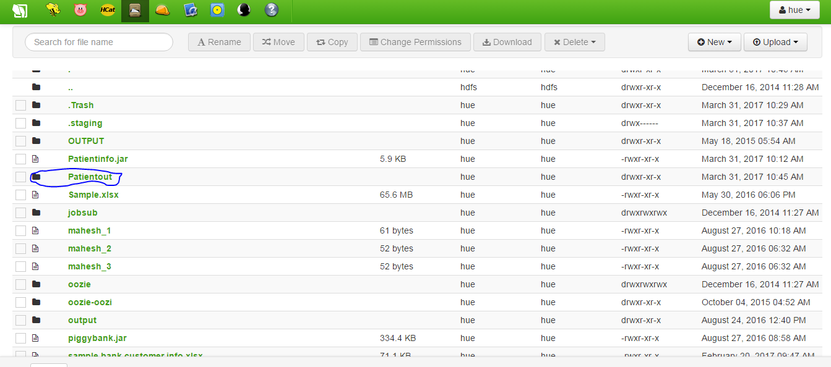
Checking the output data in output file

Slide 15
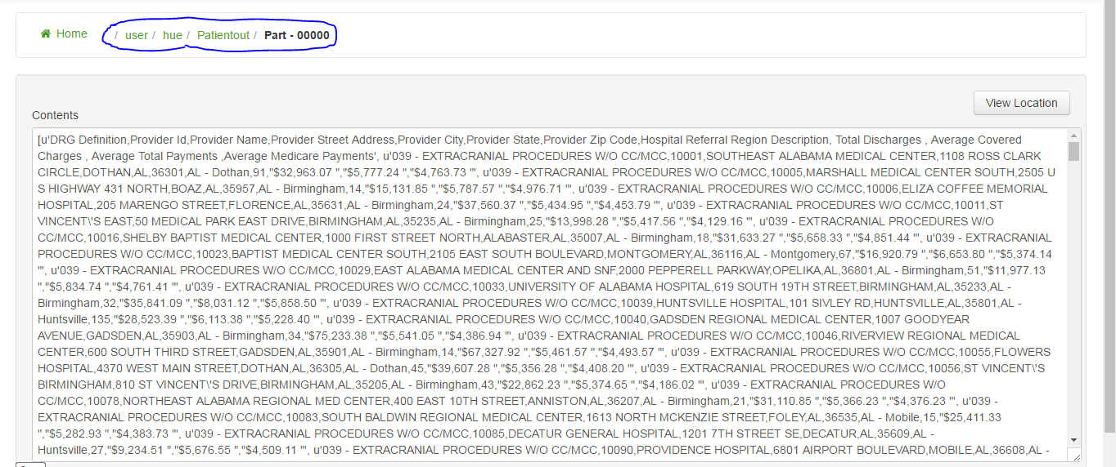
Capturing the MapReduce output.

Slide 16
To work with same input file using SPARK which we are implementing with python.
Spark competes more with MapReduce than with the entire Hadoop ecosystem.
Databrics.
Databrics is a online platform which will provide the environment to execute the SPARK in Scala, python, java etc.

Slide 17
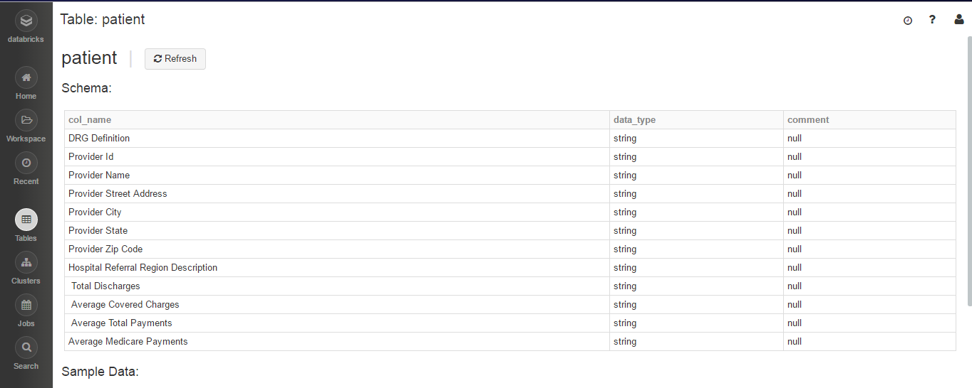
load the same input file schema into Databrics storage.

Slide 18
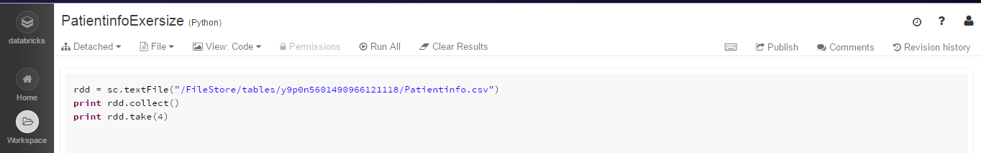
Write SPARK commands using python to load the data and performing some validations.

Slide 19
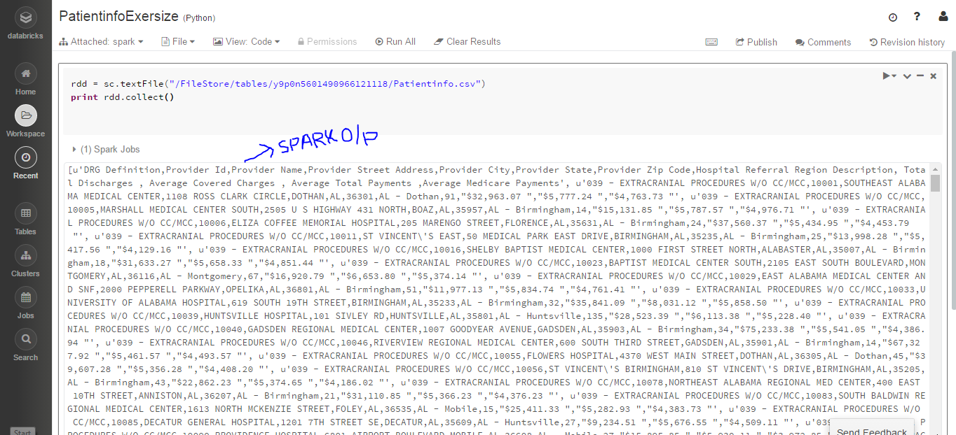
Below snip is my output after executing SPARK command

Slide 20


