Slide 1

Suicide Rate Analysis and Prediction
Presented by Anji Jeshavath
Chandradeep Reddy

Slide 2

Introduction
The World Health Organization estimates that 800,000 people die by suicide each year, making it the 18th biggest cause of death. Suicide was the tenth largest cause of death in the United States in 2018, resulting to a decrease in average life expectancy in the United States. Suicide is a global phenomenon that affects people of all ages. According to some estimates, for every adult who died by suicide, more than 20 others attempted suicide. Suicide is a worldwide problem; in 2016, 79 percent of suicides took place in low- and middle-income nations.
People today suffer from serious physical and psychological diseases because of a range of internal and external circumstances. Although depression is more common in people in their 30s and 40s, it can also be found in children and the elderly due to academic stress and interpersonal relationships. Because people with mental illnesses are stigmatized in society, they frequently conceal their sickness. Self-harm and suicide attempts are also influenced by economic conditions and drug and alcohol usage.

Slide 3

Motivation :
The project focuses on employing machine learning algorithms to accurately predict suicide attempts by analyzing various factors such as depression, economic conditions, societal factors, and incurable diseases. The goal is to utilize preliminary data analysis and machine learning models to understand the trends in suicide attempts and the impact of different factors.
The project is chosen due to the increasing concern over suicides globally, with an estimated 800,000 people dying by suicide each year. It addresses a significant gap in predicting suicide attempts with higher accuracy, aiming to contribute to suicide prevention efforts effectively.
The research question explores whether machine learning algorithms can accurately predict suicide rates and identify influential factors, thereby aiding in the development of targeted suicide prevention strategies.

Slide 4

:
Overview of Similar Approaches
State of the art: Current approaches include AI-based chatbots with approximately 75% accuracy in preventing suicides and traditional methods of suicide prediction, which have shown poor predictive accuracy according to a meta-analysis of 365 studies.
What’s missing? There is a gap in achieving high precision in suicide prediction through individual risk or protective factors. The project aims to address this by exploring the effectiveness of different machine learning models in enhancing predictive accuracy.

Slide 5

Introduction to the Dataset
Data will be studied : The dataset, "Suicide Rates Overview 1985 to 2016," contains various attributes correlated with global suicide rates, including country, year, sex, age, generation, GDP per capita, and HDI for the year.
Size : The dataset comprises 27,820 rows and 12 columns.
Source of the dataset: It is sourced from Kaggle and compiled from datasets provided by the United Nations Development Program (HDI), World Bank, World Health Organization, and Szmali. The data includes information from over 100 countries spanning from 1985 to 2016.
https://www.kaggle.com/datasets/russellyates88/suicide-rates-overview-1985-to-2016

Slide 6
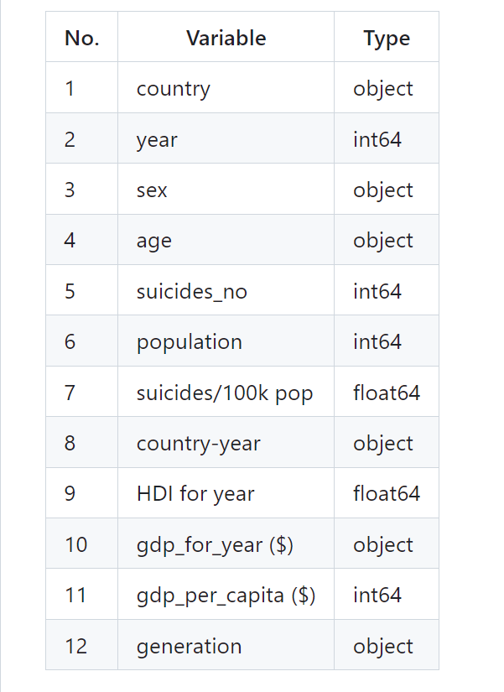
Dataset Description
Data Source: https://www.kaggle.com/datasets/russellyates88/suicide-rates-overview-1985-to-2016
Data Size : 3MB
Data Shape : 30000 Rows and 12 Columns
Time Period: 1985 to 2016
Dataset Columns

Slide 7
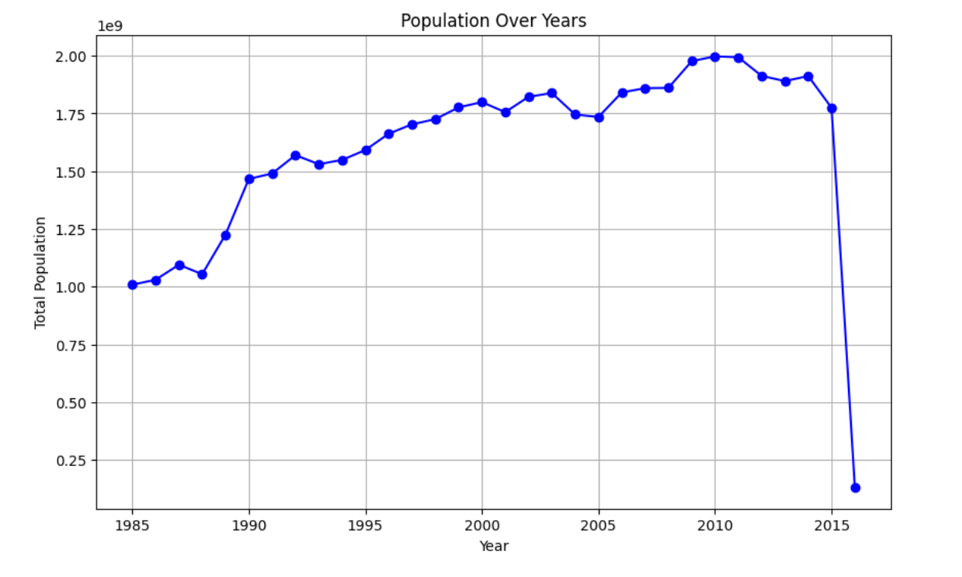
Population Over Years

Slide 8
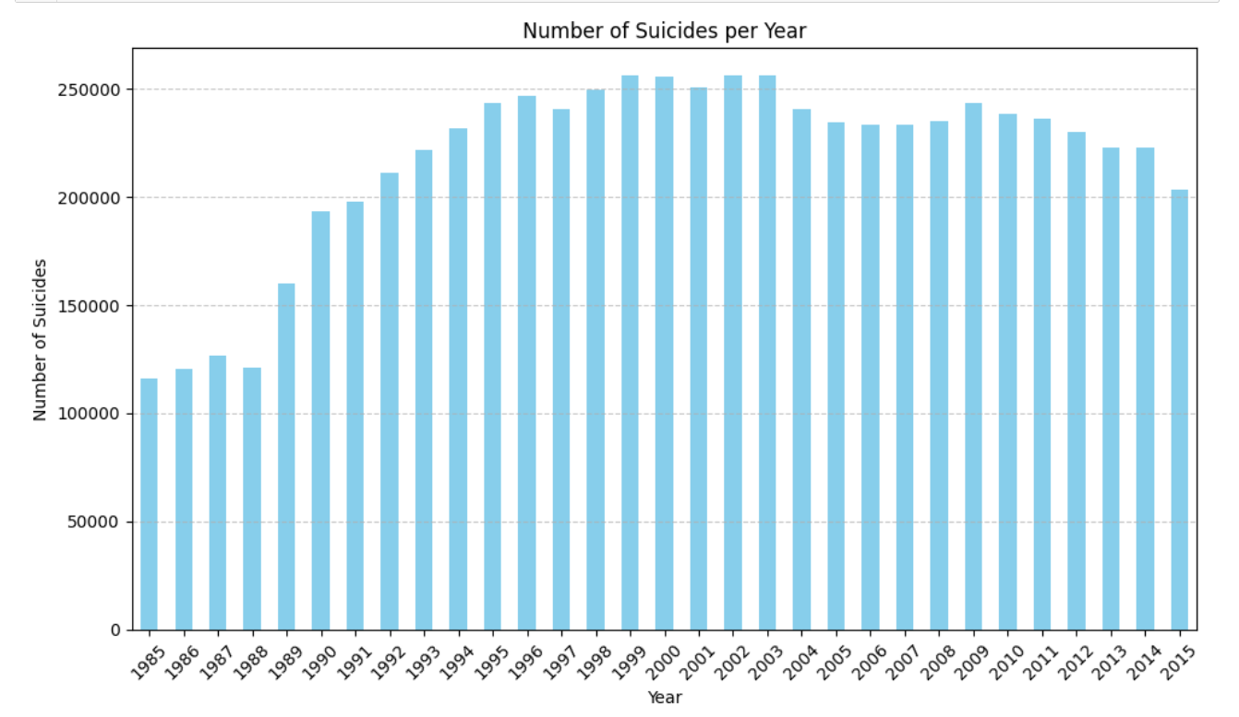
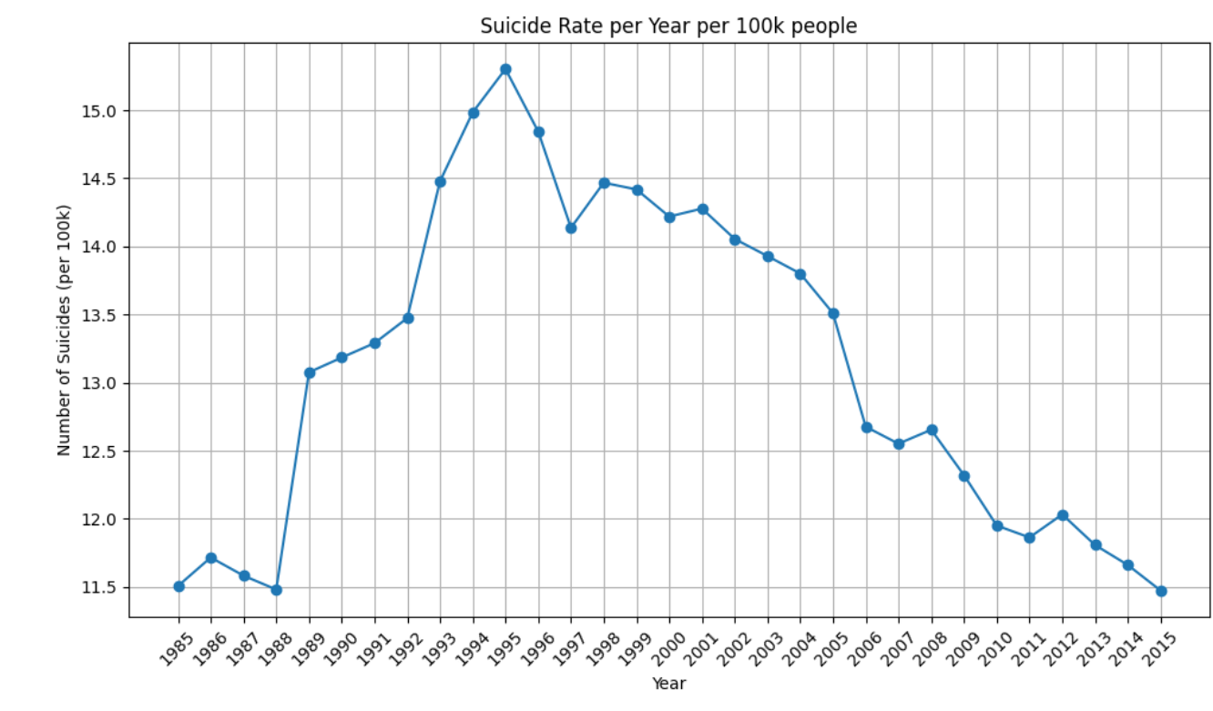
Number of Suicides & Suicide rate Over Years

Slide 9
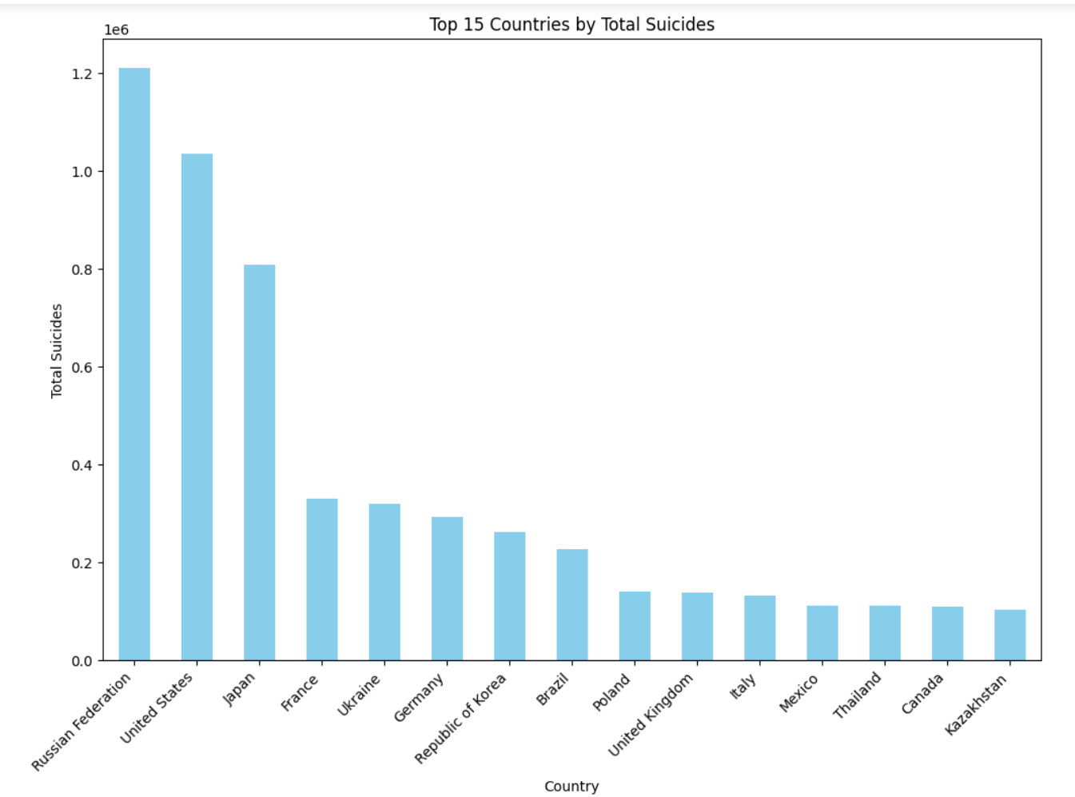
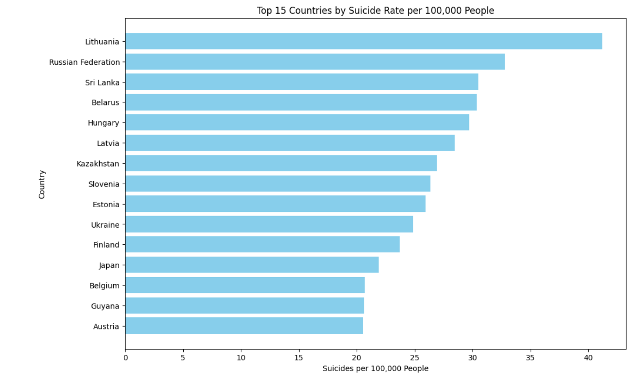
Top 15 countries by Number of Suicides & Suicide Rate

Slide 10
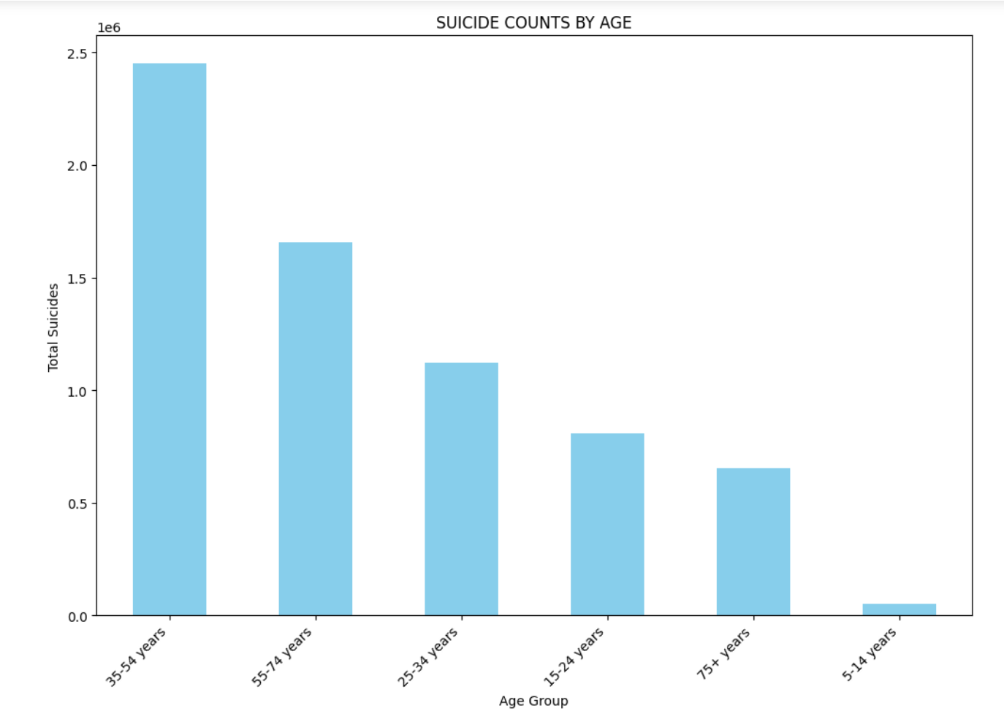
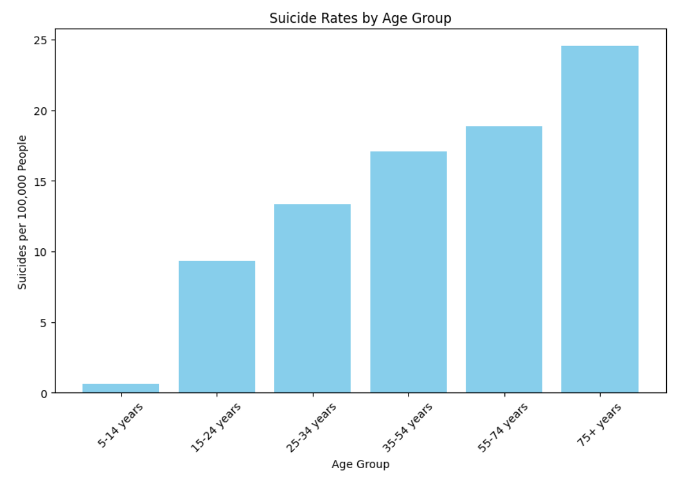
Number of Suicides & Suicide rate By Age group

Slide 11
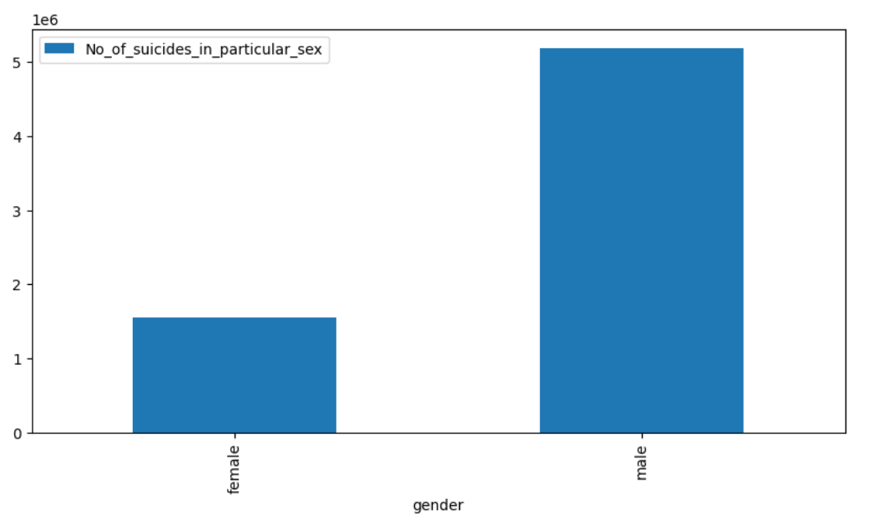
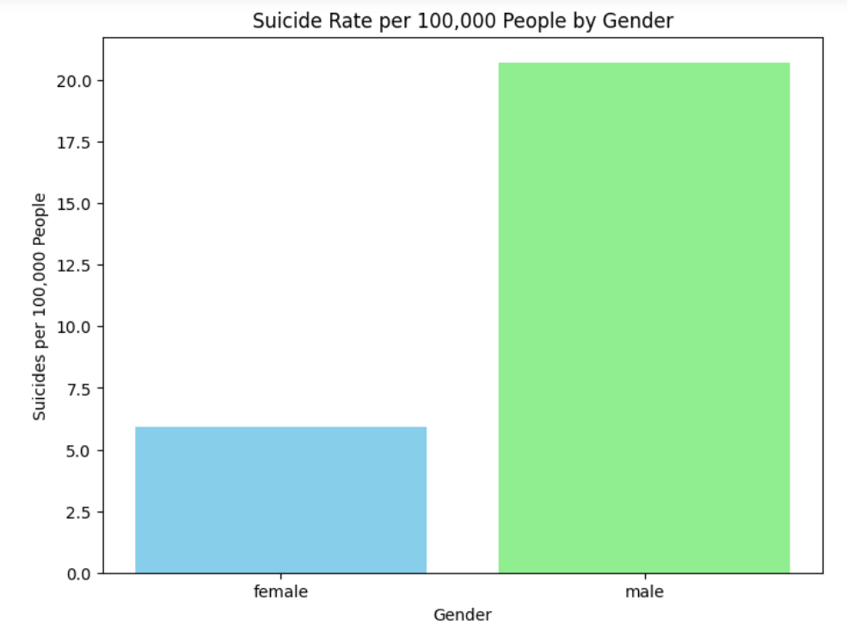
Number of Suicides & Suicide rate By Gender

Slide 12
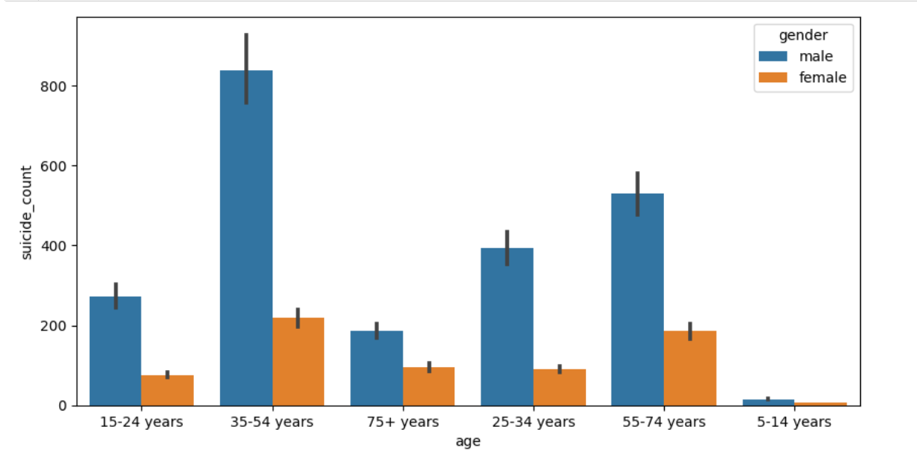
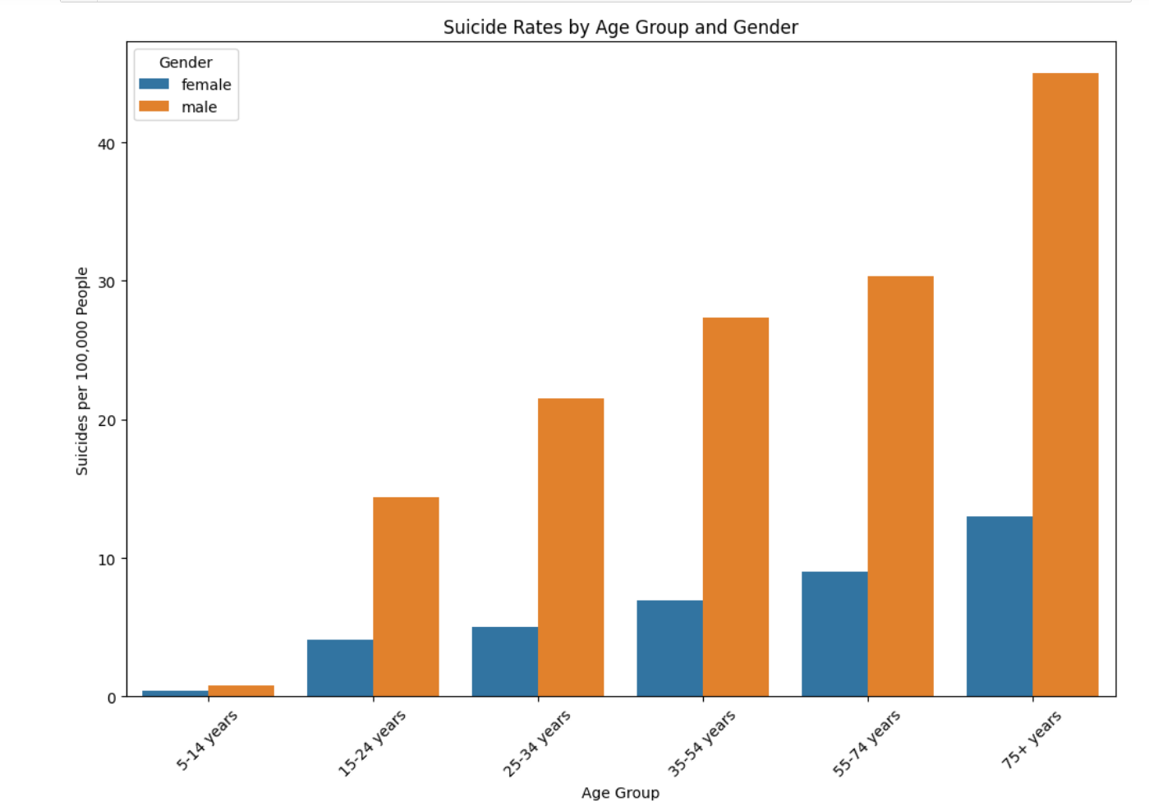
Suicide rate & Number of Suicides By Age & Gender

Slide 13
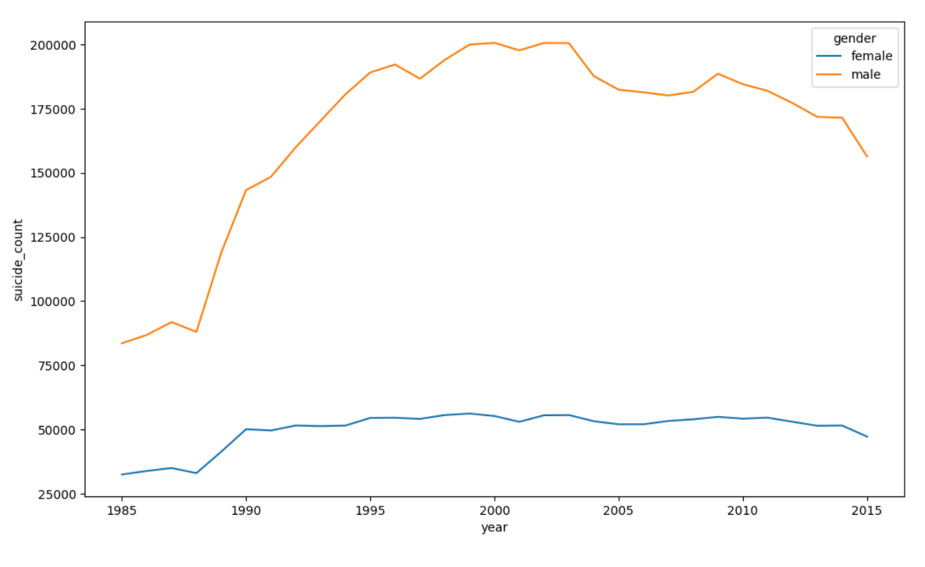
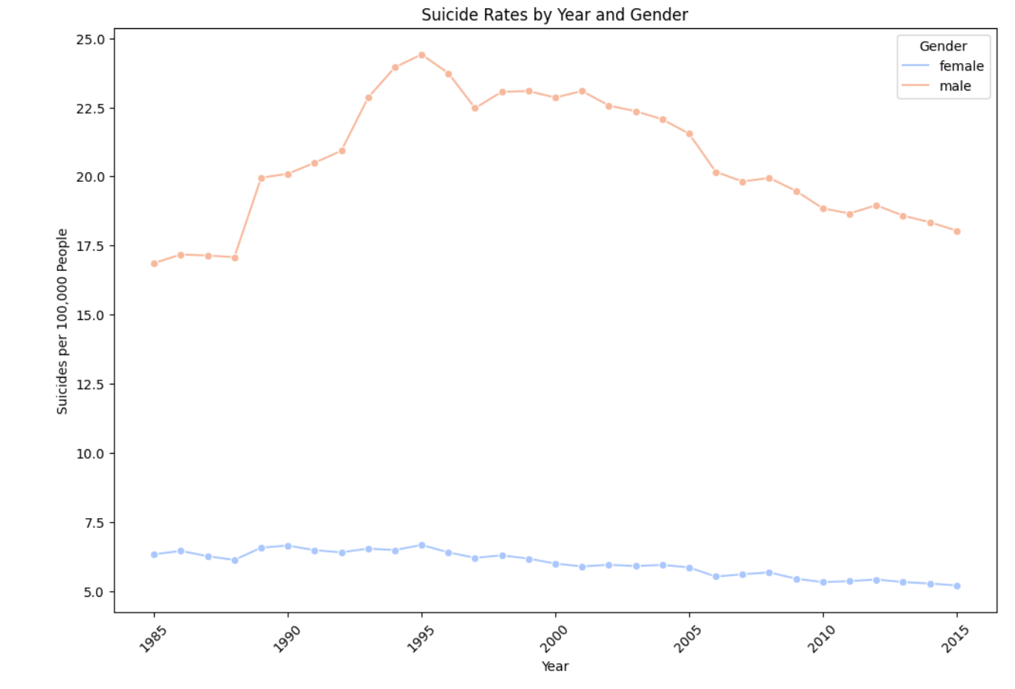
Suicide rate & Number of Suicides By Year & Gender

Slide 14
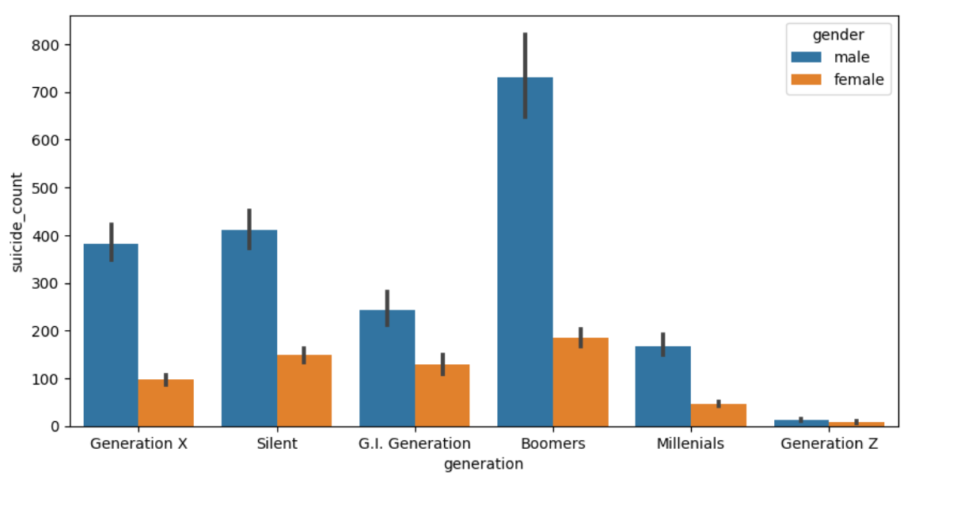
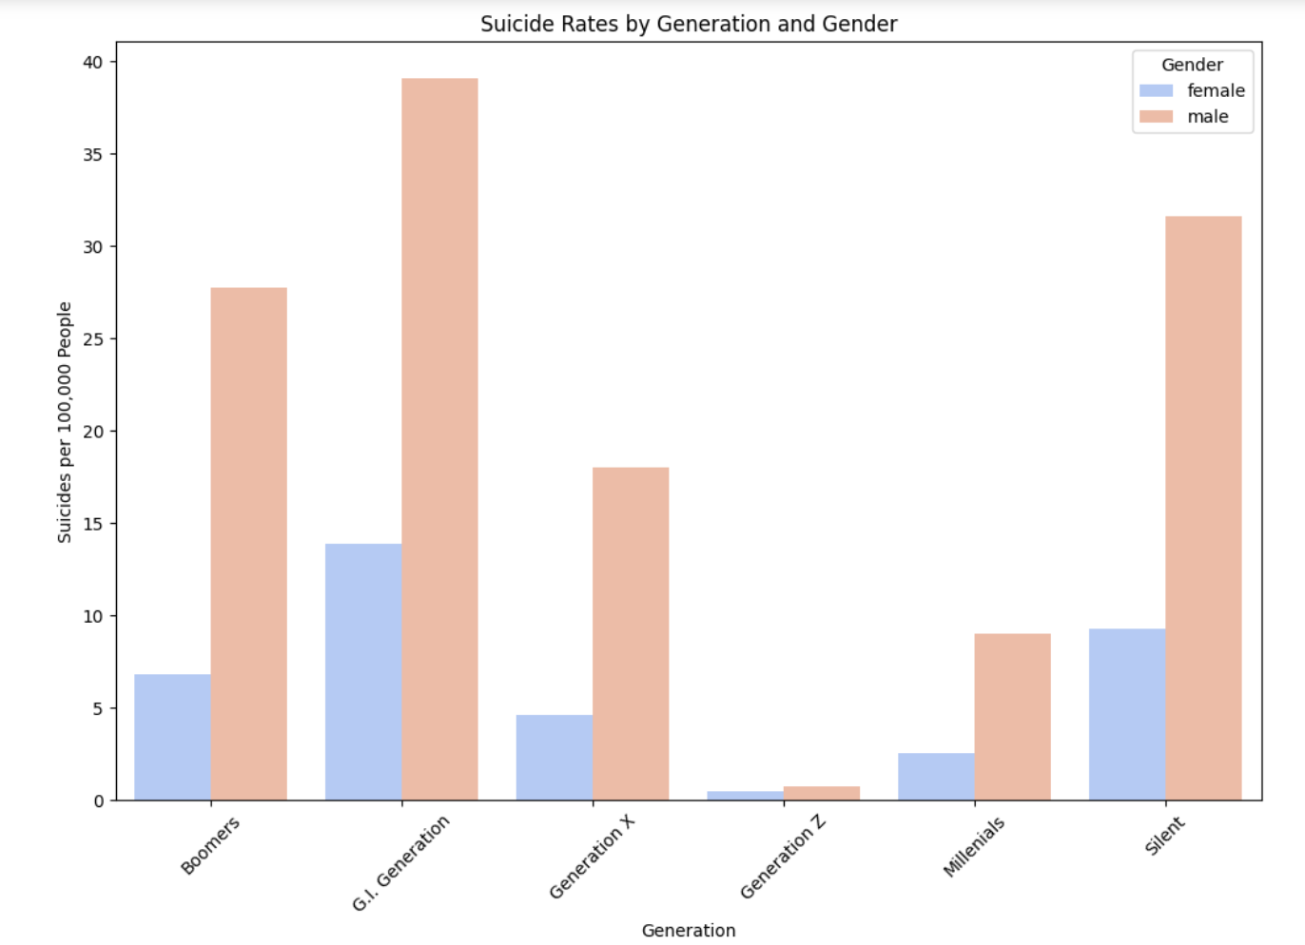
Number of Suicides & Suicide Rate By Generation & Gender

Slide 15
Suicide Rates By Gender & Generation

Slide 16
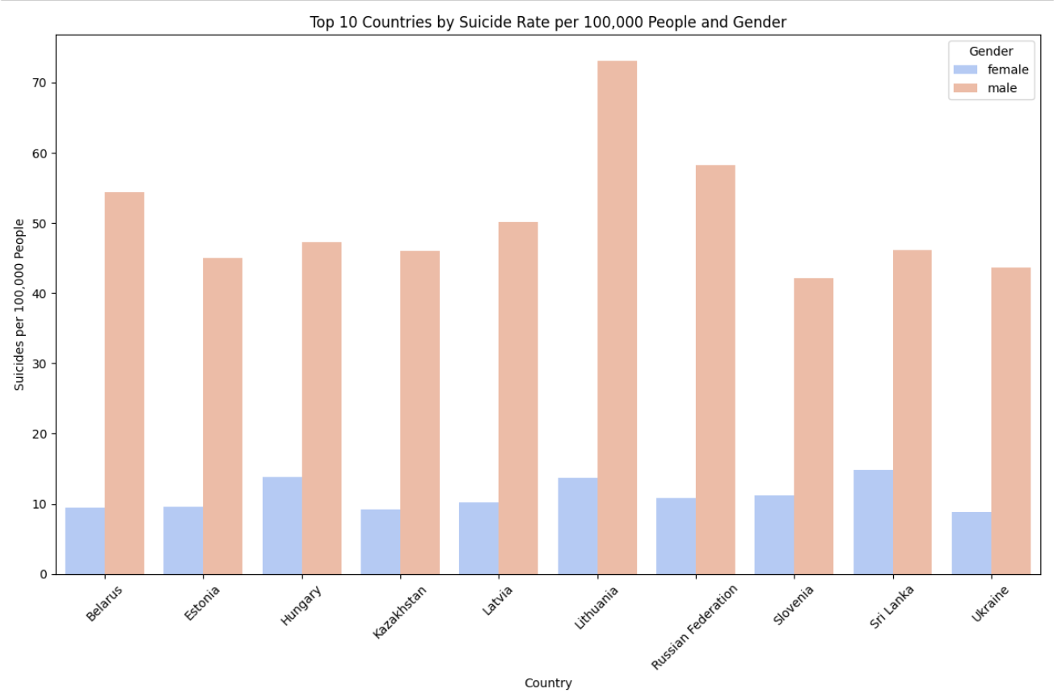
Top 10 Countries By Suicide rate by Gender

Slide 17
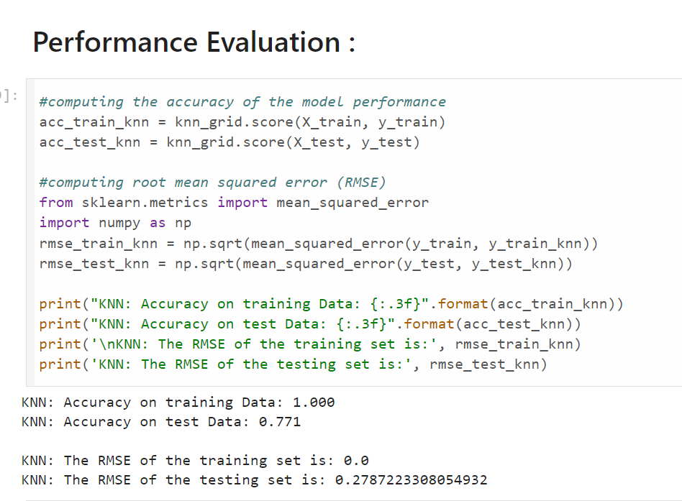
KNN ALGORITHM RESULTS

Slide 18
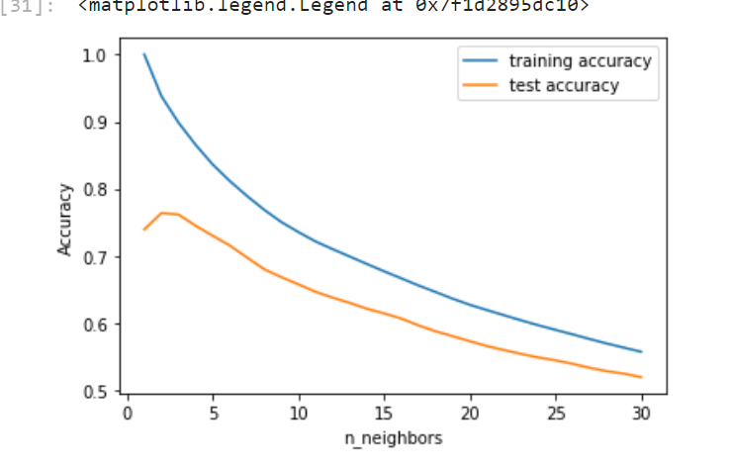
Training & testing accuracy for n_neighbours from 1 to 30
Overfitting is seen by the difference in performance between the training and testing sets.

Slide 19
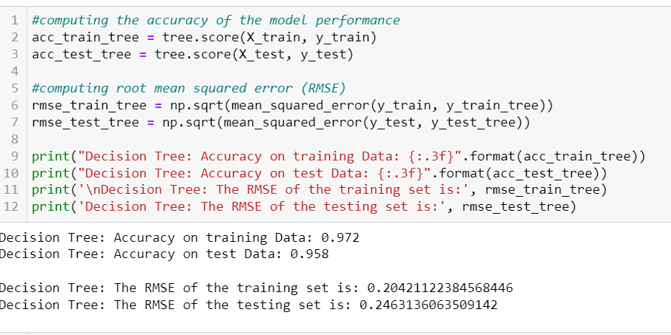
DECISION TREE MODEL

Slide 20
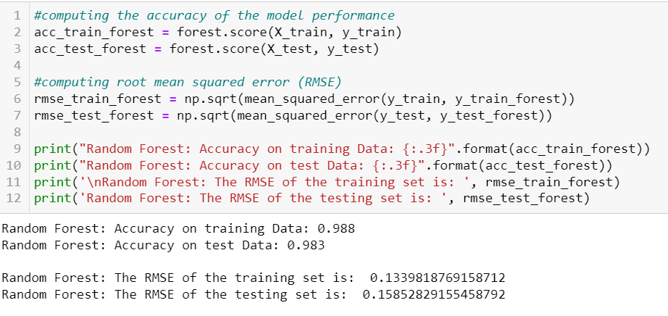
Random Forest Model

Slide 21
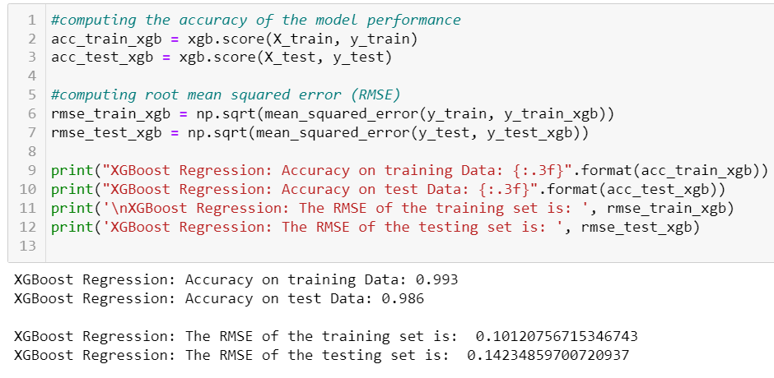
XGBOOST MODEL

Slide 22
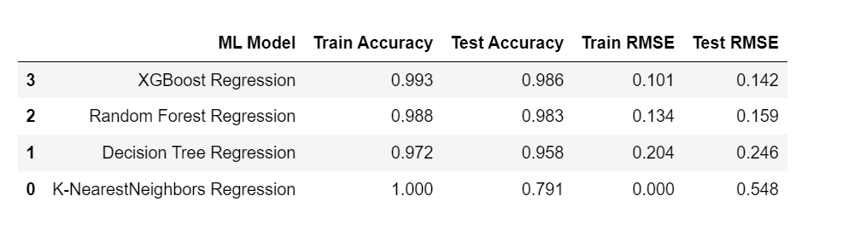
Comparison

Slide 23
Results Discussion
Data analysis helped us understand several underlying trends in suicide attempts over the years 1985 and 2016.
Coming to the performance of the four machine learning models - Among all the trained models, XGBoost has the highest accuracy and lowest RMSE.
This is because XGBoost is very good in execution Speed & model performance. Random forest had an accuracy of 98.3%, followed by Decision Tree and K-Nearest Neighbors with 95.8 and 79.1 % respectively.

Slide 24
CONCLUSION
This analysis was aimed at explaining how different machine learning algorithms can be used in predicting suicide rates based on relevant factors collected in the dataset.
Although there have been several successful high precision models, there is still potential for development. Preliminary data analysis showed some surprising findings which includes teen men are more likely to commit suicide.
Machine learning algorithms like XGBoost and Random Forest Regression consistently outperformed other algorithms and had the highest accuracy and precision.
The analysis carried out will also provide knowledge about areas of improvement to the government and other organizations working towards suicide prevention and counselling so that effective steps can be taken.

Slide 25
FUTURE WORK
This project can be further improvised by combining multiple data sets related to suicides and performing in-depth analysis.
Some statistical tests- hypothesis testing can be performed which can extract valuable insights.
Sentiment Analysis can be used to figure out in which social media people feel more free to talk about their mental health.

Slide 26
Thank You

