Slide 1


Suicide Rate Analysis and Prediction
Presented By
ANJI
CHANDRADEEP

Slide 2
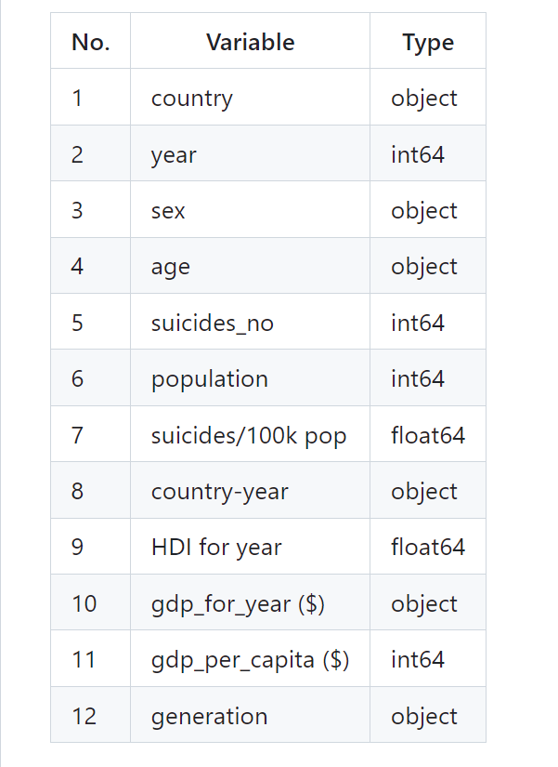
Dataset Description
Data Source: https://www.kaggle.com/datasets/russellyates88/suicide-rates-overview-1985-to-2016
Data Size : 3MB
Data Shape : 30000 Rows and 12 Columns
Time Period: 1985 to 2016
Dataset Columns

Slide 3
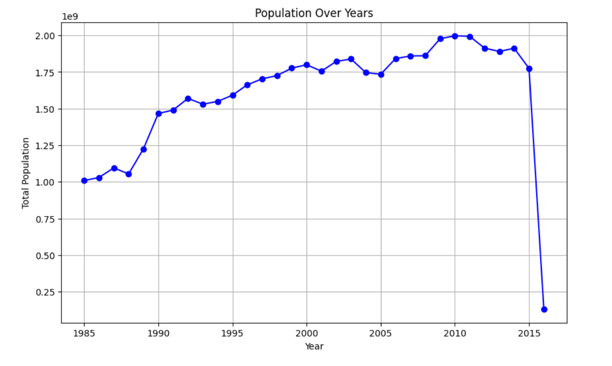
Population Over Years

Slide 4
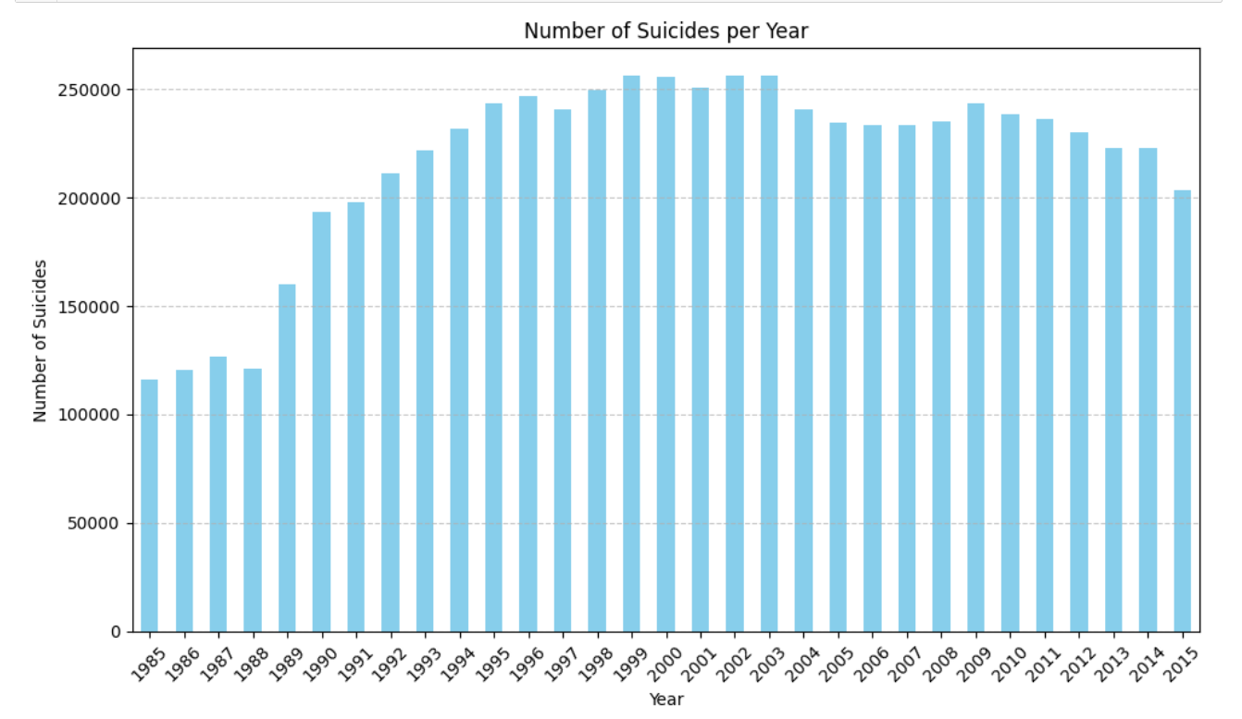
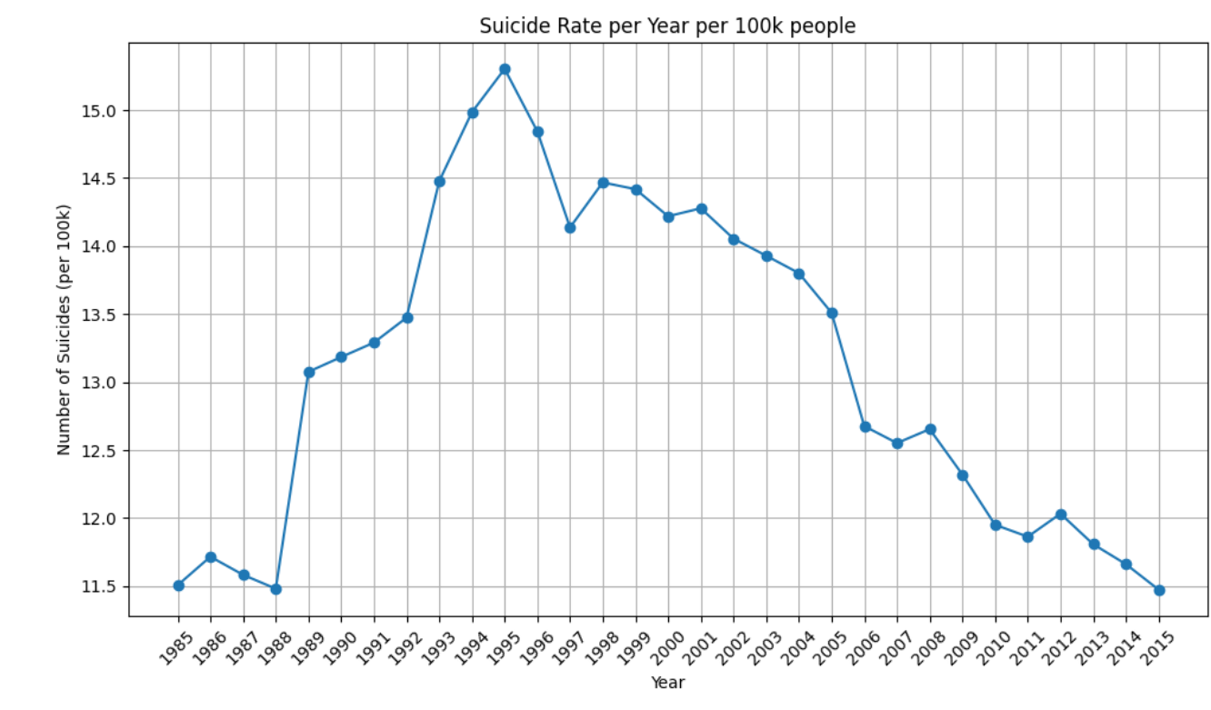
Number of Suicides & Suicide rate Over Years

Slide 5
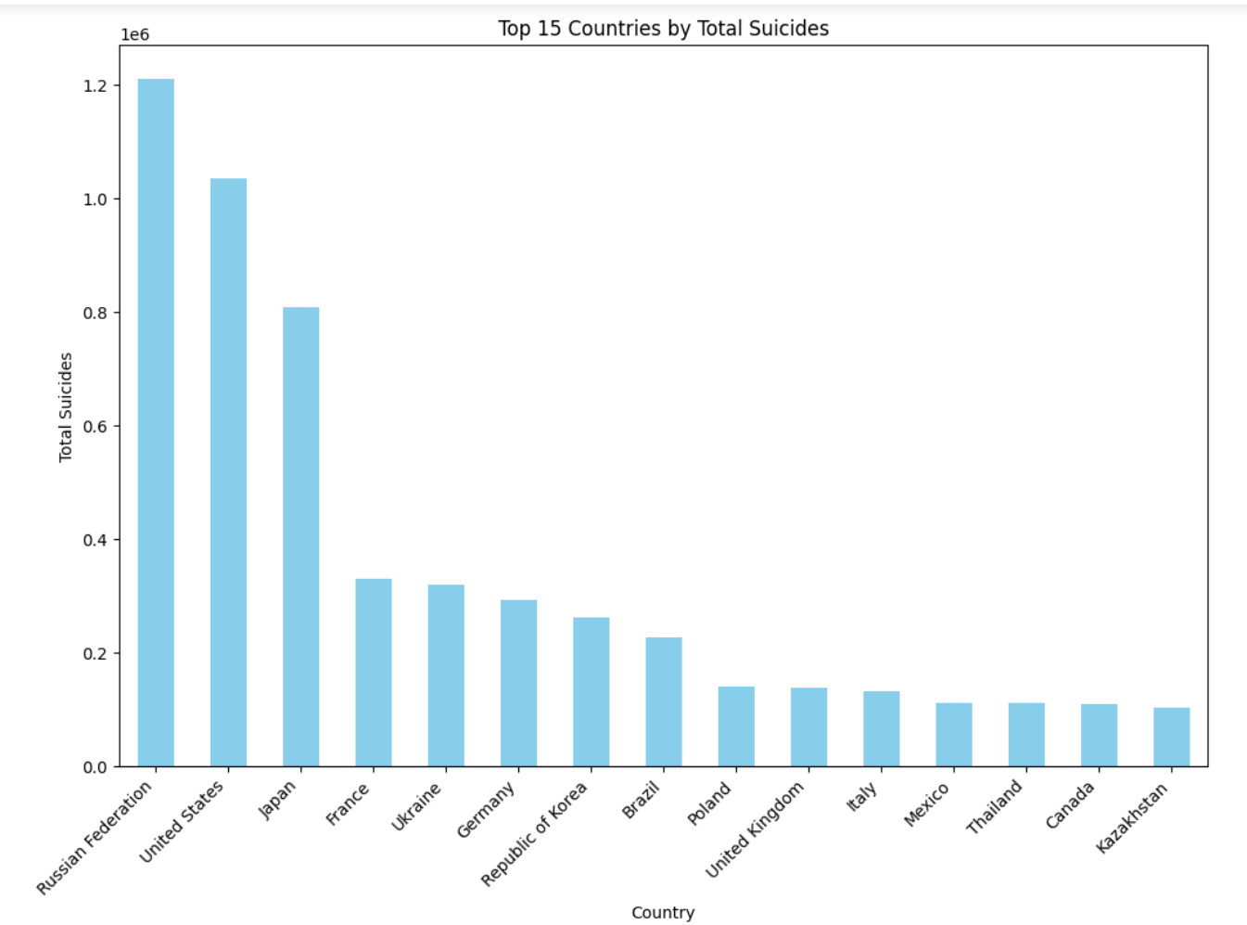
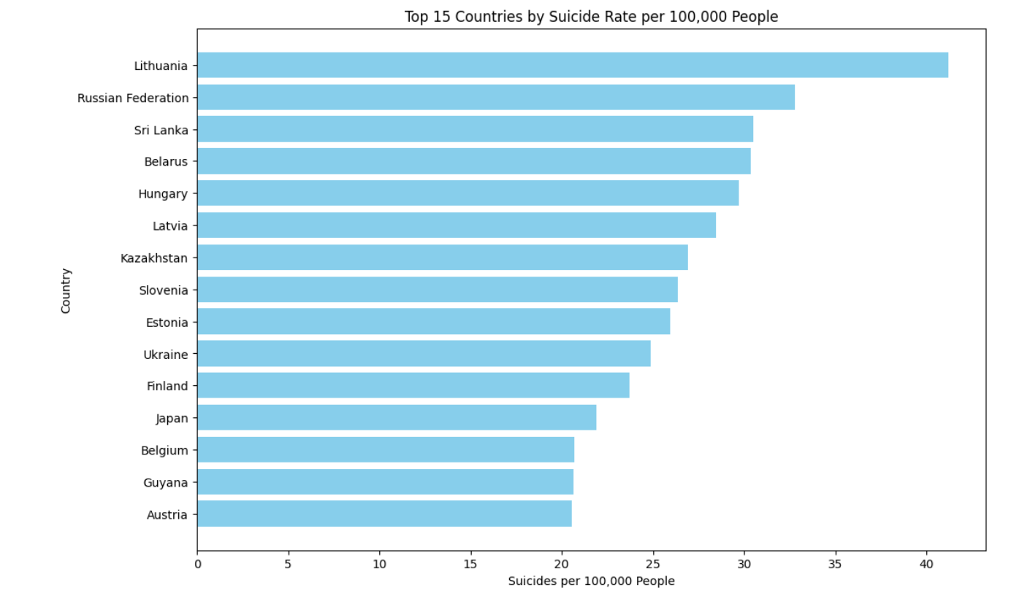
Top 15 countries by Number of Suicides & Suicide Rate

Slide 6
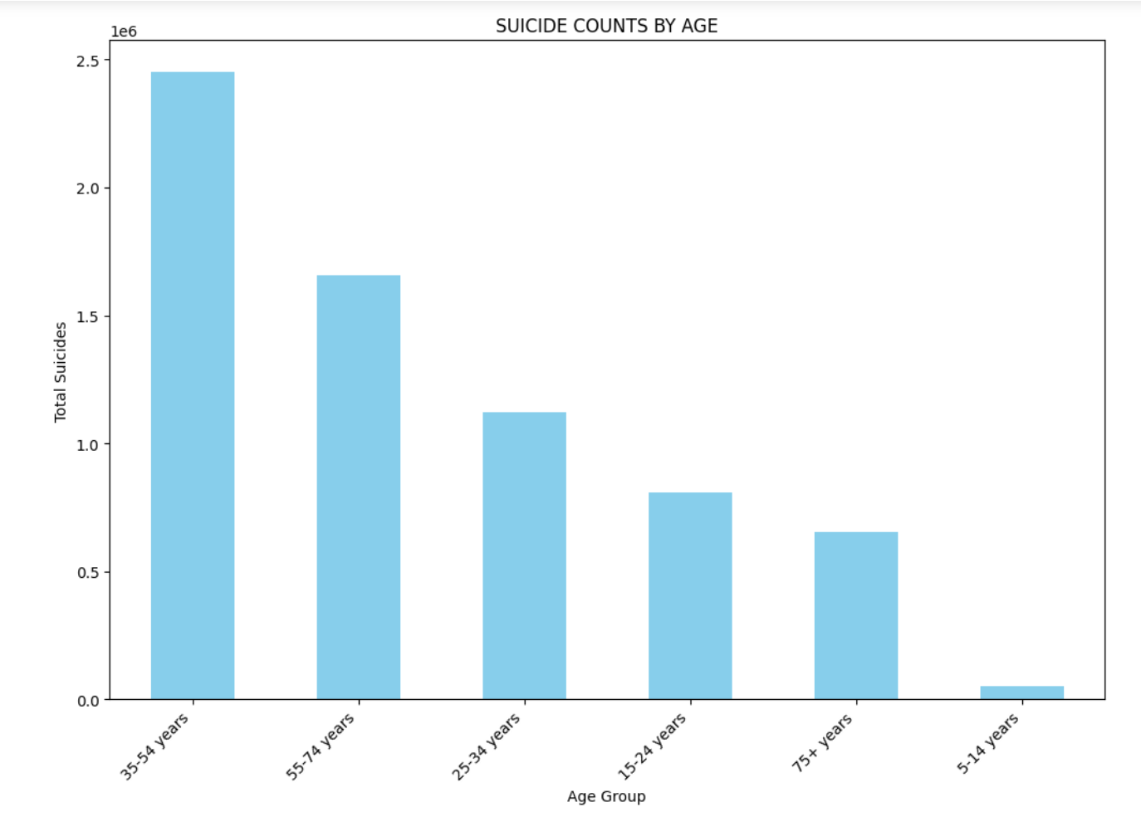
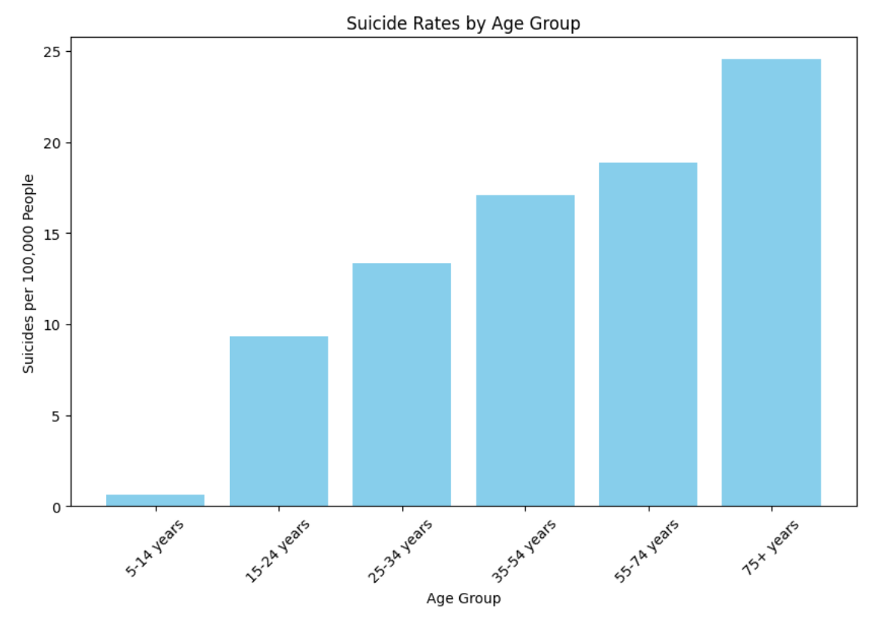
Number of Suicides & Suicide rate By Age group

Slide 7
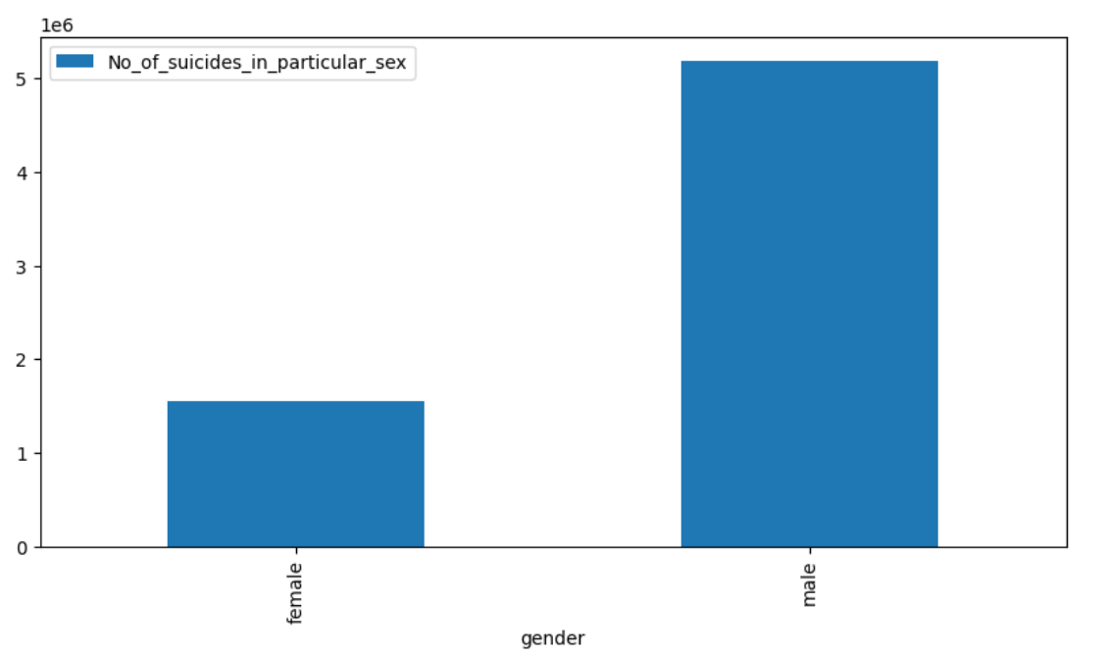
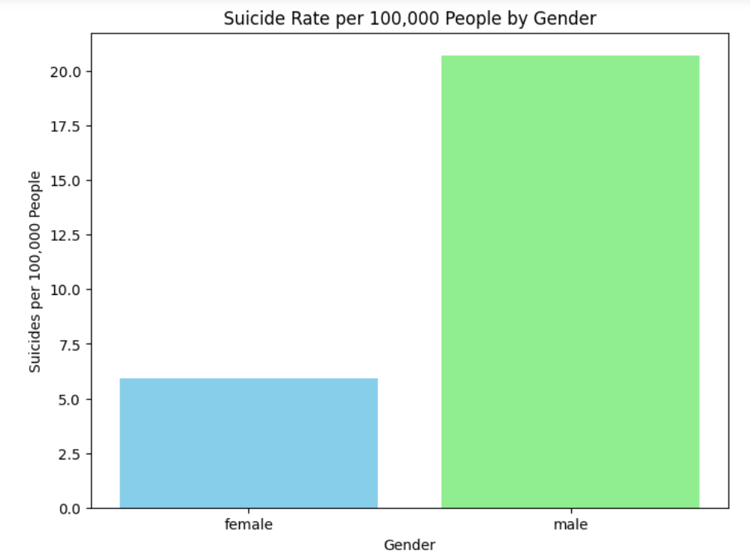
Number of Suicides & Suicide rate By Gender

Slide 8
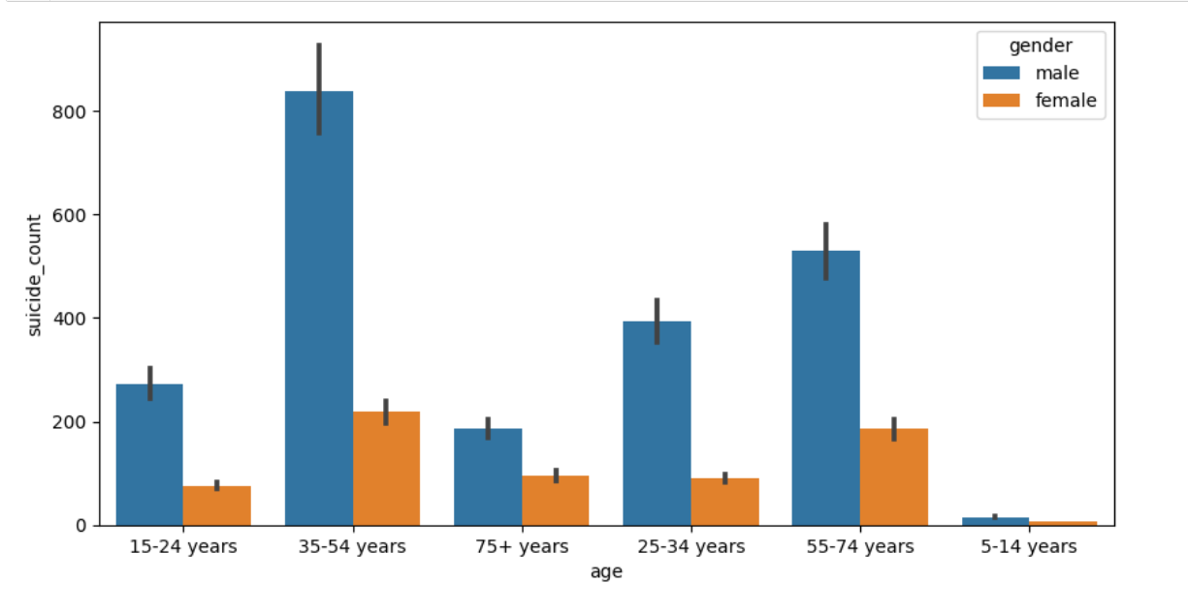
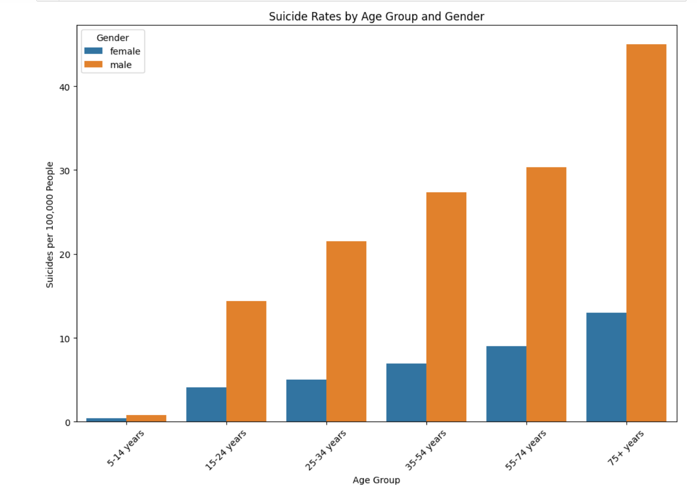
Suicide rate & Number of Suicides By Age & Gender

Slide 9
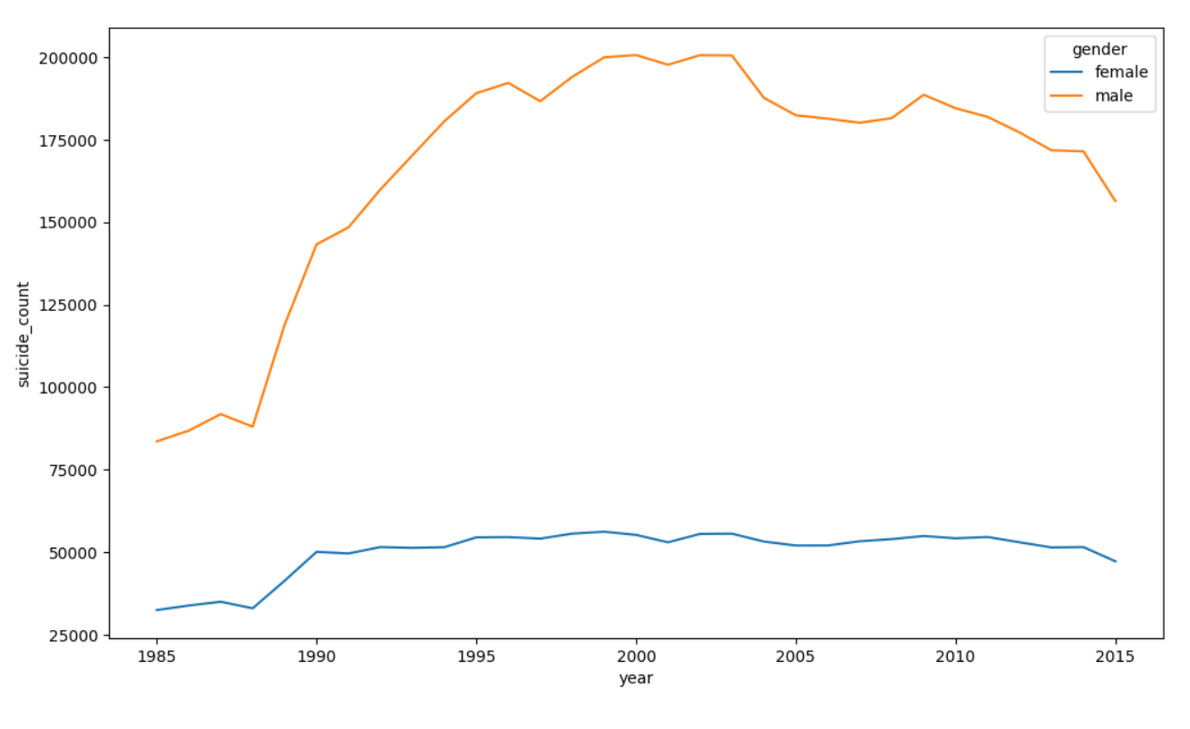
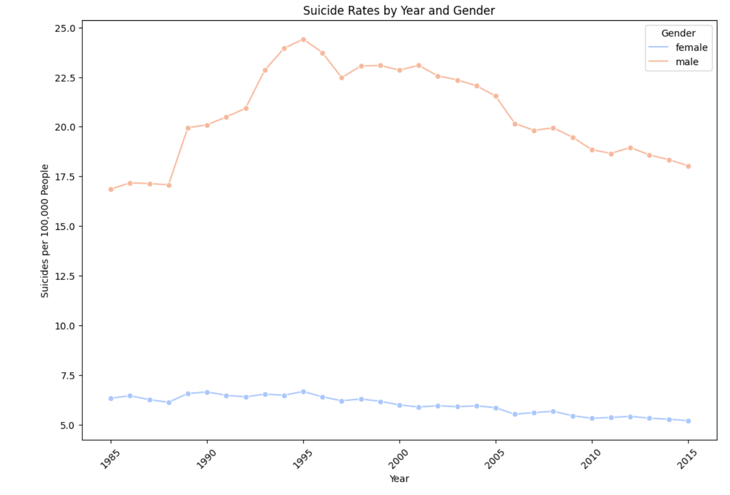
Suicide rate & Number of Suicides By Year & Gender

Slide 10
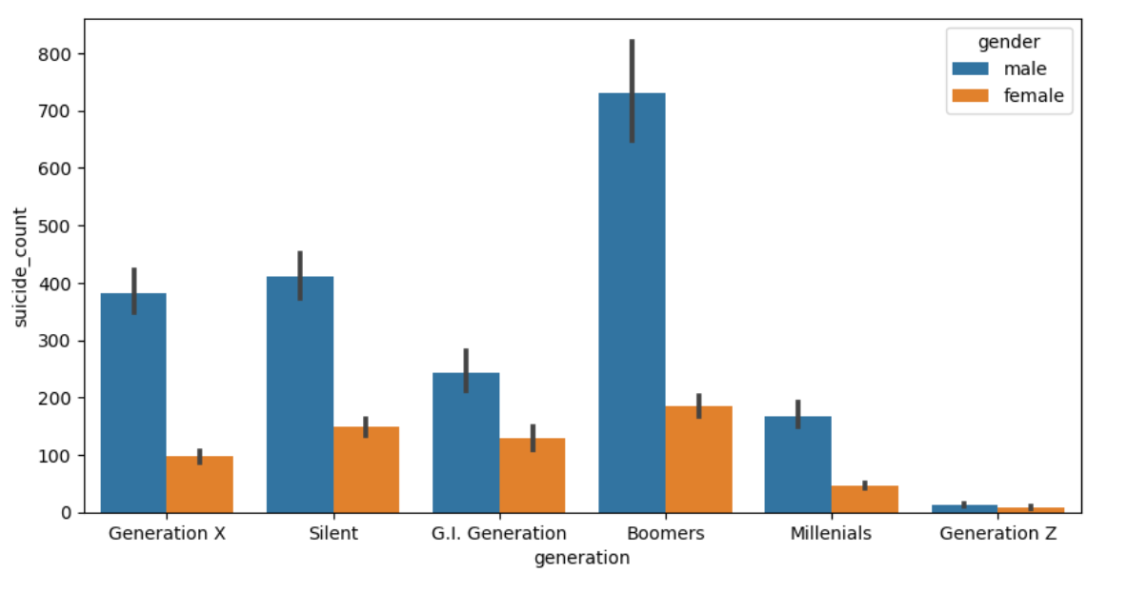
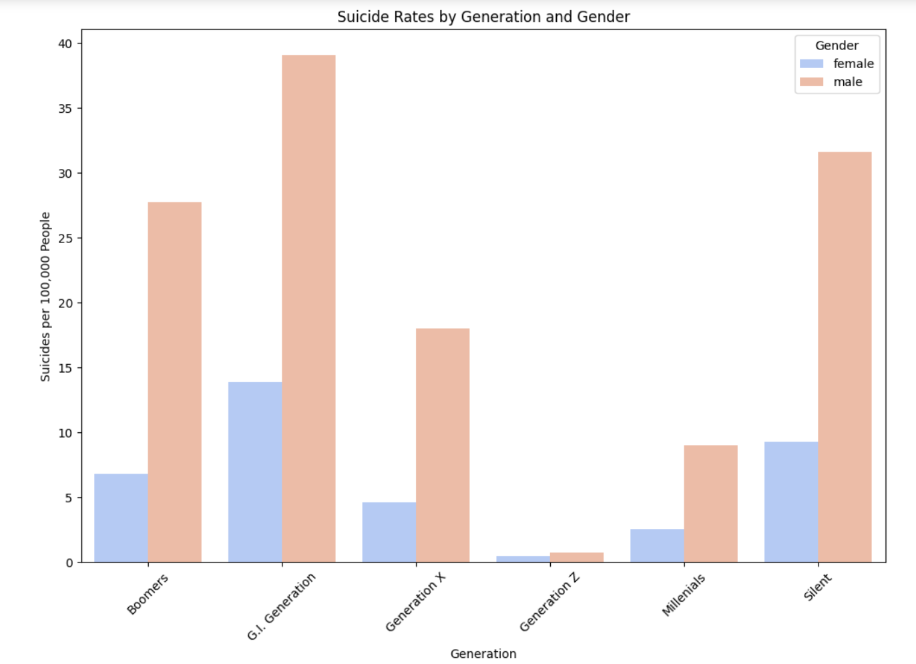
Number of Suicides & Suicide Rate By Generation & Gender

Slide 11
Suicide Rates By Gender & Generation

Slide 12
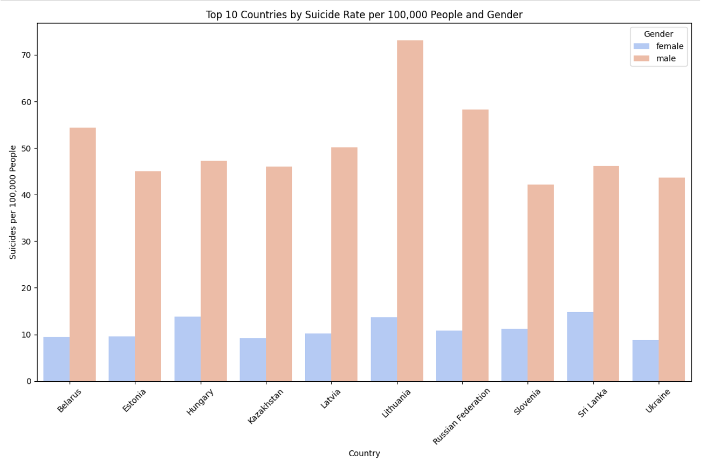
Top 10 Countries By Suicide rate by Gender

Slide 13
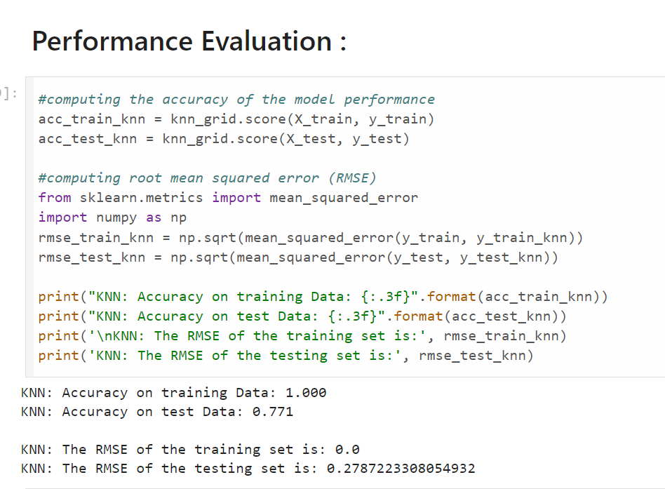
KNN ALGORITHM RESULTS

Slide 14
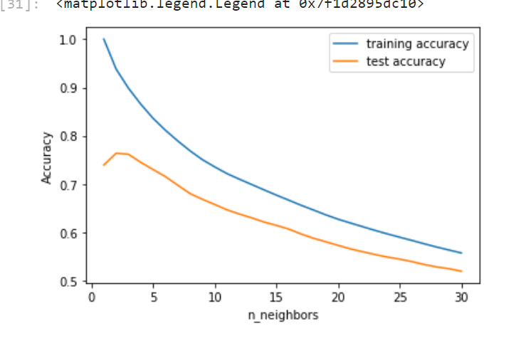
Training & testing accuracy for n_neighbours from 1 to 30
Overfitting is seen by the difference in performance between the training and testing sets.

Slide 15
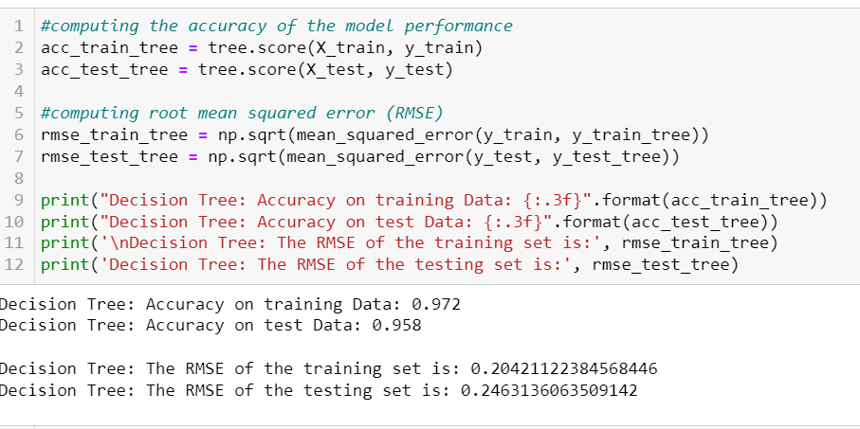
DECISION TREE MODEL

Slide 16
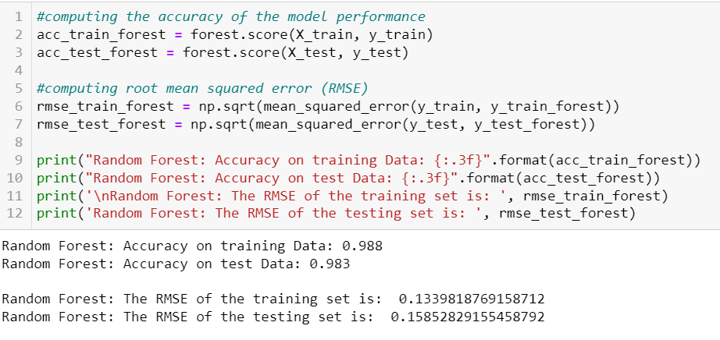
Random Forest Model

Slide 17
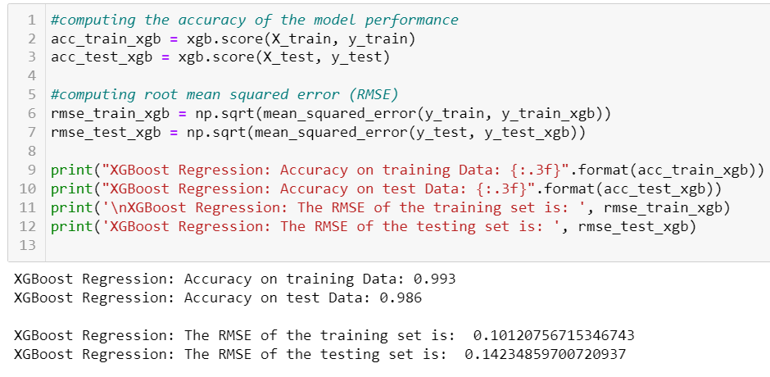
XGBOOST MODEL

Slide 18
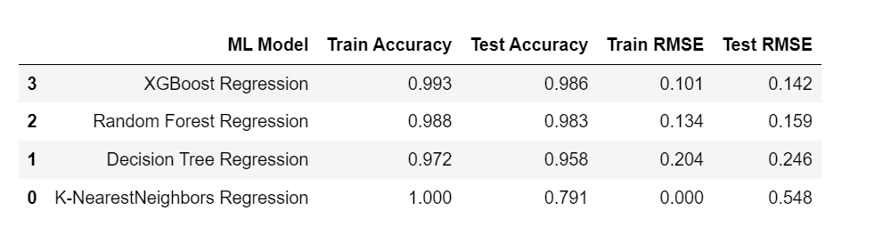
Comparison

Slide 19

NEXT STEPS

Slide 20
Thank You

