Slide 1


Suicide Rate Analysis and Prediction
Presented By
ANJI
CHANDRADEEP

Slide 2
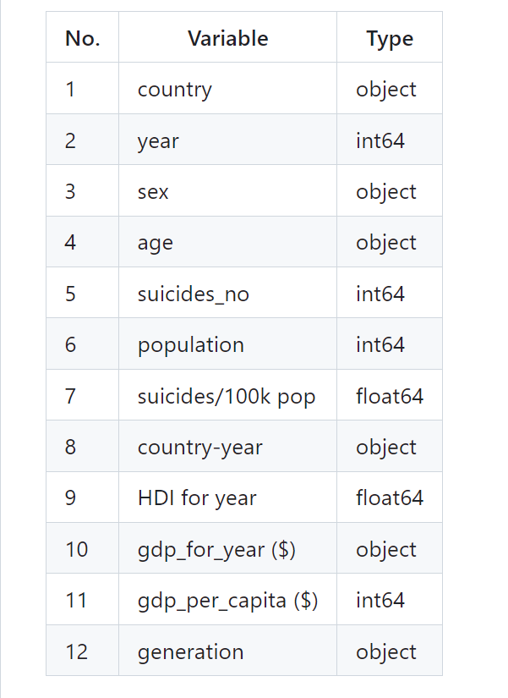
Dataset Description
Data Source: https://www.kaggle.com/datasets/russellyates88/suicide-rates-overview-1985-to-2016
Data Size : 3MB
Data Shape : 30000 Rows and 12 Columns
Time Period: 1985 to 2016
Dataset Columns

Slide 3
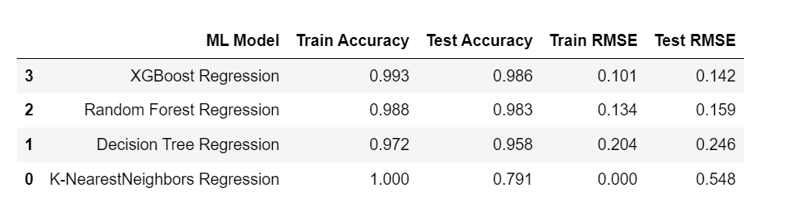
MODEL RESULTS AND EVALUATION

Slide 4
Results Discussion
Data analysis helped us understand several underlying trends in suicide attempts over the years 1985 and 2016.
Coming to the performance of the four machine learning models - Among all the trained models, XGBoost has the highest accuracy and lowest RMSE.
This is because XGBoost is very good in execution Speed & model performance. Random forest had an accuracy of 98.3%, followed by Decision Tree and K-Nearest Neighbors with 95.8 and 79.1 % respectively.

Slide 5
CONCLUSION
This analysis was aimed at explaining how different machine learning algorithms can be used in predicting suicide rates based on relevant factors collected in the dataset.
Although there have been several successful high precision models, there is still potential for development. Preliminary data analysis showed some surprising findings which includes teen men are more likely to commit suicide.
Machine learning algorithms like XGBoost and Random Forest Regression consistently outperformed other algorithms and had the highest accuracy and precision.
The analysis carried out will also provide knowledge about areas of improvement to the government and other organizations working towards suicide prevention and counselling so that effective steps can be taken.

Slide 6
FUTURE WORK
This project can be further improvised by combining multiple data sets related to suicides and performing in-depth analysis.
Some statistical tests- hypothesis testing can be performed which can extract valuable insights.
Sentiment Analysis can be used to figure out in which social media people feel more free to talk about their mental health.

Slide 7
Thank You

