Slide 1

Game Concept Idea Submission Team name – Rebels team members – Chandradeep kumar bharat yadav We are creating a digital educational game on “Lessons learnt” concepts for learners between age <12 years.

Slide 2
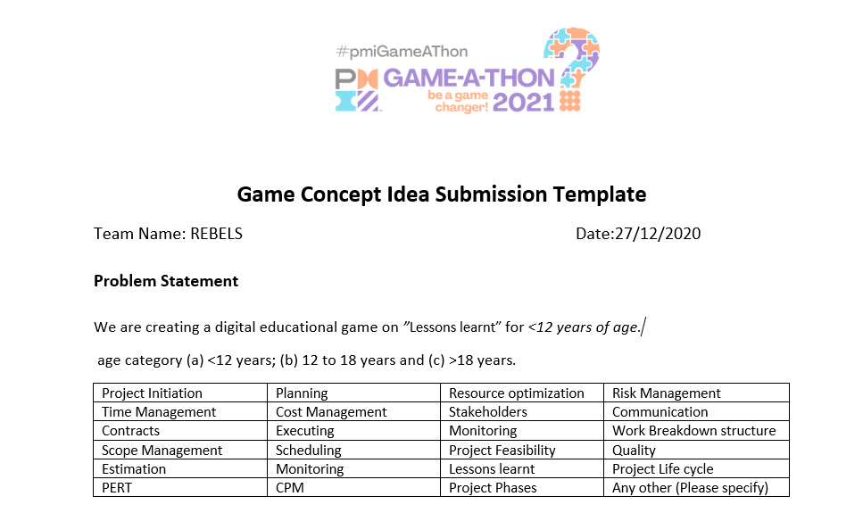

Slide 3
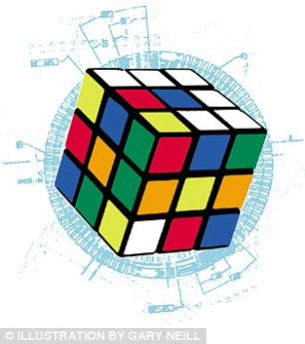
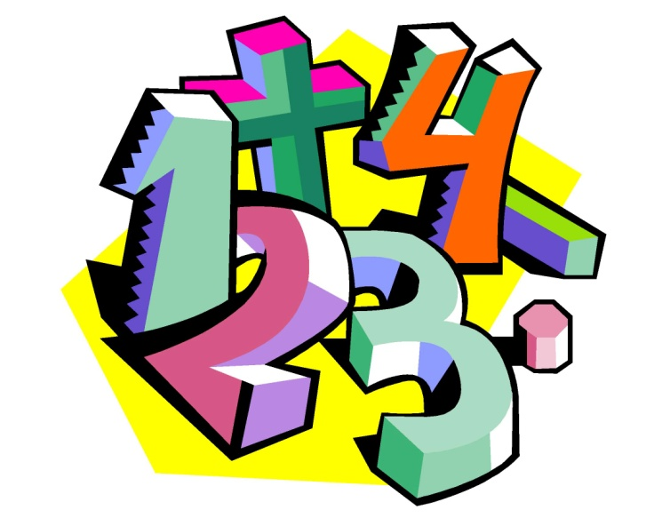
NAME OF GAME BRAIN TRAINER An EDUCATIONAL GAME APP

Slide 4

ABOUT THE GAME
This is a Math Games for kids (age upt0 12 years) . Best maths practice game to train your brain & is designed for ages including kids, girls and boys . This game uses graphics interface to attaract children to engage themselves in game

Slide 5
FEATURES
Addition games: Adding numbers with Quiz and Practice games. Subtraction games: subtracting numbers to solve the equation. Multiplication games: quizes based on multiplication problem. Division games: practice and learn division. Number Table: tables are also included in this game

Slide 6
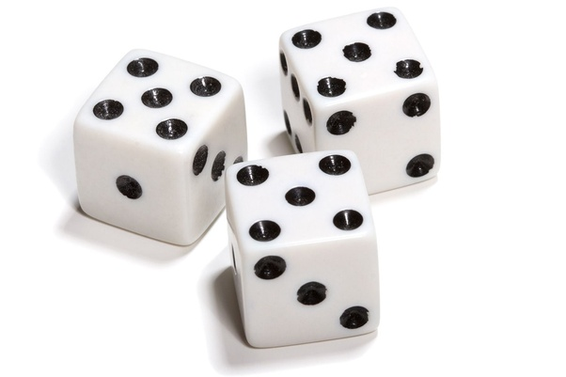
Easiest multiplication and division games with Addition and Subtraction games all in one app. Increase your brain power with an excellent educational game for learning mathematics for kids and adults of all ages. Math game free with an extra math

Slide 7

LEARNING GOALS
Each category has different play modes skills –play, learn, quiz and practice the questions. Math games can be Educational Learning for kids or brain training app for Adults. Basic and simple Math Game of addition, subtraction, multiplication and division with colourful worksheets.

Slide 8

KEY ELEMENTS
New game in addition, subtraction, multiplication, division and tables.
Once you start the game then you have maximum 30 second .
In this 30 sec you have unlimited number of question it depends on your solving speed.
At the last (after 30 sec you will be able to see your score).

Slide 9

Audience
This is an educational game for learning basic mathematics for kids.
Through this game you can increase your brain power by practising the question.

Slide 10
Objective in the game/ Game goal Brain trainer app designed for all smartphones and,no internet connection needed. With this educational app, parents, teachers and educators can help children to learn faster. Cool math games to play & challenge your friend and have extra mathfun.

Slide 11


GAME MEDIUM AND DEVICE
ANDROID STUDIO :-
A desktop software which helps in building android apps with the help of the language which follows OOPS .Language used here is JAVA
JAVA
One of the promising and versatile language used by millions of coder around the globe

Slide 12

Size of this game is small so you need not to have more space in your smartphone neither it required more mb to download this game app.
Kids will also learn table from this game in easy way.

Slide 13
Game world, setting
This game is a time based mcq game where student have to answer the mathematical questions in given time ,
There’s no limit to number of questions , students have to try to answer until time stops
Kids can enhance their multiple field such as addition , subtraction etc

Slide 14
features
PLAYERS
KEY RULES
Dynamics (elements that change with time)
It is a single player game ,with endless questions in given time
Try to answer all the questions correct to avail the maximum score and beat your own highest score
When you go in test section there will be mixture of all the mathematical operation you practiced in practice section

Slide 15
CHARACTER
Player Control
Elements of engagement – curiosity/ chance/ fantasy/ challenge
How playing affects learning
After completing every session of test there will be an option to play it again and try to improve you own score or beat your own highest score in gane
When you enter in test section multiple difficult questions will come that will be tricky to answer but timer will go on , so student need to be quick
Solving mathematical questions in limited number of time will increases solving power and that would also help him/her in academics

Slide 16

TEAM NAME – REBELS
TEAM MEMBERS – CHANDRADEEP KUMAR
BHARAT YADAV

